Slide 1
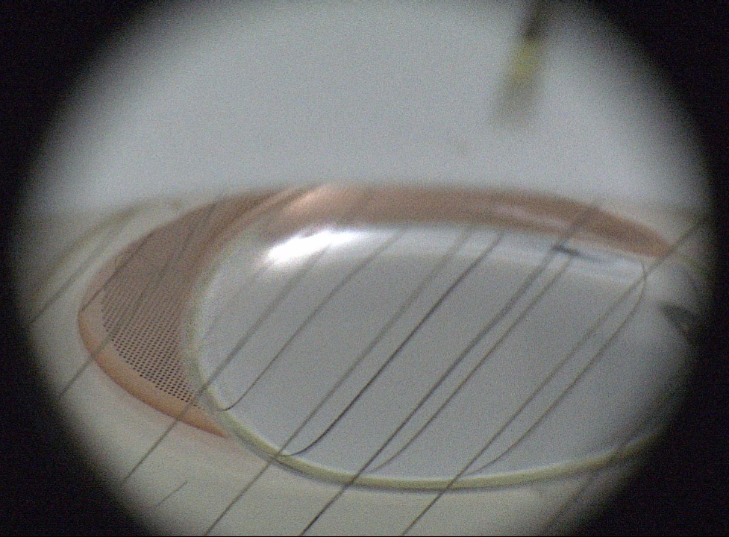

Bubble-assisted Liquid Hole Multipliers in LXe and LAr: towards “local dual-phase TPCs”
E. Erdal⁽¹⁾, L. Arazi⁽²⁾, A. Breskin⁽¹⁾, S. Shchemelinin⁽¹⁾, A. Roy⁽²⁾,
A. Tesi⁽¹⁾, D. Vartsky⁽¹⁾, and S. Bressler⁽¹⁾
(1) Dept. of Astrophysics & Particle Physics, Weizmann Institute of Science, Israel
(2) Unit of Nuclear Engineering, Faculty of Engineering Sciences, Ben-Gurion University of the Negev, Israel
LIDINE 2019
Manchester, August 2019

Slide 2
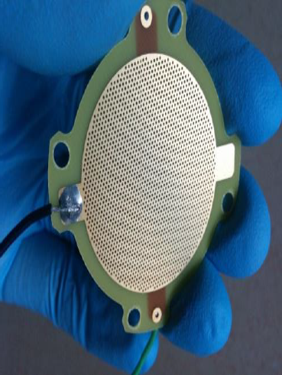
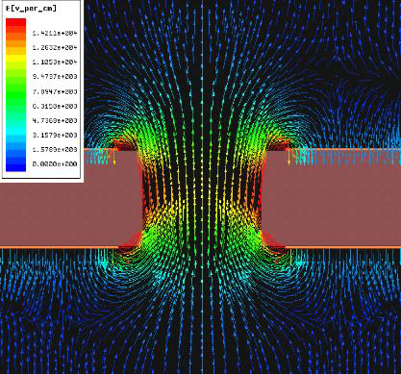
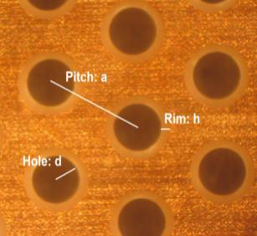
Hole-electrodes
Gas Electron Multiplier GEM
Thick Gas Electron Multiplier - THGEM (a.k.a. LEM)

Slide 3





New concept: generating electroluminescence in a bubble
“hole-electrode”
VUV photon
$$e^{−}$$
$$\vec{E}$$
$$e^{−}$$
Cs I
$$V_{top}$$
$$V_{bottom}$$
Resistive wires
Light readout (e.g. PMT , SiPM)
Noble liquid (LXe / LAr)
L. Arazi et al. 2015 JINST 10 P08015 [arXiv:1505.02316] & E. Erdal et al. 2015 JINST 10 P11002 [arXiv:1509.02354]

Slide 4
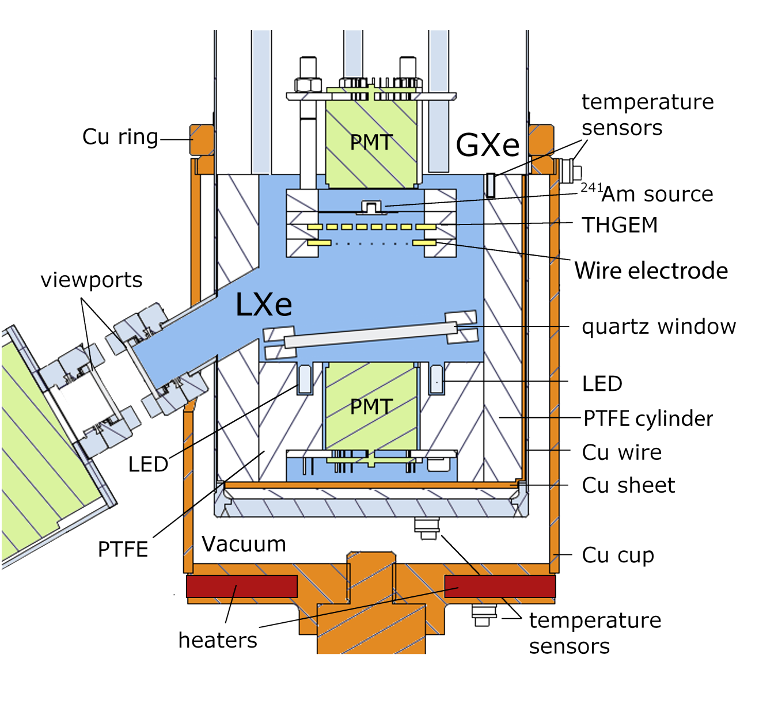
Small Liquid Xenon Cryostat
CAMERA
E. Erdal et al. 2015 JINST 10 P11002 [arXiv:1509.02354]

Slide 5
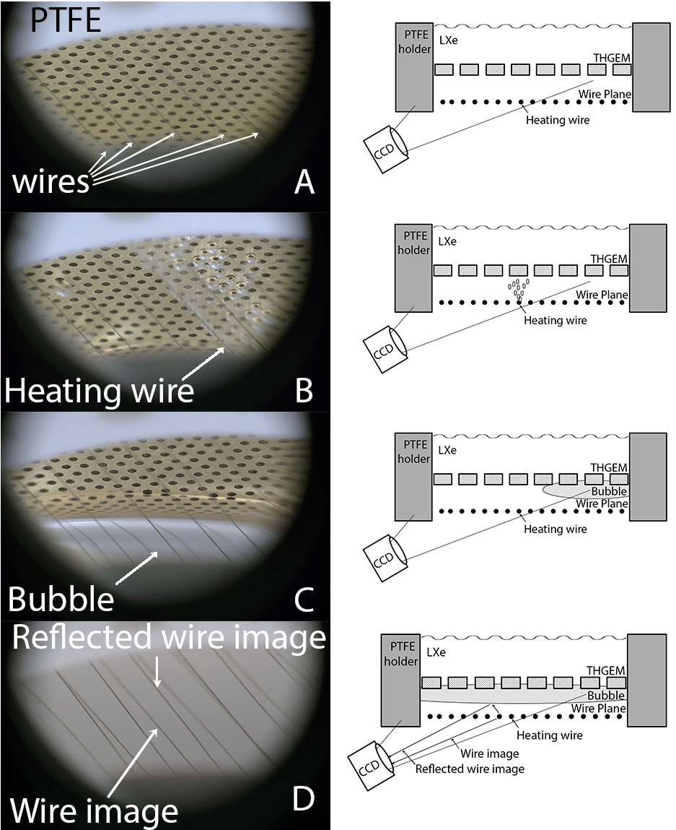
Process of bubble
generation
THGEM
E. Erdal et al. 2015 JINST 10 P11002 [arXiv:1509.02354]

Slide 6
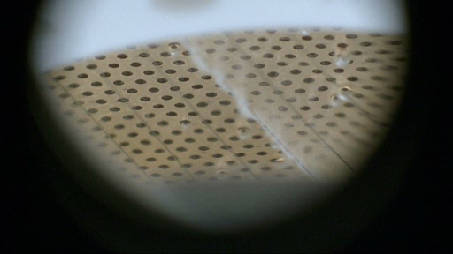
Bubble Inflation
E. Erdal et al. 2015 JINST 10 P11002 [arXiv:1509.02354]

Slide 7
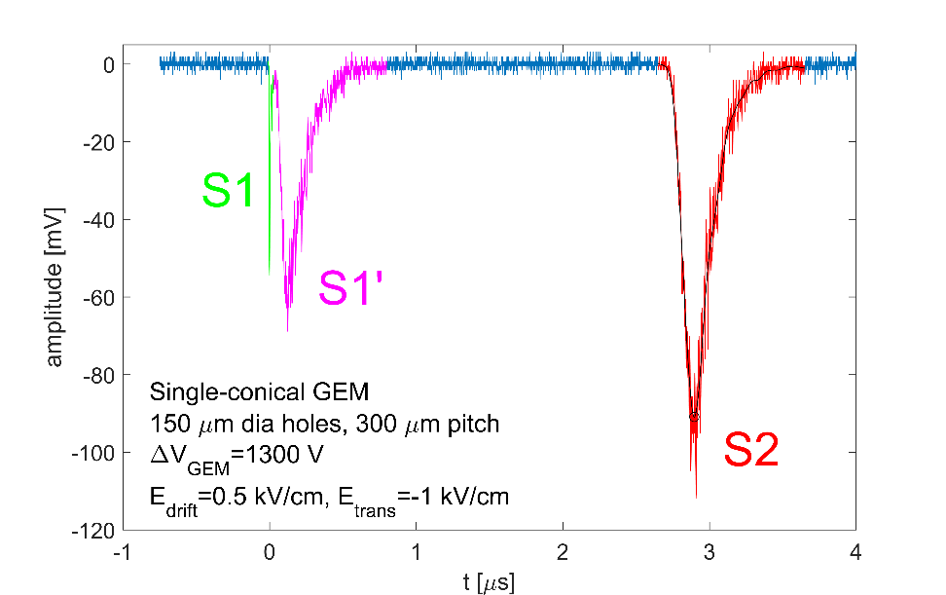
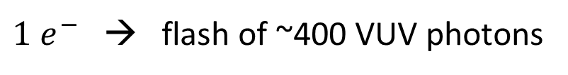
Combined light and charge readout
$1 e^{−}$ → flash of ~400 VUV photons
E. Erdal et al. 2018 JINST 13 P12008 [arXiv:1708.06645]

Slide 8
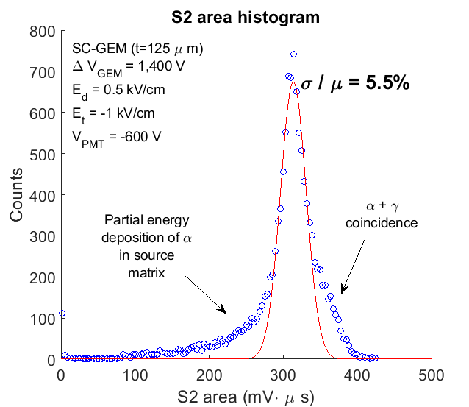
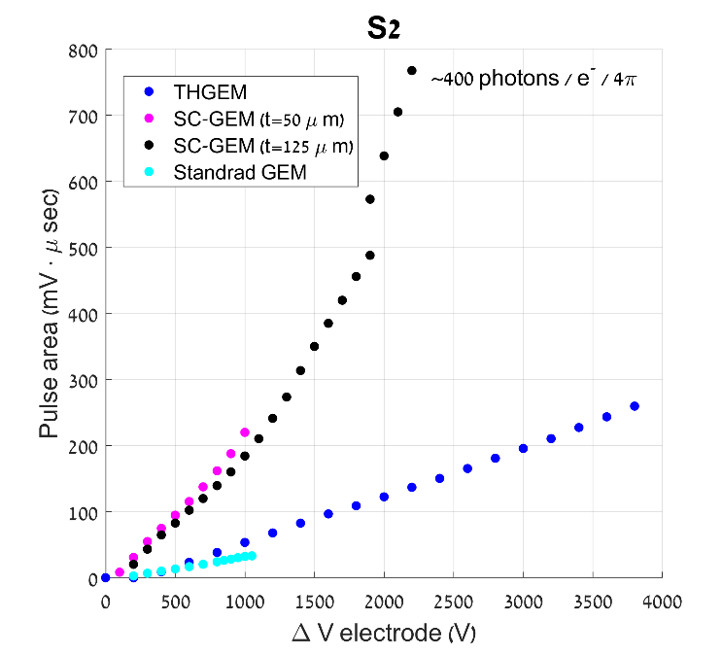
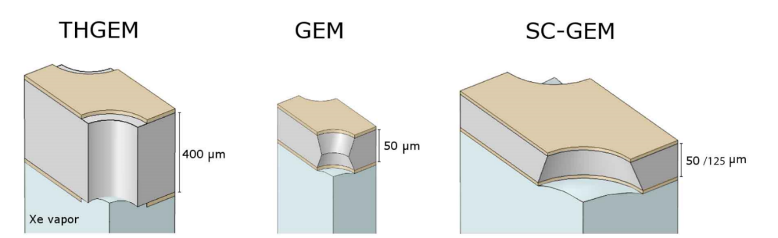
Response of different electrodes
E. Erdal et al. 2018 JINST 13 P12008 [arXiv:1708.06645]

Slide 9
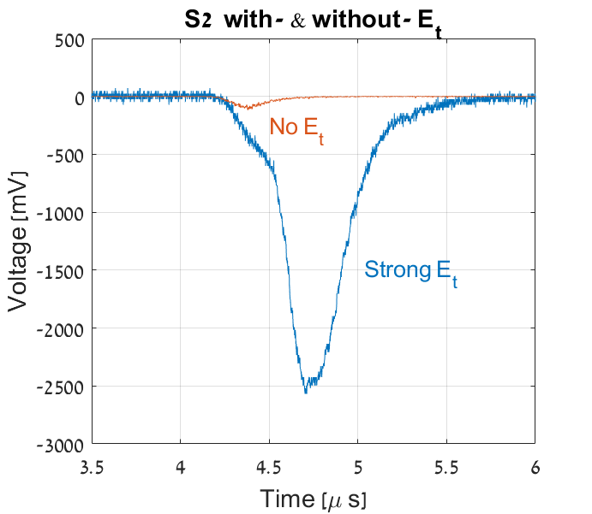
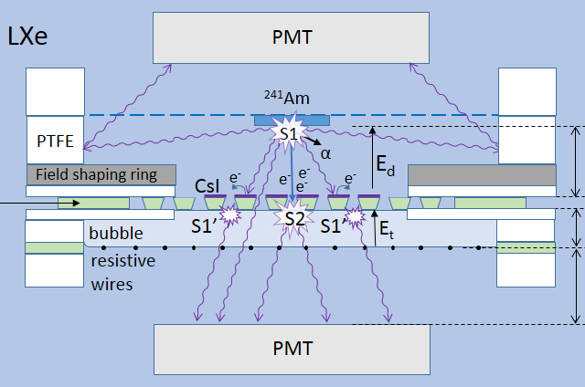
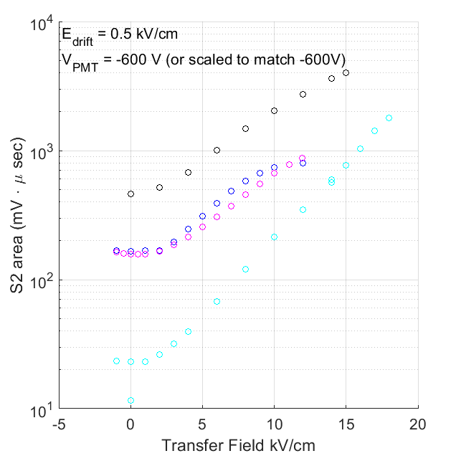
Charge multiplication in the bubble
Apply strong electric field between bottom of electrode and wires
E. Erdal et al. 2018 JINST 13 P12008 [arXiv:1708.06645]

Slide 10
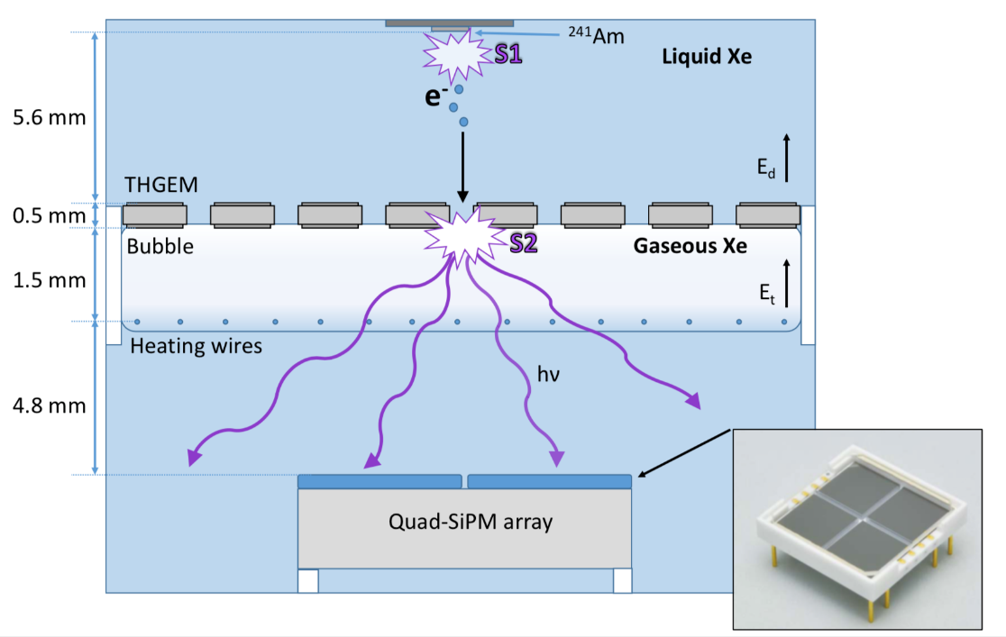
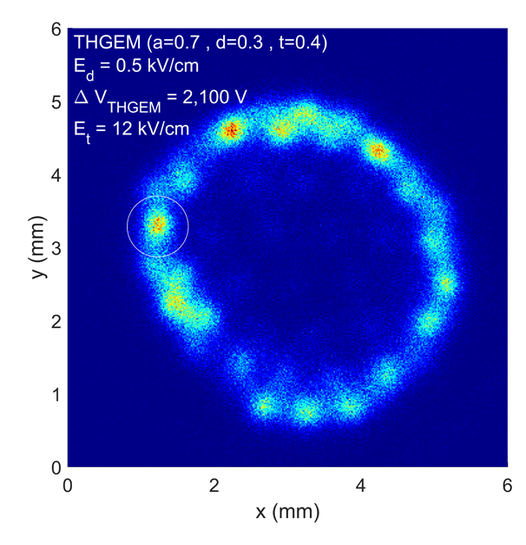
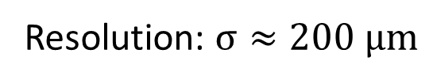
Image of ²⁴¹Am source with pixelated readout
LHM reconstruction
3.9mm dia.
Resolution: $σ≈200 μm$
E. Erdal et al. 2019 JINST 14 P01028 [arXiv:1812.00780]

Slide 11
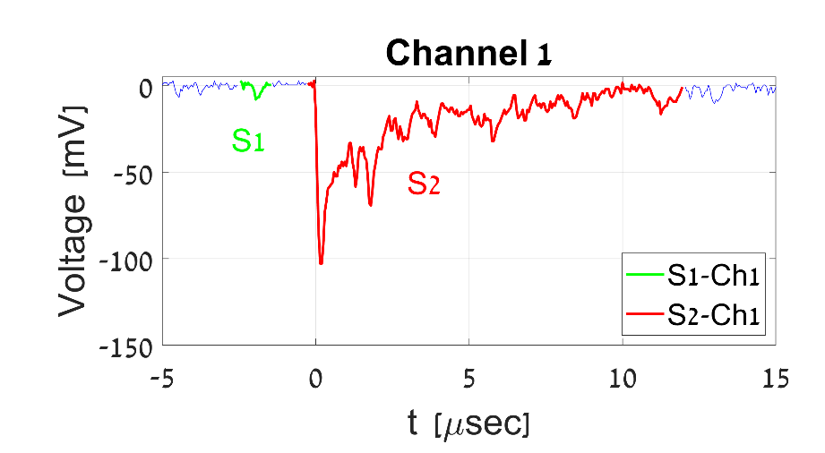

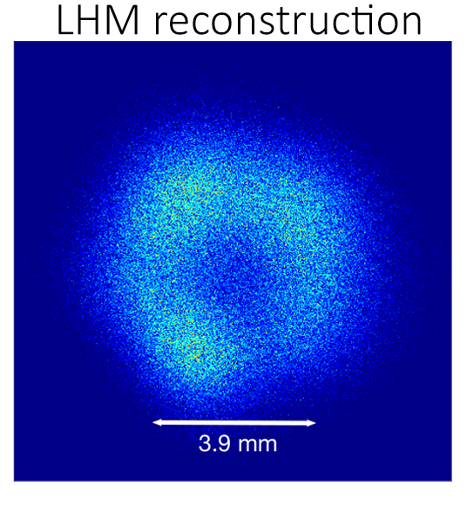
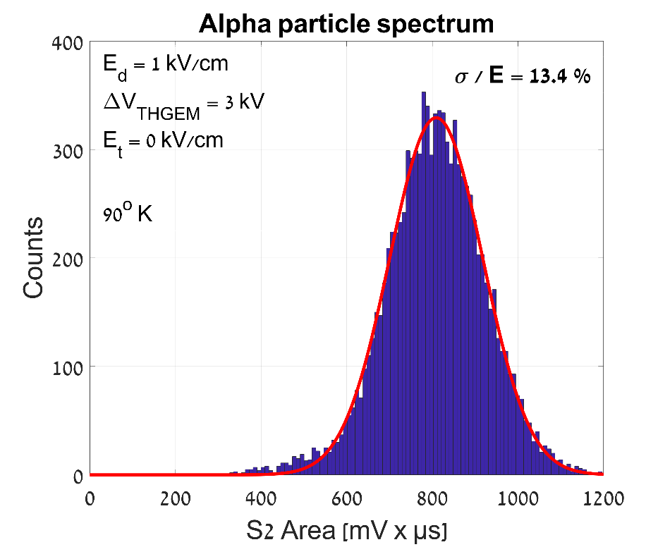
NEW: It works also in Liquid Argon!
Same setup,
No CsI on top of the THGEM: S2 only
arXiv:1908.04974 (to be submitted to JINST)

Slide 12
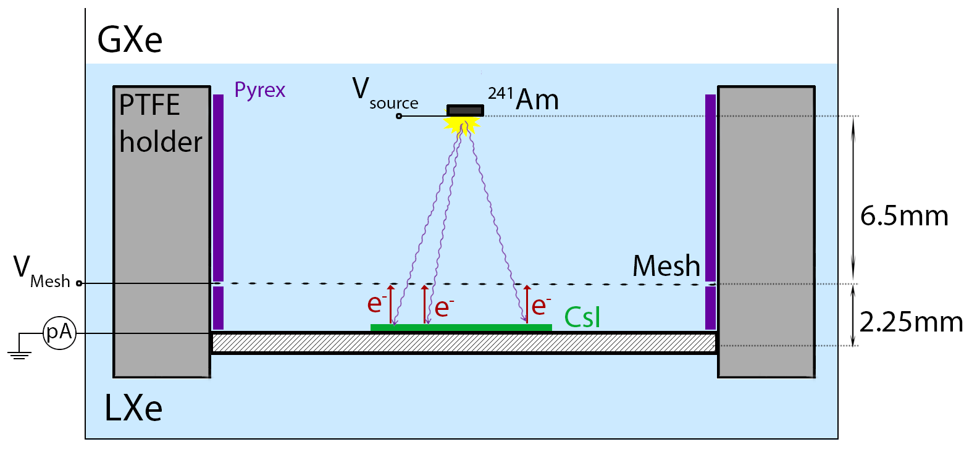
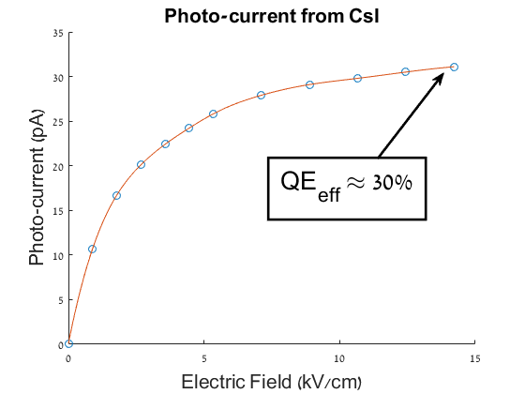
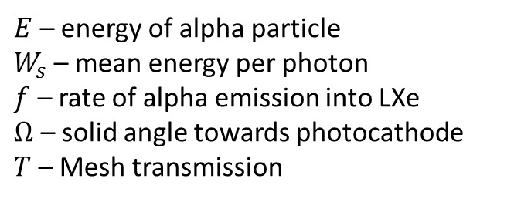
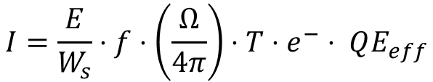
Towards single photon sensing:
Effective CsI Quantum Efficiency in LXe
$E$ – energy of alpha particle
$W_{s}$ – mean energy per photon
$f$ – rate of alpha emission into LXe
$Ω$ – solid angle towards photocathode
$T$ – Mesh transmission
$$I=\frac{E}{W_{s}}⋅f⋅\left(\frac{Ω}{4π}\right)⋅T⋅e^{−}⋅ QE_{eff}$$
Similar values measured also by: E. Aprile et al., NIM A 338 (1994) 328-335

Slide 13
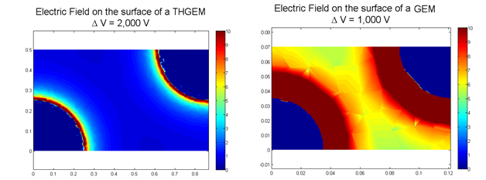
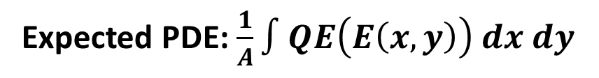
Towards single photon sensing:
Effective CsI Quantum Efficiency in LXe
Expected PDE: $\frac{1}{A}∫QE\left(E\left(x,y\right)\right) dx dy$
Expected PDE (THGEM): 15%
Measured PDE: ~2%
Expected PDE (GEM , SC-GEM): 22%
Measured PDE: ~4%

Slide 14
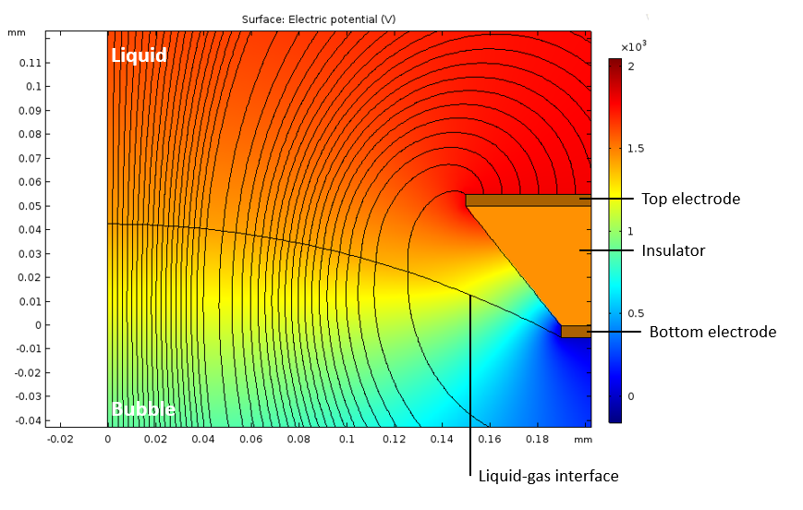
Where are electrons lost?
$$e^{−}$$
1
2
From liquid to gas: 0.69 eV potential barrier
E. Erdal et al. 2018 JINST 13 P12008 [arXiv:1708.06645]

Slide 15

What is the shape of the bubble?
How does it affect the EL signal?
$$e^{−}$$
Resistive wires
Light readout
Noble liquid (LXe / LAr)

Slide 16
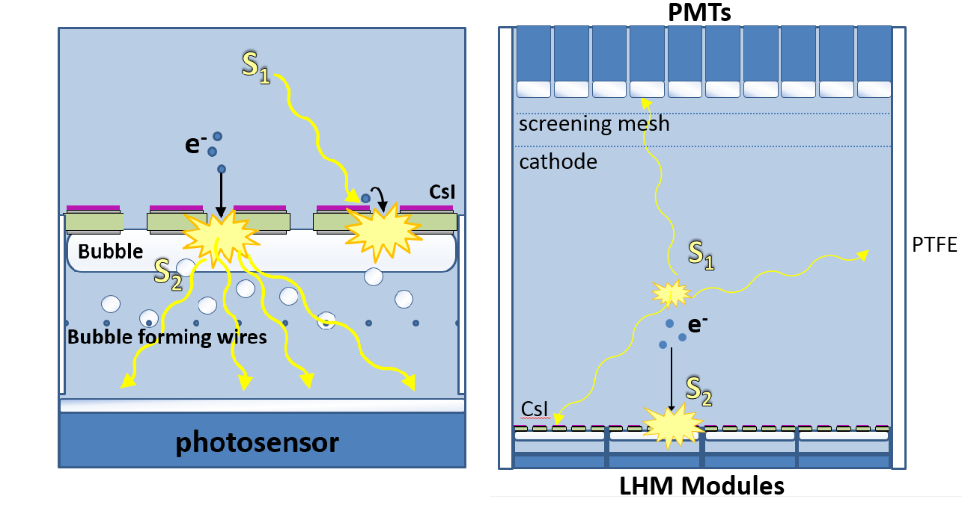
We have a dream… for large-volume dark-matter detectors
Part of the DARWIN generic R&D program:
Aalbers, J., et al., Journal of Cosmology and Astroparticle Physics, 2016. 2016(11): p. 017

Slide 17
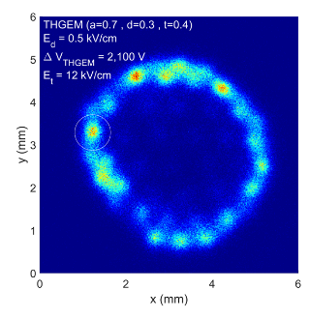
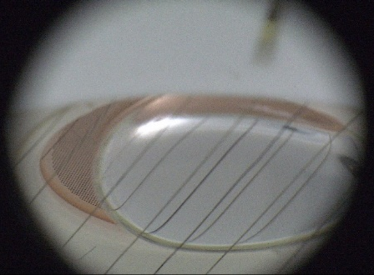
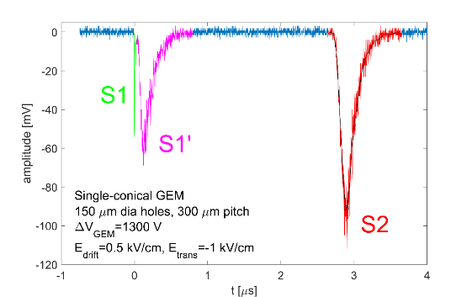



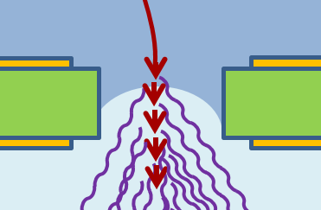
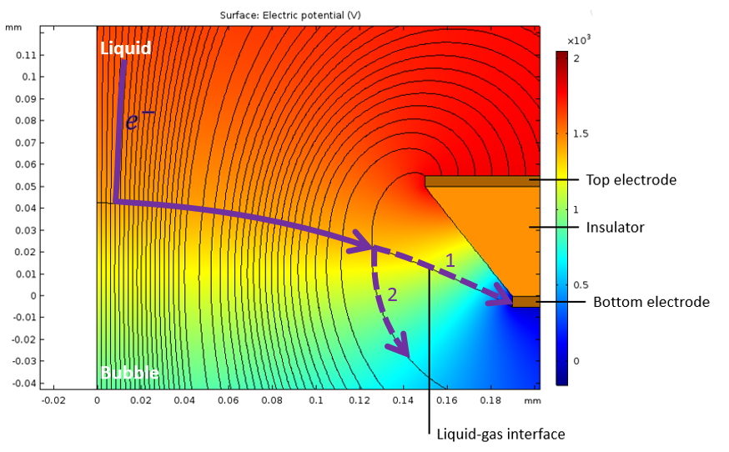
To conclude
Imaging
Stable bubble
Light and charge detection
Different geometries
Charge gain
Deeper?
Shape of the bubble?
Gliding electrons?

Slide 19
Backup slides

Slide 20
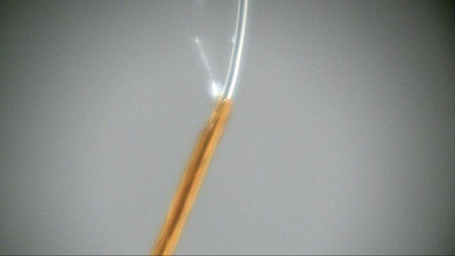
Boiling on the tip of a wire
E. Erdal et al. 2015 JINST 10 P11002 [arXiv:1509.02354]

Slide 21
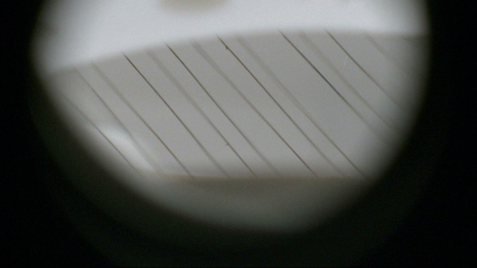
Bubble breathing
E. Erdal et al. 2015 JINST 10 P11002 [arXiv:1509.02354]

Slide 22
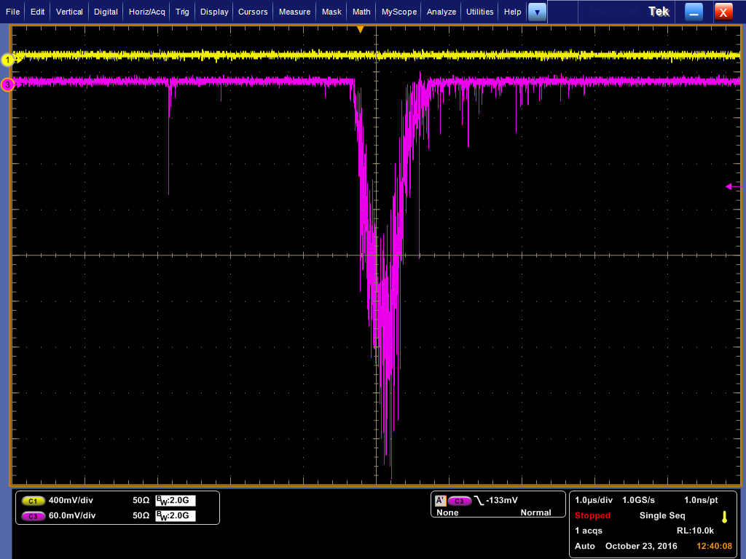
Vertical bubbles
4 mm
LXe
S1
Bubble
E_{t}
E_{d}
To PMT
S2
S1
²⁴¹Am
e
α
S2
Fine mesh
112 µm opening
THGEM
Heating wire

Slide 23
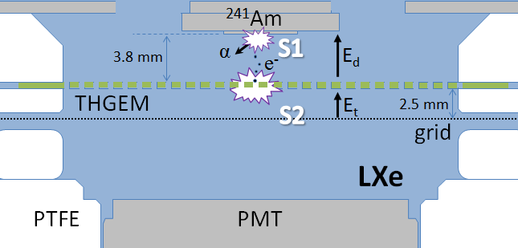
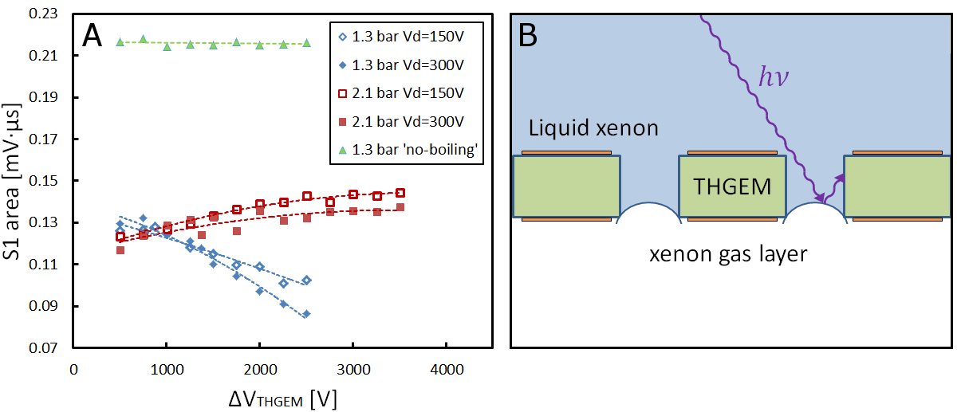
S1 dependence on THGEM voltage
L. Arazi et al. 2015 JINST 10 P08015 [arXiv:1505.02316]

Slide 24
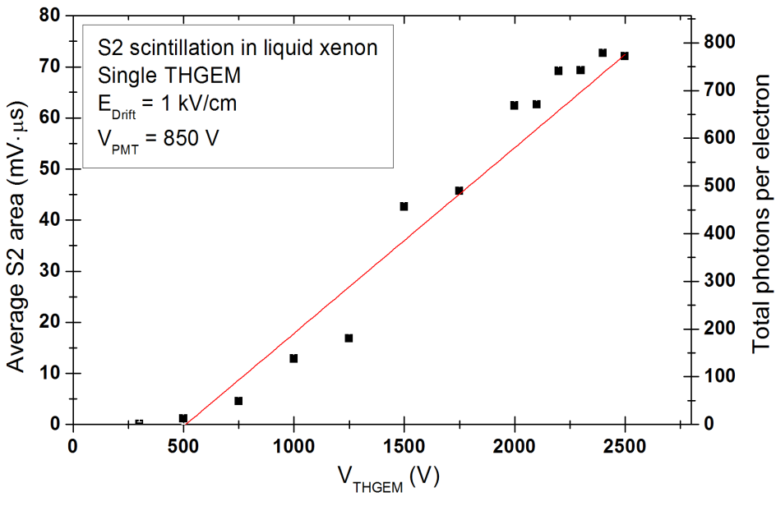
Electroluminescence “in THGEM holes”
Threshold for electroluminescence:
Vapor (@ 170K): ~ 2-3 kV/cm ††
Liquid: 400 - 700 kV/cm †††
Indirect proof of bubble-assisted electroluminescence: killing light by abrupt pressure change. Interpretation: bubbles collapse! ††††
Light gain @ 2kV
~ 600 UV photons / electron
†
† L. Arazi et al. 2013 JINST 8 C12004 [arXiv:1310.4074]
††C.M.B. Monteiro et al. 2007 JINST 2 P05001.
††† T. Doke, Nucl. Intrum. Meth. 196 (1982).
†††† L. Arazi et al. 2015 JINST 10 P08015 [arXiv:1505.02316].

Slide 25
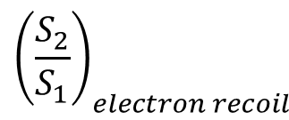
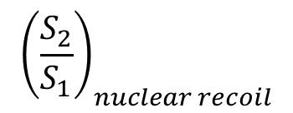
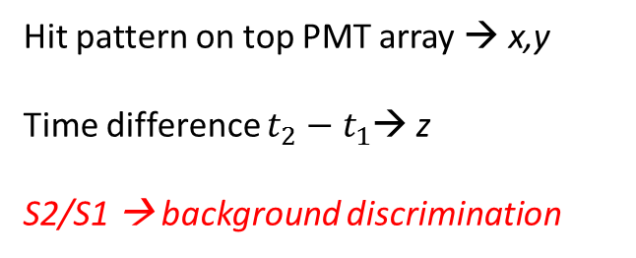
‘Classical’ dual-phase Time Projection Chamber
Top PMTs
anode
GXe
~10 kV/cm
Hit pattern on top PMT array → x,y
Time difference $t_{2}−t_{1}$→ z
S2/S1 → background discrimination
gate
~1 kV/cm
$${\left(\frac{S_{2}}{S_{1}}\right)}_{nuclear recoil}$$
<
$${\left(\frac{S_{2}}{S_{1}}\right)}_{electron recoil}$$
Signal
Background
LXe
cathode
Dark matter particle
Bottom PMTs
Aalbers, J. et al., Journal of Cosmology and Astroparticle Physics, 2016. 2016(11): p. 017

Slide 26
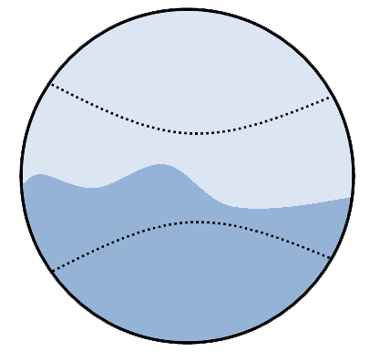

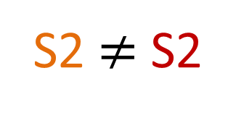
Scaling up of ‘traditional’ dual-phase TPC
Top PMTs
GXe
$$S_{2}∝N_{e}d_{gas}\left(E/ρ −const\right)$$
anode
10 kV/cm
gate
S2
S2
1 kV/cm
S2 $≠$ S2
LXe
cathode
Degradation of signal / noise ratio
Bottom PMTs
Aalbers, J. et al., Journal of Cosmology and Astroparticle Physics, 2016. 2016(11): p. 017

