Slide 1
Introduction to explainable ai
David Watson
16 April, 2019
Clinical Challenges and Opportunities

Slide 2
Overview
What’s AI?
What’s an Explanation?
Why Explain?
Explain What?
Explain How?
How Do We Measure Explanations?

Slide 3
Machine learning
Supervised Learning:
Given feature matrix X, predict outcome Y using algorithm f.
f: X → Y

Slide 4
Machine learning
Supervised Learning:
Given feature matrix X, predict outcome Y using algorithm f.
f: X → Y
Unsupervised Learning:
Given feature matrix X, use algorithm f to do…something.
(E.g., detect outliers, project X in low dimensions, cluster observations, etc.)

Slide 5
Ubiquity of ML
ML is currently used to:
Filter spam
Recommend movies
Label cat pix
Detect fraud
Predict sports outcomes
Read image to text
Beat you at chess

Slide 6
Ubiquity of ML
ML is currently used to:
Filter spam
Recommend movies
Label cat pix
Detect fraud
Predict sports outcomes
Read image to text
Beat you at chess
But also to:
Recognize your face
Detect military targets
Predict criminal recidivism
Screen job applicants
Track online behavior
Guess if you’re gay
Tweet racist vitriol

Slide 7
clinical ml is already here
Microsoft’s InnerEye helps NHS radiologists detect cancerous tumours
DeepMind Health has partnered with Moorfields Eye Hospital to train models to detect retinal pathologies
Watson for Oncology is (in?)famously deployed at New York’s Memorial Sloan Kettering Cancer Center
Notes:
How can we explain algorithmic predictions to patients? Doctors?

Slide 8
Good news
Good news: algorithms are very good at predicting things!
😃
Notes:
AlphaZero, new chemical compounds, detecting skin cancer and pneumonia, etc.

Slide 9
Good news & Bad news
Good news: algorithms are very good at predicting things!
Bad news: algorithms are very bad at explaining things!
😢

Slide 10
Explanation
The deductive-nomological model (Hempel, 1965)
The explanation for some event E consists of two components:
1) a non-empty set of observation statements S = {s₁, s₂, s₃...s_{n}}; and
2) at least one law-like generalisation L, such that
(S & L) → E.

Slide 11
explanation
Objection 1: DN model is unnecessary
s₁: Patient A has infection x
s₂: Patient A receives treatment
L₁: 0% of untreated patients with infection x survive
L₂: 99% of treated patients with infection x survive
---------------------------------------------------------------
E: Patient A survives

Slide 12
Explanation
Objection 2: DN model is insufficient
S: John Jones is a male who has been taking birth control pills regularly
L: All males who take birth control pills regularly fail to get pregnant
-----------------------------------------------------------------------------------
E: John Jones fails to get pregnant

Slide 13
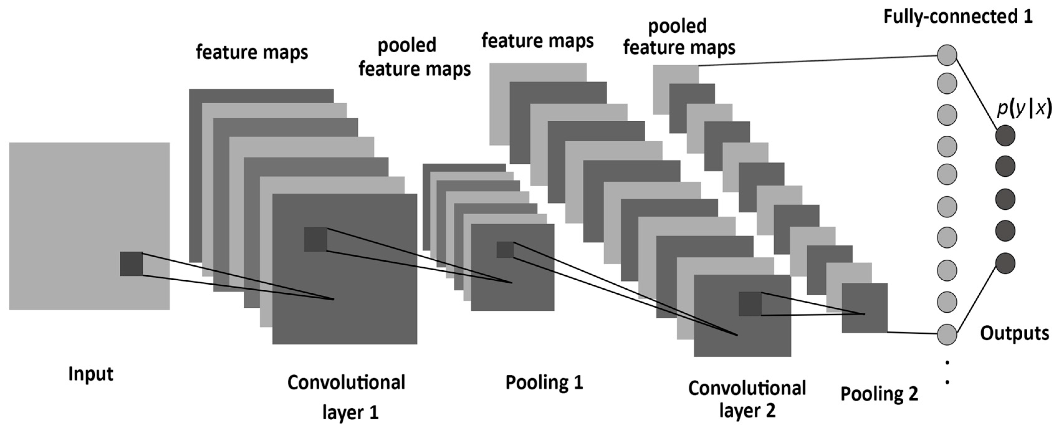
Explanation
Objection 3: DN model fails when L or S is too complex

Slide 14
explanation
Miller (2017) surveys a wide array of literature on explanation and highlights four key points. Successful explanations are:
Contrastive
Selective
Causal
Social

Slide 15

Why explain?
Reason 1: To Audit
Fairness, accountability, and transparency (FAT ML)

Slide 16
Why explain?
Reason 1: To Audit
Fairness, accountability, and transparency (FAT ML)
European Union’s 2018 General Data Protection Regulation (GDPR) may provide data subjects a “right to explanation” (Goodman & Flaxman, 2016)

Slide 17
Why explain?
Reason 1: To Audit
Fairness, accountability, and transparency (FAT ML)
European Union’s 2018 General Data Protection Regulation (GDPR) may provide data subjects a “right to explanation” (Goodman & Flaxman, 2016)
Or maybe not (Wachter et al., 2017)

Slide 18
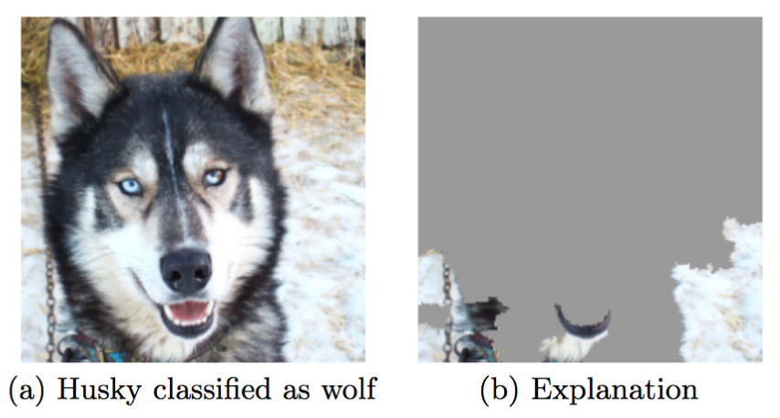
Why explain?
Reason 2: To Validate

Slide 19
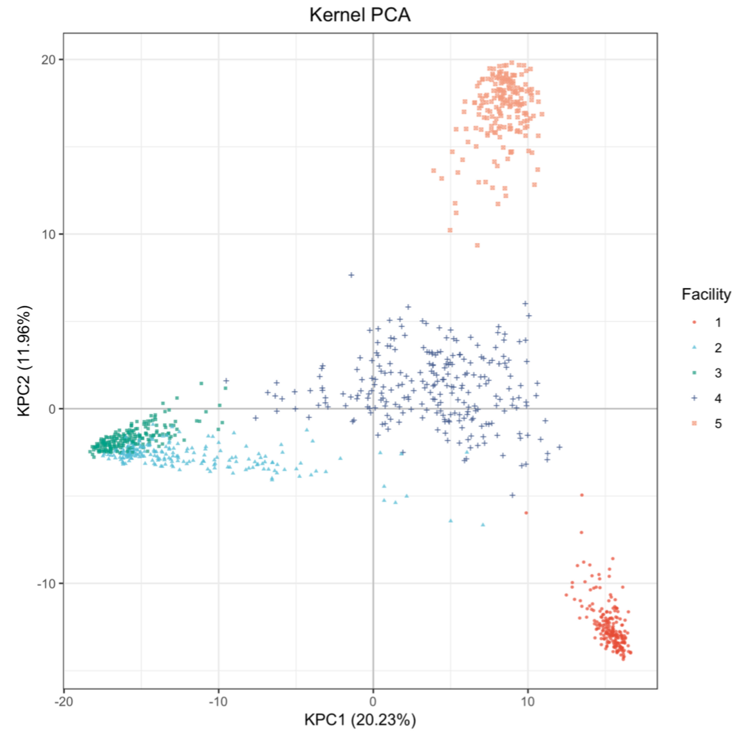
Why explain?
Reason 3: To Discover

Slide 20
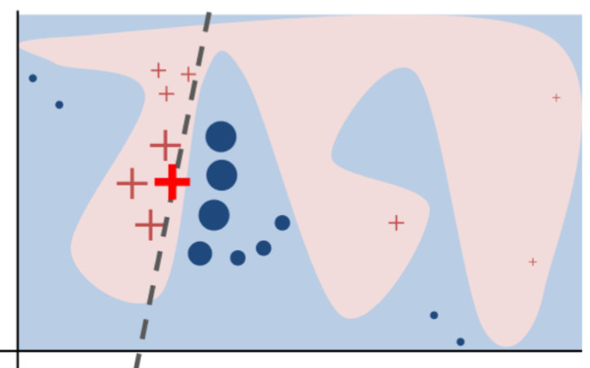
Explain What?
Global vs. Local
Notes:
Global explanation may be impt for mechanistic understanding; local explanation is impt for individual diagnoses

Slide 21
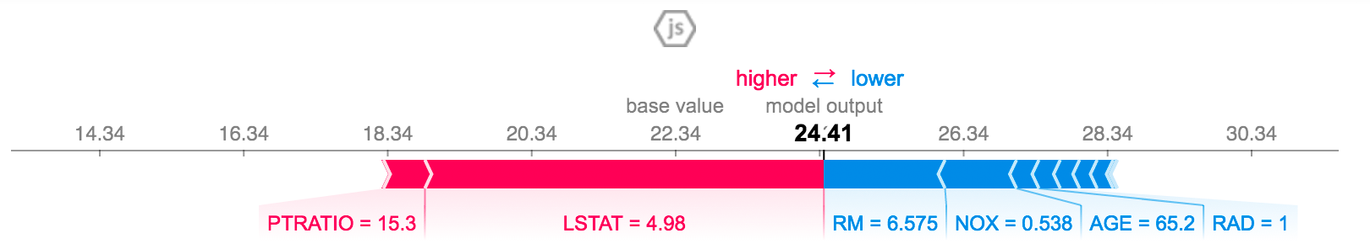
Explain What?
Contrastive Counterfactuals

Slide 22
Explain What?
Model-Specific
DeepLift
(Shrikumar et al., 2017)
RF permutations
(Breiman, 2001)
Fixed-X knockoffs
(Barber & Candès, 2015)
Model-Agnostic
LIME
(Ribeiro et al., 2016)
SHAP
(Lundberg & Lee, 2017)
SBRL
(Yang et al., 2017)

Slide 23
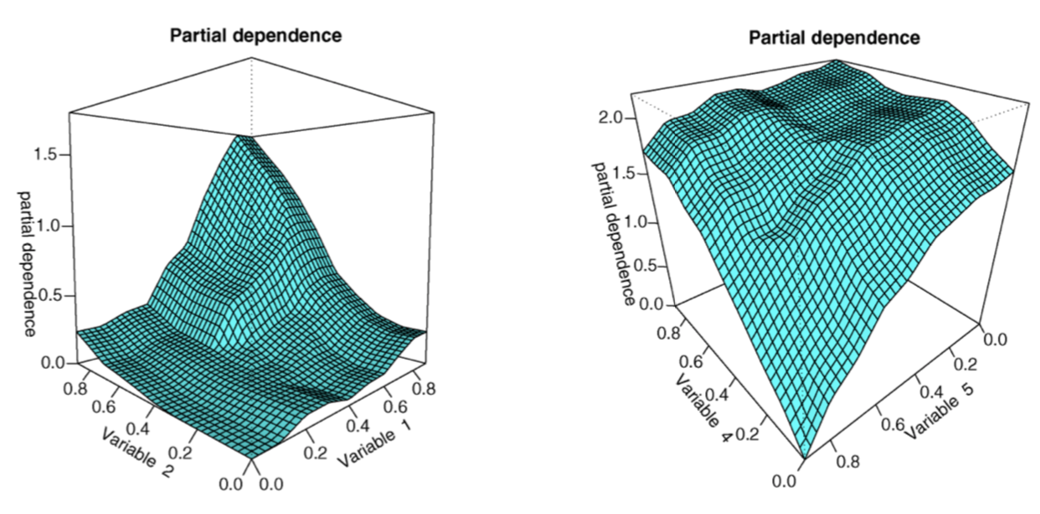
Explain How?
Feature Importance

Slide 24
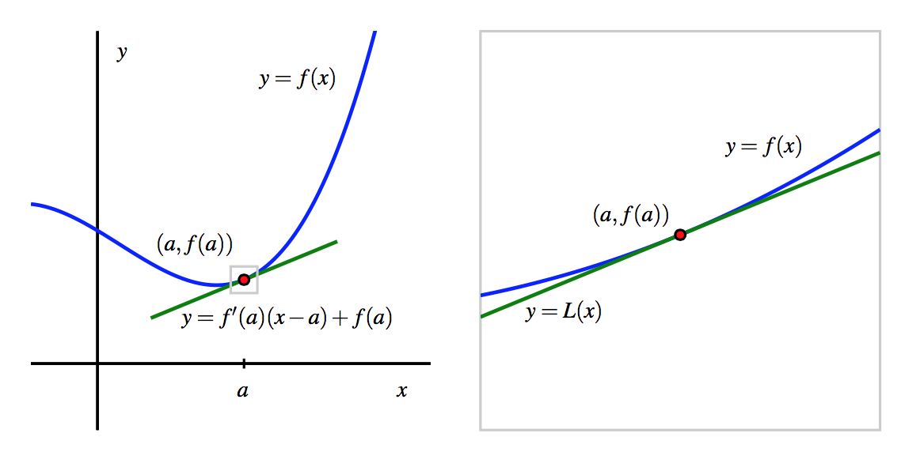
Explain How?
Local Linear Approximations

Slide 25
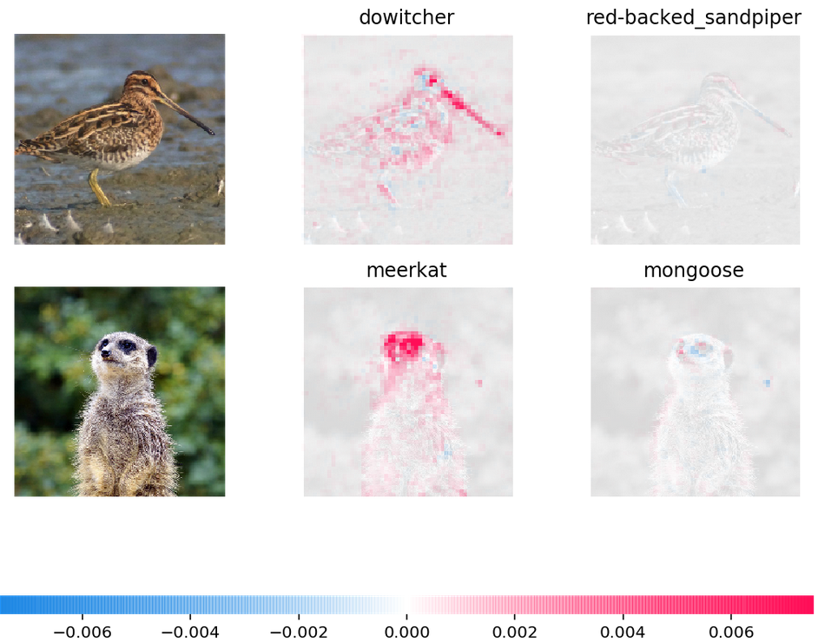
Explain How?
Saliency Maps

Slide 26
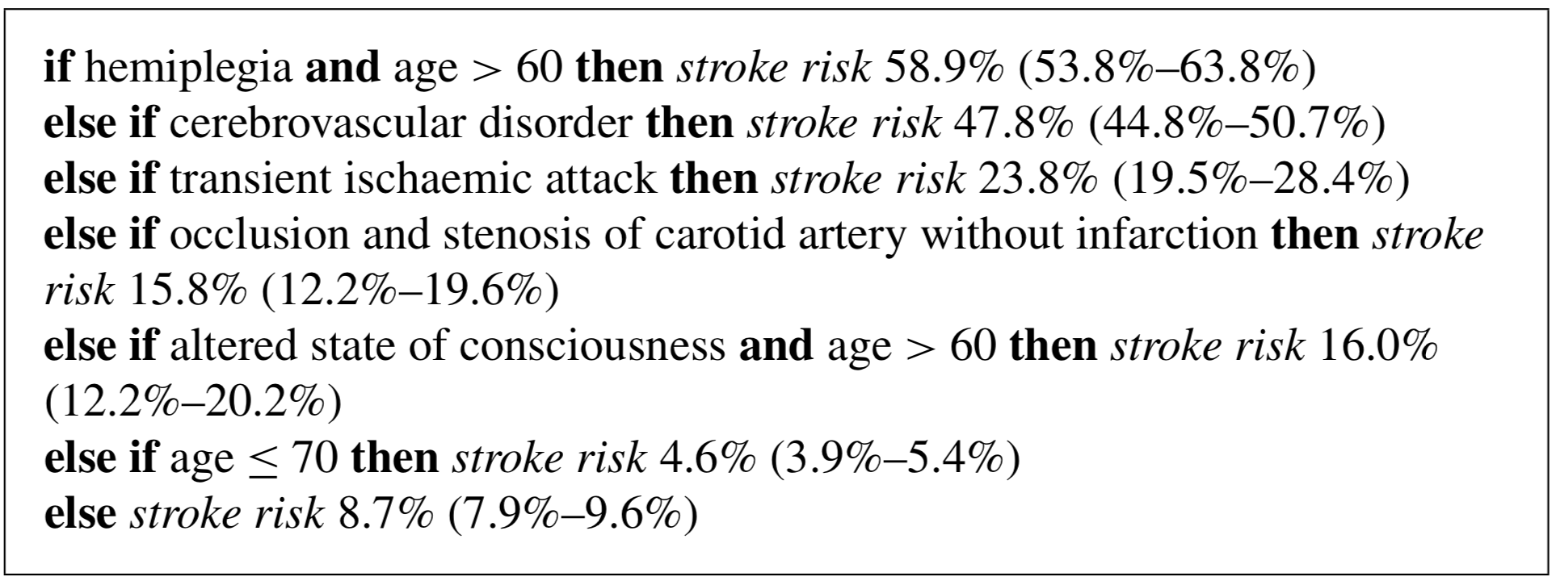
Explain How?
Rule Lists

Slide 27
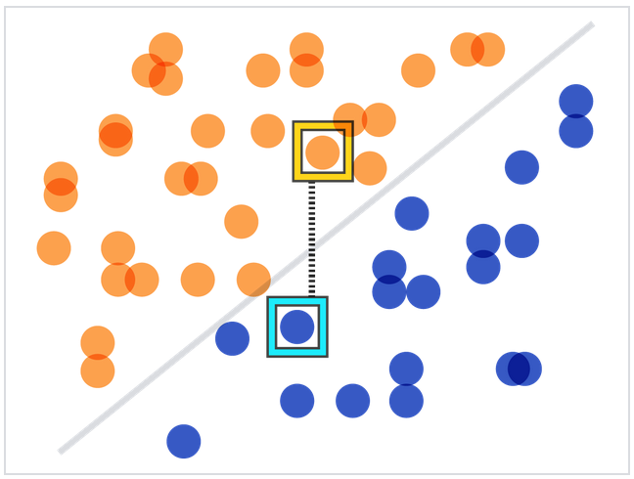
Explain How?
Counterfactuals

Slide 28
Measuring explanations
“[T]he task of interpretation appears underspecified. Papers provide diverse and sometimes non-overlapping motivations for interpretability, and offer myriad notions of what attributes render models interpretable.” (Lipton, 2017, p. 1)
“Unfortunately, there is little consensus on what interpretability in machine learning is and how to evaluate it for benchmarking.” (Doshi-Velez & Kim, 2017, p. 1)

Slide 29
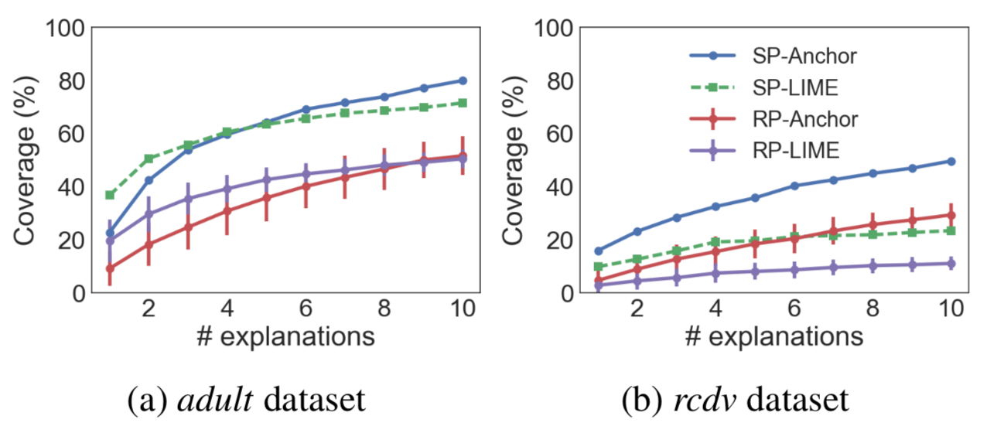
Humans vs. math
Fidelity & Sparsity

Slide 30
Conclusion

Slide 31
Conclusion
Explanations are thoroughly context-dependent: who’s the audience? What’s the goal?
Tradeoffs between fidelity to the target model and explanatory parsimony are inevitable
Explanations are a process, not a product

Slide 32
References
Barber, R. F., & Candès, E. J. (2015). Controlling the false discovery rate via knockoffs. Ann. Statist., 43(5), 2055–2085.
Breiman, L. (2001). Random Forests. Machine Learning, 45(1), 1–33.
Doshi-Velez, F., & Kim, B. (2017). Towards A Rigorous Science of Interpretable Machine Learning, (Ml), 1–13. Retrieved from http://arxiv.org/abs/1702.08608
Hempel, C. (1965). Aspects of Scientific Explanation and Other Essays in the Philosophy of Science. New York: Free Press.
Letham, B., Rudin, C., McCormick, T. H., & Madigan, D. (2015). Interpretable classifiers using rules and Bayesian analysis: Building a better stroke prediction model. Ann. Appl. Stat., 9(3), 1350–1371.
Lipton, Z. C. (2016). The Mythos of Model Interpretability. Retrieved from http://arxiv.org/abs/1606.03490
Lundberg, S. M., & Lee, S.I. (2017). A Unified Approach to Interpreting Model Predictions. In I. Guyon, U. V Luxburg, S. Bengio, H. Wallach, R. Fergus, S. Vishwanathan, & R. Garnett (Eds.), Advances in Neural Information Processing Systems 30 (pp. 4765–4774). Curran Associates, Inc.
Miller, T. (2017). Explanation in artificial intelligence: Insights from the social sciences. arXiv preprint 1706.07269.
Ribeiro, M. T., Singh, S., & Guestrin, C. (2016). “Why Should I Trust You?”: Explaining the Predictions of Any Classifier. In Proceedings of the 22nd ACM SIGKDD International Conference on Knowledge Discovery and Data Mining (pp. 1135–1144). New York, NY, USA: ACM.
Ribeiro, M. T., Singh, S., & Guestrin, C. (2018). Anchors: High-Precision Model-Agnostic Explanations. In AAAI.
Salmon, W. (1984). Scientific Explanation and the Causal Structure of the World. Princeton: Princeton University Press.
Shrikumar, A., Greenside, P., & Kundaje, A. (2017). Learning Important Features Through Propagating Activation Differences. Retrieved from http://arxiv.org/abs/1704.02685.
Wachter, S., Mittelstadt, B., & Floridi, L. (2017). Why a right to explanation of automated decision-making does not exist in the general data protection regulation. International Data Privacy Law, 7(2), 76–99.
Wachter, S., Mittelstadt, B., & Russell, C. (2018). Counterfactual Explanations without Opening the Black Box: Automated Decisions and the GDPR. Harvard Journal of Law and Technology, 31(2), 841–887.
Yang, H., Rudin, C., & Seltzer, M. (2016). Scalable Bayesian Rule Lists.

Slide 33
Thanks!
For questions, complaints, and/or readings, email me:
david.watson@oii.ox.ac.uk

