Slide 1
PASCOS 01 Jul 2019
Positivity in the Sky
Scott Melville

Slide 2


PASCOS 01 Jul 2019
Positivity in the Sky
Scott Melville

Slide 3
PASCOS 01 Jul 2019
Positivity in the Sky
Energy
Scott Melville

Slide 4


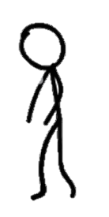

PASCOS 01 Jul 2019
Positivity in the Sky
Energy
Scott Melville

Slide 5
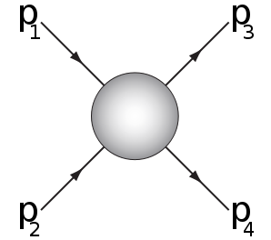

PASCOS 01 Jul 2019
Positivity in the Sky
Energy
$$AEFT$$
Scott Melville

Slide 6
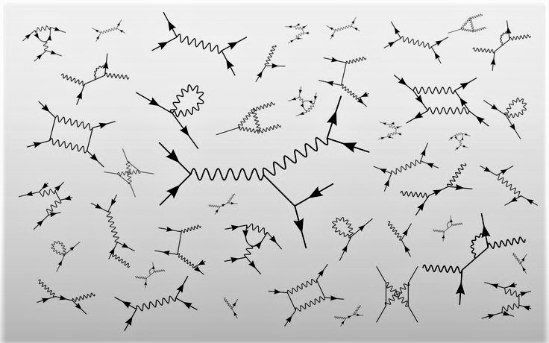

PASCOS 01 Jul 2019
Positivity in the Sky
Energy
$AUV$ ?
$$AEFT$$
Scott Melville

Slide 7

PASCOS 01 Jul 2019
Positivity in the Sky
Energy
UV Properties
$AUV$ ?
IR Parameters
$$AEFT$$
Scott Melville

Slide 8

Outline
hep-ph/9607351 Donoghue
Notes:
Let me start by describing the literature. There have been an explosion of papers on this subject recently, and they fall neatly into two categories.

Slide 9
Big Picture
Positivity Constraints
Dark Energy
SMEFT
Only some EFTs have “good” UV completions
… and this gives us constraining power!
Horndeski parameters improved by factor 110
VBS parameters improved by factor ~100
Outline
hep-ph/9607351 Donoghue
Notes:
These constraints have really come into their own in the last few years. The central ideas were laid out in 2006, and then we got to work developing all of the formalism and technical details, and now we’re finally in a position to apply the resulting constraints to all kinds of theories.
The nitty-gritty details can be found in the papers, but for today I want to paint a broad picture of what’s going on and why.

Slide 10
Big Picture
Positivity Constraints
Dark Energy
SMEFT
Only some EFTs have “good” UV completions
… and this gives us constraining power!
Horndeski parameter space reduced by factor 110
VBS parameters improved by factor ~100
Outline
hep-ph/9607351 Donoghue
Notes:
These constraints have really come into their own in the last few years. The central ideas were laid out in 2006, and then we got to work developing all of the formalism and technical details, and now we’re finally in a position to apply the resulting constraints to all kinds of theories.
The nitty-gritty details can be found in the papers, but for today I want to paint a broad picture of what’s going on and why.

Slide 11
Where do they come from?
hep-ph/9607351 Donoghue 1605.06111 Bellazzini
hep-th/0602178 Adams et al 1702.06134 SM et al
hep-th/0609159 Jenkins et al 1706.02712 SM et al
Big Picture
Positivity Constraints
Dark Energy
SMEFT
Only some EFTs have “good” UV completions
… and this gives us constraining power!
What good are they?
1204.63880 Dvali
1502.07304 Baumann et al
1702.08577 SM et al
0802.4081 Adams et al
1405.2960 Bellazzini et al
1808.00010 Zhang, Zhou
1509.00851 Bellazzini et al
1601.04068 Cheung et al
1607.06084 Bonifacio et al
1608.02942 Cheung et al
1710.02539 Bellazzini
1710.09611 SM et al
1804.10624 SM et al
Horndeski parameter space reduced by factor 110
VBS parameters improved by factor ~100
References:
Donoghue hep-ph/9607351
EFTs and Dispersion relations
Adams et al., hep-th/0602178
Causality, Analyticity and an IR Obstruction to UV Completion
SM, de Rham, Tolley, Zhou 1702.06134, 1706.02712
Positivity Bounds for Effective Field Theories
hep-th/0602178 Adams, Arkani-Hamed, Dubovsky, Nicolis, Rattazzi
1702.06134 de Rham, SM, Tolley, Zhou
1811.12928 Noller, Nicola
1904.05874 SM, Noller
Outline
[1904.05874]
hep-ph/9607351 Donoghue
Notes:
These constraints have really come into their own in the last few years. The central ideas were laid out in 2006, and then we got to work developing all of the formalism and technical details, and now we’re finally in a position to apply the resulting constraints to all kinds of theories.
The nitty-gritty details can be found in the papers, but for today I want to paint a broad picture of what’s going on and why.

Slide 12
Positivity
[1904.05874]

Slide 13
UV
IR
Positivity
[1904.05874]
Notes:
Can have classicalization in other places

Slide 14
UV
IR
General Relativity
Positivity
[1904.05874]
Notes:
Can have classicalization in other places

Slide 15
UV
New physics
IR
General Relativity
Positivity
[1904.05874]
Notes:
Can have classicalization in other places

Slide 16


UV
New physics
$$???$$
$$M$$
IR
General Relativity
Positivity
[1904.05874]
Notes:
Can have classicalization in other places

Slide 17
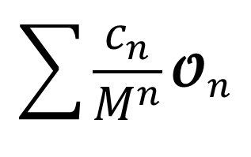

UV
New physics
$$???$$
$$M$$
$$\sum{\frac{c_{n}}{M^{n}}{\text{𝓞}}_{n}}$$
$$+$$
IR
General Relativity
Positivity
[1904.05874]
Notes:
Can have classicalization in other places

Slide 18

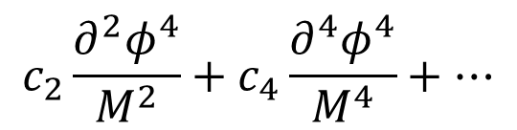
UV
New physics
$$???$$
$$M$$
$$\sum{\frac{c_{n}}{M^{n}}{\text{𝓞}}_{n}}$$
$$+$$
Known operator basis
IR
General Relativity
e.g.
$$c_{2}\frac{∂^{2}φ^{4}}{M^{2}}+c_{4}\frac{∂^{4}φ^{4}}{M^{4}}+…$$
Positivity
[1904.05874]
Notes:
This lets us calculate things without needing to worry about the complicated underlying UV physics.

Slide 19

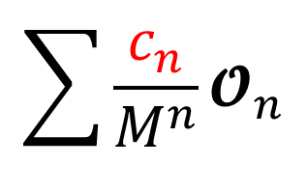
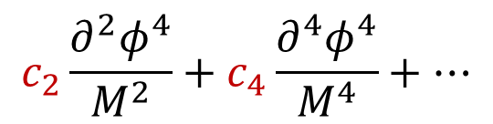
UV
New physics
$$???$$
$$M$$
$$\sum{\frac{c_{n}}{M^{n}}{\text{𝓞}}_{n}}$$
$$+$$
Known operator basis
IR
General Relativity
with undetermined
coefficients
e.g.
$$c_{2}\frac{∂^{2}φ^{4}}{M^{2}}+c_{4}\frac{∂^{4}φ^{4}}{M^{4}}+…$$
Positivity
[1904.05874]
Notes:
BUT, the price to pay is that each local operator gets its own undetermined coefficient. I’ll refer to these as EFT parameters, Wilson coefficients, or couplings.

Slide 20
UV
New physics
$$???$$
$$M$$
$$\sum{\frac{c_{n}}{M^{n}}{\text{𝓞}}_{n}}$$
$$+$$
Known operator basis
IR
General Relativity
with undetermined
coefficients
e.g.
$$c_{2}\frac{∂^{2}φ^{4}}{M^{2}}+c_{4}\frac{∂^{4}φ^{4}}{M^{4}}+…$$
Need many measurements
Positivity
[1904.05874]
Notes:
Problem number 1: often there are many operators to consider, even at relatively small n. We need to make AT LEAST this many independent measurements in order to fix c_n and make the theory predictive. In the SM, working with the leading order dimension 4 operators gives 19 undetermined parameters. In GR there’s all contractions of Ricci Scalar, Ricci Tensor and Riemann and their derivatives, and so we’d need to make a lot of very precise quantum gravity measurements in order to make this GR EFT predictive beyond leading orders.

Slide 21

UV
New physics
$$???$$
$$M$$
$$\sum{\frac{c_{n}}{M^{n}}{\text{𝓞}}_{n}}$$
$$+$$
Known operator basis
IR
General Relativity
with undetermined
coefficients
e.g.
$$c_{2}\frac{∂^{2}φ^{4}}{M^{2}}+c_{4}\frac{∂^{4}φ^{4}}{M^{4}}+…$$
Need many measurements
(2) No deeper understanding of UV physics
Positivity
[1904.05874]
Notes:
Because we’ve given up on understanding the UV, no amount of testing or experimentation can reveal fundamental truths about the underlying physics on very small length scales. This isn’t a very satisfying state of affairs.

Slide 22

UV
New physics
Unitary, Causal, Local, …
$$???$$
$$M$$
$$\sum{\frac{c_{n}}{M^{n}}{\text{𝓞}}_{n}}$$
$$+$$
Known operator basis
IR
General Relativity
with undetermined
coefficients
e.g.
$$c_{2}\frac{∂^{2}φ^{4}}{M^{2}}+c_{4}\frac{∂^{4}φ^{4}}{M^{4}}+…$$
Need many measurements
(2) No deeper understanding of UV physics
Positivity
[1904.05874]
Notes:
Because we’ve given up on understanding the UV, no amount of testing or experimentation can reveal fundamental truths about the underlying physics on very small length scales. This isn’t a very satisfying state of affairs.

Slide 23


UV
New physics
Unitary, Causal, Local, …
$$???$$
$$M$$
$$\sum{\frac{c_{n}}{M^{n}}{\text{𝓞}}_{n}}$$
$$c_{4}$$
$$+$$
IR
General Relativity
$$c_{2}$$
$$c_{2}\frac{∂^{2}φ^{4}}{M^{2}}+c_{4}\frac{∂^{4}φ^{4}}{M^{4}}+…$$
Need many measurements
(2) No deeper understanding of UV physics
Positivity
[1904.05874]
Notes:
Any questions at this stage, about what we’re going to do or why it’s important

Slide 24
UV
New physics
Unitary, Causal, Local, …
$$???$$
$$M$$
$$\sum{\frac{c_{n}}{M^{n}}{\text{𝓞}}_{n}}$$
$$c_{4}$$
$$+$$
IR
General Relativity
$$c_{2}$$
$$c_{2}\frac{∂^{2}φ^{4}}{M^{2}}+c_{4}\frac{∂^{4}φ^{4}}{M^{4}}+…$$
Need many measurements
(2) No deeper understanding of UV physics
Positivity
[1904.05874]
Notes:
Any questions at this stage, about what we’re going to do or why it’s important

Slide 25
UV
New physics
Unitary, Causal, Local, …
$$???$$
$$M$$
$$\sum{\frac{c_{n}}{M^{n}}{\text{𝓞}}_{n}}$$
$$c_{4}$$
$$+$$
IR
General Relativity
$$c_{2}$$
$$c_{2}\frac{∂^{2}φ^{4}}{M^{2}}+c_{4}\frac{∂^{4}φ^{4}}{M^{4}}+…$$
Need many measurements
(2) No deeper understanding of UV physics
Positivity
[1904.05874]
Notes:
Any questions at this stage, about what we’re going to do or why it’s important

Slide 26
UV
New physics
Unitary, Causal, Local, …
$$???$$
$$M$$
$$\sum{\frac{c_{n}}{M^{n}}{\text{𝓞}}_{n}}$$
$$c_{4}$$
$$+$$
IR
General Relativity
$$c_{2}$$
$$c_{2}\frac{∂^{2}φ^{4}}{M^{2}}+c_{4}\frac{∂^{4}φ^{4}}{M^{4}}+…$$
Need many measurements
(2) No deeper understanding of UV physics
Positivity
[1904.05874]
Notes:
Any questions at this stage, about what we’re going to do or why it’s important

Slide 27

UV
New physics
Unitary, Causal, Local, …
$$???$$
$$M$$
$$\sum{\frac{c_{n}}{M^{n}}{\text{𝓞}}_{n}}$$
$$c_{4}$$
$$+$$
IR
General Relativity
$$c_{2}$$
$$c_{2}\frac{∂^{2}φ^{4}}{M^{2}}+c_{4}\frac{∂^{4}φ^{4}}{M^{4}}+…$$
Data more constraining
(2) No deeper understanding of UV physics
Positivity
[1904.05874]
Notes:
Any questions at this stage, about what we’re going to do or why it’s important

Slide 28
UV
New physics
Unitary, Causal, Local, …
$$???$$
$$M$$
$$\sum{\frac{c_{n}}{M^{n}}{\text{𝓞}}_{n}}$$
$$c_{4}$$
$$+$$
IR
General Relativity
$$c_{2}$$
$$c_{2}\frac{∂^{2}φ^{4}}{M^{2}}+c_{4}\frac{∂^{4}φ^{4}}{M^{4}}+…$$
Data more constraining
(2) Can infer UV properties from IR measurements
Positivity
[1904.05874]
Notes:
Any questions at this stage, about what we’re going to do or why it’s important

Slide 29
UV
New physics
Unitary, Causal, Local, …
$$???$$
$$M$$
$$\sum{\frac{c_{n}}{M^{n}}{\text{𝓞}}_{n}}$$
$$c_{4}$$
$$+$$
IR
General Relativity
$$c_{2}$$
Data more constraining
Positivity Bounds
(2) Can infer UV properties from IR measurements
Positivity
[1904.05874]
Notes:
Any questions at this stage, about what we’re going to do or why it’s important

Slide 30

$$a$$
$$a$$
?
$$b$$
$$b$$
Positivity
[1904.05874]
Notes:
Being explicit, the positivity bounds which we’ll derive and use today are:

Slide 31



$$a$$
$$a$$
$$p_{1}$$
$$p_{3}$$
?
$$p_{2}$$
$$p_{4}$$
$$b$$
$$b$$
Positivity
[1904.05874]
Notes:
Being explicit, the positivity bounds which we’ll derive and use today are:

Slide 32

$$t=−{\left(p_{1}+p_{3}\right)}^{2}$$
$$a$$
$$a$$
$$p_{1}$$
$$p_{3}$$
$$s=−{\left(p_{1}+p_{2}\right)}^{2}$$
?
$$p_{2}$$
$$p_{4}$$
$$b$$
$$b$$
Positivity
[1904.05874]
Notes:
Being explicit, the positivity bounds which we’ll derive and use today are:

Slide 33
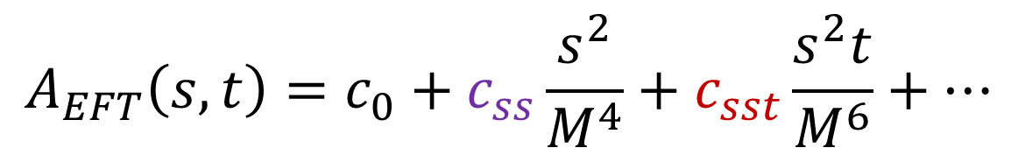
$$t=−{\left(p_{1}+p_{3}\right)}^{2}$$
$$a$$
$$a$$
$$p_{1}$$
$$p_{3}$$
$$s=−{\left(p_{1}+p_{2}\right)}^{2}$$
?
$$p_{2}$$
$$p_{4}$$
$$b$$
$$b$$
$$A_{EFT}\left(s,t\right)=c_{0}+c_{ss}\frac{s^{2}}{M^{4}}+c_{sst}\frac{s^{2}t}{M^{6}}+…$$
Positivity
[1904.05874]
Notes:
Being explicit, the positivity bounds which we’ll derive and use today are:

Slide 34



$$t=−{\left(p_{1}+p_{3}\right)}^{2}$$
$$a$$
$$a$$
$$p_{1}$$
$$p_{3}$$
$$s=−{\left(p_{1}+p_{2}\right)}^{2}$$
?
$$p_{2}$$
$$p_{4}$$
$$b$$
$$b$$
$$A_{EFT}\left(s,t\right)=c_{0}+c_{ss}\frac{s^{2}}{M^{4}}+c_{sst}\frac{s^{2}t}{M^{6}}+…$$
Unitarity, Causality, Locality of
?
$$⇒$$
$$c_{ss}>0 ,$$
$$c_{sst} ≳0$$
Positivity
[1904.05874]
Notes:
Being explicit, the positivity bounds which we’ll derive and use today are:

Slide 35
Simple UV Example
UV
IR
Positivity
[1904.05874]

Slide 36
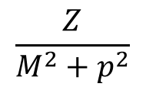



Simple UV Example
UV
$$φ$$
$$H$$
$$\frac{1}{m^{2}+p^{2}}$$
$$\frac{Z}{M^{2}+p^{2}}$$
IR
Positivity
[1904.05874]

Slide 37


Simple UV Example
UV
$$φ$$
$$H$$
$$g H φ^{2}$$
$$\frac{1}{m^{2}+p^{2}}$$
$$\frac{Z}{M^{2}+p^{2}}$$
$$g$$
IR
Positivity
[1904.05874]

Slide 38




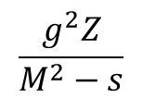
Simple UV Example
UV
$$φ$$
$$H$$
$$g H φ^{2}$$
$$p_{1}$$
$$p_{3}$$
$$\frac{1}{m^{2}+p^{2}}$$
$$\frac{Z}{M^{2}+p^{2}}$$
$$g$$
$$\frac{g^{2}Z}{M^{2}−s}$$
$$p_{2}$$
$$p_{4}$$
IR
Positivity
[1904.05874]

Slide 39

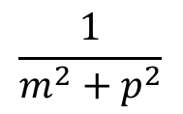

Simple UV Example
UV
$$φ$$
$$H$$
$$g H φ^{2}$$
$$p_{1}$$
$$p_{3}$$
$$\frac{1}{m^{2}+p^{2}}$$
$$\frac{Z}{M^{2}+p^{2}}$$
$$g$$
$$\frac{g^{2}Z}{M^{2}−s}$$
$$p_{2}$$
$$p_{4}$$
$$M^{2}$$
$$φ$$
IR
$$\frac{1}{m^{2}+p^{2}}$$
Positivity
[1904.05874]

Slide 40
Simple UV Example
UV
$$φ$$
$$H$$
$$g H φ^{2}$$
$$p_{1}$$
$$p_{3}$$
$$\frac{1}{m^{2}+p^{2}}$$
$$\frac{Z}{M^{2}+p^{2}}$$
$$g$$
$$\frac{g^{2}Z}{M^{2}−s}$$
$$p_{2}$$
$$p_{4}$$
$$M^{2}$$
$$φ$$
IR
$$\frac{1}{m^{2}+p^{2}}$$
$$\frac{g^{2}Z}{M^{2}} \left(1+\frac{s}{M^{2}} +\frac{s^{2}}{M^{4}} +… \right)$$
Positivity
[1904.05874]

Slide 41







Simple UV Example
UV
$$φ$$
$$H$$
$$g H φ^{2}$$
$$p_{1}$$
$$p_{3}$$
$$\frac{1}{m^{2}+p^{2}}$$
$$\frac{Z}{M^{2}+p^{2}}$$
$$g$$
$$\frac{g^{2}Z}{M^{2}−s}$$
$$p_{2}$$
$$p_{4}$$
$$M^{2}$$
$$φ$$
$$c_{0}φ^{4}$$
$$c_{1}∂^{2}φ^{4}$$
$$c_{2}∂^{4}φ^{4}$$
$$…$$
$$+$$
$$+$$
$$+… =$$
IR
$$\frac{1}{m^{2}+p^{2}}$$
$$\frac{g^{2}Z}{M^{2}} \left(1+\frac{s}{M^{2}} +\frac{s^{2}}{M^{4}} +… \right)$$
Positivity
[1904.05874]

Slide 42


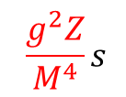
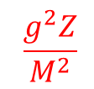
Simple UV Example
UV
$$φ$$
$$H$$
$$g H φ^{2}$$
$$p_{1}$$
$$p_{3}$$
$$\frac{1}{m^{2}+p^{2}}$$
$$\frac{Z}{M^{2}+p^{2}}$$
$$g$$
$$\frac{g^{2}Z}{M^{2}−s}$$
$$p_{2}$$
$$p_{4}$$
$$M^{2}$$
$$φ$$
$$c_{0}φ^{4}$$
$$c_{1}∂^{2}φ^{4}$$
$$c_{2}∂^{4}φ^{4}$$
$$…$$
$$+$$
$$+$$
$$+… =$$
IR
$$\frac{1}{m^{2}+p^{2}}$$
$$\frac{g^{2}Z}{M^{2}}$$
$$+$$
$$\frac{g^{2}Z}{M^{4}}s$$
$$+$$
$$\frac{g^{2}Z}{M^{6}}s^{2}$$
$$+… =$$
$$\frac{g^{2}Z}{M^{2}} \left(1+\frac{s}{M^{2}} +\frac{s^{2}}{M^{4}} +… \right)$$
Positivity
[1904.05874]

Slide 43
Simple UV Example
UV
$$φ$$
$$H$$
$$g H φ^{2}$$
$$p_{1}$$
$$p_{3}$$
$$\frac{1}{m^{2}+p^{2}}$$
$$\frac{Z}{M^{2}+p^{2}}$$
$$g$$
$$\frac{g^{2}Z}{M^{2}−s}$$
$$p_{2}$$
$$p_{4}$$
$$M^{2}$$
$$φ$$
$$c_{0}φ^{4}$$
$$c_{1}∂^{2}φ^{4}$$
$$c_{2}∂^{4}φ^{4}$$
$$…$$
$$+$$
$$+$$
$$+… =$$
IR
$$\frac{1}{m^{2}+p^{2}}$$
$$\frac{g^{2}Z}{M^{2}}$$
$$+$$
$$\frac{g^{2}Z}{M^{4}}s$$
$$+$$
$$\frac{g^{2}Z}{M^{6}}s^{2}$$
$$+… =$$
$$\frac{g^{2}Z}{M^{2}} \left(1+\frac{s}{M^{2}} +\frac{s^{2}}{M^{4}} +… \right)$$
Positivity
[1904.05874]

Slide 44
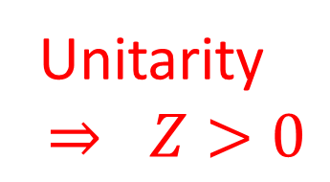
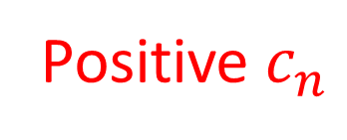
Simple UV Example
UV
$$φ$$
$$H$$
$$g H φ^{2}$$
$$p_{1}$$
$$p_{3}$$
Unitarity
$$⇒ Z>0$$
$$\frac{1}{m^{2}+p^{2}}$$
$$\frac{Z}{M^{2}+p^{2}}$$
$$g$$
$$\frac{g^{2}Z}{M^{2}−s}$$
$$p_{2}$$
$$p_{4}$$
$$M^{2}$$
$$φ$$
$$c_{0}φ^{4}$$
$$c_{1}∂^{2}φ^{4}$$
$$c_{2}∂^{4}φ^{4}$$
$$…$$
Positive $c_{n}$
$$+$$
$$+$$
$$+… =$$
IR
$$\frac{1}{m^{2}+p^{2}}$$
$$\frac{g^{2}Z}{M^{2}}$$
$$+$$
$$\frac{g^{2}Z}{M^{4}}s$$
$$+$$
$$\frac{g^{2}Z}{M^{6}}s^{2}$$
$$+… =$$
$$\frac{g^{2}Z}{M^{2}} \left(1+\frac{s}{M^{2}} +\frac{s^{2}}{M^{4}} +… \right)$$
Positivity
[1904.05874]

Slide 45

Simple UV Example
UV
$$φ$$
$$H$$
$$g H φ^{2}$$
Causal + Local
$$⇒$$
$$p_{1}$$
$$p_{3}$$
Unitarity
$$⇒ Z>0$$
Various Poles
$$\frac{1}{m^{2}+p^{2}}$$
$$\frac{Z}{M^{2}+p^{2}}$$
$$g$$
$$\frac{g^{2}Z}{M^{2}−s}$$
$$p_{2}$$
$$p_{4}$$
$$M^{2}$$
$$φ$$
$$c_{0}φ^{4}$$
$$c_{1}∂^{2}φ^{4}$$
$$c_{2}∂^{4}φ^{4}$$
$$…$$
Positive $c_{n}$
$$+$$
$$+$$
$$+… =$$
IR
$$\frac{1}{m^{2}+p^{2}}$$
$$\frac{g^{2}Z}{M^{2}}$$
$$+$$
$$\frac{g^{2}Z}{M^{4}}s$$
$$+$$
$$\frac{g^{2}Z}{M^{6}}s^{2}$$
$$+… =$$
$$\frac{g^{2}Z}{M^{2}} \left(1+\frac{s}{M^{2}} +\frac{s^{2}}{M^{4}} +… \right)$$
Positivity
[1904.05874]

Slide 46

$$t=−{\left(p_{1}+p_{3}\right)}^{2}$$
$$a$$
$$a$$
$$p_{1}$$
$$p_{3}$$
$$s=−{\left(p_{1}+p_{2}\right)}^{2}$$
?
$$p_{2}$$
$$p_{4}$$
$$b$$
$$b$$
$$A_{EFT}\left(s,t\right)=c_{0}+c_{ss}\frac{s^{2}}{M^{4}}+c_{sst}\frac{s^{2}t}{M^{6}}+…$$
Unitarity, Causality, Locality of
?
$$⇒$$
$$c_{ss}>0 ,$$
$$c_{sst} ≳0$$
Positivity
[1904.05874]

Slide 47



Dark Energy
[1904.05874]

Slide 48



Scalar-Tensor Theories
$$ℒ=ℒ_{GR}+ℒ_{Scalar−Tensor}$$
Dark Energy
[1904.05874]

Slide 49
Scalar-Tensor Theories
$$ℒ=ℒ_{GR}+ℒ_{Scalar−Tensor}$$
Single Scalar Field
Dark Energy
[1904.05874]

Slide 50




Scalar-Tensor Theories
$$ℒ=ℒ_{GR}+ℒ_{Scalar−Tensor}$$
Single Scalar Field
$${\left(∇φ\right)}^{2}$$
$${\left(∇φ\right)}^{6}$$
$${\left(∇φ\right)}^{4}$$
$$…$$
Dark Energy
[1904.05874]

Slide 51



Scalar-Tensor Theories
$$ℒ=ℒ_{GR}+ℒ_{Scalar−Tensor}$$
Single Scalar Field
$${\left(∇φ\right)}^{2}$$
$${\left(∇φ\right)}^{6}$$
$${\left(∇φ\right)}^{4}$$
$$…$$
$$\left(∇∇φ\right)$$
$$…$$
$$\left(∇∇φ\right){\left(∇φ\right)}^{2}$$
Dark Energy
[1904.05874]

Slide 52


Scalar-Tensor Theories
$$ℒ=ℒ_{GR}+ℒ_{Scalar−Tensor}$$
Single Scalar Field
$${\left(∇φ\right)}^{2}$$
$${\left(∇φ\right)}^{6}$$
$${\left(∇φ\right)}^{4}$$
$$…$$
$$\left(∇∇φ\right)$$
$$…$$
$$\left(∇∇φ\right){\left(∇φ\right)}^{2}$$
$${\left(∇∇φ\right)}^{2}$$
$$…$$
Dark Energy
[1904.05874]

Slide 53


Scalar-Tensor Theories
$$ℒ=ℒ_{GR}+ℒ_{Scalar−Tensor}$$
Single Scalar Field
$${\left(∇φ\right)}^{2}$$
$${\left(∇φ\right)}^{6}$$
$$G_{2}\left(X\right)$$
$$(X=−\frac{1}{2}{\left(∇φ\right)}^{2})$$
$${\left(∇φ\right)}^{4}$$
$$…$$
$$\left(∇∇φ\right)$$
$$…$$
$$\left(∇∇φ\right){\left(∇φ\right)}^{2}$$
$${\left(∇∇φ\right)}^{2}$$
$$…$$
Dark Energy
[1904.05874]

Slide 54

Scalar-Tensor Theories
$$ℒ=ℒ_{GR}+ℒ_{Scalar−Tensor}$$
Single Scalar Field
$${\left(∇φ\right)}^{2}$$
$${\left(∇φ\right)}^{6}$$
$$G_{2}\left(X\right)$$
$$(X=−\frac{1}{2}{\left(∇φ\right)}^{2})$$
$${\left(∇φ\right)}^{4}$$
$$…$$
$$\left(∇∇φ\right)$$
$$…$$
$$G_{3}\left(X\right)∇^{2}φ$$
$$\left(∇∇φ\right){\left(∇φ\right)}^{2}$$
$${\left(∇∇φ\right)}^{2}$$
$$…$$
Dark Energy
[1904.05874]

Slide 55

Scalar-Tensor Theories
$$ℒ=ℒ_{GR}+ℒ_{Scalar−Tensor}$$
Single Scalar Field
$${\left(∇φ\right)}^{2}$$
$${\left(∇φ\right)}^{6}$$
$$G_{2}\left(X\right)$$
$$(X=−\frac{1}{2}{\left(∇φ\right)}^{2})$$
$${\left(∇φ\right)}^{4}$$
$$…$$
$$\left(∇∇φ\right)$$
$$…$$
$$G_{3}\left(X\right)∇^{2}φ$$
$$\left(∇∇φ\right){\left(∇φ\right)}^{2}$$
$${\left(∇∇φ\right)}^{2}$$
$$…$$
$$G_{4,X}\left(X\right){\left(∇∇φ\right)}^{2}$$
Dark Energy
[1904.05874]

Slide 56
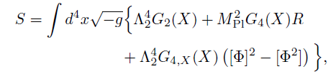

Positivity in Horndeski
$$ℒ=ℒ_{GR}+ℒ_{Scalar−Tensor}$$
Dark Energy
[1904.05874]

Slide 57

Positivity in Horndeski
$$(X=−\frac{1}{2}{\left(∇φ\right)}^{2})$$
$$ℒ=ℒ_{GR}+G_{4}\left(X\right)R+G_{2}\left(X\right)+G_{4,X}(X) {(∇∇φ)}^{2}$$
Dark Energy
[1904.05874]

Slide 58
Positivity in Horndeski
$$(X=−\frac{1}{2}{\left(∇φ\right)}^{2})$$
$$ℒ=ℒ_{GR}+G_{4}\left(X\right)R+G_{2}\left(X\right)+G_{4,X}(X) {(∇∇φ)}^{2}$$
Part of ``Horndeski’’ class
Dark Energy
[1904.05874]

Slide 59
Positivity in Horndeski
$$(X=−\frac{1}{2}{\left(∇φ\right)}^{2})$$
$$ℒ=ℒ_{GR}+G_{4}\left(X\right)R+G_{2}\left(X\right)+G_{4,X}(X) {(∇∇φ)}^{2}$$
Part of ``Horndeski’’ class
$$φ$$
$$φ$$
$$A \sim G_{2,XX} s^{2}−G_{4,XX} s^{2}t+…$$
$$φ$$
$$φ$$
Dark Energy
[1904.05874]

Slide 60

Positivity in Horndeski
$$(X=−\frac{1}{2}{\left(∇φ\right)}^{2})$$
$$ℒ=ℒ_{GR}+G_{4}\left(X\right)R+G_{2}\left(X\right)+G_{4,X}(X) {(∇∇φ)}^{2}$$
Part of ``Horndeski’’ class
$$φ$$
$$φ$$
$$A \sim G_{2,XX} s^{2}−G_{4,XX} s^{2}t+…$$
$G_{2,XX}>0,$ $−G_{4,XX}≳0$
$$φ$$
$$φ$$
Dark Energy
[1904.05874]

Slide 61
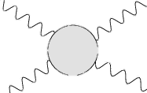
Positivity in Horndeski
$$(X=−\frac{1}{2}{\left(∇φ\right)}^{2})$$
$$ℒ=ℒ_{GR}+G_{4}\left(X\right)R+G_{2}\left(X\right)+G_{4,X}(X) {(∇∇φ)}^{2}$$
Part of ``Horndeski’’ class
$$φ$$
$$φ$$
$$A \sim G_{2,XX} s^{2}−G_{4,XX} s^{2}t+…$$
$G_{2,XX}>0,$ $−G_{4,XX}≳0$
$$φ$$
$$φ$$
$$h_{μν}$$
$$h_{μν}$$
$$A \sim G_{4,X} s^{2}+…$$
$$φ$$
$$φ$$
Dark Energy
[1904.05874]

Slide 62
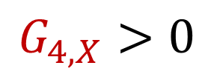
Positivity in Horndeski
$$(X=−\frac{1}{2}{\left(∇φ\right)}^{2})$$
$$ℒ=ℒ_{GR}+G_{4}\left(X\right)R+G_{2}\left(X\right)+G_{4,X}(X) {(∇∇φ)}^{2}$$
Part of ``Horndeski’’ class
$$φ$$
$$φ$$
$$A \sim G_{2,XX} s^{2}−G_{4,XX} s^{2}t+…$$
$G_{2,XX}>0,$ $−G_{4,XX}≳0$
$$φ$$
$$φ$$
$$h_{μν}$$
$$h_{μν}$$
$$A \sim G_{4,X} s^{2}+…$$
$$φ$$
$$G_{4,X}>0$$
$$φ$$
Dark Energy
[1904.05874]

Slide 63
Our Assumptions
Dark Energy
[1904.05874]

Slide 64
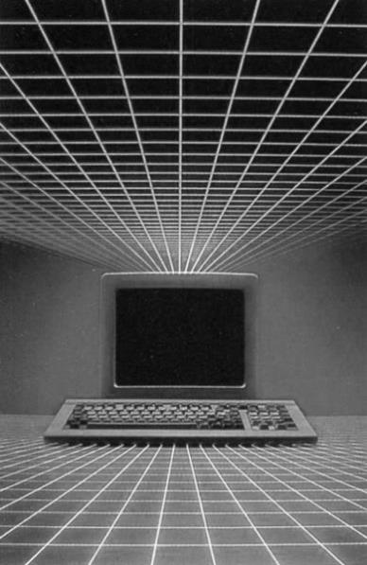
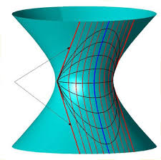
Our Assumptions
  Flat space positivity continues to
hold on Cosmological background
Dark Energy
[1904.05874]

Slide 65

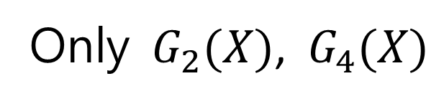
Our Assumptions
  Flat space positivity continues to
hold on Cosmological background
  Particular subset of Horndeski
3
2
5
Only $G_{2}(X)$, $G_{4}(X)$
4
Dark Energy
[1904.05874]

Slide 66
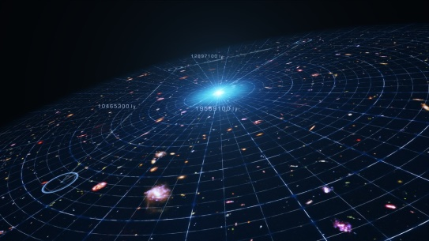


Our Assumptions
  Flat space positivity continues to
hold on Cosmological background
  Particular subset of Horndeski
3
2
5
Only $G_{2}(X)$, $G_{4}(X)$
4
  Particular parametrization
$$G_{n}\left(t\right)→c_{n} Ω_{DE}(t)$$
$$t$$
Dark Energy
[1904.05874]
Notes:
https://arxiv.org/pdf/1509.07816.pdf

Slide 67

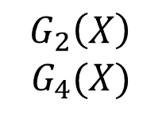




Parameter estimation with positivity
Scott Melville
$$c_{B}$$
‘Braiding’ (mixing of scalar and tensor)
$G_{2}\left(X\right)$
$$G_{4}(X)$$
$$c_{M}$$
Time-dependence of $M_{P}$ (i.e. $G_{N}$)
$$c_{T}$$
Gravitational wave speed
[SM, Noller, 1904.xxxxx]
Dark Energy
[1904.05874]
Notes:
Contours mark 1 and 2
condence intervals, computed using CMB, RSD, BAO and
matter power spectrum measurements.

Slide 68
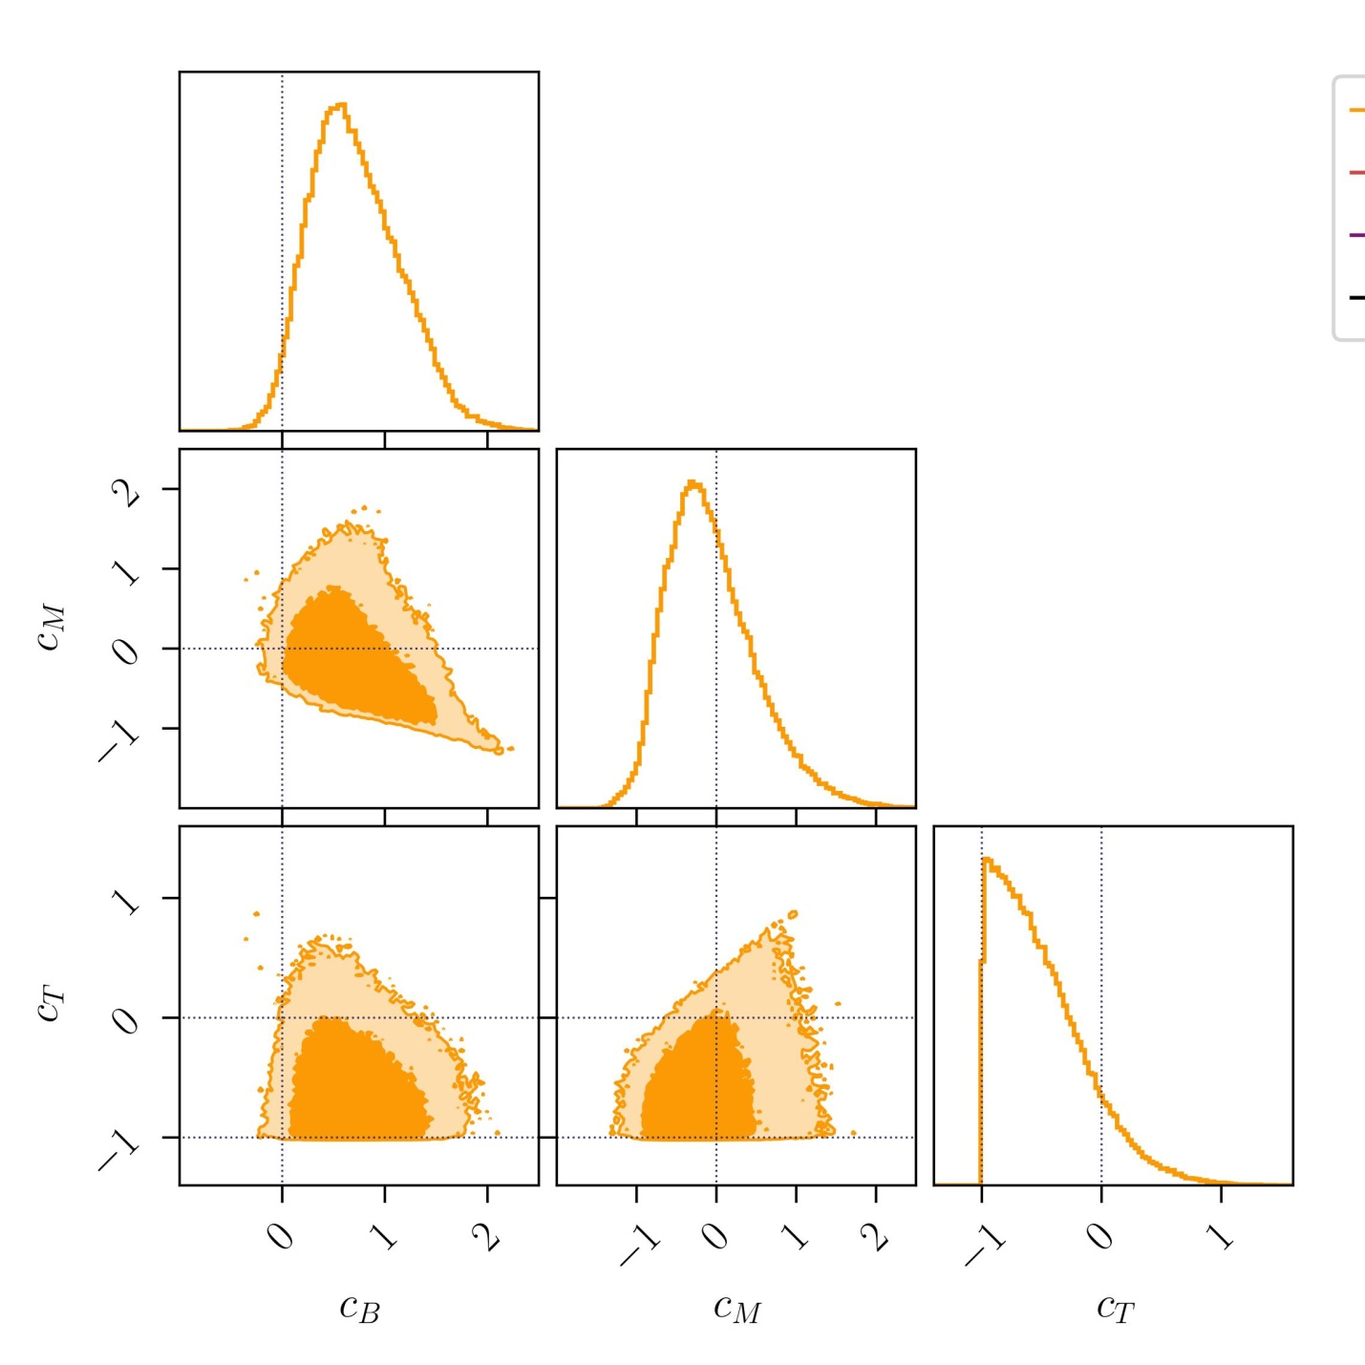
Parameter estimation with positivity
Scott Melville
$$c_{B}$$
‘Braiding’ (mixing of scalar and tensor)
$$c_{M}$$
Time-dependence of $M_{P}$ (i.e. $G_{N}$)
$$c_{T}$$
Gravitational wave speed
[SM, Noller, 1904.xxxxx]
Dark Energy
[1904.05874]
Notes:
Contours mark 1 and 2
condence intervals, computed using CMB, RSD, BAO and
matter power spectrum measurements.

Slide 69
Parameter estimation with positivity
Scott Melville
$$c_{B}$$
‘Braiding’ (mixing of scalar and tensor)
$$c_{M}$$
Time-dependence of $M_{P}$ (i.e. $G_{N}$)
$$c_{T}$$
Gravitational wave speed
[SM, Noller, 1904.xxxxx]
Dark Energy
[1904.05874]
Notes:
Contours mark 1 and 2
condence intervals, computed using CMB, RSD, BAO and
matter power spectrum measurements.

Slide 70
Parameter estimation with positivity
Scott Melville
[SM, Noller, 1904.xxxxx]
Dark Energy
[1904.05874]
Notes:
Contours mark 1 and 2
condence intervals, computed using CMB, RSD, BAO and
matter power spectrum measurements.

Slide 71
Parameter estimation with positivity
Scott Melville
CMB (Planck 2015)
BAO (SDSS/BOSS)
RSD (BOSS/6dF)
Matter (SDSS DR4 LRG)
[SM, Noller, 1904.xxxxx]
Dark Energy
[1904.05874]
Notes:
Contours mark 1 and 2
condence intervals, computed using CMB, RSD, BAO and
matter power spectrum measurements.

Slide 72
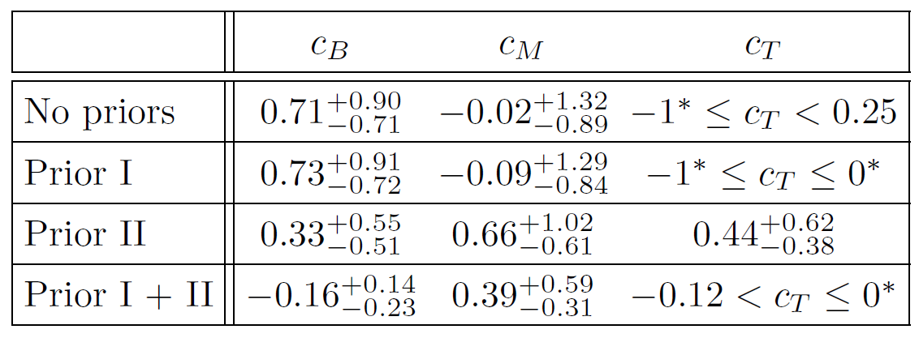
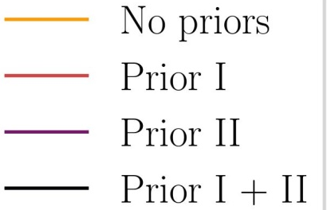
Parameter estimation with positivity
Scott Melville
CMB (Planck 2015)
BAO (SDSS/BOSS)
RSD (BOSS/6dF)
Matter (SDSS DR4 LRG)
[SM, Noller, 1904.xxxxx]
Dark Energy
[1904.05874]
Notes:
Contours mark 1 and 2
condence intervals, computed using CMB, RSD, BAO and
matter power spectrum measurements.

Slide 73
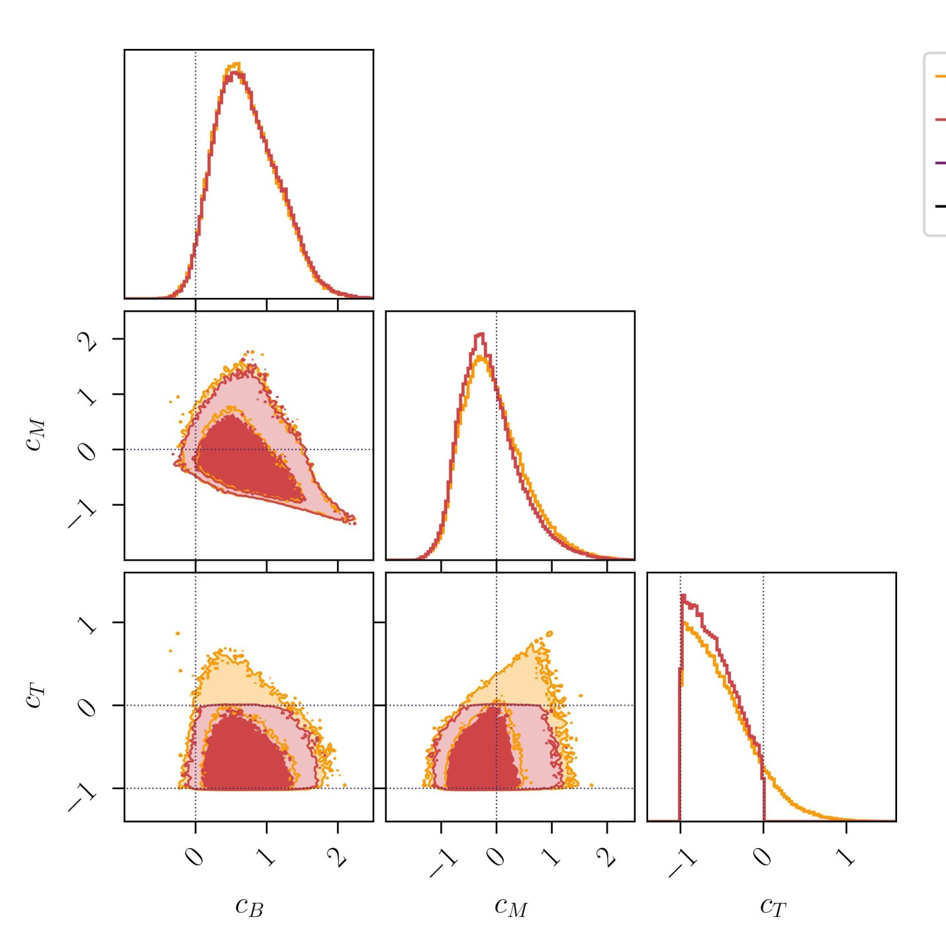
Parameter estimation with positivity
Scott Melville
CMB
BAO
RSD
Matter
Prior I:
$$h_{μν}$$
$$h_{μν}$$
$$c_{T}<0$$
[SM, Noller, 1904.xxxxx]
$$φ$$
$$φ$$
Dark Energy
[1904.05874]

Slide 74
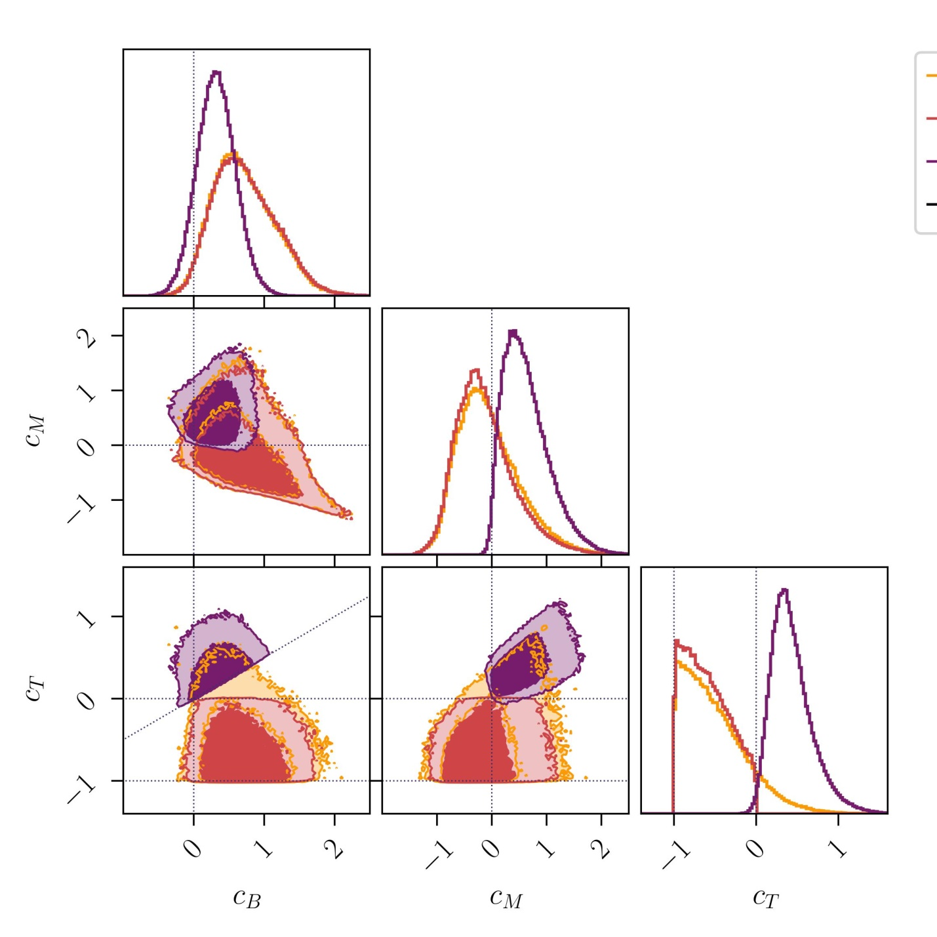
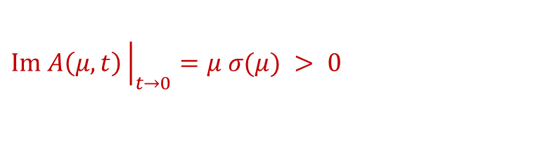
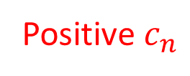
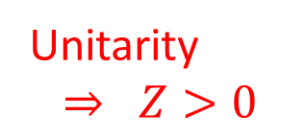
Parameter estimation with positivity
Scott Melville
CMB
BAO
RSD
Matter
Prior I:
$$h_{μν}$$
$$h_{μν}$$
$$c_{T}<0$$
$$φ$$
$$φ$$
Prior II:
$$φ$$
$$φ$$
$$c_{B}<2c_{T}$$
$$φ$$
$$φ$$
Dark Energy
[1904.05874]

Slide 75
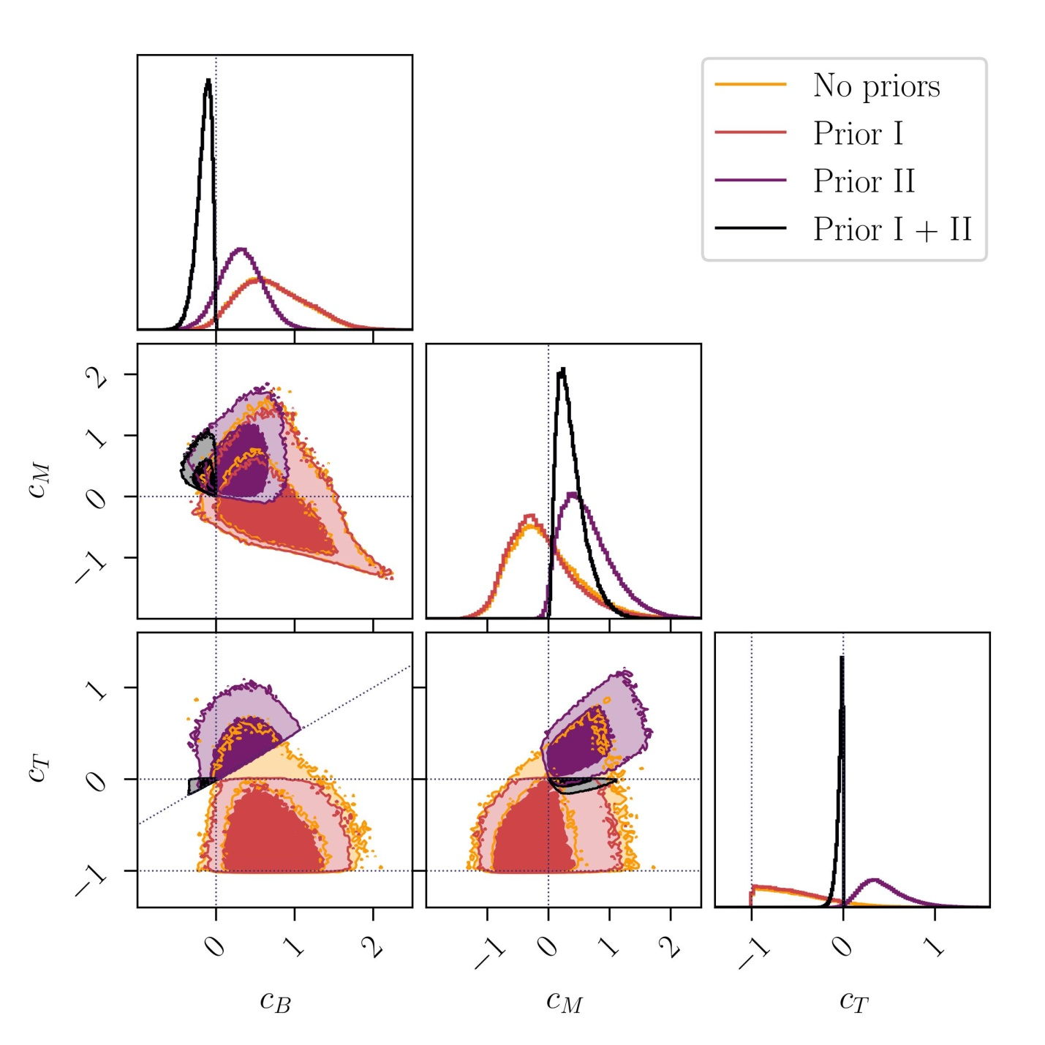
Parameter estimation with positivity
Scott Melville
CMB
BAO
RSD
Matter
Prior I:
$$h_{μν}$$
$$h_{μν}$$
$$c_{T}<0$$
[SM, Noller, 1904.xxxxx]
$$φ$$
$$φ$$
Prior II:
$$φ$$
$$φ$$
$$c_{B}<2c_{T}$$
$$φ$$
$$φ$$
Dark Energy
[1904.05874]
Notes:
Data is more constraining

Slide 76

Parameter estimation with positivity
Scott Melville
CMB
BAO
RSD
Matter
Prior I:
$$h_{μν}$$
$$h_{μν}$$
$$c_{T}<0$$
[SM, Noller, 1904.xxxxx]
$$φ$$
$$φ$$
Positivity
Data more constraining
Prior II:
$$⇒$$
$$φ$$
$$φ$$
$$c_{B}<2c_{T}$$
$$φ$$
$$φ$$
Dark Energy
[1904.05874]
Notes:
In future, more data will shrink these contours even further.

Slide 77

Summary
[1904.05874]

Slide 78
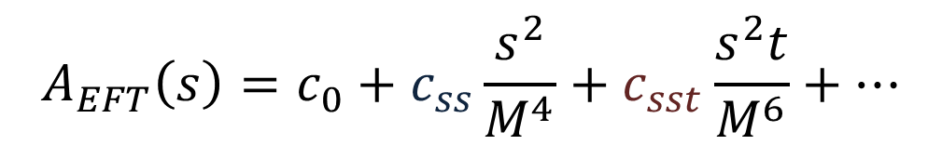
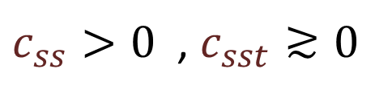
$$a$$
$$a$$
$$A_{EFT}\left(s\right)=c_{0}+c_{ss}\frac{s^{2}}{M^{4}}+c_{sst}\frac{s^{2}t}{M^{6}}+…$$
Unitary, causal, local
$c_{ss}>0$ , $c_{sst}≳0$
$$b$$
$$b$$
Summary
[1904.05874]

Slide 79

$$a$$
$$a$$
$$A_{EFT}\left(s\right)=c_{0}+c_{ss}\frac{s^{2}}{M^{4}}+c_{sst}\frac{s^{2}t}{M^{6}}+…$$
Unitary, causal, local
$c_{ss}>0$ , $c_{sst}≳0$
$$b$$
$$b$$
Dark Energy
[1904.05874]
Summary
[1904.05874]

Slide 80
$$a$$
$$a$$
$$A_{EFT}\left(s\right)=c_{0}+c_{ss}\frac{s^{2}}{M^{4}}+c_{sst}\frac{s^{2}t}{M^{6}}+…$$
Unitary, causal, local
$c_{ss}>0$ , $c_{sst}≳0$
$$b$$
$$b$$
Dark Energy
Up next:
[1904.05874]
Improved positivity bounds
Inflation
Beyond Standard Model
Summary
[1904.05874]

Slide 81
Backup Slides
Backup Slides

Slide 82
General UV
IR
UV
Positivity Constraints

Slide 83

General UV
$$A_{EFT}(s)$$
IR
UV
Positivity Constraints

Slide 84


General UV
???
$$A_{EFT}(s)$$
$$A_{UV}(s)$$
$$M$$
IR
UV
Positivity Constraints

Slide 85


General UV
$$s$$
$$M$$
$$A_{EFT}(s)$$
$$A_{UV}(s)$$
IR
UV
Positivity Constraints

Slide 86
General UV
$$s$$
$$M$$
$$A_{EFT}(s)$$
$$A_{UV}(s)$$
IR
UV
Causality
$⇒ A\left(s\right)$ is analytic (up to known poles & branch cuts)
Positivity Constraints

Slide 87




General UV
$$s$$
$$M$$
$$A_{EFT}(s)$$
$$A_{UV}(s)$$
-
-
$$−t$$
$$m^{2}$$
IR
$$3m^{2}−t$$
$$4m^{2}$$
UV
Causality
$⇒ A\left(s\right)$ is analytic (up to known poles & branch cuts)
Positivity Constraints

Slide 88

General UV
$$s$$
$$M$$
$$C$$
-
x
-
$$−t$$
$$m^{2}$$
$$3m^{2}−t$$
$$4m^{2}$$
Causality
$⇒ A\left(s\right)$ is analytic (up to known poles & branch cuts)
Positivity Constraints

Slide 89








General UV
$$s$$
$$M$$
$$C$$
-
x
-
$$−t$$
$$m^{2}$$
$$3m^{2}−t$$
$$4m^{2}$$
$$=$$
(Causality)
$$s$$
$$M$$
$$C$$
-
x
-
$$−t$$
$$m^{2}$$
$$3m^{2}−t$$
$$4m^{2}$$
Positivity Constraints

Slide 90








General UV
$$s$$
$$M$$
$$C$$
-
x
-
$$−t$$
$$m^{2}$$
$$3m^{2}−t$$
$$4m^{2}$$
$$=$$
(Causality)
$$s$$
$$M$$
$$∞$$
-
x
-
$$−t$$
$$m^{2}$$
$$3m^{2}−t$$
$$4m^{2}$$
$$∞$$
Positivity Constraints

Slide 91
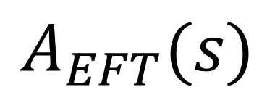
General UV
$$s$$
$$M$$
$$C$$
-
x
-
$$−t$$
$$m^{2}$$
$$3m^{2}−t$$
$$4m^{2}$$
$$A_{EFT}(s)$$
$$=$$
(Causality)
$$s$$
$$M$$
$$∞$$
-
x
-
$$−t$$
$$m^{2}$$
$$3m^{2}−t$$
$$4m^{2}$$
$$∞$$
Positivity Constraints

Slide 92
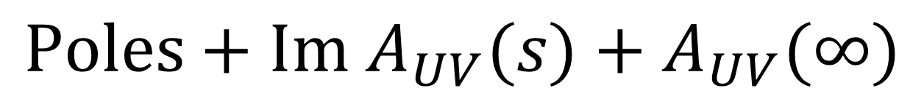
General UV
$$s$$
$$M$$
$$C$$
-
x
-
$$−t$$
$$m^{2}$$
$$3m^{2}−t$$
$$4m^{2}$$
$$A_{EFT}(s)$$
$$=$$
(Causality)
$$s$$
$$M$$
$$∞$$
$$Poles+Im{ A}_{UV}(s)+A_{UV}(∞)$$
-
x
-
$$−t$$
$$m^{2}$$
$$3m^{2}−t$$
$$4m^{2}$$
$$∞$$
Positivity Constraints

Slide 93
General UV
$$s$$
$$M$$
$$C$$
-
x
-
$$−t$$
$$m^{2}$$
$$3m^{2}−t$$
$$4m^{2}$$
$$A_{EFT}(s)$$
$$=$$
(Causality)
$$s$$
$$M$$
$$∞$$
$$Poles+Im{ A}_{UV}(s)+A_{UV}(∞)$$
-
x
-
$$−t$$
$$m^{2}$$
$$3m^{2}−t$$
$$4m^{2}$$
Positive
(Unitarity)
$$∞$$
Positivity Constraints

Slide 94
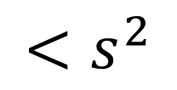
General UV
$$s$$
$$M$$
$$C$$
-
x
-
$$−t$$
$$m^{2}$$
$$3m^{2}−t$$
$$4m^{2}$$
$$A_{EFT}(s)$$
$$=$$
(Causality)
$$s$$
$$M$$
$$∞$$
$$Poles+Im{ A}_{UV}(s)+A_{UV}(∞)$$
-
x
-
$$−t$$
$$m^{2}$$
$$3m^{2}−t$$
$$4m^{2}$$
Positive
$$<s^{2}$$
(Unitarity)
(Locality)
$$∞$$
Positivity Constraints

Slide 95


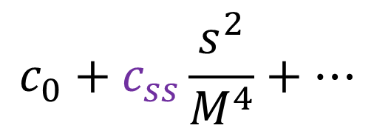
General UV
$$s$$
$$c_{0}+c_{ss}\frac{s^{2}}{M^{4}}+…$$
$$M$$
$$c_{ss}>0$$
$$C$$
-
$$=$$
-
x
$$−t$$
$$m^{2}$$
$$3m^{2}−t$$
$$4m^{2}$$
$$A_{EFT}(s)$$
$$=$$
(Causality)
$$s$$
$$M$$
$$∞$$
$$Poles+Im{ A}_{UV}(s)+A_{UV}(∞)$$
-
x
-
$$−t$$
$$m^{2}$$
$$3m^{2}−t$$
$$4m^{2}$$
Positive
$$<s^{2}$$
(Unitarity)
(Locality)
$$∞$$
Positivity Constraints

Slide 96
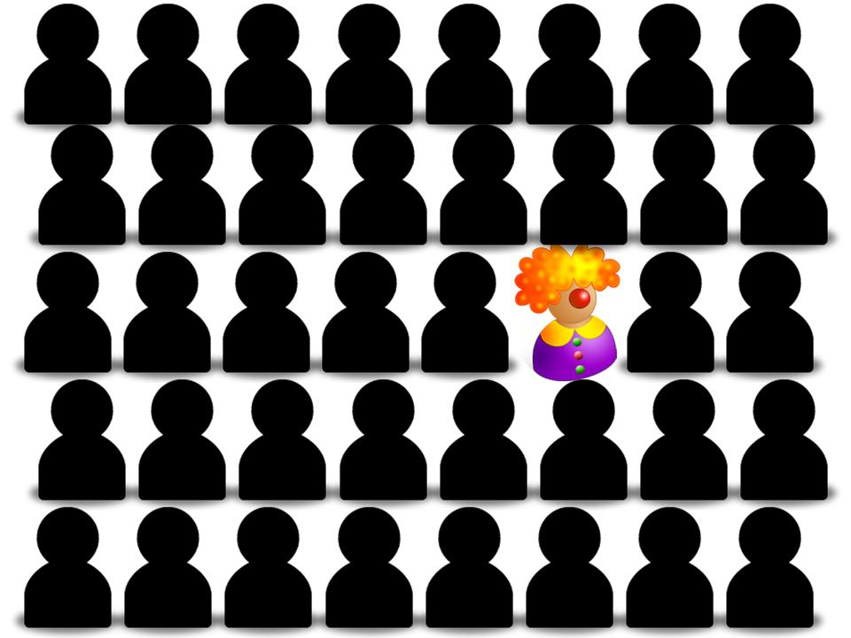
Scalar-Tensor Theories
$$ℒ=ℒ_{GR}+ℒ_{Scalar−Tensor}$$
- Uniqueness?
Dark Energy
[1904.05874]

Slide 97
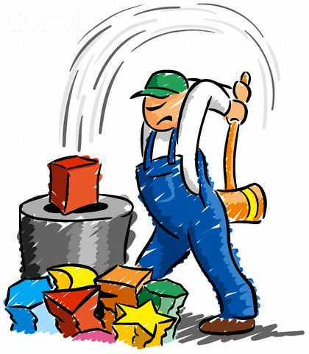
Scalar-Tensor Theories
$$ℒ=ℒ_{GR}+ℒ_{Scalar−Tensor}$$
- Uniqueness?
- New Experimental Tests
Dark Energy
[1904.05874]

Slide 98
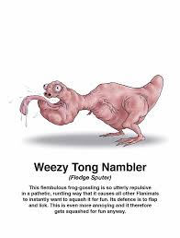


Scalar-Tensor Theories
$$ℒ=ℒ_{GR}+ℒ_{Scalar−Tensor}$$
- Uniqueness?
- New Experimental Tests
- Naturalness Arguments
Dark Energy
[1904.05874]

Slide 99

Scalar-Tensor Theories
$$ℒ=ℒ_{GR}+ℒ_{Scalar−Tensor}$$
- Uniqueness?
- New Experimental Tests
- Naturalness Arguments
- Possible UV Completions
Dark Energy
[1904.05874]

