Slide 1
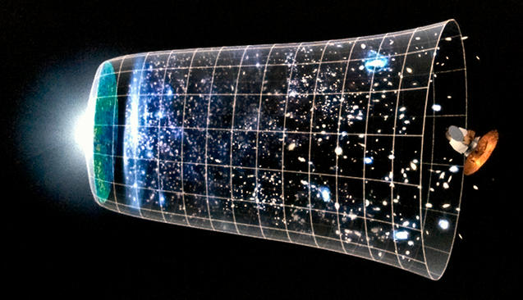

Parametric amplification of chiral gravitational waves in single field inflation
M. Mylova, G. Tasinato
Particle Physics and Cosmology Group
Swansea University
Swansea, U.K.
PASCOS, July 2019

Slide 2
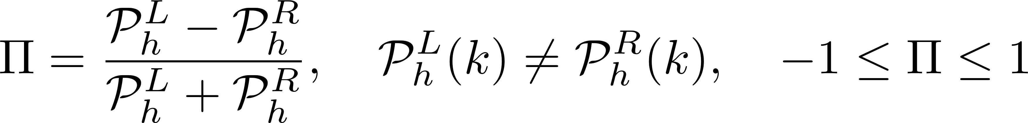
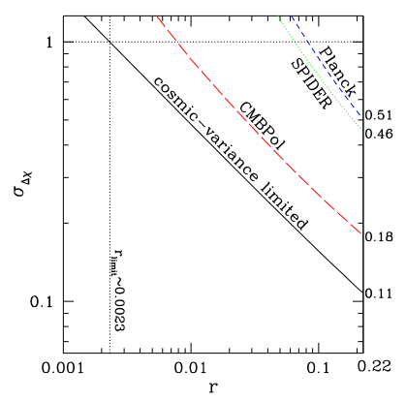
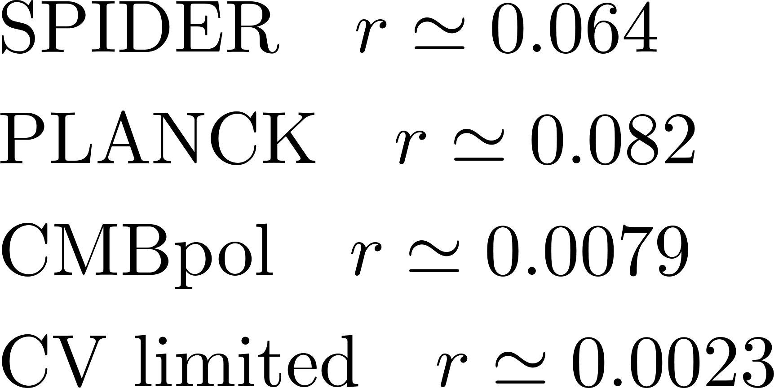
Parity Violation in Gravity
Circular polarization degree
Saito, Ichiki
Taruya (2007)
Gluscevic,
Kamionkowski (2010)

Slide 3
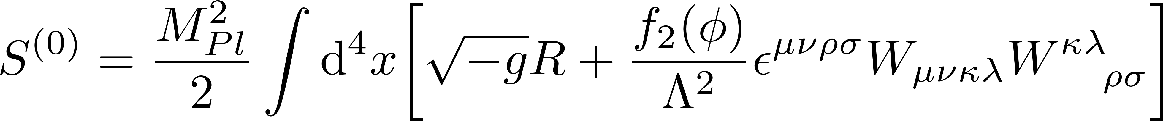
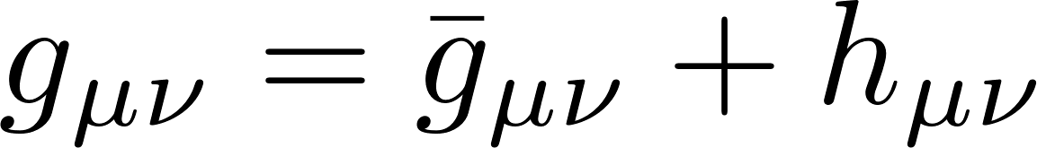
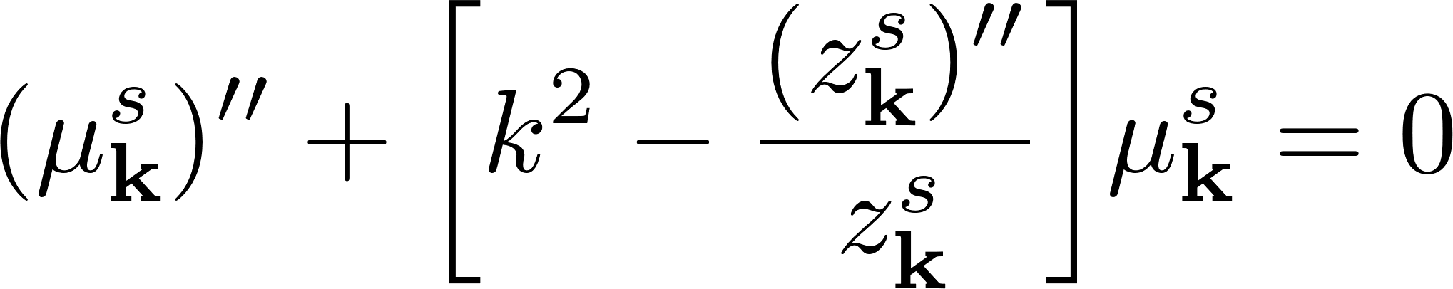
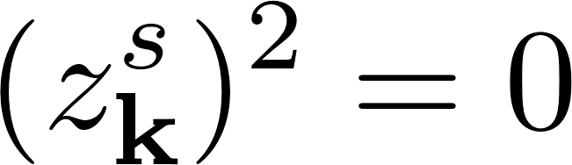
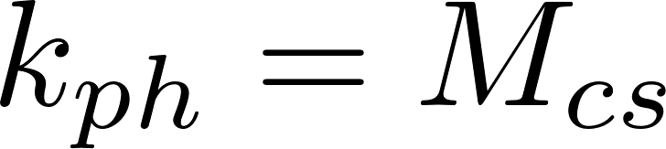
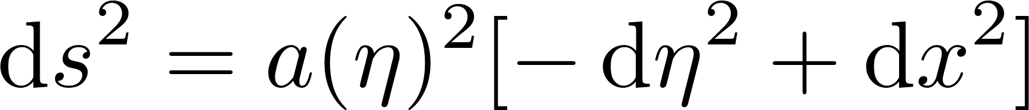
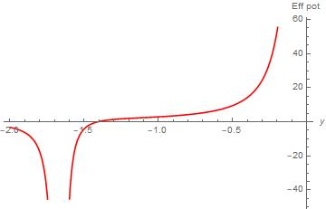
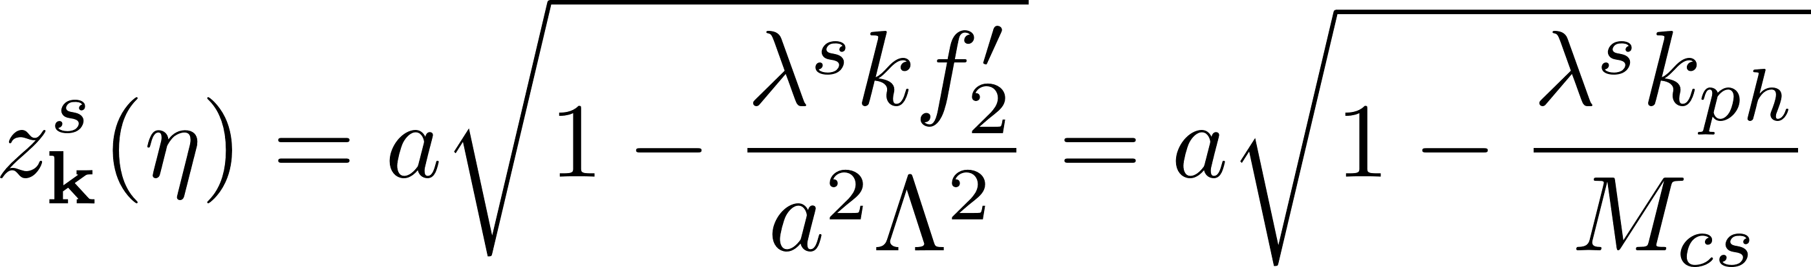
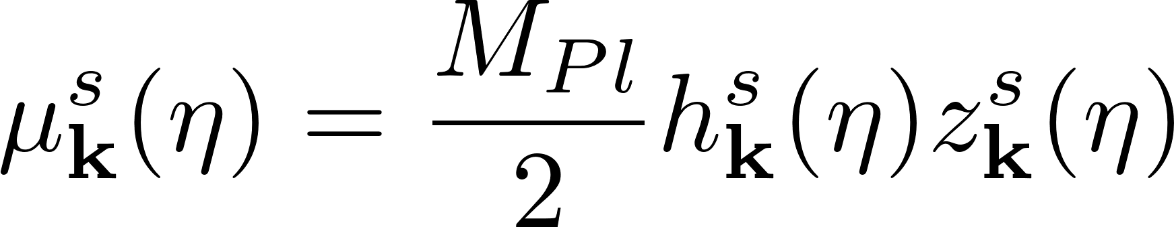
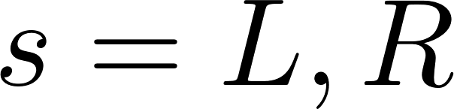
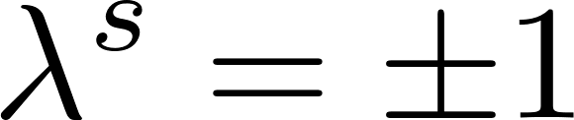
Chern Simons Instability
Action: Einstein-Hilbert + CS
Alexander,
Martin (2004)
Metric perturbation
Evolution equations
CS Instability
FRW background
Effective potential
Amplitudes
Dyda, Flanagan,
Kamionkowski (2012)

Slide 4
We put forward a framework:
Produces a large circular polarization degree
Ensures stability for all modes

Slide 5
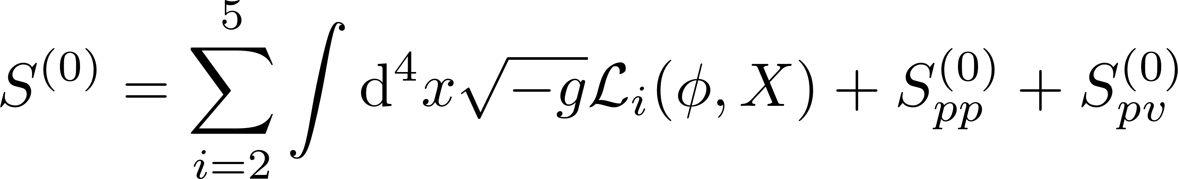
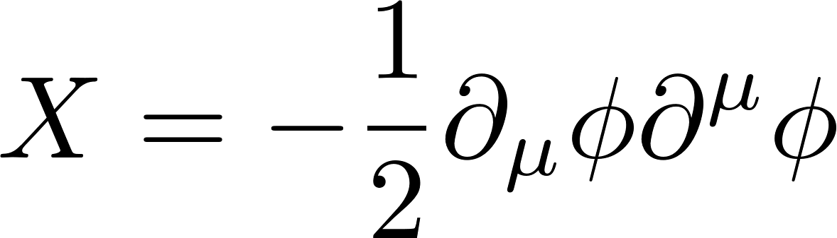
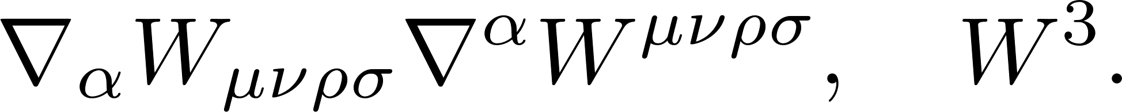
EFT of Scalar-Tensor gravity
Extended action:
Leading-order
Higher-order corrections
Kobayashi, Yamaguchi,
Yokoyama (2011)
NLO:
Weinberg (2008)
NNLO pv:
Chrisostomi, Noui,
Charmousis (2018)
NNLO pp:
Solomon,
Trodden (2018)
Partial extension*:
*Excluding contributions of the form

Slide 6
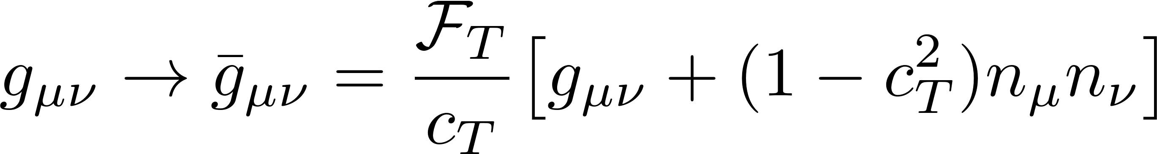
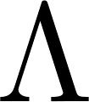
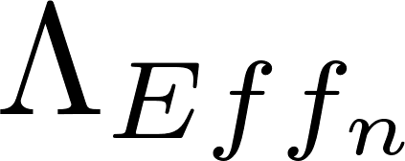
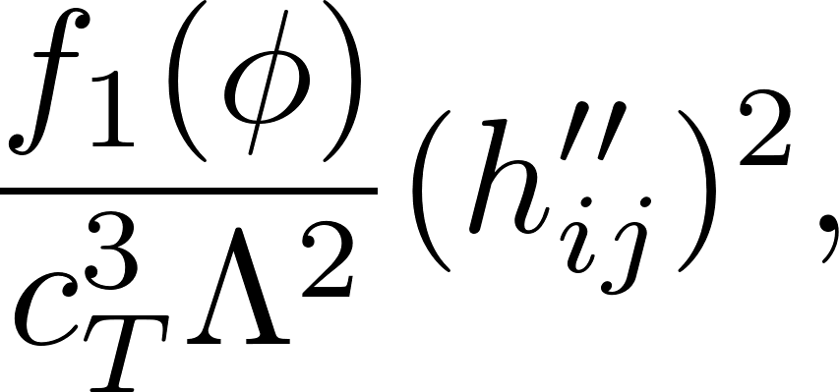
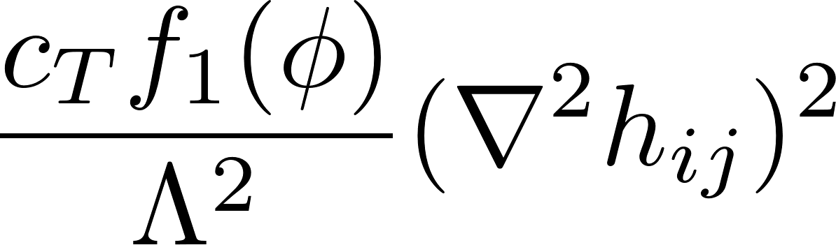
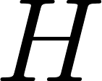
Enhancing NLO & NNLO operators
Disformally map higher-order corrections to the Horndeski action
This introduces a range of effective mass scales
Disformal mapping
NNLO operators Important!
Bekenstein (1993), Zumalacarregui, Bellido (2014)
Domenech, Sasaki (2015)
Scale of
new physics
Time derivatives are enhanced
with respect to
spatial derivatives
Effective
mass-scales
Energy scale
of inflation
Similar conclusions, albeit with some difference as in the EFTI formulations
of Cheung, Creminelli, Fitzpatrick, Kaplan, Senatore (2008)

Slide 7
Ostrogradsky no-go theorem
At NLO+NNLO order
Field redefinitions, possible but difficult to find!
Gong, Seoc,
Sypsas (2014)
Instead, make an educated guess…
Remove offending terms
Action guarantees second-order equations of motion:

Slide 8
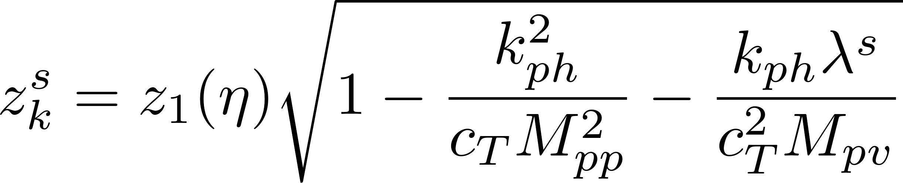
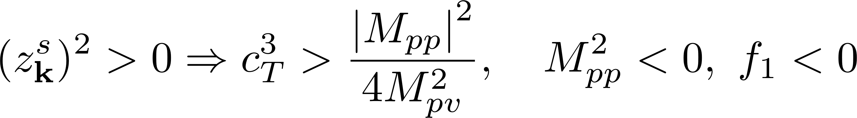
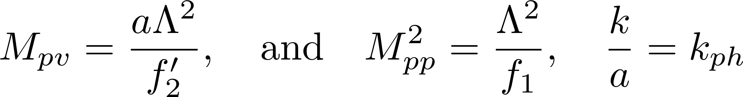
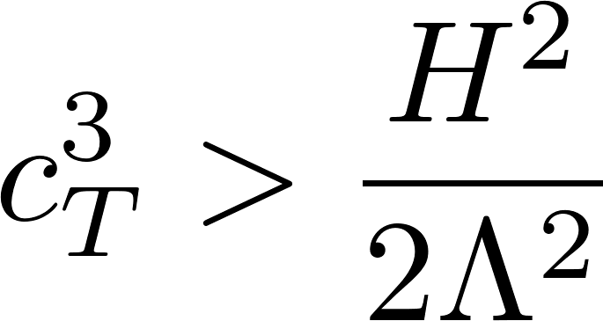
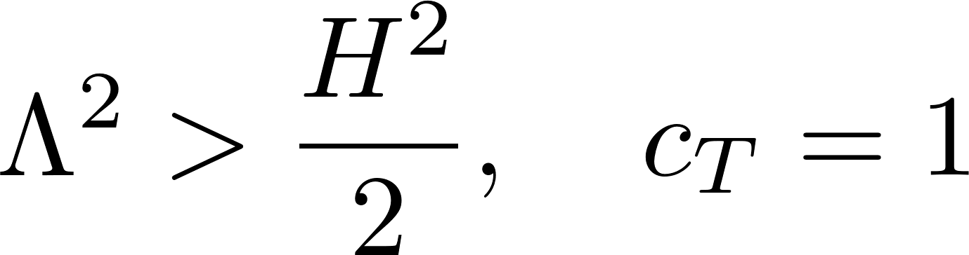
Validity of the EFT
Effective potential
Constraint
Dynamical parameters:
Special case:
Dynamical parameters drop out
Example:
Constraint always satisfied
Ensures stability
for all modes!

Slide 9
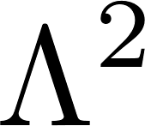
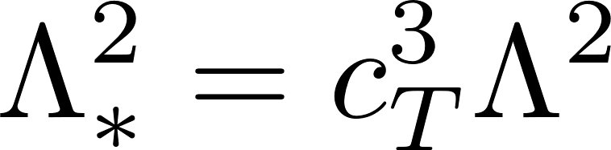
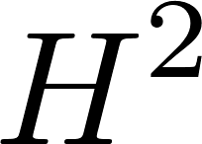
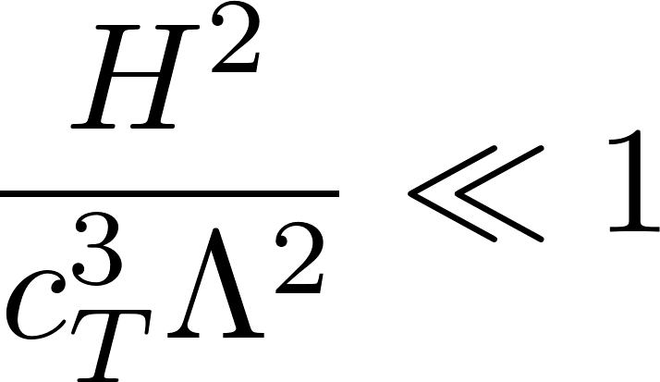
Strong Coupling Scale
Scale of
new physics
Restore fake Lorentz invariance
Baumann, Green (2011)
Strong
coupling scale
Energy scale
of inflation
Demand theory is weakly coupled at horizon crossing

Slide 10
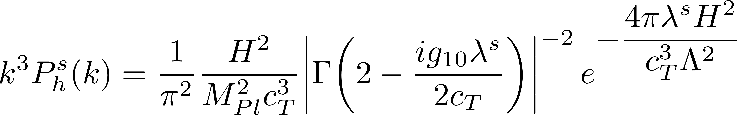
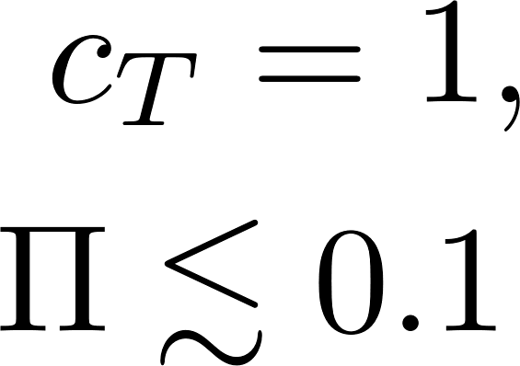
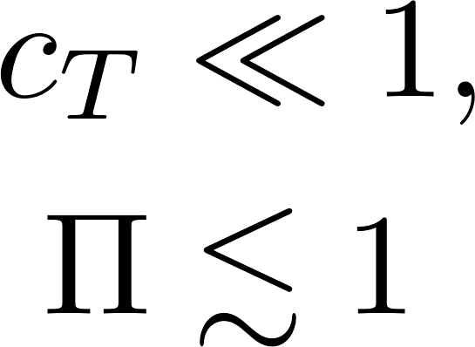
A toy model
Solve evolution and constraint equations in the simplest way possible:
Tensor powerspectrum
Left-modes
are enhanced!
Maximum enhancement

Slide 11
Future Considerations
Understand how NNLO corrections affect post-inflationary dynamics.
Find a phenomenologically viable inflationary model that satisfies this special case.
A complete analyses is needed on the full set of NNLO non-redundant operators.
Find a field redefinition for tensors at NLO+NNLO.

Slide 12
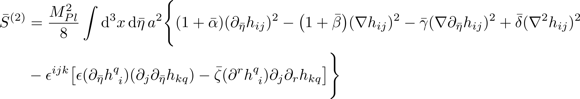
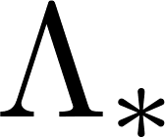
Final remarks
Einstein frame of a general scalar-tensor extension
Geometrically related extensions to gravity
Need additional DOF for the theory to be weakly coupled up to
Strongly
coupled
Jordan frame
Weakly coupled
Baumann, Green (2011)
Gwyn, Palma, Sypsas
Sakellariadou (2013)
Disformal
Transformation
Einstein frame
Weakly coupled
Weinberg (2008)

Slide 13
Thank you for your attention!

