Slide 1
A Swampland Update
Cumrun Vafa
Harvard University
PASCOS 2019
University of Manchester
July 5, 2019

Slide 2

Plan for this talk:
-Generalities about the Swampland program
-Examples: Weak gravity conjecture
Bounds on the number of light fields
N=2 supergravity and problem
Distance conjecture
de Sitter conjecture
-Finite Tuning and Sequestering
-Cosmological Implications:
Evolving dark energy and fading Dark Sector
Relation with H0 problem

Slide 3
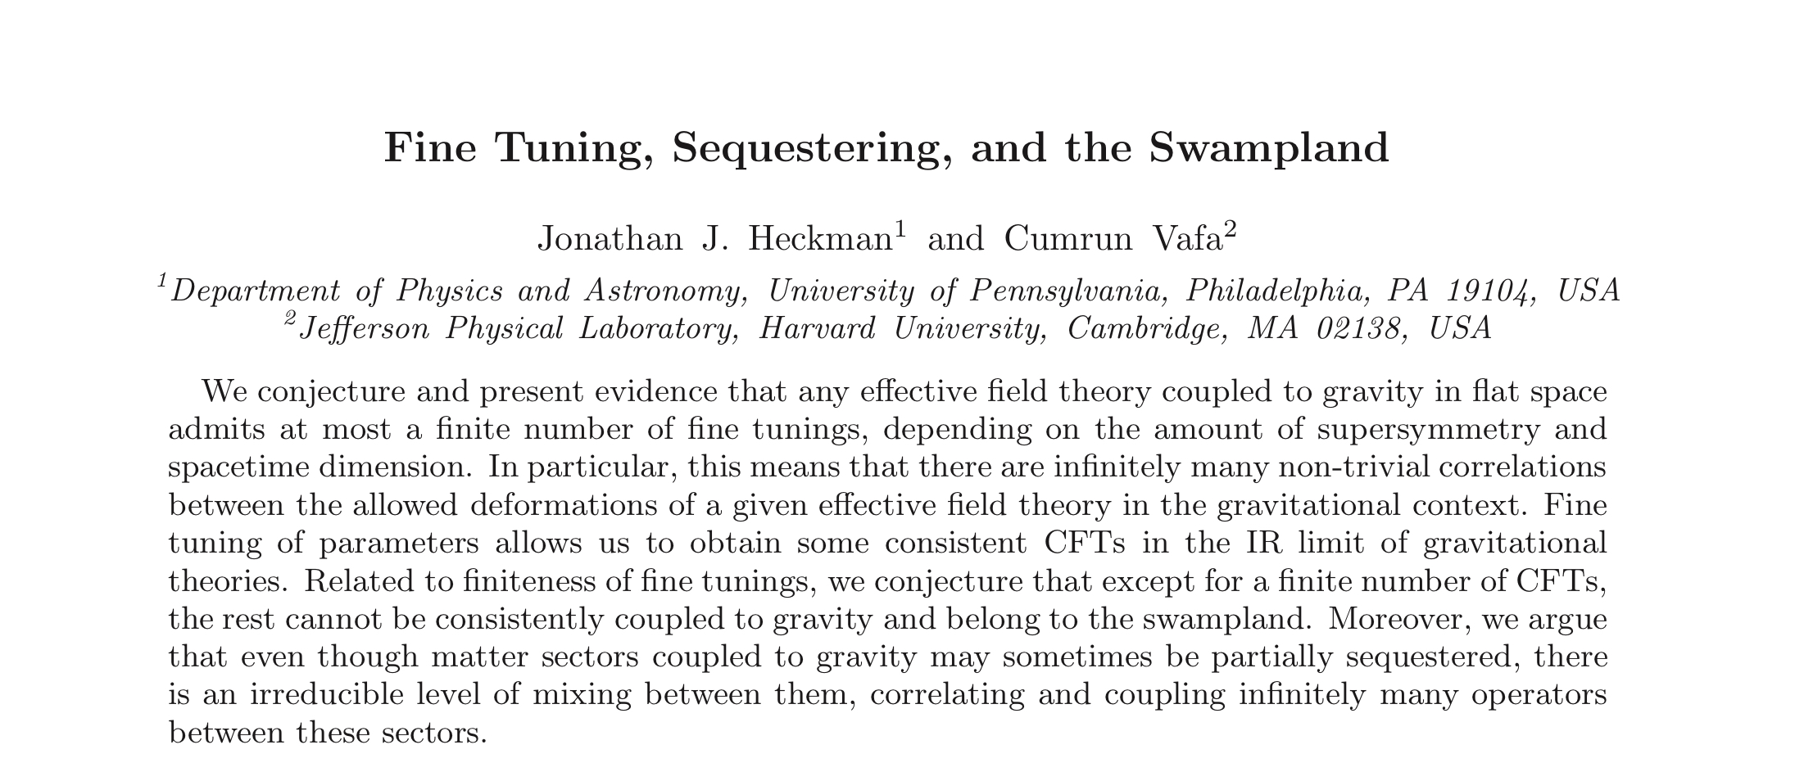
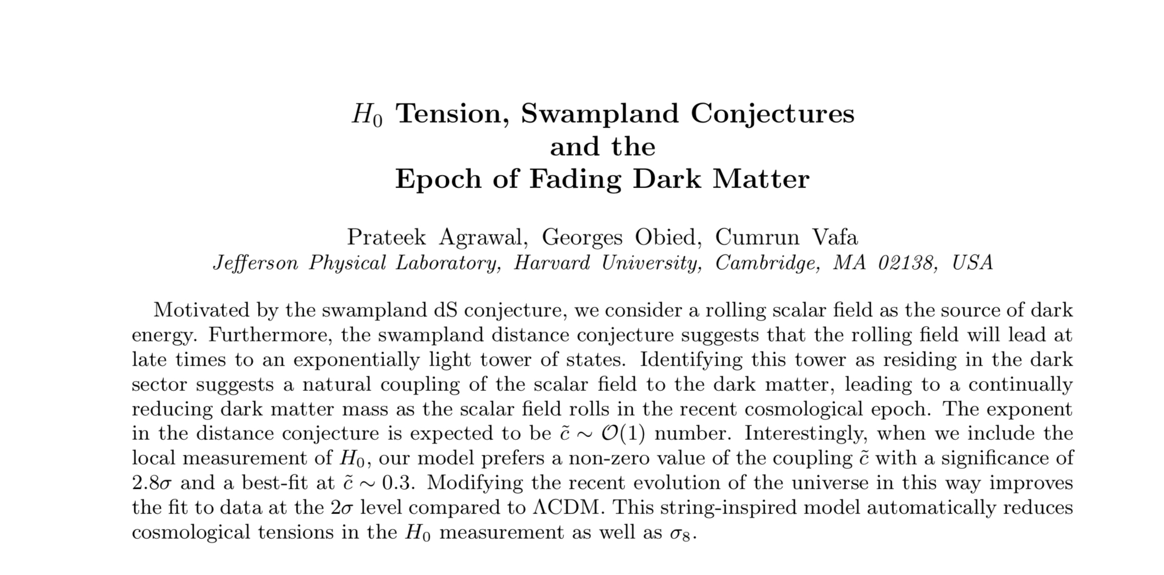

Slide 4
The Swampland Program
The conventional wisdom in QFT in connection with gravity:
Consider a consistent quantum field theory.
Coupling to gravity=
Promote the metric to a dynamical field + Einstein action

Slide 5
The Swampland Program
The conventional wisdom in QFT in connection with gravity:
Consider a consistent quantum field theory.
Coupling to gravity=
Promote the metric to a dynamical field + Einstein action
Not correct!
The QFT systems that can be coupled to quantum gravity are rare! The rest belong to the ‘swampland’.

Slide 6

Examples
WGC: Gravity is always the weakest force.
Motivation:
1-String theory examples all seem to satisfy it.
2-Black holes can decay away (otherwise near extremal charged black holes would not be able to Hawking radiate due to kinematics)

Slide 7



Examples
WGC: Gravity is always the weakest force.
Consequences:
No non-supersymmetric AdS can be stable.
Standard model on circle avoiding AdS3 leads to constraints on neutrino masses and type

Slide 8
Examples
Upper bound on number of light particles: For a fixed dimension and fixed number of supersymmetry
there is an upper bound B(d,N) for number of massless particles.
Motivation: in all string models the massless fields come from cohomology of internal space, and these seem to have a uniform bound.

Slide 9
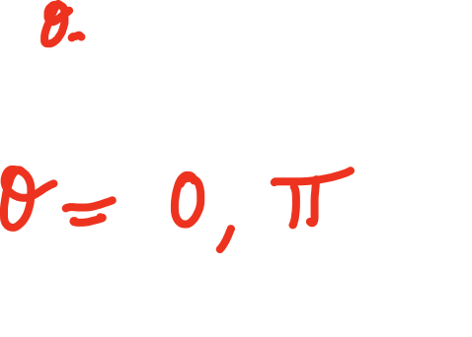
Examples
N=2 Supergravity and Problem [C., V.]: For N=2 supergravity coupled to matter without vector multiplets which has a U(1) graviphoton the theta-angle is either
The evidence for this comes from stringy realizations; Type IIB on rigid CY 3-folds.

Slide 10






Examples
Distance Conjecture: The range of validity of any effective theory involving massless (or light) scalars is bounded by Planck scale. If we vary by more than Mp
you get a tower of light states with mass
Motivation: All string solutions behave this way. Moreover the tower of light states lead to a dual formulation.

Slide 11
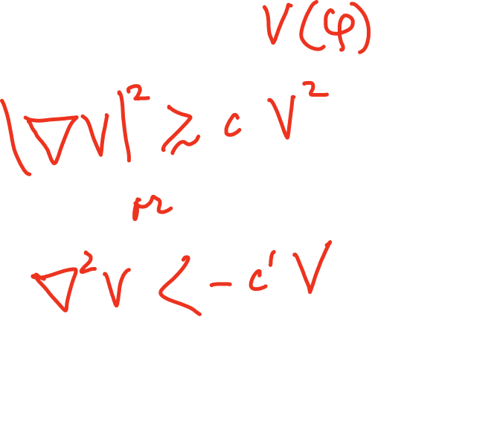

Examples
de Sitter Conjecture:
No meta-stable dS! Dark energy should be a rolling field.

Slide 12


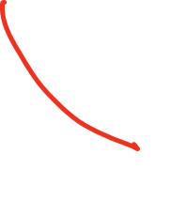

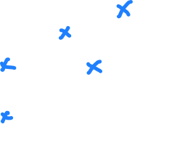


Fine Tuning and Sequestering

Slide 13

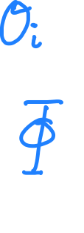



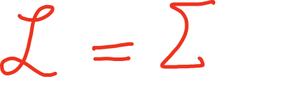
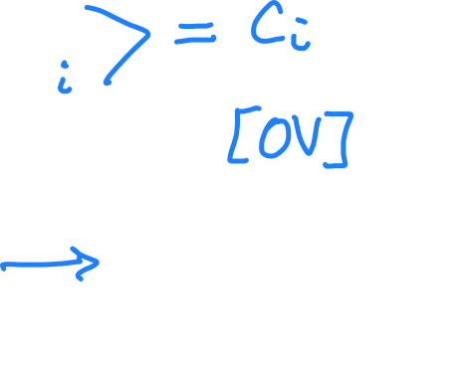




Slide 14
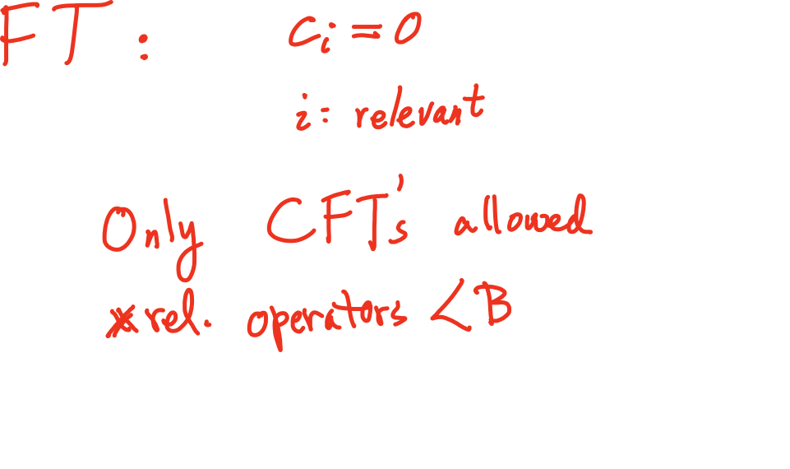


Only a finite number of CFT’s don’t belong to the Swampland!
Example: N=4 YM with rank(G)>22 in Swampland!
Only partial Sequestering possible

Slide 15



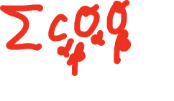
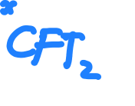


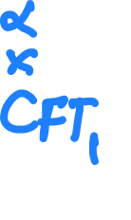
Only partial Sequestering possible

Slide 16
Fading Dark Sector and the Swampland
dS Swampland conjecture forbids quasi-dS.
If so, current cosmology must be governed by a quintessence field. But it seems variation of the quintessence field has been already order 1 in Planck units. So we should expect a tower of light states;
The Dark Sector must be getting light!

Slide 17
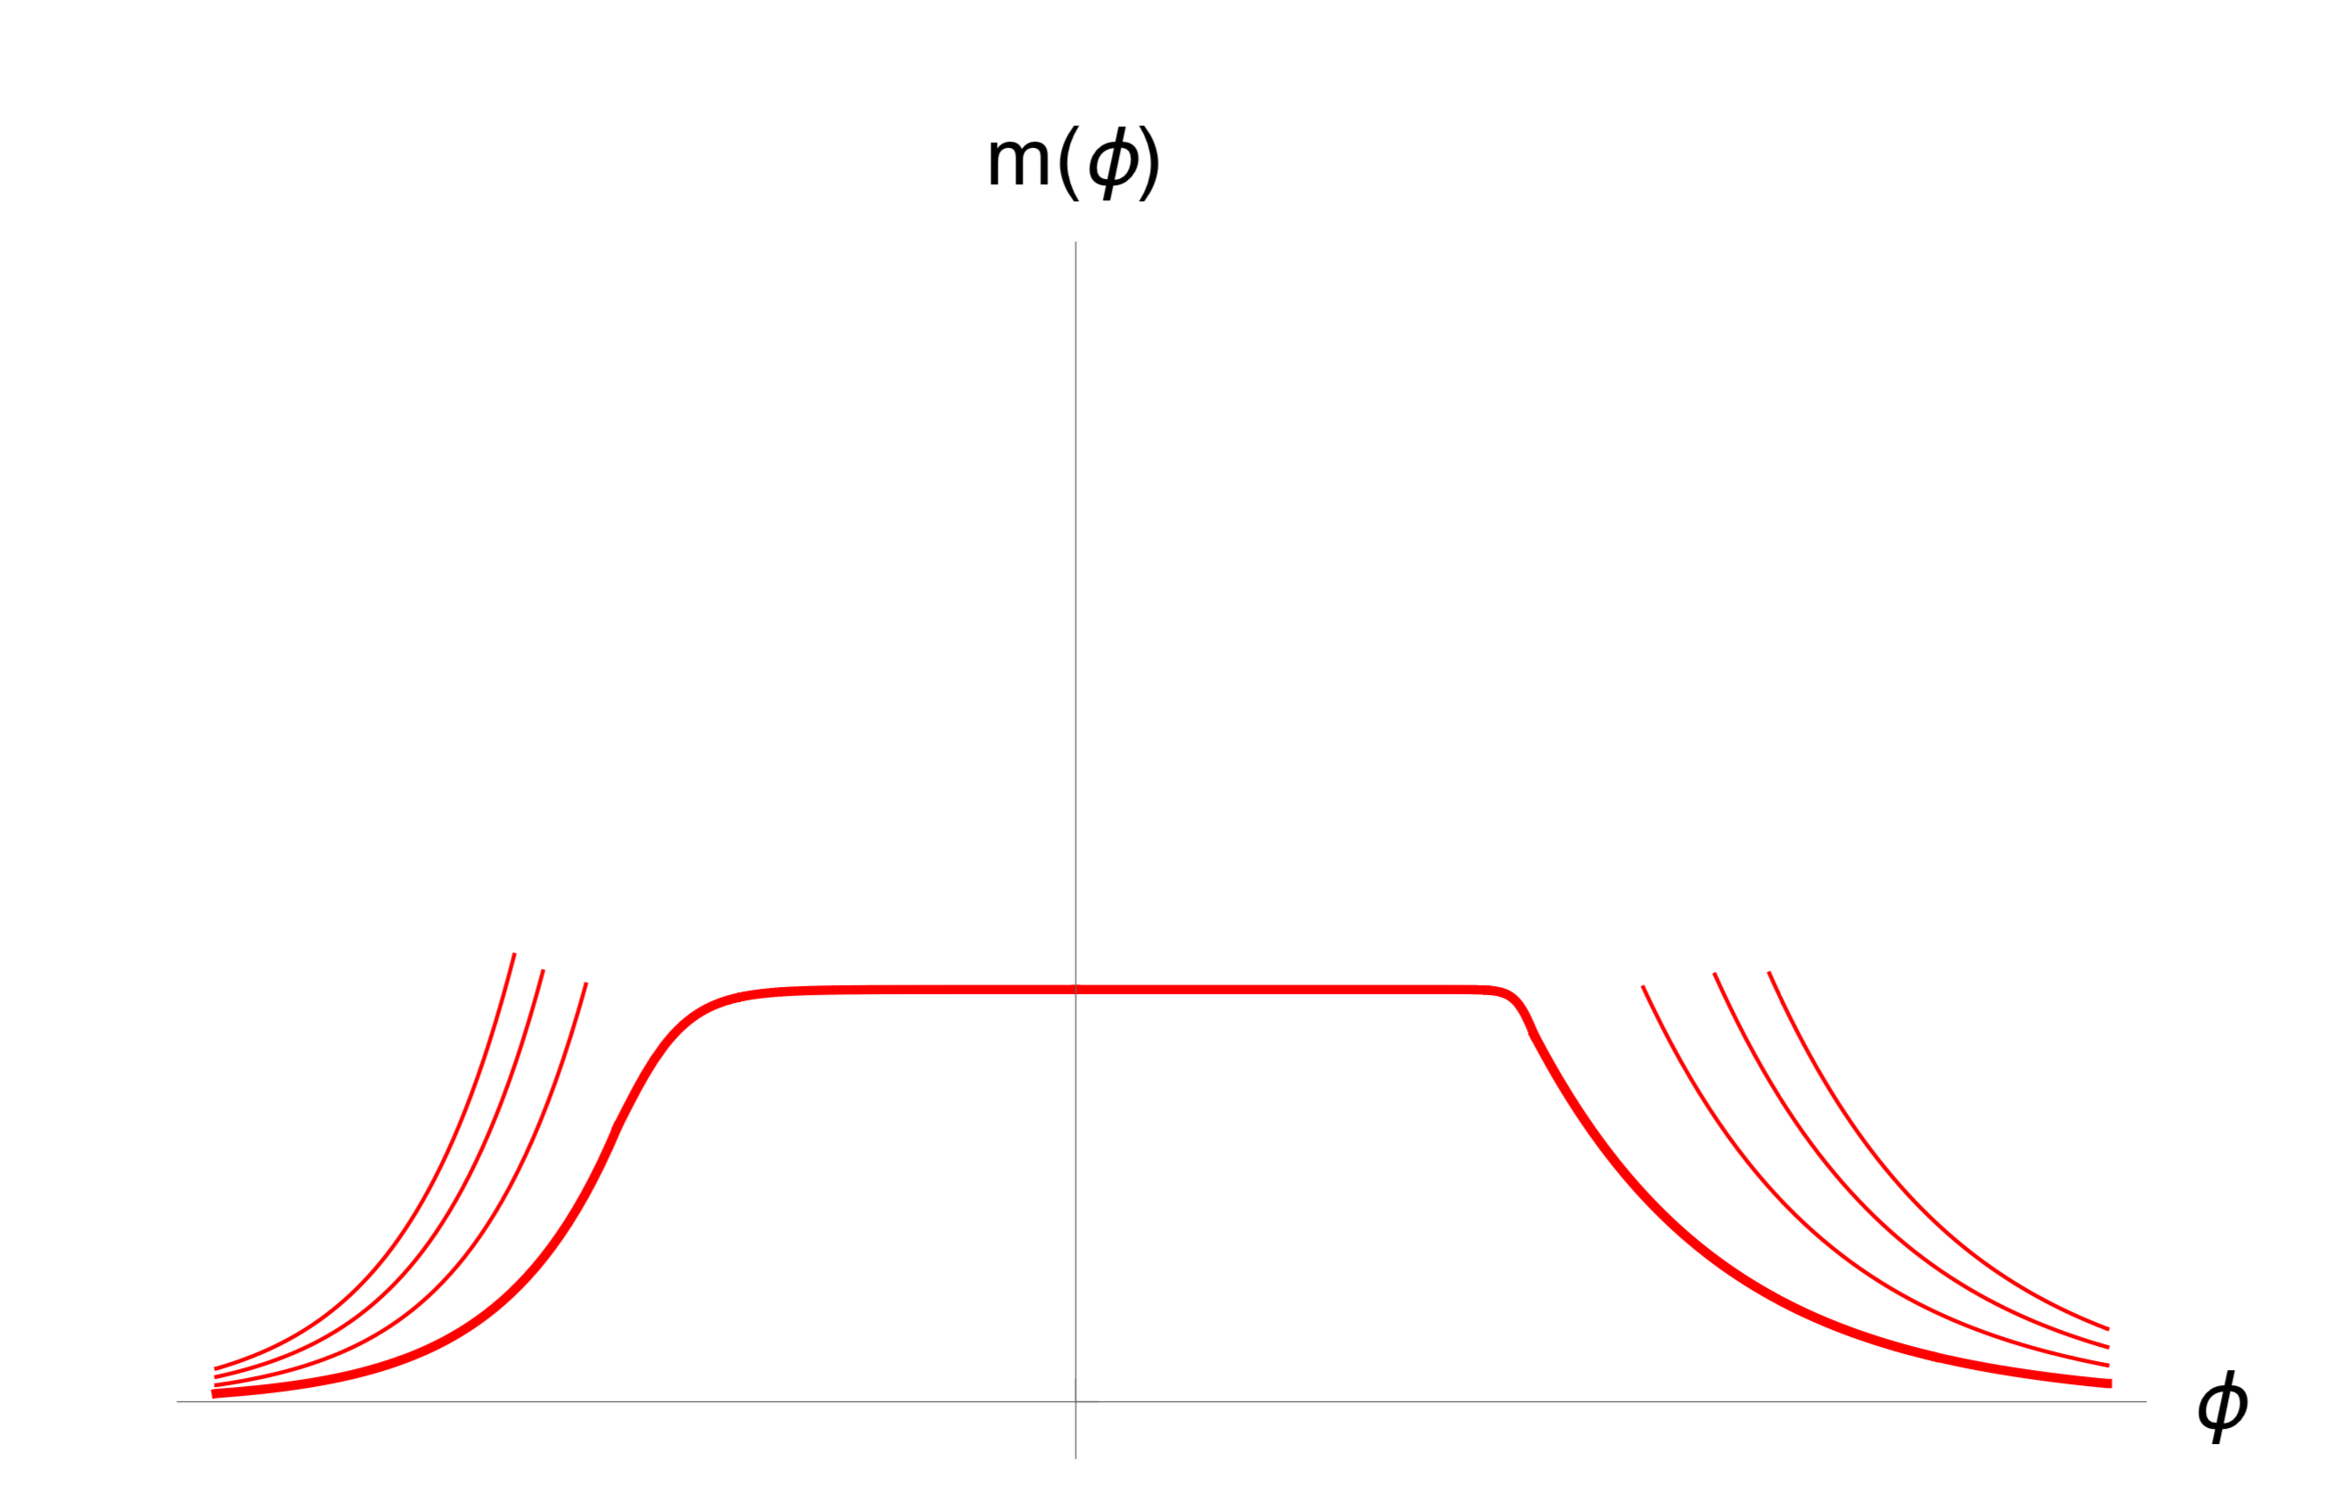



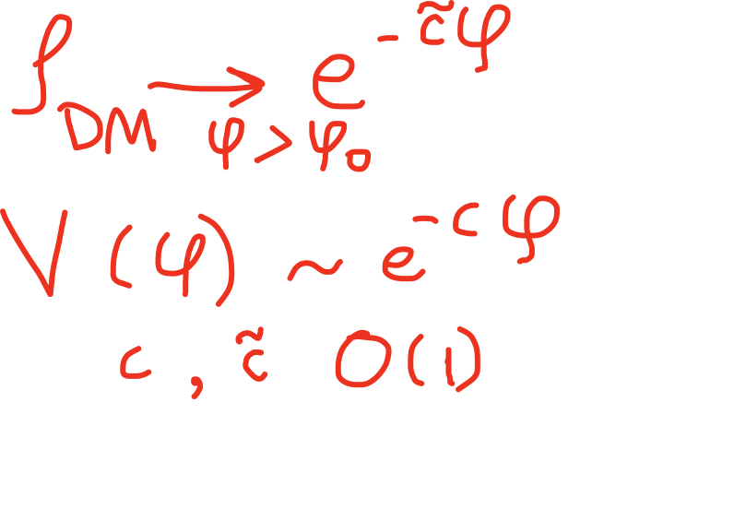


Slide 18
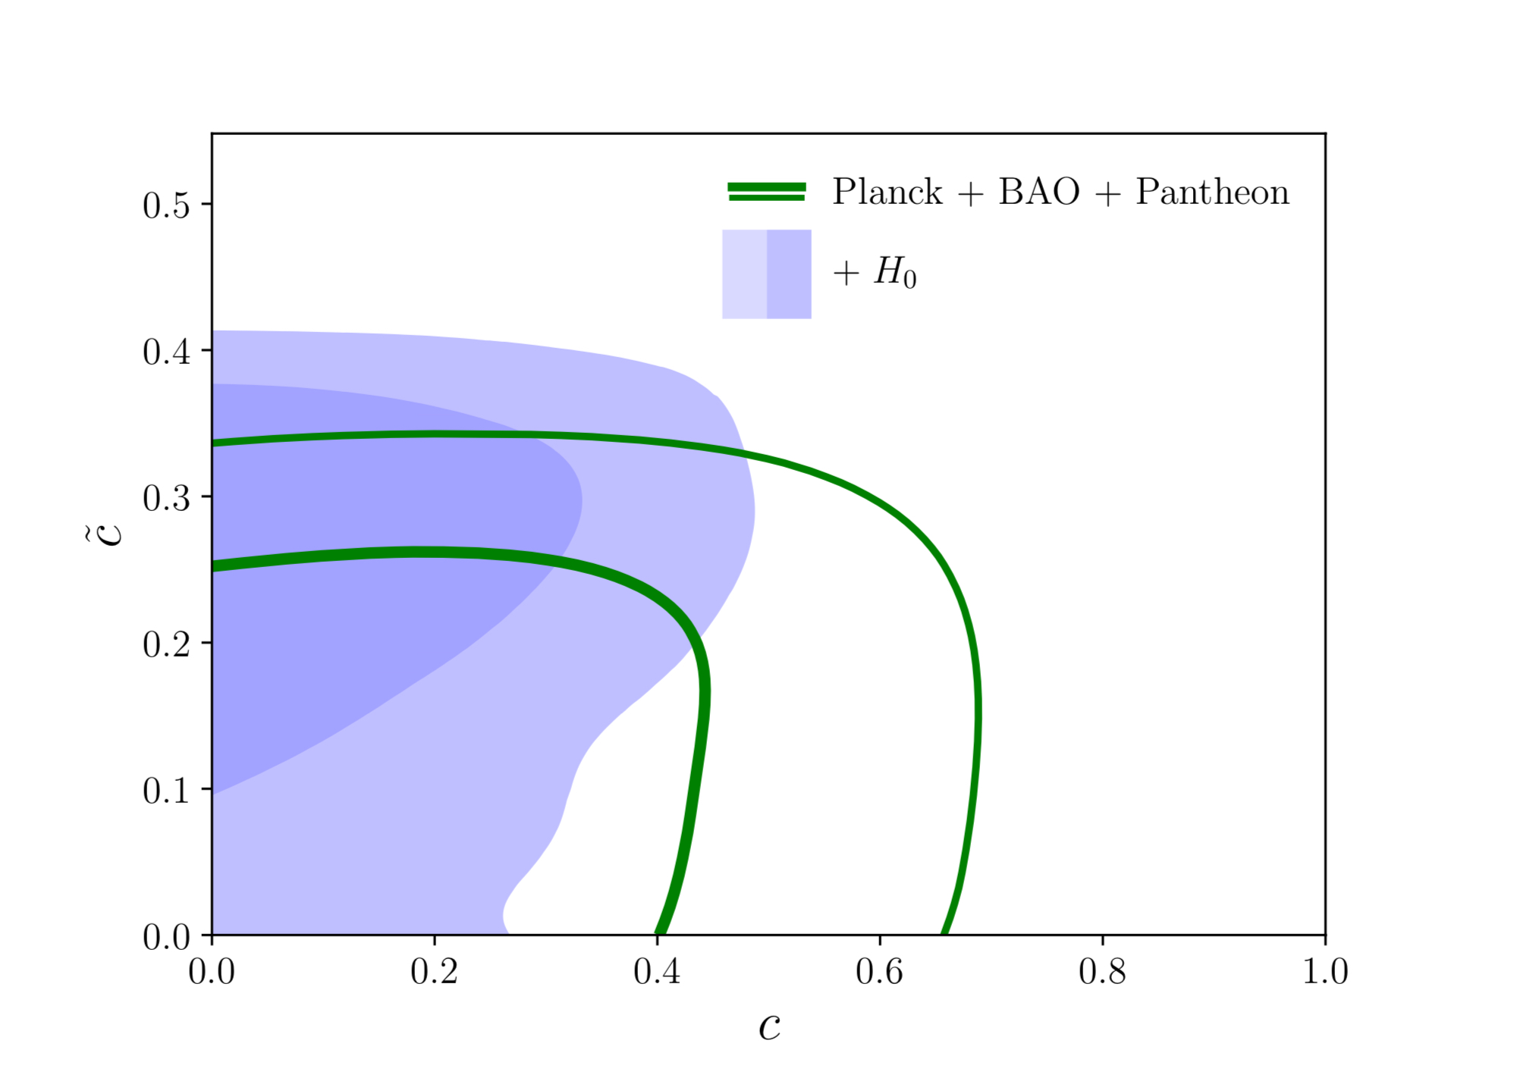

Slide 19
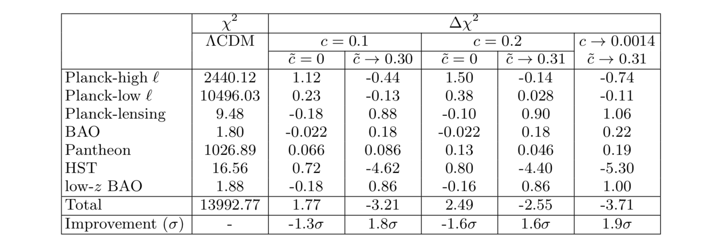

Slide 20


Slide 21
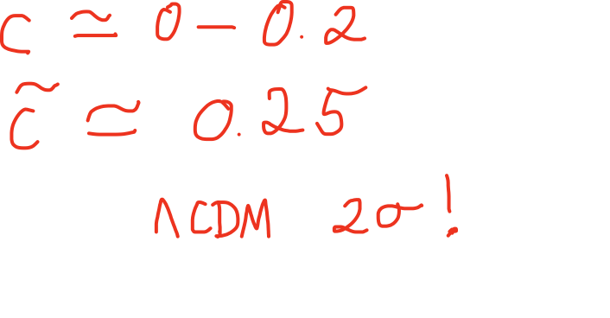

Better fit than by
Moreover as a by-product, our model automatically improves the H0 (and S8) tension.
Dark matter fading by 10% beginning around redshift z=15.

Slide 22
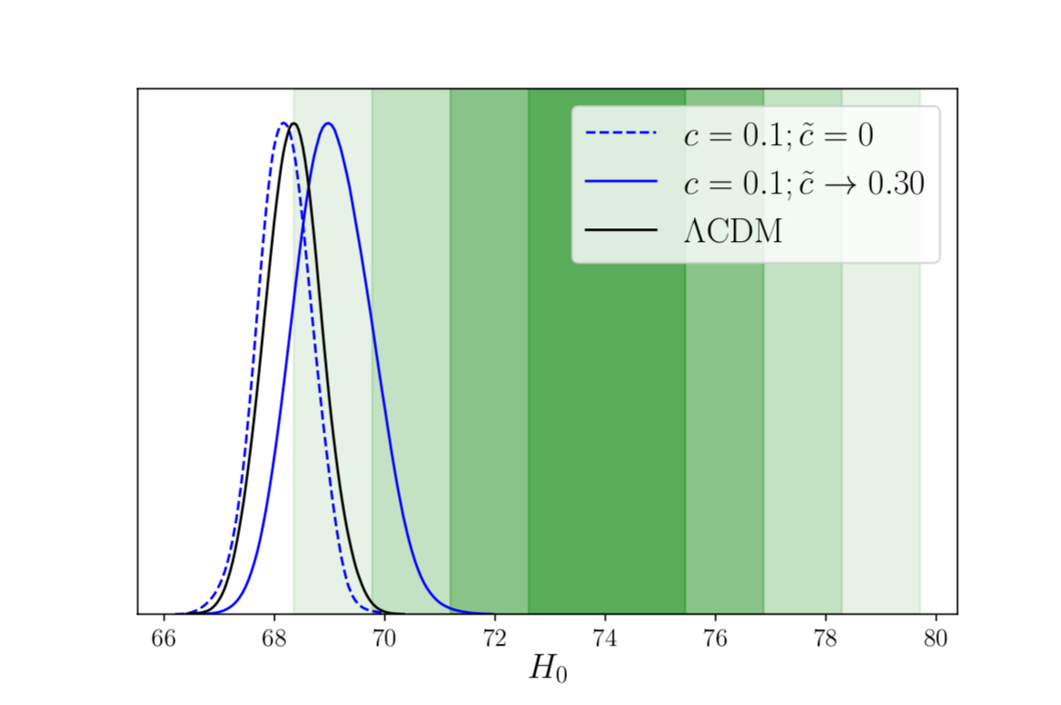

Slide 23
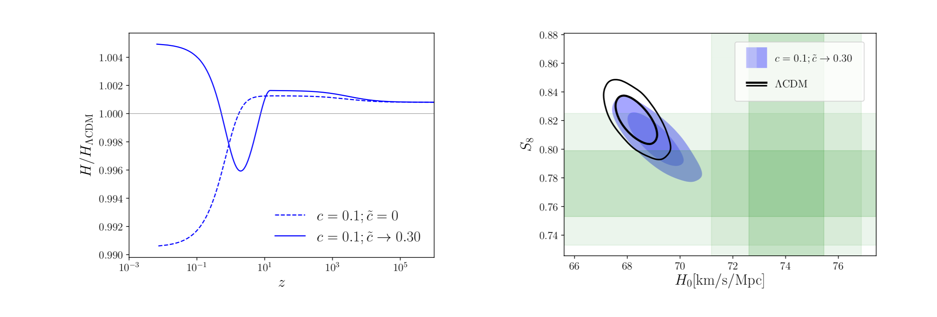
Dark matter fading by 10% beginning around redshift z=15.

Slide 24
Conclusions
Swampland ideas seem to have interesting phenomenological implications for particles physics as well as cosmology.
It would be important to more deeply understand these conditions from first principles.

