Slide 1
Neutrinos
A. Yu. Smirnov
Max-Planck Institute for Nuclear Physics, Heidelberg, Germany
SUSY 2014
July 21 – 26, 2014 ,
Manchester

Slide 2
… with instructions to cover
after detection of the PeV cosmic neutrinos even LHC energies are low
?
AP:
Current status of the low-energy oscillation data,
including recent results pertinent to
- very light sterile neutrinos and
- CP violation
AS:
Not much Super Symmetry …
AP:
Well, just add “Super”
to whatever you will say

Slide 3
Content:
1. Super-spread of scales and patterns
2. Super - PINGU & CP-violation
3. Super - light sterile neutrinos

Slide 4
1. Super-spread
of scales & patterns

Slide 5
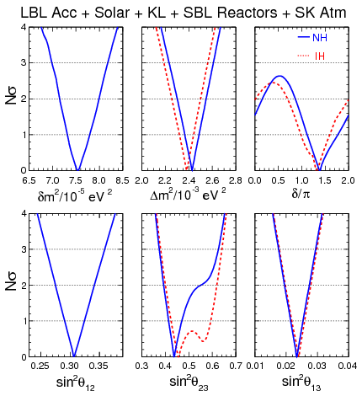
Global fit
F . Capozzi, et al
arXiv:1312.2878
With update after nu2014
U_{PMNS} = U₂₃I_{δ} U₁₃I_{−δ} U₁₂
I_{δ} = diag (1, 1, e^{iδ} )
Latest trends:
CP-phase 1.4 π
1.5 σ from 0
sin²θ₂₃
Closer to maximal mixing
0.39 - 0.40 → 0.44 – 0.45

Slide 6
Scales
28 orders of
magnitude
GUT - Planck
High scale seesaw
Quark- lepton
symmetry /analogy
GUT
of new
mass
physics
V_{EW}²
m_{ν}
behind neutrino
mass
Low scale seesaw,
radiative mechanisms, RPV,
high dimensional
operators
Electroweak –
Unification
LHC
Looking under the lamp
Scale of neutrino masses themselves
Relation to dark
energy, MAVAN?
eV-
m
ν
sub-eV
Spurious scale?
Neutrino mass itself is the fundamental scale of new physics

Slide 7
High scale line: the problem
Simplest seesaw implies new physical scale
M_{R} ~ m_{D}² /m_{ν} ~ 10¹⁴ GeV
<< M_{Pl}
(Another indication: unification
of gauge couplings)
ν_{R}
ν_{L}
F. Vissani
hep-phl9709409
H
H
J Elias-Miro et al,
1112.3022 [hep-ph]
ν_{R}
y²
(2 π )²
δm_{H}² ~ M_{R}² log (q /M_{R})
M_{R}³ m_{ν}
(2 π v)²
M. Fabbrichesi
~ log (q /M_{R})
Cancellation?
New physics below Planck scale
Small Yukawas,
Leptogenesis ?
M_{R} < 10⁷ GeV
“Partial” SUSY?

Slide 8
Mixing pattern: TBM + corrections
P. F. Harrison, D. H. Perkins,W. G. Scott
L. Wolfenstein
2/3 1/3 0
- 1/6 1/3 - 1/2
- 1/6 1/3 1/2
0.16
U_{tbm} =
U_{tbm} = U₂₃(π/4) U₁₂
0.62
sin²θ₁₂ = 1/3
0.78
0.30- 0.31
Implies
Symmetry
Accidental
Fundamental
just convenient book keeping
weakly broken symmetry of Lagrangian,
certain dynamics and new structures behind, other consequences
Mixing “decouples” from masses
Spread of interpretations: From symmetry to anarchy

Slide 9
S_{ν}
Residual symmetries approach
Mixing appears as a result of different ways of the flavor symmetry
breaking in the neutrino and charged lepton (Yukawa) sectors.
S₄
T’
G_{f}
A₄
T₇
Flavons
G_{l}
G_{ν}
Residual symmetries
of the mass matrices
Z_{m}
Z₂ x Z₂
or Z₂
M_{l}
M_{ν}
Generic symmetries
which do not depend
on values of masses to get TBM
Symmetry transformations
in mass bases
T
S_{ν}
S_{ν} M_{ν} S_{ν} ^{T} = M_{ν}
Maximal control over mixing as implied by TBM
Now: broken TBM symmetry

Slide 10
1-3 mixing
The same value with completely
different implications
relation
implications
Quark-Lepton Complementarity
GUT, family symmetry, …
~ ½sin²θ_{C}
Δm₂₁²
Δm₃₂²
``Naturalness’’ , absence of
fine tuning of mass matrix
O(1)
sin²θ₁₃
Analogy with quark mixing relation
¼ sin²θ₁₂sin²θ₂₃
~ ½cos² 2θ₂₃
universal ν_{μ} − ν_{τ} – symmetry violation
θ₁₃ = 2^{1/2}(π/4 - θ₂₃)
Eby,Frampton, Matsuzaki
> 0.025
Mixing anarchy

Slide 11
Relation
sin²θ₁₃~ ½sin²θ_{C}
Pheno. level
can be obtained in the context
C. Giunti, M. Tanimoto
H. Minakata, A Y S
U_{PMNS} = V_{CKM}⁺ U_{X}
From charged leptons or
Dirac matrices of charged leptons and neutrinos
Related to mechanism of neutrino mass generation
CKM structure
New neutrino structure
U_{X} = U₂₃(π/2) U₁₂
U_{X} = U_{BM}, U_{TBM}
Realized in QLC (Quark-Lepton Complementarity)
U₁₂ (θ_{c}) U₂₃(π/2)
permutation - to reduce the lepton mixing matrix
to the standard form leads to
θ₁₃~ ½ θ_{c}

Slide 12
New physics
Smallness of
Peculiar lepton
neutrino mass
Mixing pattern
which is probably not related to masses and can be described as
Both facts are probably related to
Majorana nature
TBM + corrections
of neutrinos
“CKM –type” responsible for small quark mixing and hierarchical structure of the Dirac masses
Two types of
New physics
It is common for quarks and leptons
“Neutrino new physics” responsible
for two above features
They are different but both should know about each other
This NP is related to additional structures in neutrino sector as see saw

Slide 13
2. CP-violation
&
Super-PINGU

Slide 14
Leptonic
Theoretical
Implications
Probe of the underlying
Physics,
enters various test equalities
CP-phase
phenomenology
Cosmic
neutrinos
Atmospheric
Long
neutrinos
Baseline
Neutrino beams
0nbb- decay
insensitive to CPV in
standard 3nu scenario
Cosmology
Solar neutrinos
Leptogenesis
Lepton asymmetry,
oscillations in the
Early Universe
Supernova
neutrinos

Slide 15
First glimpses
T2K
reactor experiments
Measurements of 1-3 mixing and 2-3 mixing by T2K
P. De Perio,
arXiv:1405.3871
δ_{CP} ~ - 0.5 π
SuperKamiokande, Atmospheric neutrinos
A. Himmel
arXiv: 1310.6677
An excess of the sub-GeV e-like events
preference
δ_{CP} ~ 200º (NH)
< 1σ
1.1 π
δ_{CP} ~ 220º (IH)
~ 2σ

Slide 16
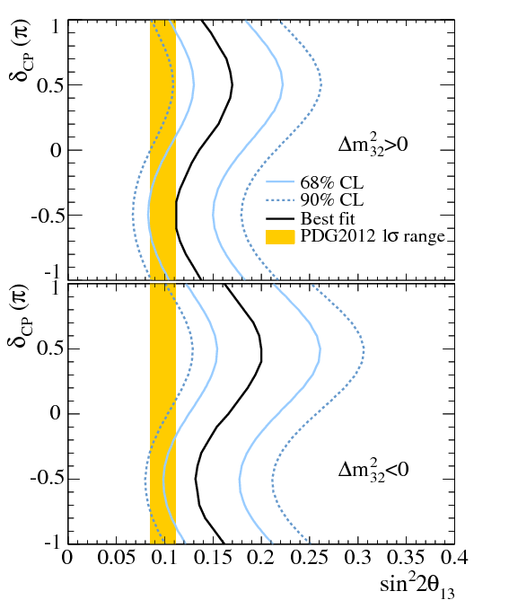
Before dedicated experiments?
Marginalized over 2-3 mixing
J-PARK (beam upgrade)
Super-Kamiokande
p.o.t. 6 10²⁰ → 7.8 10²¹
13 times higher
statistics in
few years
by 2018
ν_{μ} → ν_{e} sensitive to both mass splittings
sin 2θ₁₃
δ
sin θ₂₃
from ν_{μ} → ν_{μ}
NOvA
Reactors
sin 2θ₁₃
PDG (reactors)
Distinguishing - π/2 from 0 at > 3σ level?

Slide 17
Predicting CP-phase
Corrections to TBM mixing matrix
ν_{μ} - ν_{τ} symmetry breaking
Properties of mass matrices of neutrinos and charged leptons
Matrices with texture zeros
CP in specific models,
mechanisms of mass generation
with radiative ν mass generation
GUT’s
CP and flavor symmetries
Flavor symmetries → relations between the mixing matrix elements
Combining CP and flavor symmetries
ν_{μ} - ν_{τ} reflection symmetry
Relation between
δ and mixing angles
or / mass ratios
generalized CP transformations

Slide 18
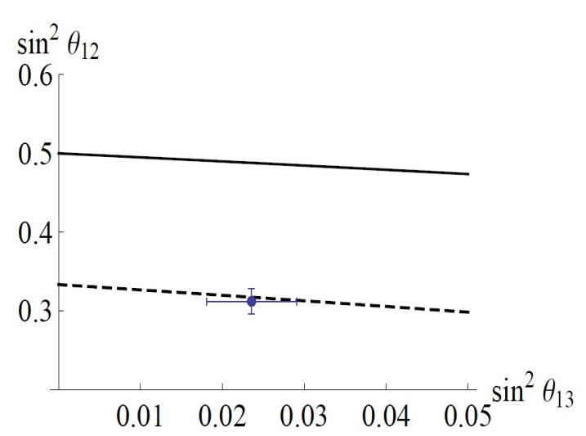
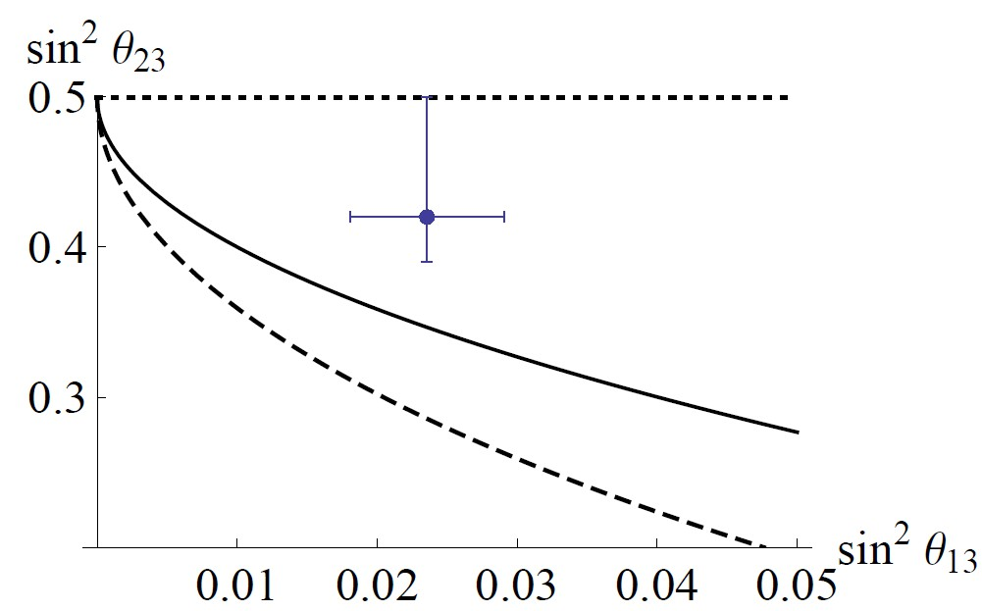
Relating δ to mixing by symmetry
D. Hernandez, A Y S.
1304.7738 [hep-ph]
In the residual symmetries approach
for column of the mixing matrix:
|U_{βi}|² = |U_{γi}|²
k_{α} = 0
|U_{αi}|² =
1 + a
4 sin² (πk/m)
S₄
k, m, p integers which
determine symmetry group
δ = +/-103⁰
TBM

Slide 19
Relating to mass degeneracy
Symmetry which left mass matrices invariant for specific mass spectra:
Partially degenerate spectrum
m₁ = m₂ , m₃
D. Hernandez, A.S.
Transformation matrix
S_{ν} = O₂
G_{ν} = SO(2) x Z₂
Relation:
m₁
m₂
sin² 2θ₂₃ = +/- sin δ = cos κ = = 1
maximal
+/- π/2
Majorana phase
1-2 mixing is undefined
Small corrections to mass matrix lead to 1-2 mass splitting and 1-2 mixing
Is δ = +/- π/2 generic?

Slide 20
Generalized CP-symmetry
Combine CP with flavor symmetries to predict CP phase
Combined CP and flavor transformation
ν_{μ} - ν_{τ}^{C} reflection symmetry of the mass matrix
P.F. Harrison, W. G. Scott
PLB547, 219 (2002)
ν_{μ} → ν_{τ}^{C}
ν_{τ} → ν_{μ}^{C}
W. Grimus, L Lavoura, PL579, 113 (2004)
sin θ₁₃ cos δ = 0
δ = +/- 90⁰
Y. Farzan, A.S.
hep-ph/0610337
Generalized reflection symmetry
ν_{α} → X_{αβ} ν_{β}^{C}
X is a unitary matrix
Invariance
X^{T} m_{ν} X = m_{ν}*
Generalization of the residual symmetry approach

Slide 21
S_{n} D
Flavor and CP symmetry
G_{f}x H_{CP}
T’
A₄
S₄
Residual symmetries
of the mass matrices
Flavons
Δ(96)
Δ(48)
G_{l}x H^{l}_{CP}
G_{ν}x H^{ν}_{CP}
Δ(27)
R. Mohapatra, C C Nishi,
F. Feruglio, C. Hagedorn,
R. Ziegler, E Ma, G-J. Ding, S.F. King, C. Luhn,
A. J. Stuart, Y-L. Zhou,
…
M_{l}
M_{ν}
Condition that elements of G_{f} and H_{CP} form the group (consistency condition)
Talk by T. Neder
M. Holthausen, M. Lindner,
M. Schmidt, JHEP1304 (2012)
X ρ(g) X⁻¹ = ρ(g’)
G_{ν} = Z₂ x Z₂
→ no CP violation δ = 0
C. Hagedorn, et al
G_{ν} = Z₂
→ usually δ = 0, +/- π/2 , π
δ may depend on free parameter and take any value
Y. Farzan, A.S.

Slide 22
Can we really predict the phase?
There is no convincing explanation of the value of CP phase in quark sector.
In lepton sector where situation is more complicated
due to additional elements producing smallness of neutrino mass.
Keeping unification line, should CPV in quark and lepton sectors related?
What we will learn measuring δ_{CP} ?
at least we can compare δ_{l} with δ_{q}

Slide 23
Comparing the phases
Following the unification line, similarity of the Dirac mass matrices:
m_{D}^{ν} ~ m_{D}^{q}
U_{PMNS} ~ V_{CKM}⁺ U_{X}
B. Dasgupta, A.S.
If the only source
of CP violation
No CPV
sinθ₁₃ sin δ_{CP} = (-cos θ₂₃) sinθ₁₃^{q} sinδ_{q}
λ
λ³
δ_{q} = 1.2 +/- 0.08 rad
sin δ_{CP} ~ λ³/s₁₃ ~ λ²
~ 0.046
δ_{CP} ~ - δ or π + δ
where δ = (s₁₃^{q} /s₁₃) c₂₃ sin δ_{q}
If the phase δ_{CP} deviates substantially from 0 or π, new sources of CPV beyond CKM should exists (e.g. from the RH sector) or another framework
New sources may have specific symmetries or structures which lead to particular values of δ_{CP} e.g. -π /2, and q - l unification will give just small corrections

Slide 24
In the Seesaw type I
B Dasgupta A.S
m_{D}^{ν} ~ m_{D}^{q}
U_{x} is the matrix diagonalizes
M_{X} = - m_{D}^{diag} U_{R}⁺ (M_{R})⁻¹ U_{R}* m_{D}^{diag}
Here
m_{D} = U_{L} (m_{D} ^{diag}) U_{R}⁺
In contrast to quarks for Majorana neutrinos the RH rotation that diagonalizes m_{D} becomes relevant and contributes to PMNS
CPV from U
In the LR symmetric basis
U_{X} = U_{R} U_{S}
R
From seesaw
Minimal extension is the L- R symmetry:
U_{R} = U_{L} ~ V_{CKM}*
and no CPV in M_{R}
Seesaw can enhance this small CPV effect
so that resulting phase in PMNS is large

Slide 25
Measuring CP-phase
Global fit
Dedicated experiments
J-PARC- HK
T2K + NOvA
LBNF
+ reactors
ESS
European spalation source Lund
J-PARC- SK
LBNO
750 kw upgrade
~ 5 - 7 σ
3π/2 from 0
at 3 - ? σ
result in 2030 - 2035
O(1) bln US$
In this connection

Slide 26
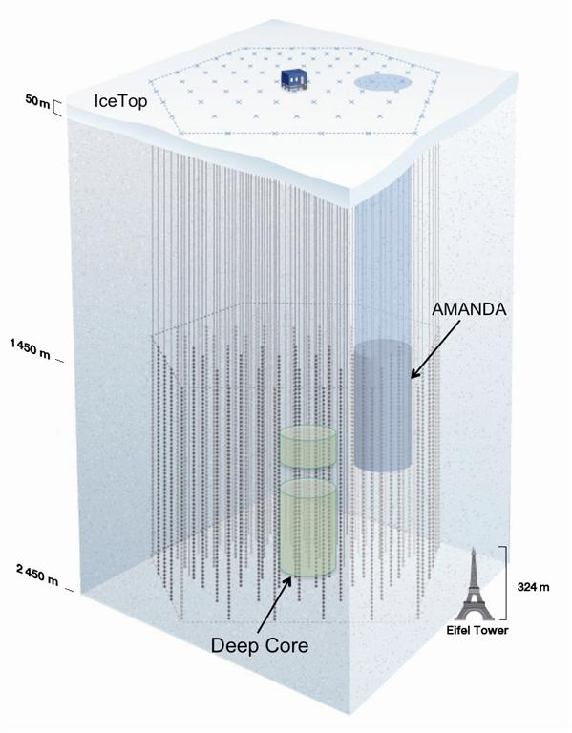
Ice Cube
100 GeV
Deep Core
10 - 15 GeV
PINGU
Precision
IceCube
Next
Generation
Upgrade
1 - 3 GeV
arXiv:1401.2046
Mass hierarchy
0.1 – 0.3 GeV
Super-PINGU
Few Mtons in sub-GeV
range
-ORCA
S. Razzaque, A.Y.S.
1406.1407 hep-ph
Megaton-scale
Ice
Cherenkov Array
MICA
0.01 GeV

Slide 27
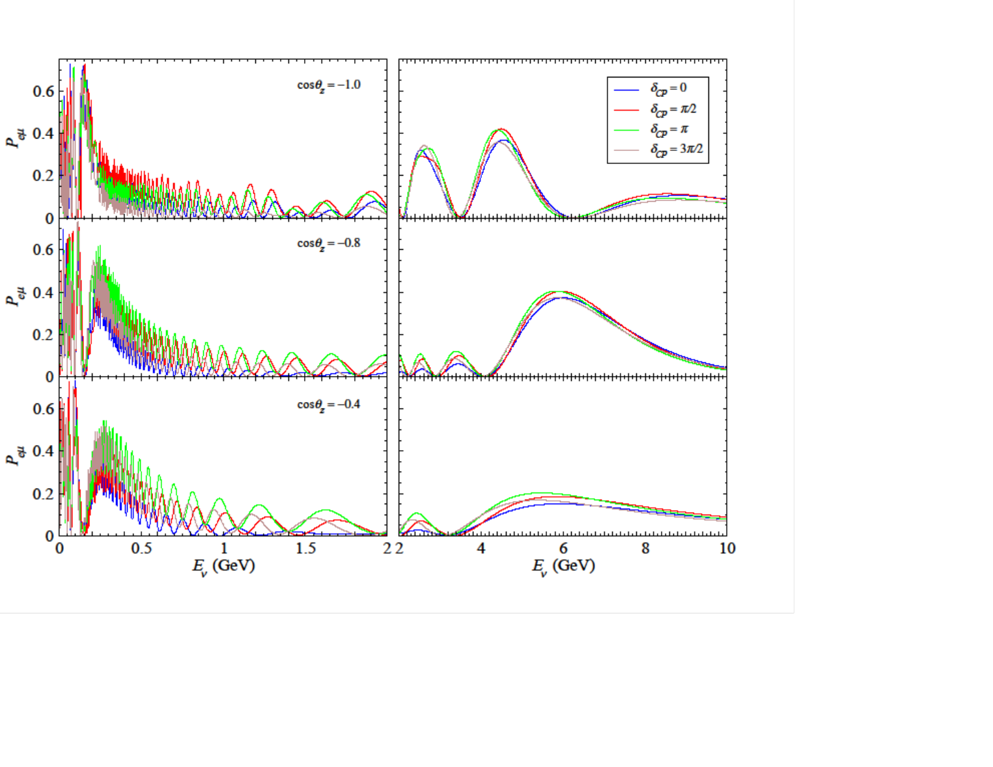
Probabilities
S. Razzaque, A.Y.S.
arXiv: 1406.1407 hep-ph
ν_{e} → ν_{μ}
NH
Large (10%) effect
at E ~ (0.5 – 1.5) GeV
Parametric effects
Systematic shift
of curves,
the same for all zenith
angles in mantle
1-2 resonance
1-3 resonance
Averaging over
fast oscillations
and integration over zenith angle does not wash out CP phase effect

Slide 28
Distinguishability for CP
Quick estimator (metric) of discovery potential
E. Kh. Akhmedov,
S. Razzaque, A. Y. S.
arXiv: 1205.7071
For each energy-zenith
angle bin ij
relative CP-difference
N_{ij} ^{δ} - N_{ij}^{δ = 0}
S_{ij} =
no fluctuations
N_{ij}^{δ = 0}
If is true value → N_{ij} ^{δ} corresponds to ``true’’ value of events
→ N_{ij}^{δ = 0} ``measured’’ number of events
|S_{ij}|
- distinguishability of different values of CP-phase
Total distinguishability
S^{tot} = [Σ _{ij} S_{ij}² ]^{1/2}

Slide 29
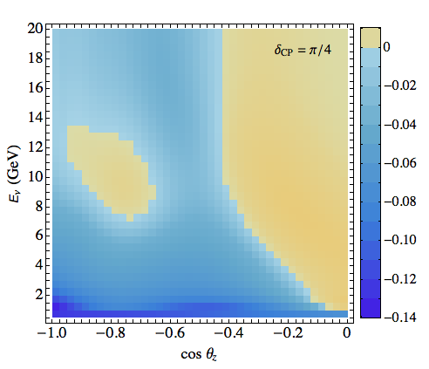
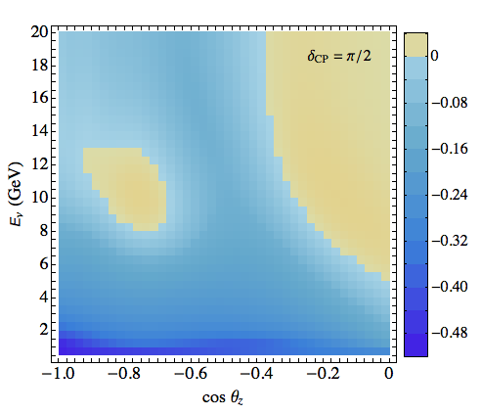
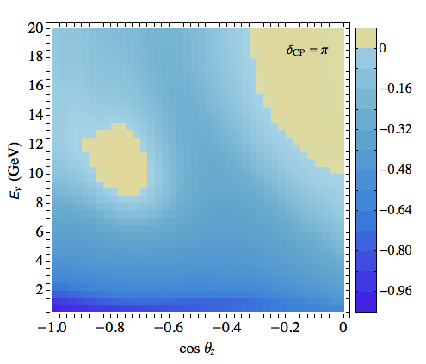
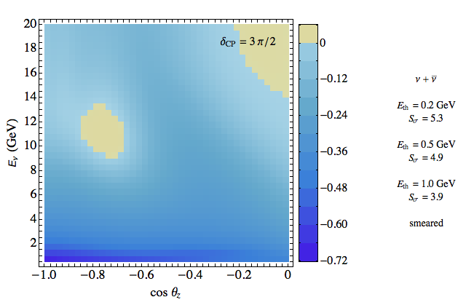
S-distributions
After smearing over neutrino energy and direction
ν_{μ}- CC events
(track + cascade)
S-distributions
for different
values of δ
Super PINGU
1 year
S. Razzaque, A.Y.S.
arXiv: 1406.1407
hep-ph

Slide 30
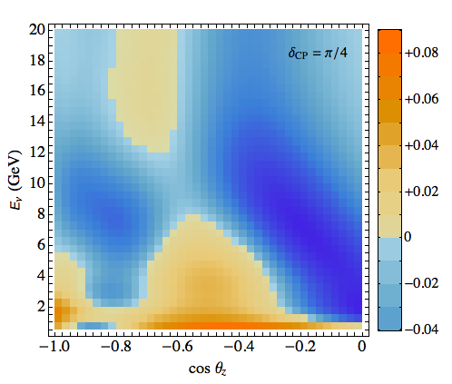
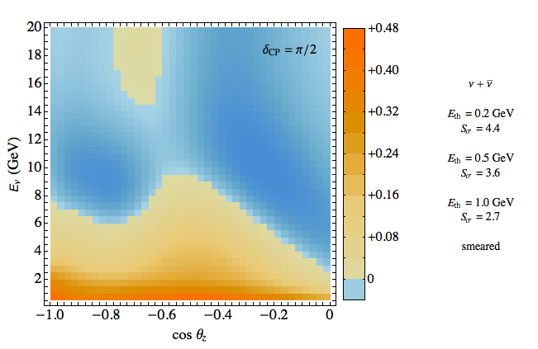
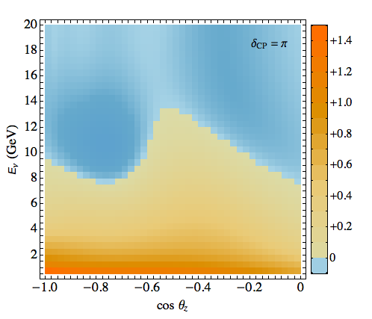
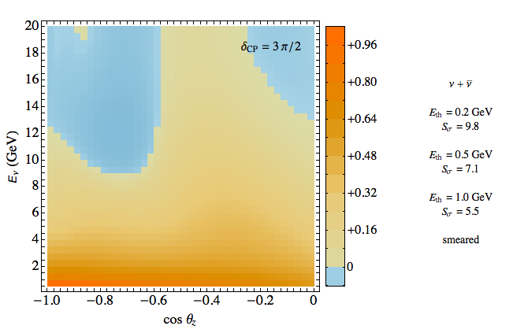
S-distributions
After smearing over neutrino energy and direction
ν_{e} - CC events
(cascades)
S-distributions
for different
values of δ
Super PINGU
1 year
S. Razzaque, A.Y.S.
arXiv: 1406.1407
hep-ph

Slide 31
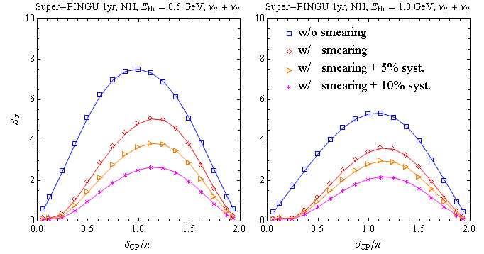
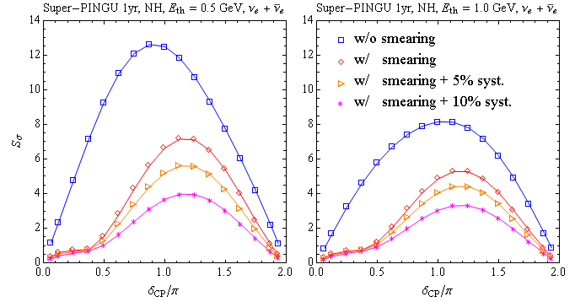
Total distinguishability
δ from 0
After 4 years of operation
with 5% uncorrelated error,
no correlated systematic
errors (cross-section, fluxes)
Distinguishability
of π/2 from 0: S_{tot} = 4 - 5
of π from 0: S_{tot} = 6 - 7
depending on detection
features at low energies
(still to be studied),
contribution of cascades
Correlated systematics
(X-section, fluxes), flavor misidentification
Can reduce S by factor 2

Slide 32
3.Superlight
Sterile
neutrinos

Slide 33
ν_{s}
New neutrino states
mixing
θ_{aS}²
δm ~ θ_{aS}² m_{S}
1 MeV
appealing
Warm Dark
matter
Pulsar kick
5 - 10 keV
2 10⁻¹¹
(1 – 2) 10⁻⁸ eV
1 keV
controversial
- LSND, MB
Reactor
Ga anomalies
- Extra radiation
1 eV
0.5 - 2 eV
0.02
0.02 eV
(2 – 4) 10⁻³ eV
10⁻³
10⁻⁶ eV
- Solar neutrinos
- Extra radiation
in the Universe
10⁻³ eV
Compare with large elements of the mass matrix 0.02 eV
interesting

Slide 34
meV physics
ν_{s}
ν_{e}
ν_{μ}
ν_{τ}
sterile neutrino
m₀ ~ 0.003 eV
Motivated by
ν₃
Solar neutrino data
absence of upturn of spectrum
sin²β
additional radiation
in the Universe if mixed in ν₃
Δm²₃₁
mass
no problem with LSS
bound on neutrino mass
ν₂
Origins:
Δm²₂₁
ν₀
M²
M_{Planck}
ν₁
Δm²₀₁
m₀ ~
M ~ 2 - 3 TeV
sin²α
α, β ~ v /M
DE scale?
For solar nu:
sin² 2α ~ 10⁻³
sin² 2β ~ 10⁻³ (NH)
or
Low scale radiative inverse seesaw model
For dark radiation
sin² 2β ~ 10⁻¹ (IH)
P.S. Bhupal Dev and A. Pilaftsis, 1212.3808

Slide 35
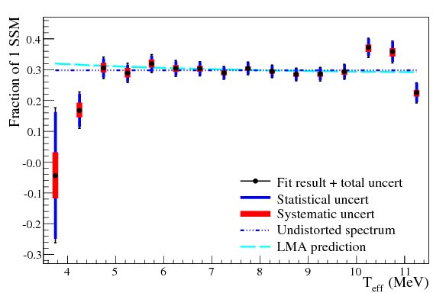
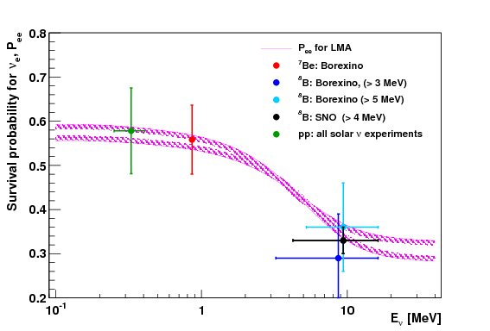
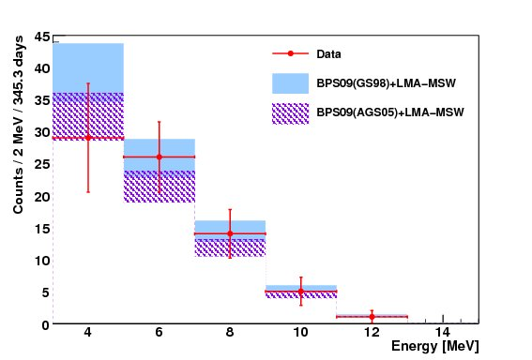
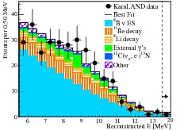
Up-turn?
SNO: LETA
pp ⁷Be CNO ⁸B
pep
.
BOREXINO
gap
ν_{e} - survival probability from solar
neutrino data vs LMA-MSW solution
KamLAND
HOMESTAKE: low rate
BOREXINO:
direct detection of pp neutrinos
Better measurement of the boron spectrum
Expected soon

Slide 36
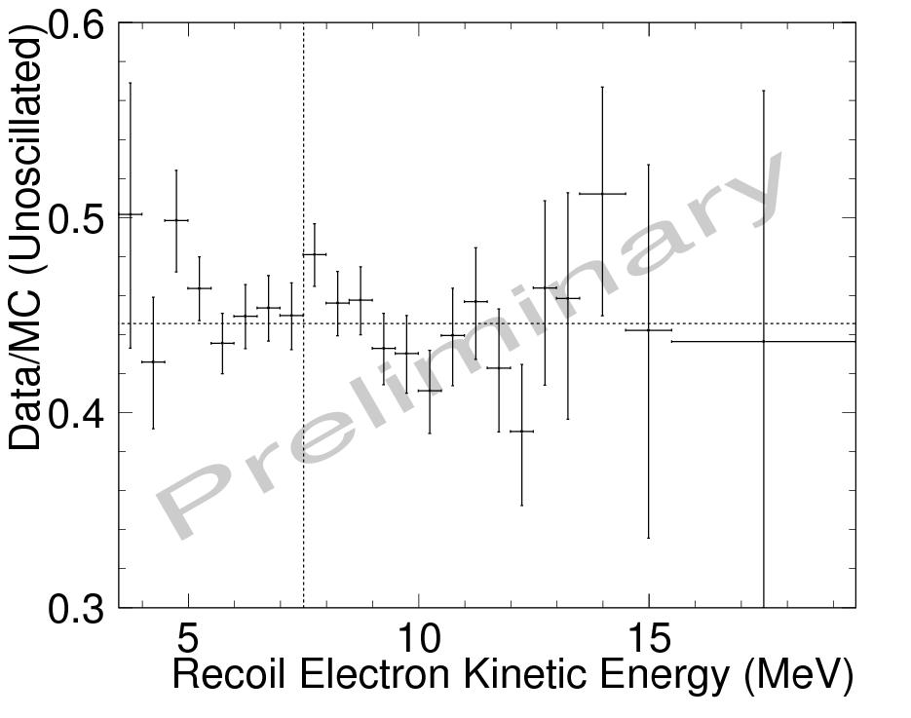
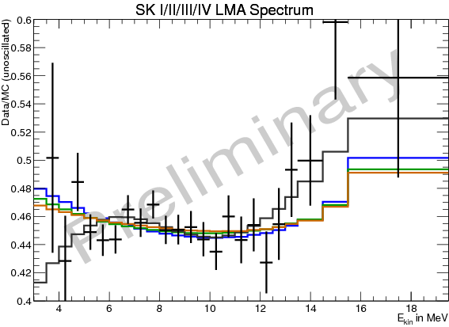
Spectral upturn SK:
1 .7 σ tension
SK-IV energy spectrum, the ratio of the measured rate to the MC simulated unoscillated rate.
SK-I+II+III+IV recoil electron spectrum
to the no-oscillation expectation.
The green (blue) shape is the MSW expectation using the SK (solar+KamLAND) best-fit oscillation parameters.
SK further reducing threshold down to 2.5 MeV !

Slide 37
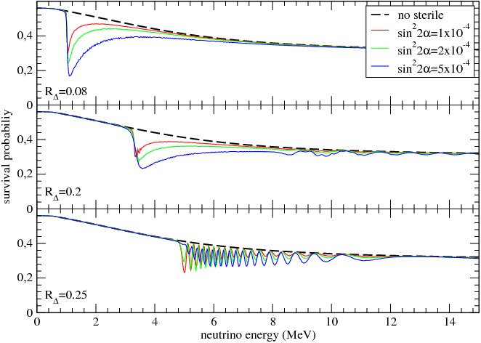
Effect of sterile on survival probability
- dip
- wiggles
Shift which eliminates
discrepancy of dms

Slide 38
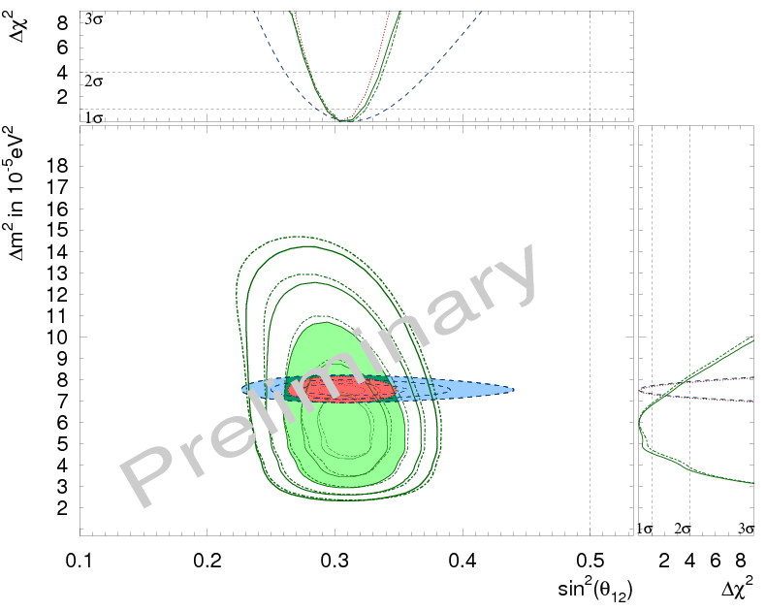
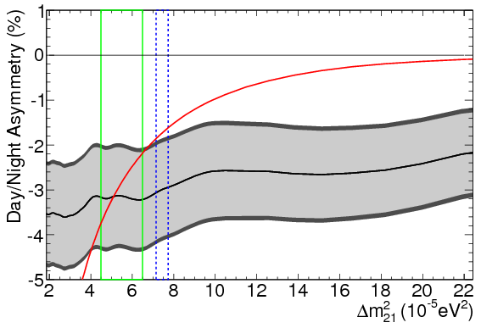
DM^2 tension
Super-Kamiokande collaboration
(Renshaw, A. et al.)
Phys.Rev.Lett. 112 (2014) 091805 arXiv:1312.5176
arXiv:1403.4575 [hep-ex]
SUPER-KAMIOKANDE
2 σ tension
LMA MSW prediction
Modified in nu 2014
Allowed contours of Δm₂₁ ² vs. sin²θ₁₂
from solar neutrino data (green) at 1, 2, 3, 4 and 5σ and KamLAND data (blue) at the 1, 2 and 3σ confidence levels.
Lack of upturn and DN asymmetry
push Δm₂₁ ² to lower values
Sterile neutrino can eliminate the first factor

Slide 39
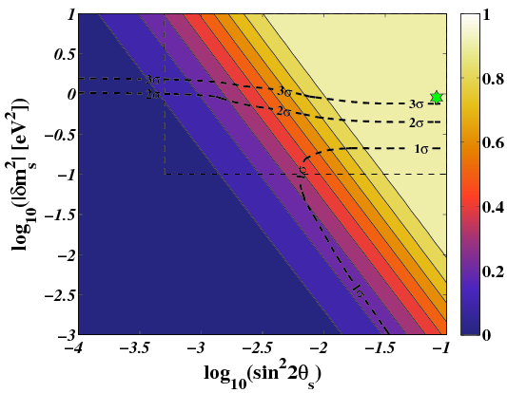
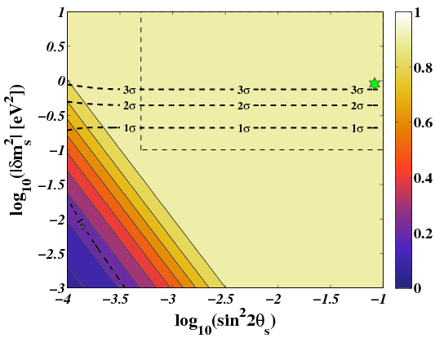
Production of sterile neutrinos
S. Hannestad, I. Tamborra , T. Tram,
JCAP 1207 (2012) 025 , arXiv:1204.5861 [astro-ph.CO]
Δm _{s}² > 0 (sterile is heavier)
Δm _{s}² < 0
IH of active nu
NH of active nu
Iso-δN_{eff} contours in the sin²2θ_{s} - Δm _{s}² plane for L(μ) = 0.
The 1−2−3σ contours denote the CMB+LSS allowed regions for steriles with sub-eV mass.
Cosmological data:
ΔN_{eff} = 0.3 – 0.7

Slide 40
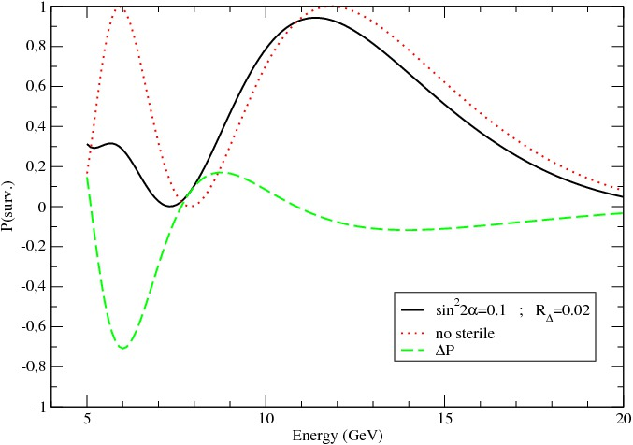
Atmospheric neutrinos
P. De Holanda, A. S.
ν_{τ}’ – ν _{s} resonance at E_{R} ~ 12 GeV
Interplay of ν_{μ} → ν _{s} and ν_{μ} → ν_{τ} oscillations
But due to small phase maximal effect is shifted to low energies
where enhancement is not very strong
cos θ_{z} = - 0.8
IceCube Deep Core
~ 20 % suppression of rate
of events in the muon
energy bins 10 – 20 GeV
with sterile
difference
Largest effect is at 5 – 8 GeV
→ PINGU

Slide 41
Significance of nu-sterile effect
after smearing
P. De Holanda, A Y S
in preparation
sin² 2β ~ 10⁻¹
N_{ij}^{s} - N_{ij}⁰
N_{ij}⁰
Numbers of events with
and without sterile
S_{ij} =
Size of bin:
ΔE = 1 GeV, cos θ_{z} = 0.05
Total significance
with 10% uncorrelated systematic error
S = 6 - 7 after 4 years of PINGU operation
Degenerasy with 1-3 mixing effect, mass hierarchy, etc.

Slide 42
Summary
Composite explanation of data:
the CKM type new physics common to quarks and leptons and new physics responsible for smallness of neutrino mass and large lepton mixing. The latter may have enlarged symmetries
CP violation
If the CKM structure is the only source of CPV in lepton sector one expects the CP phase close to zero or π. Other values will imply new sources of CPV or departure from the unification approach.
Specific values like 0, π , +/- π/2 often appear as a result of certain symmetry. In particular, +/- π/2 can be related (via symmetry) to maximal 2-3 mixing, or partial degeneracy on neutrino
mass spectrum, or symmetries of the RH (hidden) sector of theory, or the generalized CP symmetry.

Slide 43
Future Multi Megaton scale atmospheric neutrino detectors with sub GeV threshold can be rather sensitive to the CPV phase and may be competitive with existing proposals
Sterile
meV mass sterile neutrinos may explain the absence of upturn of the energy spectrum of solar neutrinos, remove tension in 1-2 mass splitting, and provide the dark radiation in the Universe. Their existence can be checked in atmospheric neutrinos.
Required parameters of these neutrinos can be related to new physics at TeV scale and Planck mass. They may be a part of very low energy scale of new physics.

Slide 44
Backup slides

Slide 45
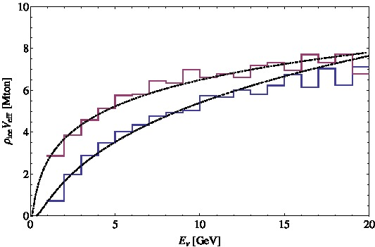
Super-PINGU
S. Razzaque A Y S
Effective volume
Str. DOM’s
v15: 40, 60
v12
v12: 126, 60
v15
MICA: 60, 120
MICA: 220, 140
64 3’’ PMT per module
Lagre volume at small energies

Slide 46
Results and further improvements
Super-PINGU with 0.5 GeV threshold
After 4 years of operation with 5% uncorrelated error
Distinguishability
S_{tot} = 4 - 5 (depending on contribution of cascades)
π /2 from 0
π from 0
S_{tot} = 6 - 7
Lowering threshold 1.0 → 0.5 GeV 50 % improvement
Further improvements:
Lowering threshold 0.5 → 0.2 GeV 20 – 30 % improvement
Partial separation of the neutrino and antineutrino events
Larger effective volume at ~ 1 GeV denser DOMs array
Better flavor identification
Increase of exposure time

Slide 47
EW – LHC scale
- No hierarchy problem (even without SUSY)
- testable at LHC, new particles at 0.1 – few TeV scale
- LNV decays
Low scale seesaw
Small VEV
Radiative
Higgs
Triplet
0ne loop
νMSM
Two loops
New Higgs
doublets
L-R
Low scale
Three loops
R_{p}-SUSY
Neutralino as RH neutrino
Inverse
seesaw
High dimensional operators
Connection to Dark Matter
Radiative seesaw

Slide 48
ν
MSM
M. Shaposhnikov et al
Everything below EW scale
→ small Yukawa couplings
L
R
- generate light
mass of neutrinos
generate via oscillations
lepton asymmetry
in the Universe
can be produced in
B-decays (BR ~ 10⁻¹⁰ )
Few 100 MeV –
GeV
BAU
split ~ eV
WDM
3- 10 kev
- warm dark
matter
- radiative decays →
X-rays
Normal
Mass
hierarchy
EW seesaw
Higgs inflation
Nothing new below Planck scale

Slide 49
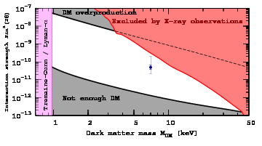
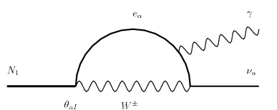
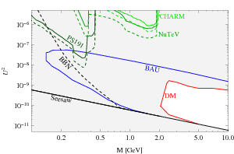
s
Bounds on parameters of nuMSM
allowed
A Boyarsky et al, 1402.4119
The blue point: the best-fit value from M31 (Andromeda galaxy). Thick error bars
are ±1σ limits on the flux. Thin error bars correspond to the uncertainty in the DM distribution in the center of M31.

Slide 50
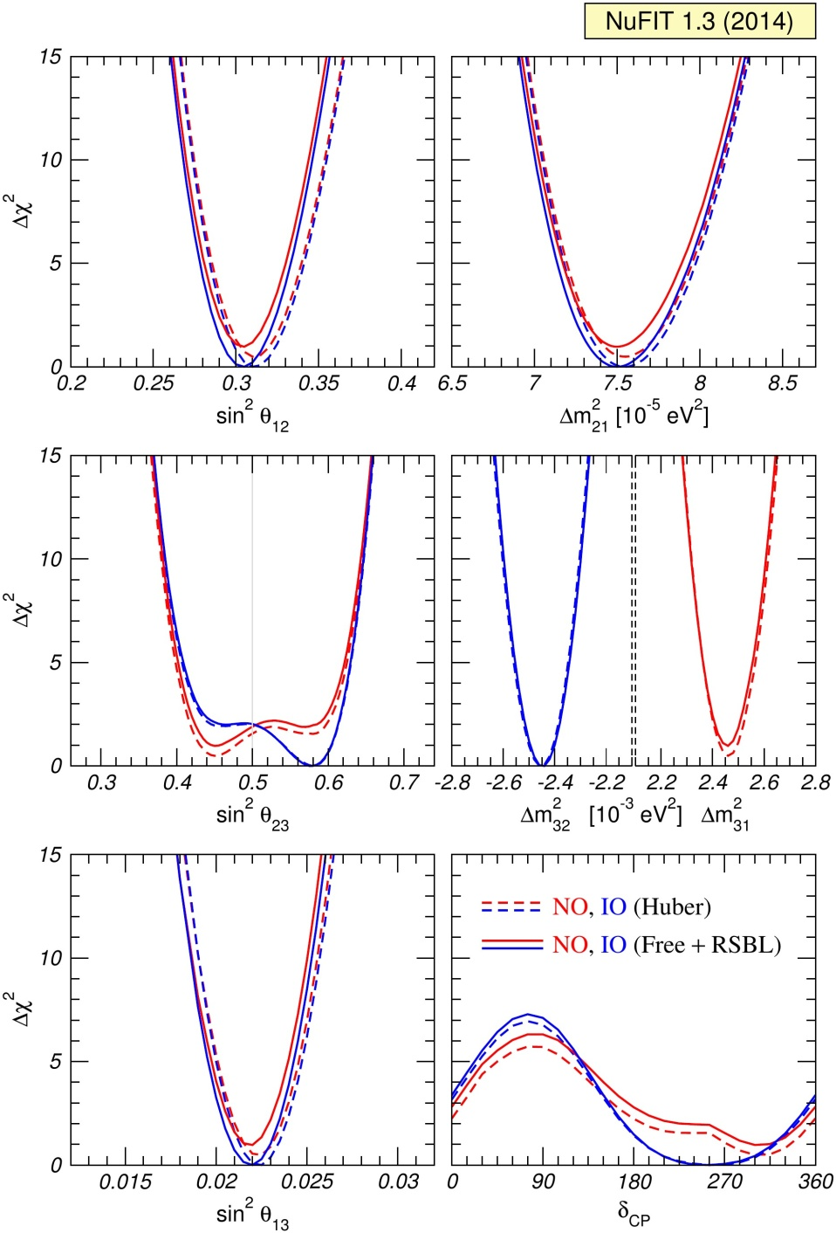
Global fit
M. Gonzalez Garcia, M. Maltoni,
T. Schwetz, J. Salvado
JHEP 12 (2012) 123 [arXiv:1209.3023]
Update after nu 2014
Results for different assumptions concerning the analysis of data from reactor experiments: for solid curves the normalization of reactor fluxes is left free and data from short-baseline (less than 100 m) reactor experiments are included. For dashed curves short-baseline data are not included, reactor fluxes according to arXiv:1106.0687 .

Slide 51
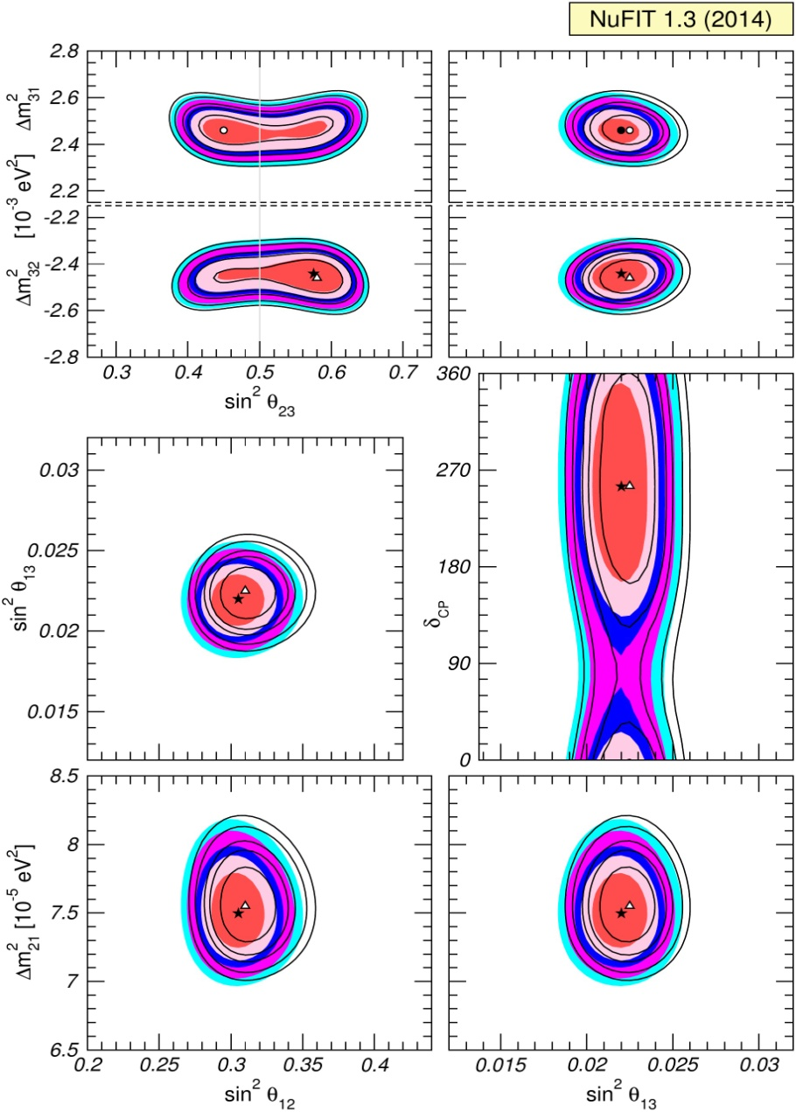
M. Gonzalez Garcia, M. Maltoni,
T. Schwetz, J. Salvado
Global fit
The different contours correspond to the two-dimensional allowed regions at 1σ, 90%, 2σ, 99%, 3σ CL (2 dof).

Slide 52
eV - sub eV scale physics
- new scalar bosons, majorons, axions,
- new fermions (sterile neutrinos, baryonic nu) ,
- new gauge bosons (e.g. Dark photons)
Very light sector
which may include
M. Pospelov
Maybe related to Dark energy, MAVAN
Generate finite neutrino masses,
usual Dirac masses can be suppressed by seesaw with M_{R} = M_{Pl}
eV scale Seesaw with RH neutrinos
for sterile anomalies LSND/ MiniBooNE ....
A. De Gouvea
Tests:
5th force searches experiments
Modification of dynamics of neutrino oscillations
Checks of standard oscillation formulas,
searches for deviations

Slide 53
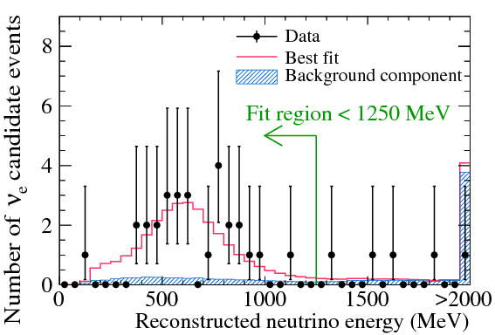
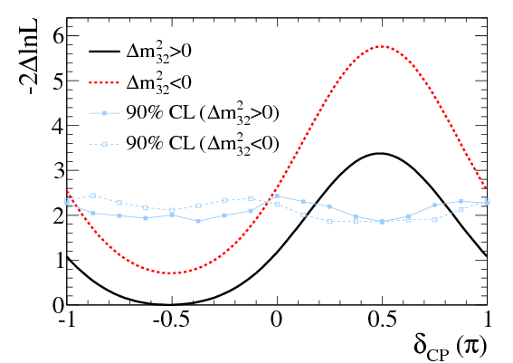
Nu_e appearance
T2K Collaboration (Abe, K. et al.)
Phys.Rev.Lett. 112 (2014) 061802
arXiv:1311.4750 [hep-ex]
The E ^{rec} distribution for νe candidate events with the MC prediction at the best fit of sin²2θ₁₃ = 0.144 (normal hierarchy) .
Maximum likelihood function
The δ_{CP} regions with values above the lines are excluded at 90% CL.

Slide 54
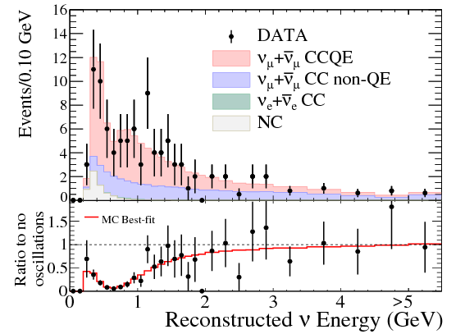
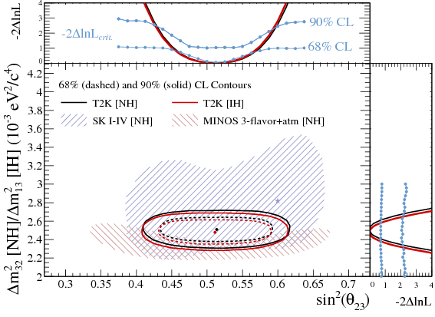
2-3 mixing
T2K Collaboration (Abe, K. et al.) Phys.Rev.Lett. 112 (2014) 181801 arXiv:1403.1532 [hep-ex]
The 68% and 90 % C.L. confidence regions for sin2(θ23) and Δm232 (NH) or Δm213 (IH). The SK and MINOS 90% C.L. regions for NH are shown for comparison.
Reconstructed energy spectrum for single-ring
μ -like SK events.

Slide 55
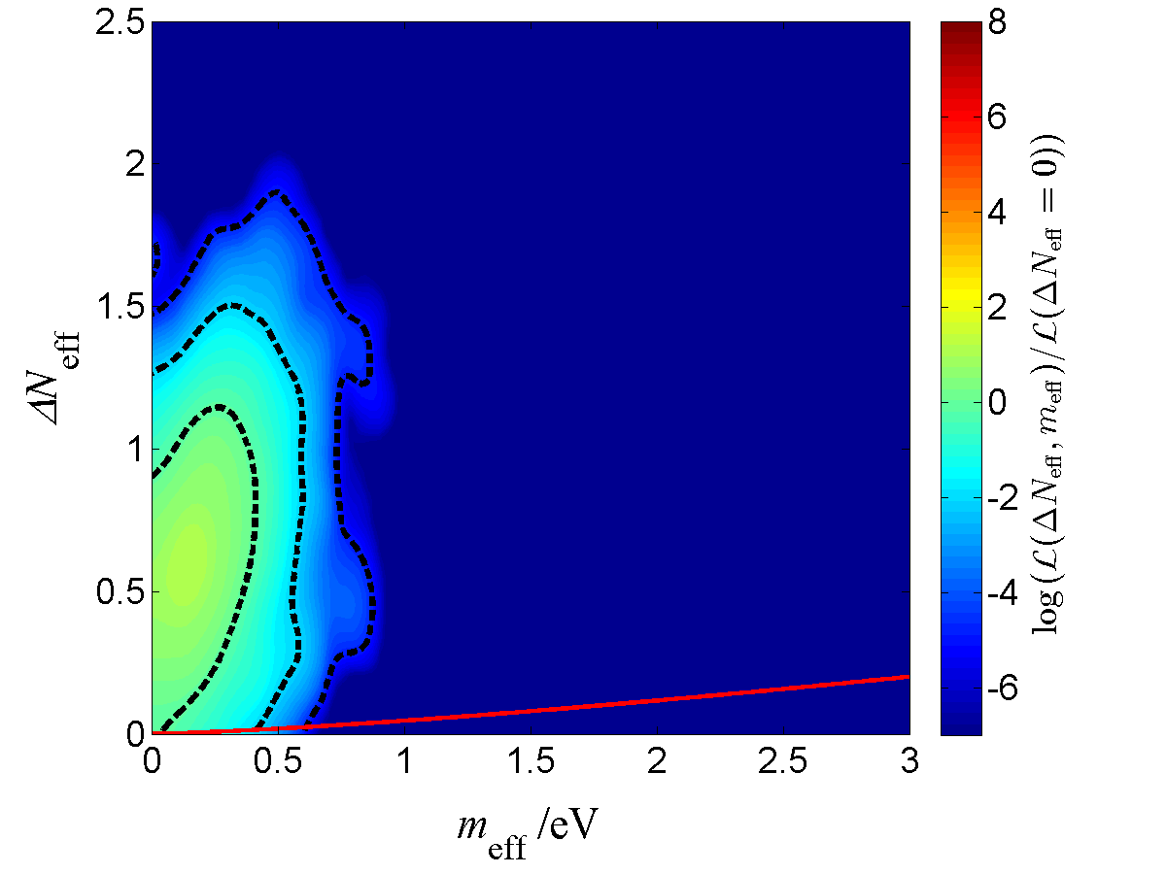
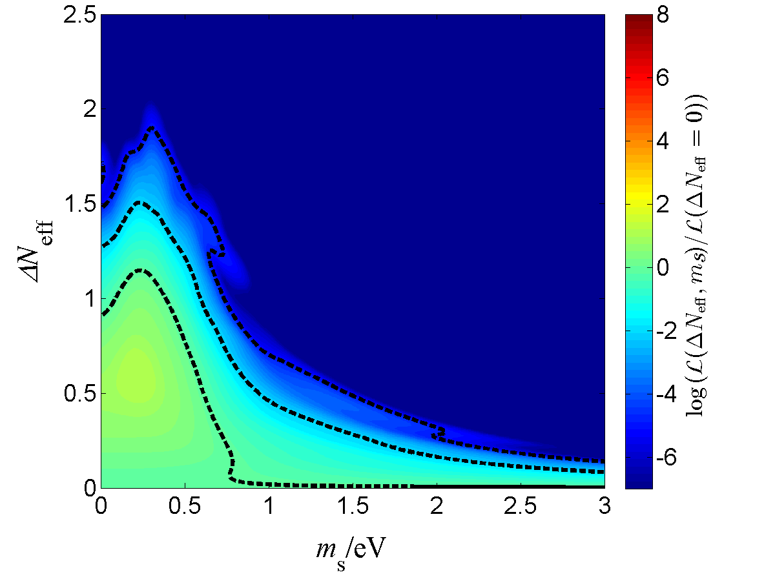
Cosmological bounds
Johannes Bergström, M.C. Gonzalez-Garcia, V. Niro, J. Salvado
e-Print: arXiv:1407.3806 [hep-ph]

Slide 56
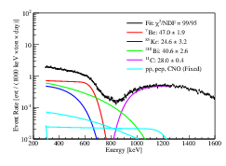
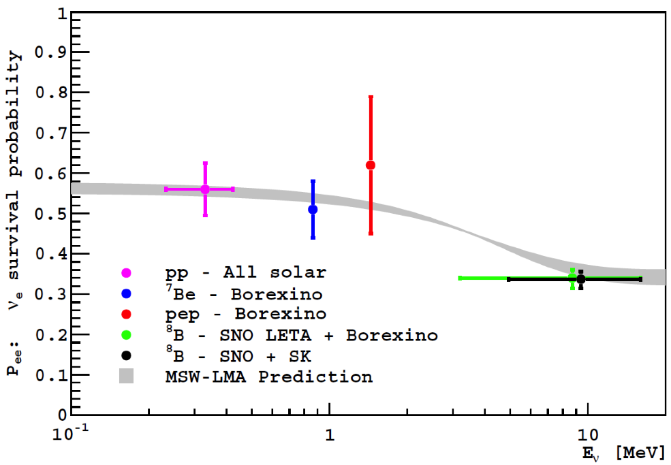
BOREXINO
e-Print: arXiv:1405.7919 [hep-ex] |
Survival probability of electron neutrinos as foreseen by the MSW-LMA model. Data points discussed here are als
KAMLAND
Gado et al,
arXiv: 1405.6190 [hep-ex]
P(Be) = 0.66 +/- 0.14

Slide 57
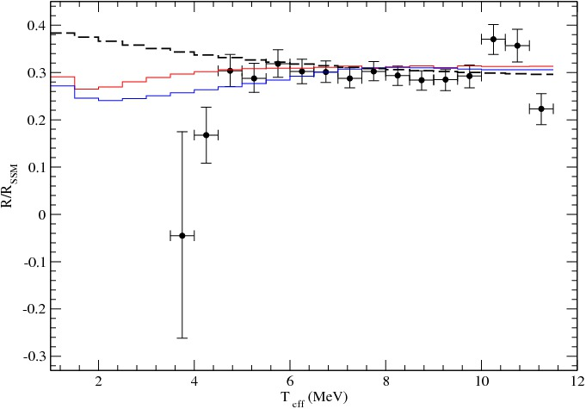
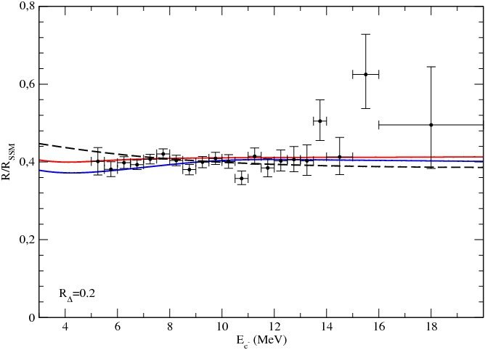
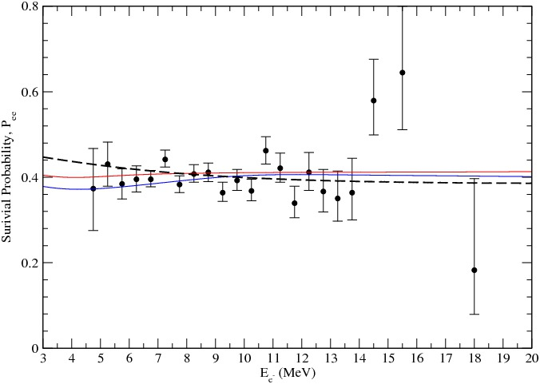
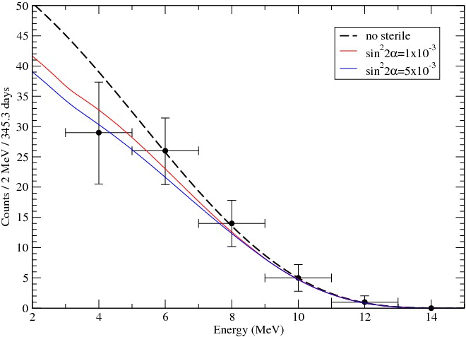
Up-turns
sin²2α = 10⁻³ (red), 5 10⁻³ (blue)
SK-I
SNO-LETA
P. De Holanda, A.S.
SK-III
Borexino
SNO-LETA
R_{Δ} = 0.2
Δm² = 1.5 10⁻⁵ eV²

Slide 58
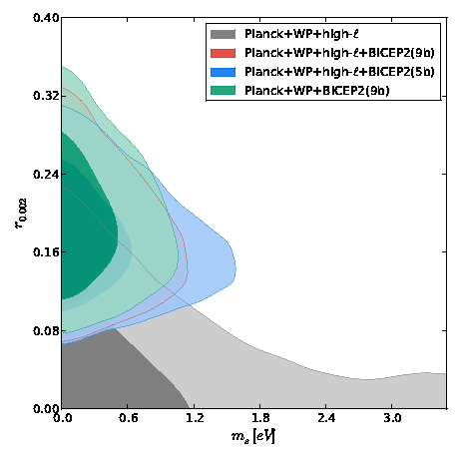
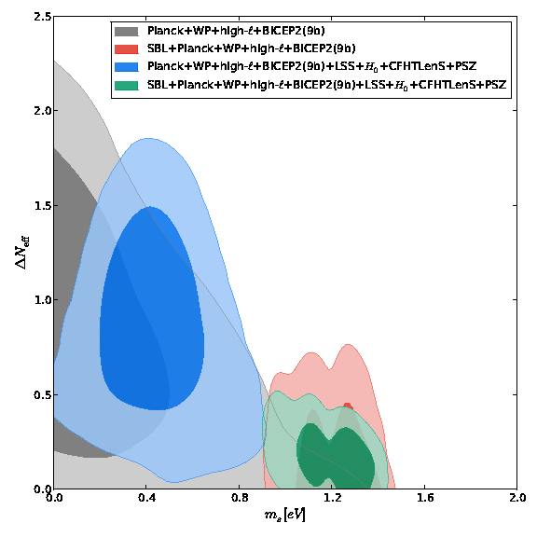
Extra radiation
M. Archidiacono ,et al JCAP 1406 (2014) 031e-Print: arXiv:1404.1794 [astro-ph.CO]
1σ and 2σ marginalized contours in the plane (ms,\ns). The banana shaped regions allowed by cosmology indicate a sub-eV mass and an excess in Neff, while the inclusion of SBL data forces the mass around 1eV,
1σ and 2σ marginalized contours for different combinations of CMB data sets.

Slide 59
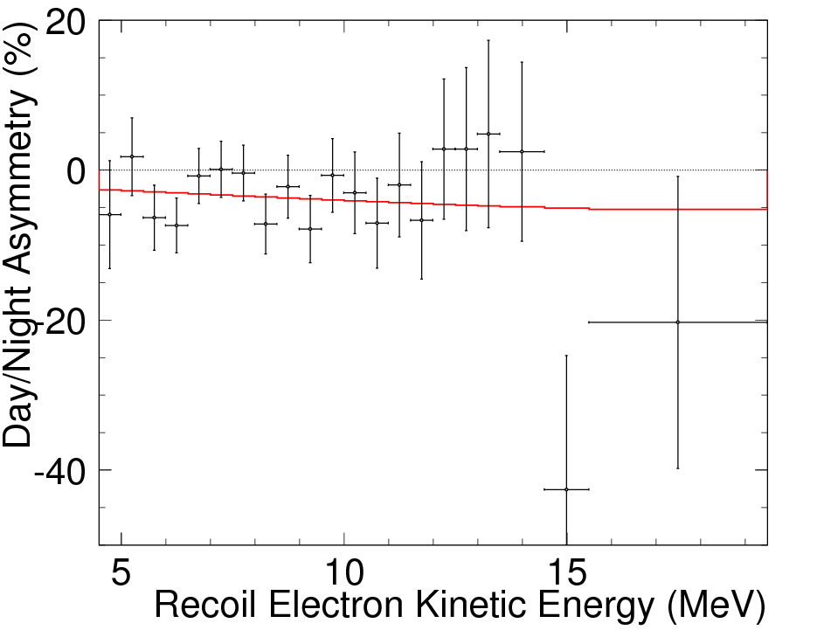
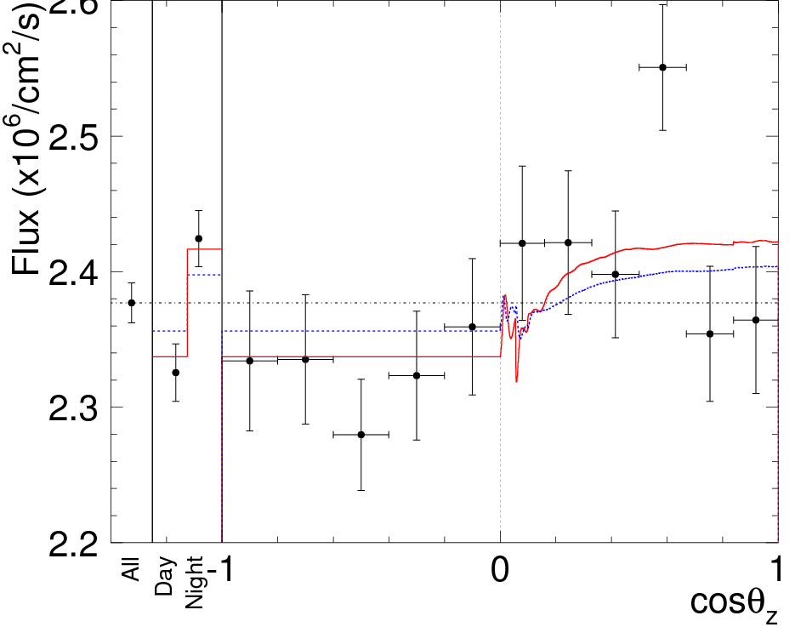
Day-Night effect
Super-Kamiokande collaboration
(Renshaw, A. et al.)
Phys.Rev.Lett. 112 (2014) 091805 arXiv:1312.5176

Slide 60
DM2 tension
e-Print: arXiv:1403.4575 [hep-ex]
Experiment: SUPER-KAMIOKANDE
Allowed contours of Δm₂₁ ² vs. sin²θ₁₂
from solar neutrino data (green) at 1, 2, 3, 4 and 5σ and KamLAND data (blue) at the 1, 2 and 3σ confidence levels. Also shown is the combined result in red. For comparison, the almost identical result of the SK+SNO combined fit is shown by the dashed dotted lines. The filled regions give the 3σ confidence levels.
Modified in nu 2014

Slide 61


CP vs. hierarchy
CP-difference
Hierarchy asymmetry
S = 0.4
Sub-leading effect
but different topology
S = 0.4

Slide 62
Significance of nu-sterile effect
P. De Holanda, A Y S
in preparation
with smearing
For IH
Bin size:
sm1
sm2

Slide 63

Challenges, improvements
Small effects. Rather flat distributions in energy and zenith angle distributions
→ Various systematics become important
Cross-section, quasi-elastic, resonance region dependence on energy
Neutrino fluxes
Dependence of the effective volume on energy
Flavor identification
10% overal normalization 5% energy tilt
Improvements:
Lowering threshold 0.5 → 0.2 GeV 20 – 30 % improvement
Partial separation of the neutrino and antineutrino events
Larger effective volume at ~ 1 GeV denser DOMs array
Increase of exposure time

Slide 64
In general
neglecting terms of the order ~ λ³
sin δ_{CP} = s₁₃⁻¹ [sin(α_{μ} + δ_{X})V_{ud}|X_{e3}| – sin α_{e} |V_{cd}|X_{μ3} ]
here α_{μ} , δ_{X} and α_{e} are parameters of the matrix U_{X}
Some special values of δ_{CP} can be obtained under certain assumptions
if X_{e3} = 0
sin δ_{CP} ~ – sin α_{e}
and if α_{e} = π /2
δ_{CP} ~ 3π/2
The latter implies certain structure of the RH sector

Slide 65
Effect of sterile neutrinos
m_{ν} = m_{a} + δm
on the 3ν structure
Original active mass
matrix e.g. from see-saw
Induced mass matrix
due to mixing with nu sterile
m_{a} = 0.025 eV
For keV
δm << m_{a}
Decouples from generation of the light neutrino masses → not RH neutrino has some other origin (but split seesaw)
3.5 kev line
appealing
For eV
δm ~ m_{a}
Not a small perturbation
Controversial
but must be checked by minimal cost
δm can change structure (symmetries)
of the original mass matrix completely
be origin of difference of
and
U_{PMNS}
V_{CKM}
For meV
δm << m_{a}
very small perturbation of the 3ν system
interesting

Slide 66
Results: mixing & masses
ν_{e}
ν_{μ}
ν_{τ}
1-3 mixing
2%
ν₃
ν₂
Δm²₂₁
ν₁
MASS
MASS
Δm²₃₂
Δm²₂₃
CP
ν₂
ν₁
Δm²₂₁
ν₃
Normal mass hierarchy
Inverted mass hierarchy
(cyclic permutation)
For antineutrinos distribution of the ν_{μ} and ν_{τ} - flavors in ν₁ and ν₂ different due to possible CP-violation
U_{PMNS} = U₂₃I_{δ} U₁₃I_{−δ} U₁₂
I_{δ} = diag (1, 1, e^{iδ} )

