Slide 1





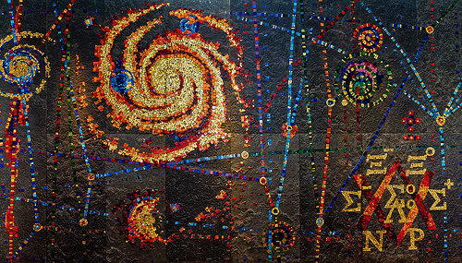
ATLAS Searches for non-SUSY Exotics at the LHC
Vasiliki A. Mitsou
IFIC Valencia
On behalf of the
ATLAS Collaboration
SUSY2014
22nd International Conference on
Supersymmetry and
Unification of Fundamental Interactions
21 - 26 July 2014, Manchester, England

Slide 2
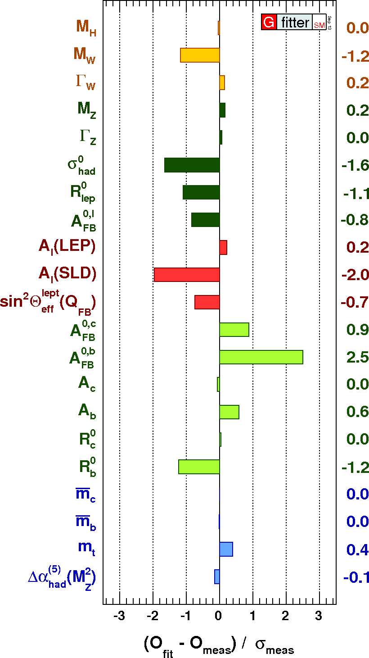
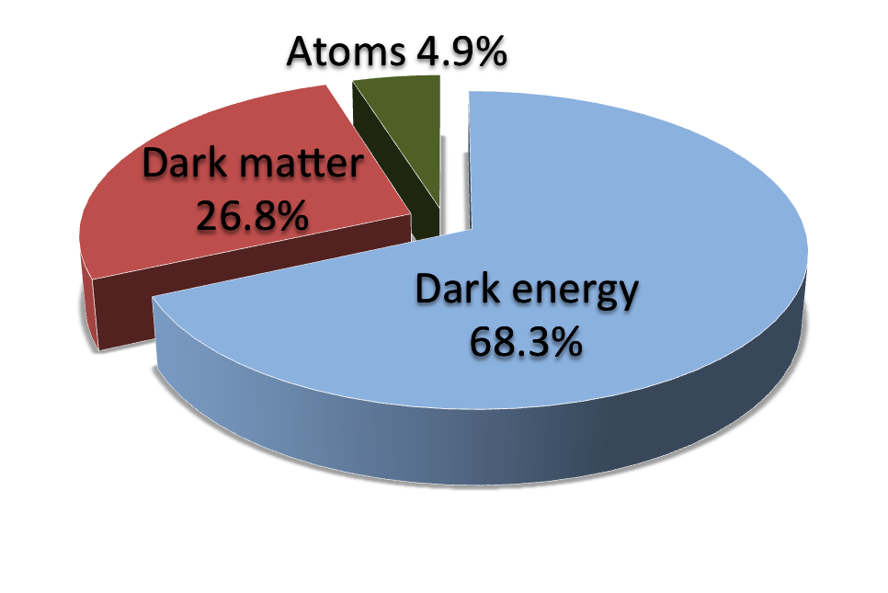
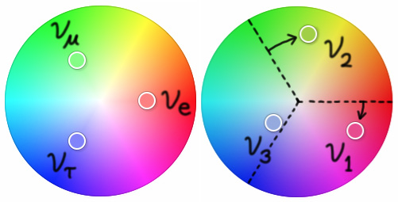
Why going beyond the Standard Model?
SM provides an excellent description of the experimental data so far
  QCD and hadronic structure
  precision EW physics
  top quark
  flavour physics
yet… it does not provide an answer to:
  hierarchy / fine tuning problem
  matter-antimatter asymmetry
  dark matter & dark energy
  neutrino masses
  unification of EW interactions & QCD
  gravitation
  more than one fermion generation
☛ An extension of the Standard Model is needed

Slide 3
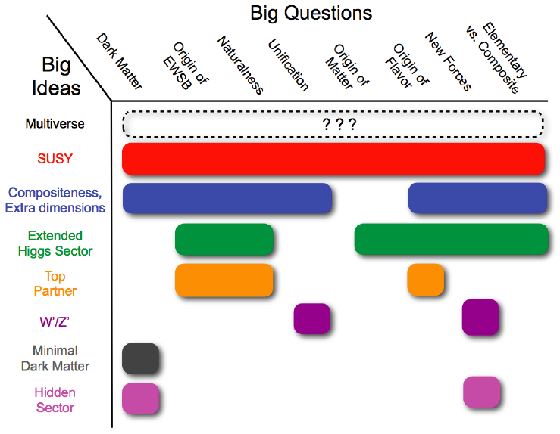
(some) ideas beyond Standard Model
Snowmass 2013 Summary Paper

Slide 4
Signatures probing model predictions
Resonances
  dijets
  dileptons
  W’ → 𝓁ν
  dibosons
  top/bottom
  …
Non-resonant final states
  dileptons
  leptons+jets
  generic searches
  mono-X + E_{T}^{miss}
  …
Long-lived particles
  high ionisation
  unusual energy depositions in calorimeters
  …
Signature-based searches cover multitude of theoretical scenarios
Emphasis given on most recent results here
Christopher Marino’s talk
Jiahang Zhong’s talk
David Salek’s talk

Slide 5
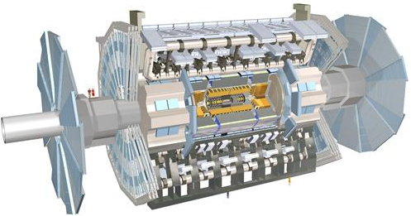

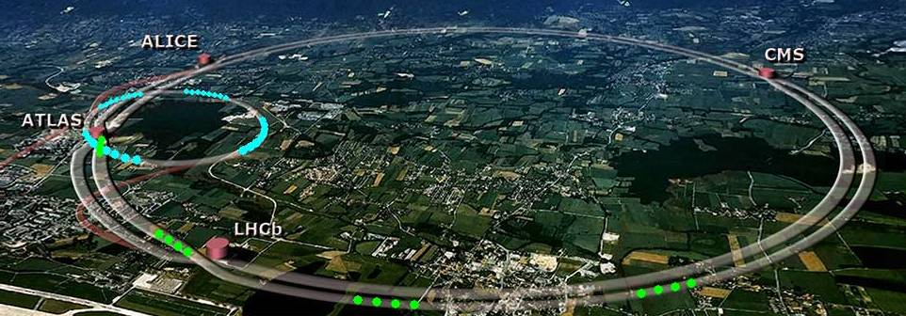
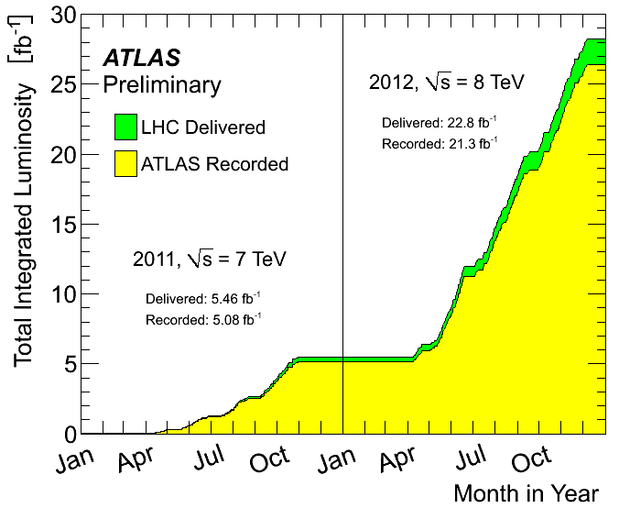
ATLAS at the LHC
Spectacular LHC performance
Run 1: 2010 – 2012
  ~5 fb⁻¹ pp collisions at √s = 7 TeV
  ~20 fb⁻¹ pp collisions at √s = 8 TeV
Physics run will resume in 2015
with 13‐14 TeV collisions

Slide 6
Beyond SM searches strategy
Pursue signature-driven analyses:
  resonances: dileptons, jets, photons, ...
  tails in kinematic distributions
  special particles: slow-moving, long-lived, ...
  ...
Search for excess of events over the expected SM background
If no significant excess is observed
  set cross-section upper limits
  interpret in specific models to obtain limits on masses, couplings, ...
☛ Background estimate: data-driven techniques for main; MC for smaller
☛ Blind analysis: first define and validate analysis, then open signal box

Slide 7
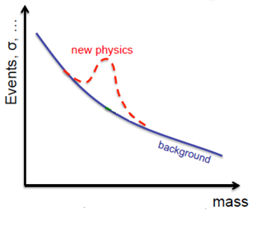
Looking for resonances
Dijets [arXiv:1407.1376]
Dileptons [arXiv:1405.4123]
X → HH → bb̄bb̄b[ATLAS-CONF-2014-005]
ZV → 𝓁𝓁qq̄ [ATLAS-CONF-2014-039]
WZ → 𝓁ν𝓁’𝓁’ [arXiv:1406.4456]
leptonic W/Z + γ
[to be published soon in PLB]
Top/bottom resonances

Slide 8

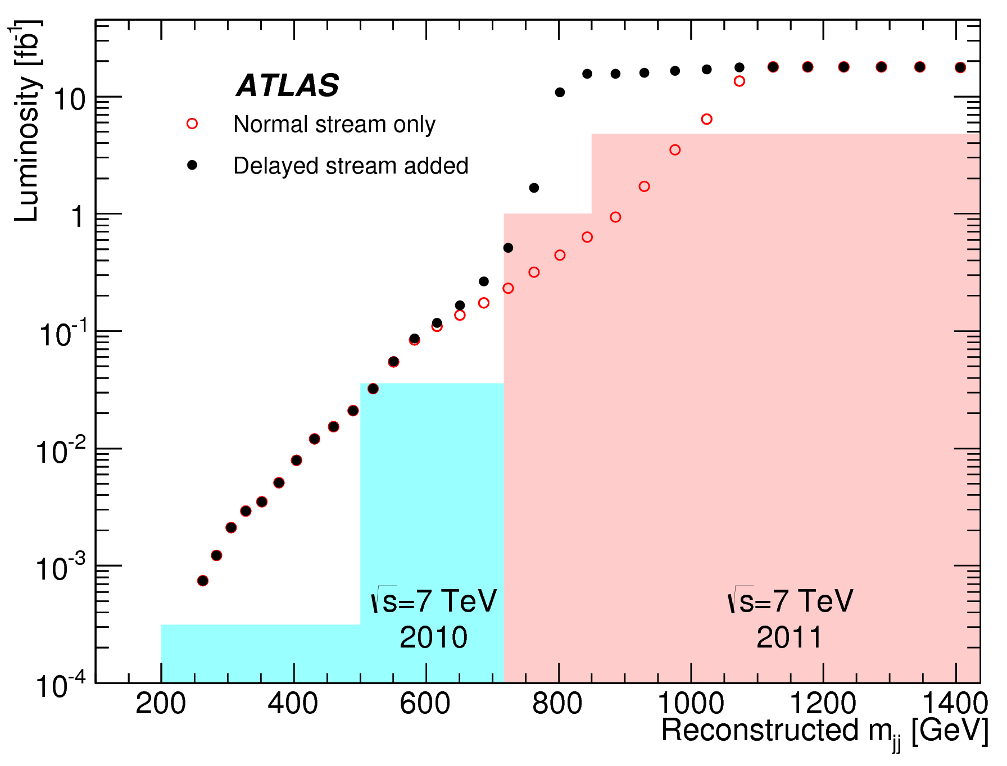
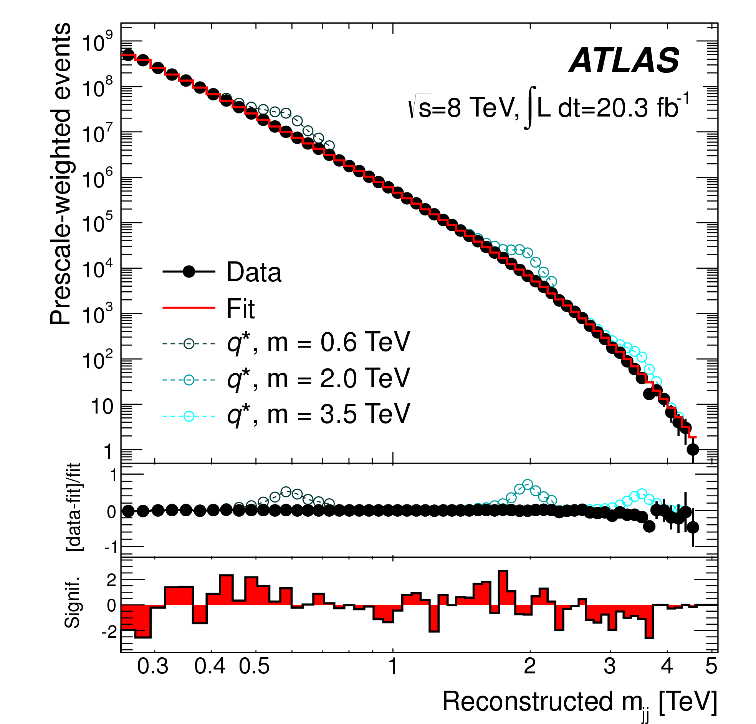
Resonance in dijet distribution
Large statistics, yet high background level (QCD)
New: data sample enriched by data recorded yet reconstructed later (‘delayed stream’)
  increased statistics at 0.75 < m_{jj} < 1.0 TeV
Event selection
  combination of single-jet triggers
  only good-quality jets
  at least 2 jets with p_{T} > 50 GeV & |y|< 2.8
  ½|y₁-y₂| < 0.6 & m_{jj} > 250 GeV
Looking for bump above phenomenological
fit of the data
  dijet mass resolution 8% (4%)
  at 200 GeV (> 2 TeV)
➡ No resonance-like features observed up to dijet masses of 4.5 TeV
20.3 fb⁻¹ @ 8 TeV
arXiv:1407.1376

Slide 9
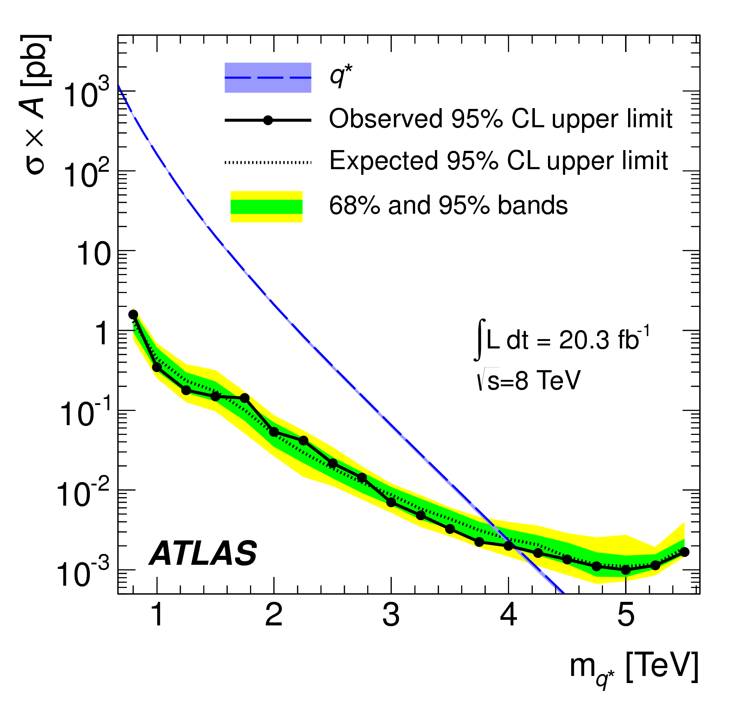
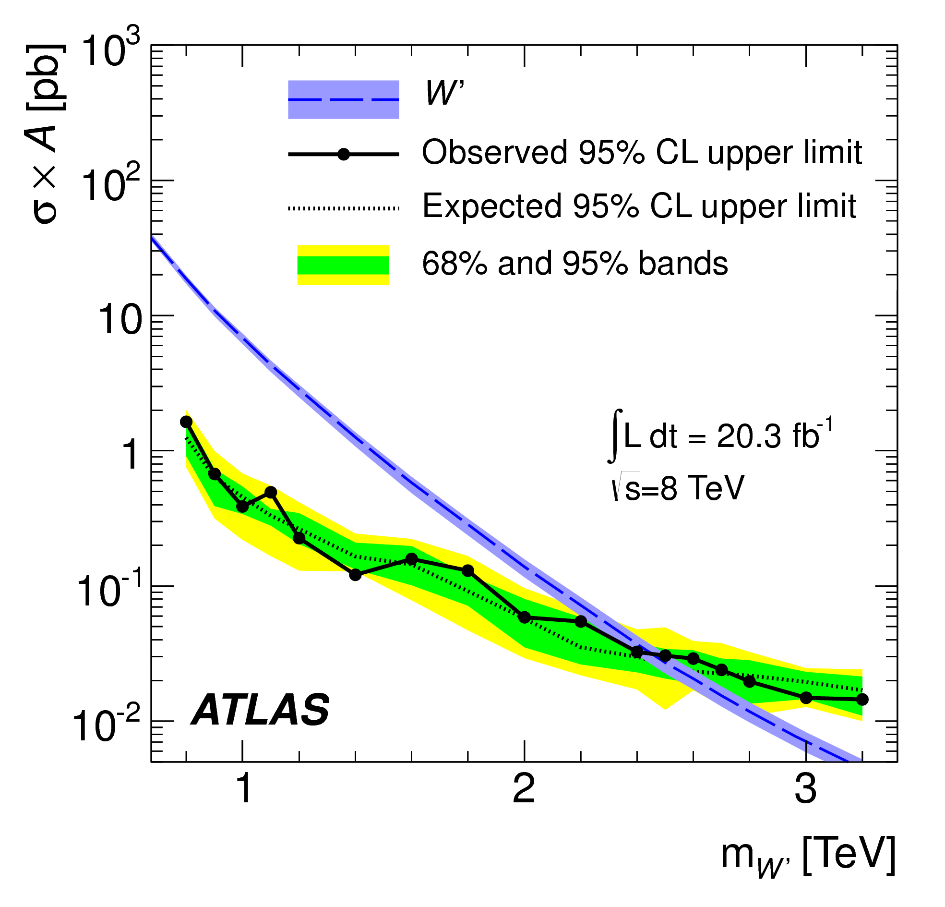
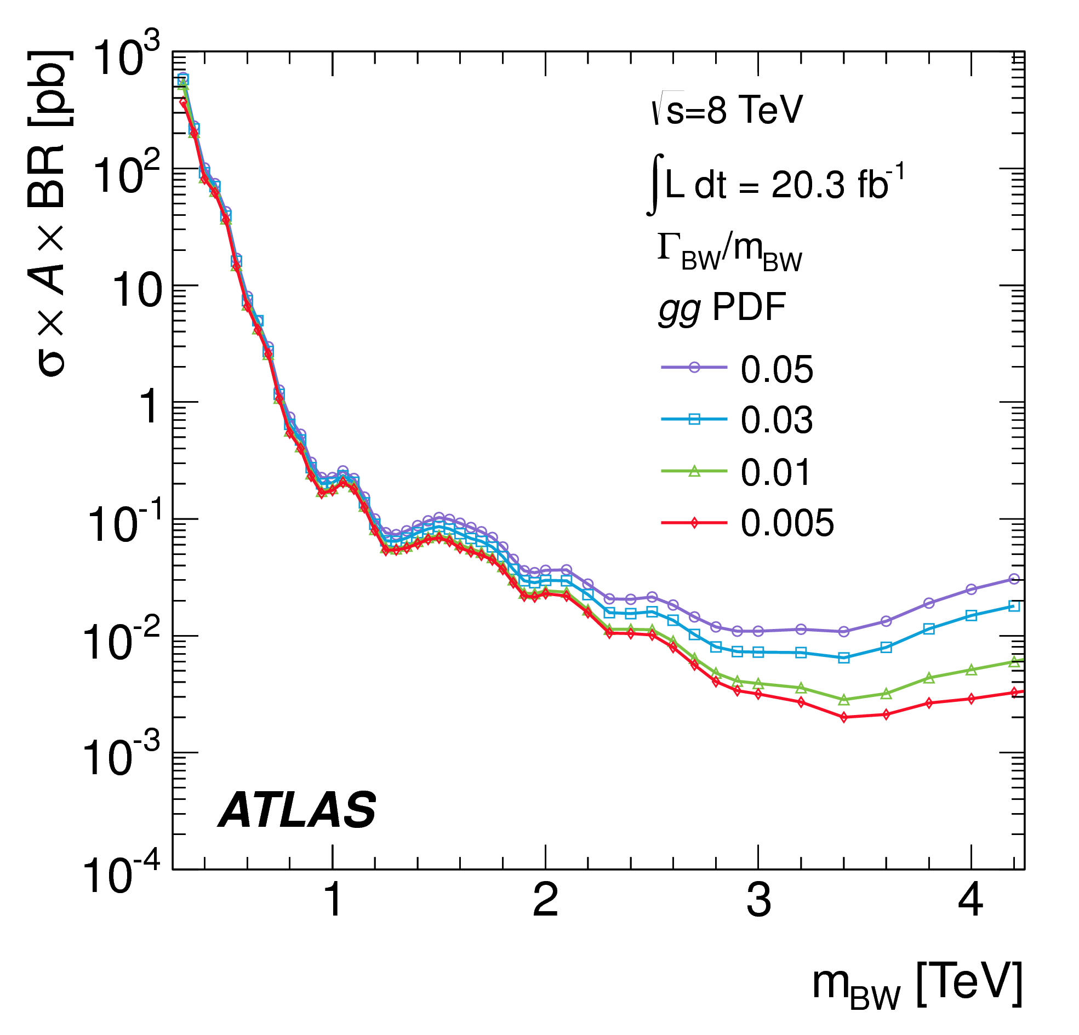
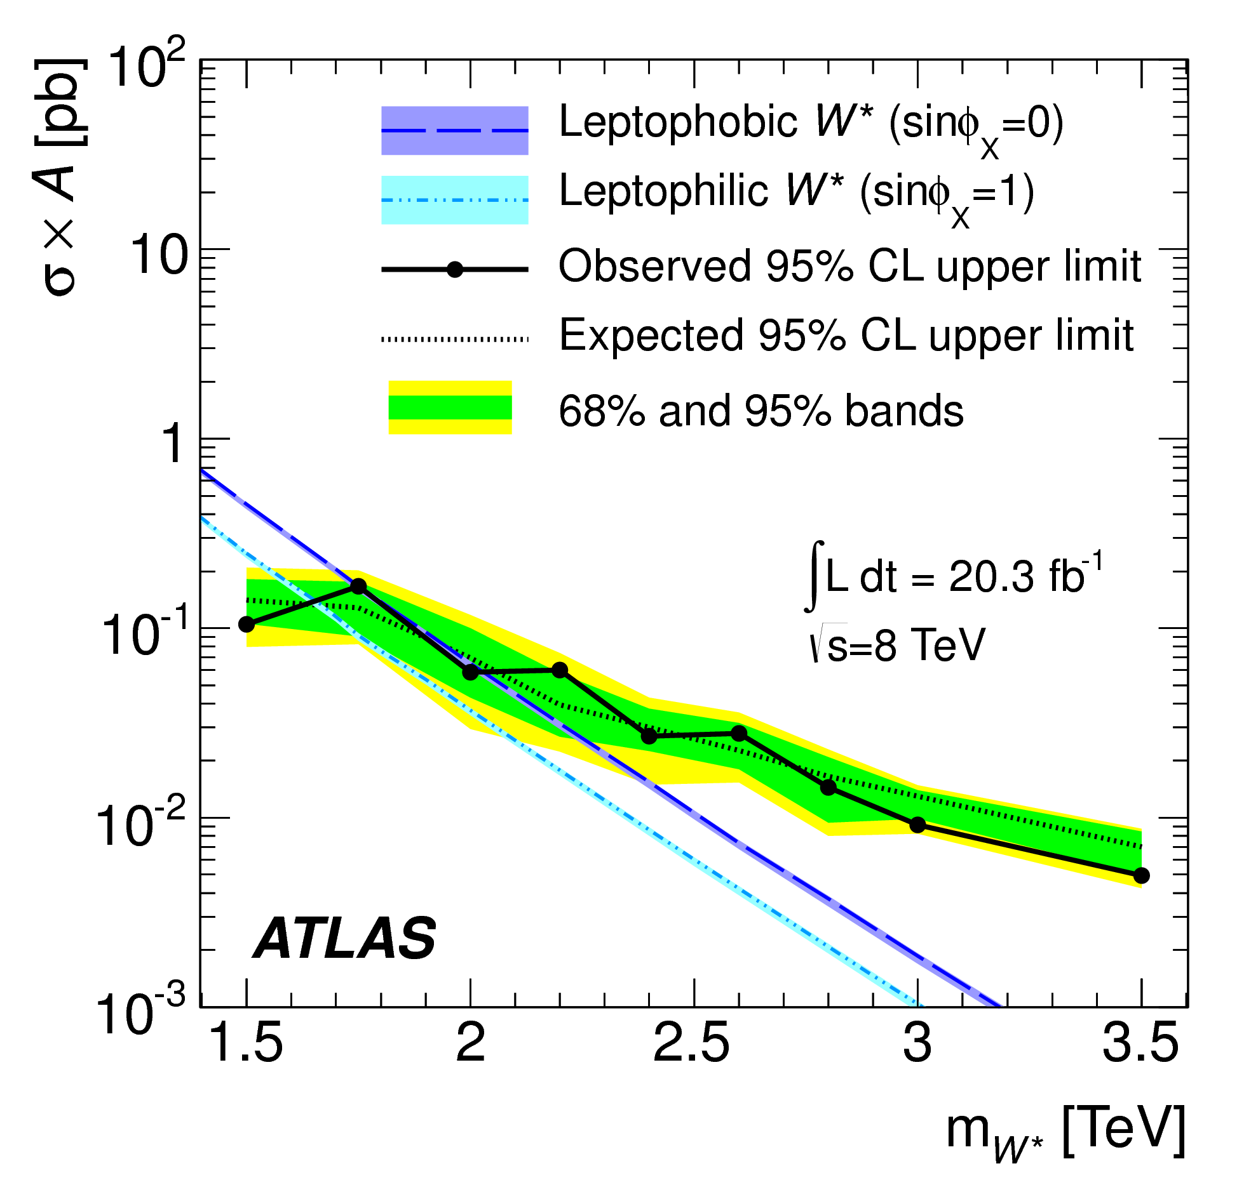
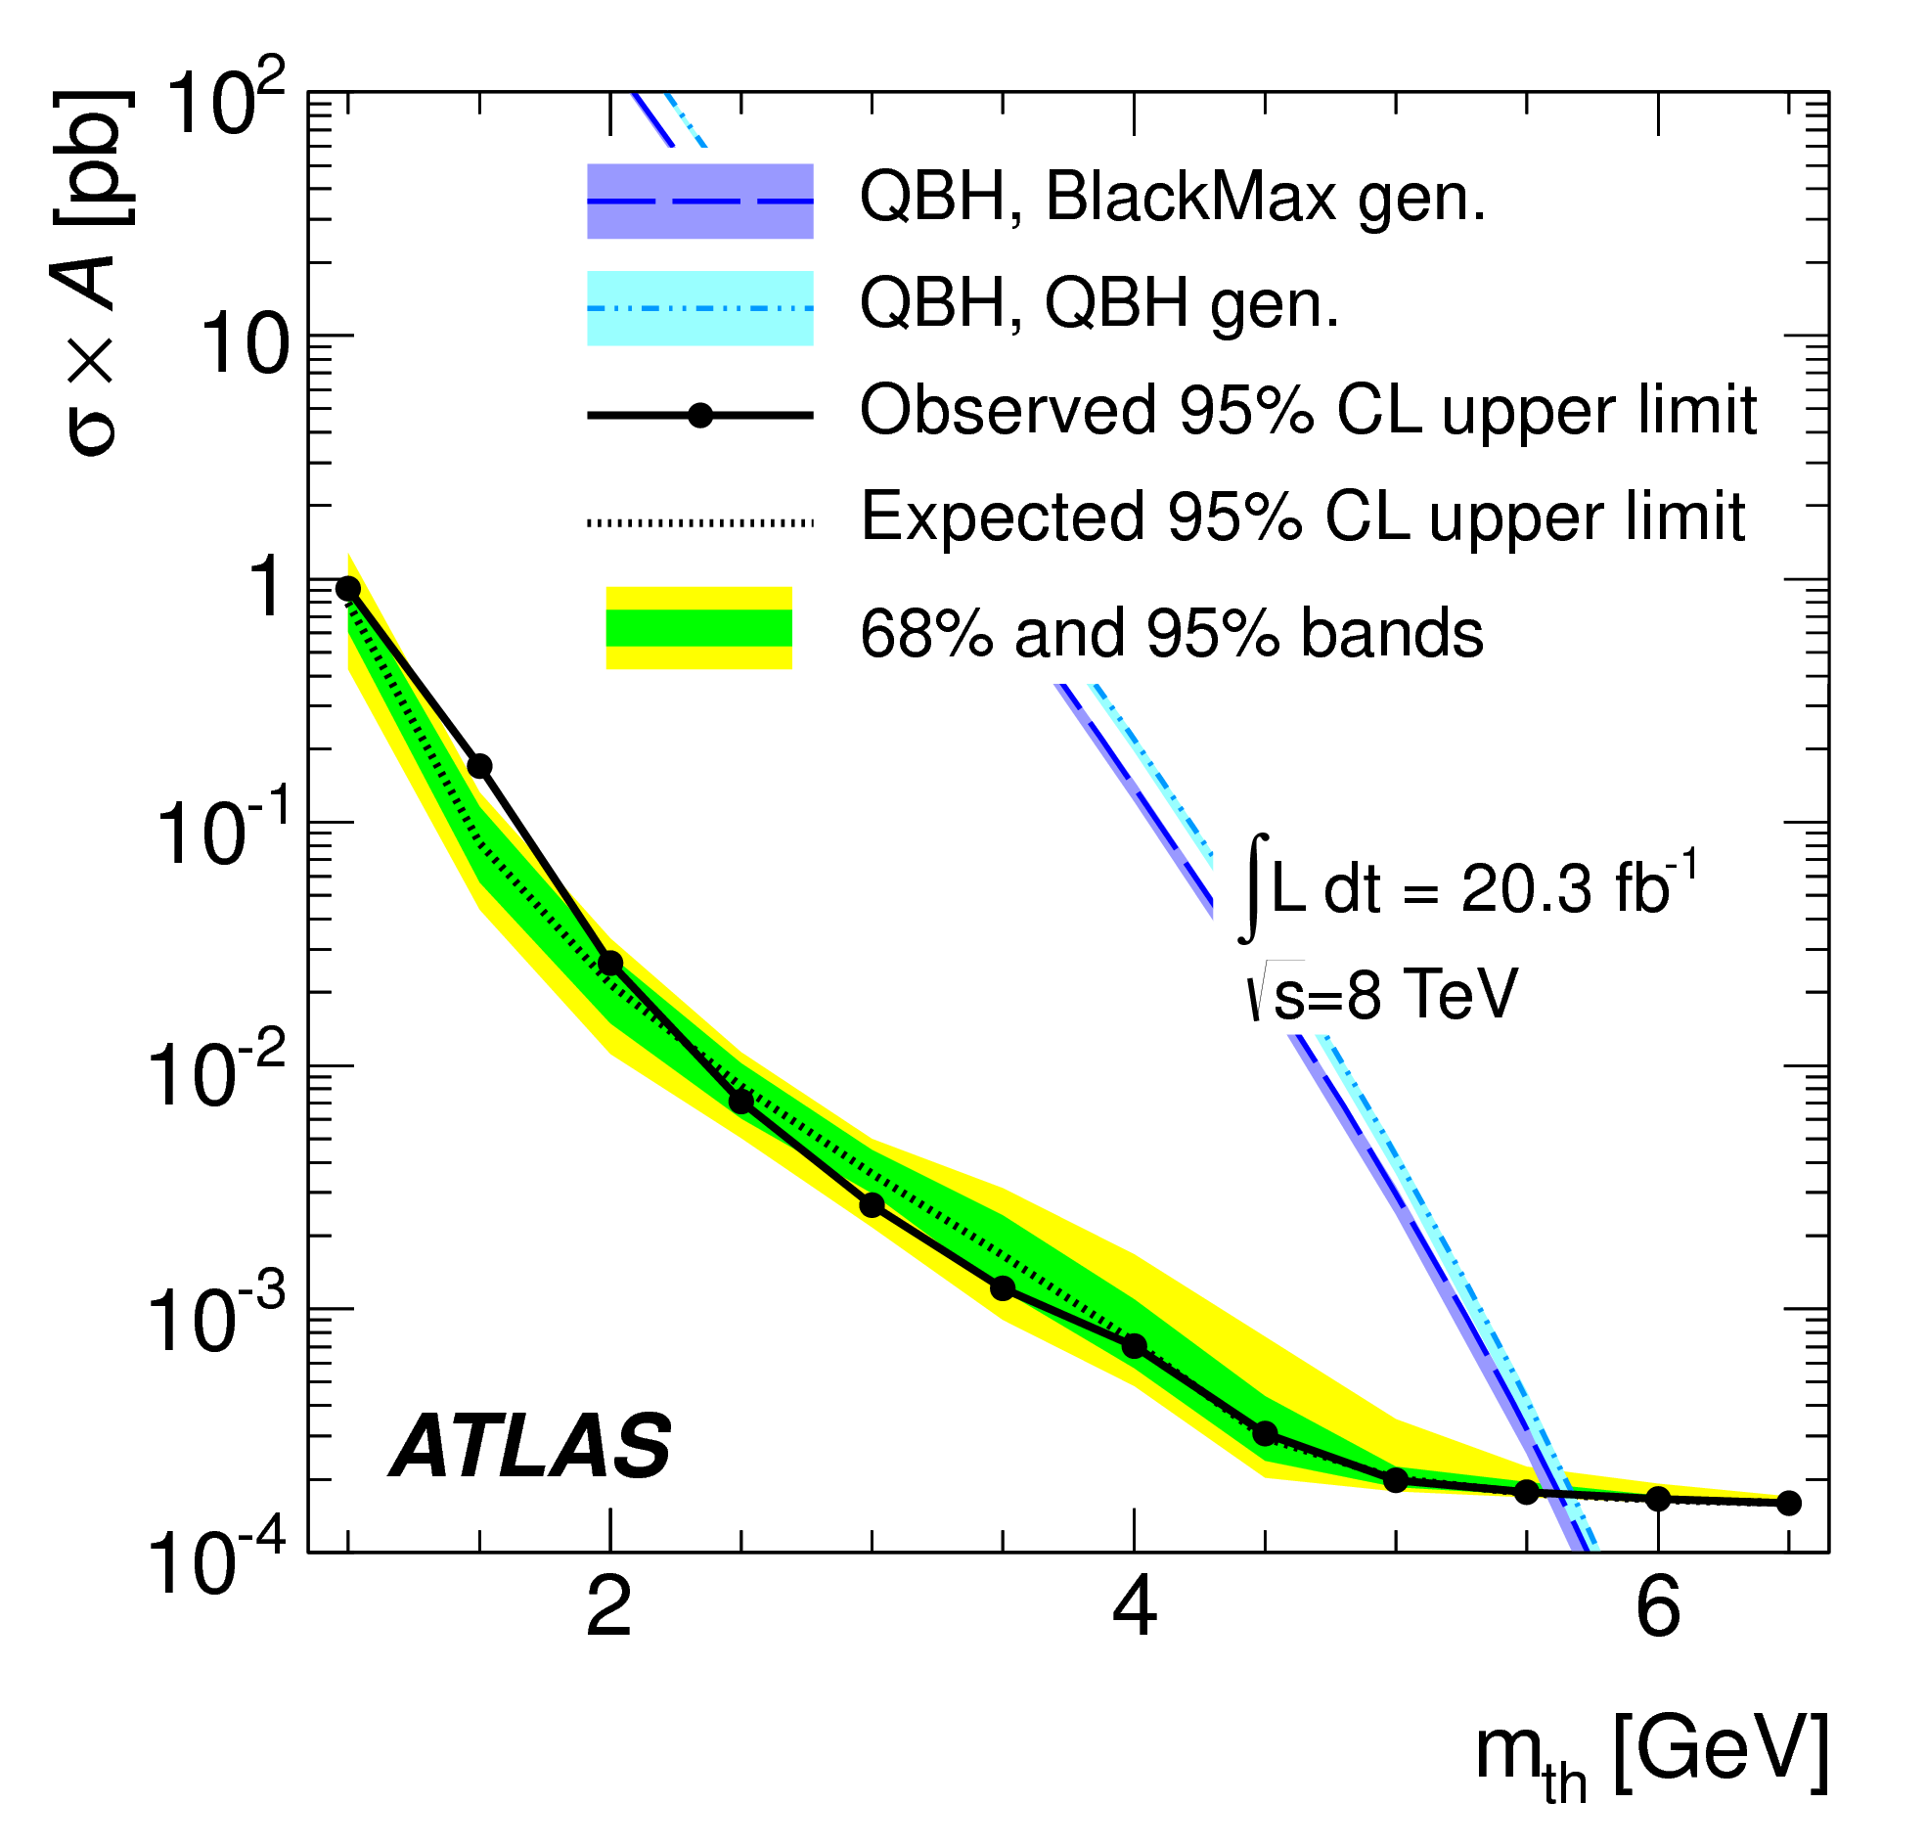
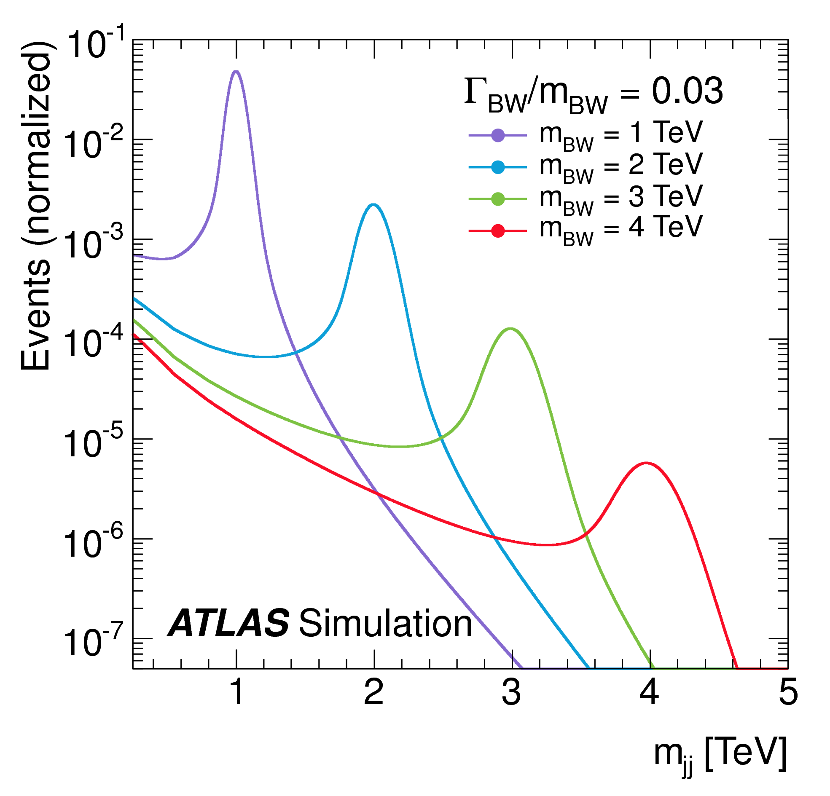
Dijets: interpretation
20.3 fb⁻¹ @ 8 TeV
gg to Breit-Wigner resonance decaying to dijets
excited quarks q* → qg
heavy vector bosons W’ → q̄q’
excited vector bosons W*
quantum black holes
arXiv:1407.1376

Slide 10
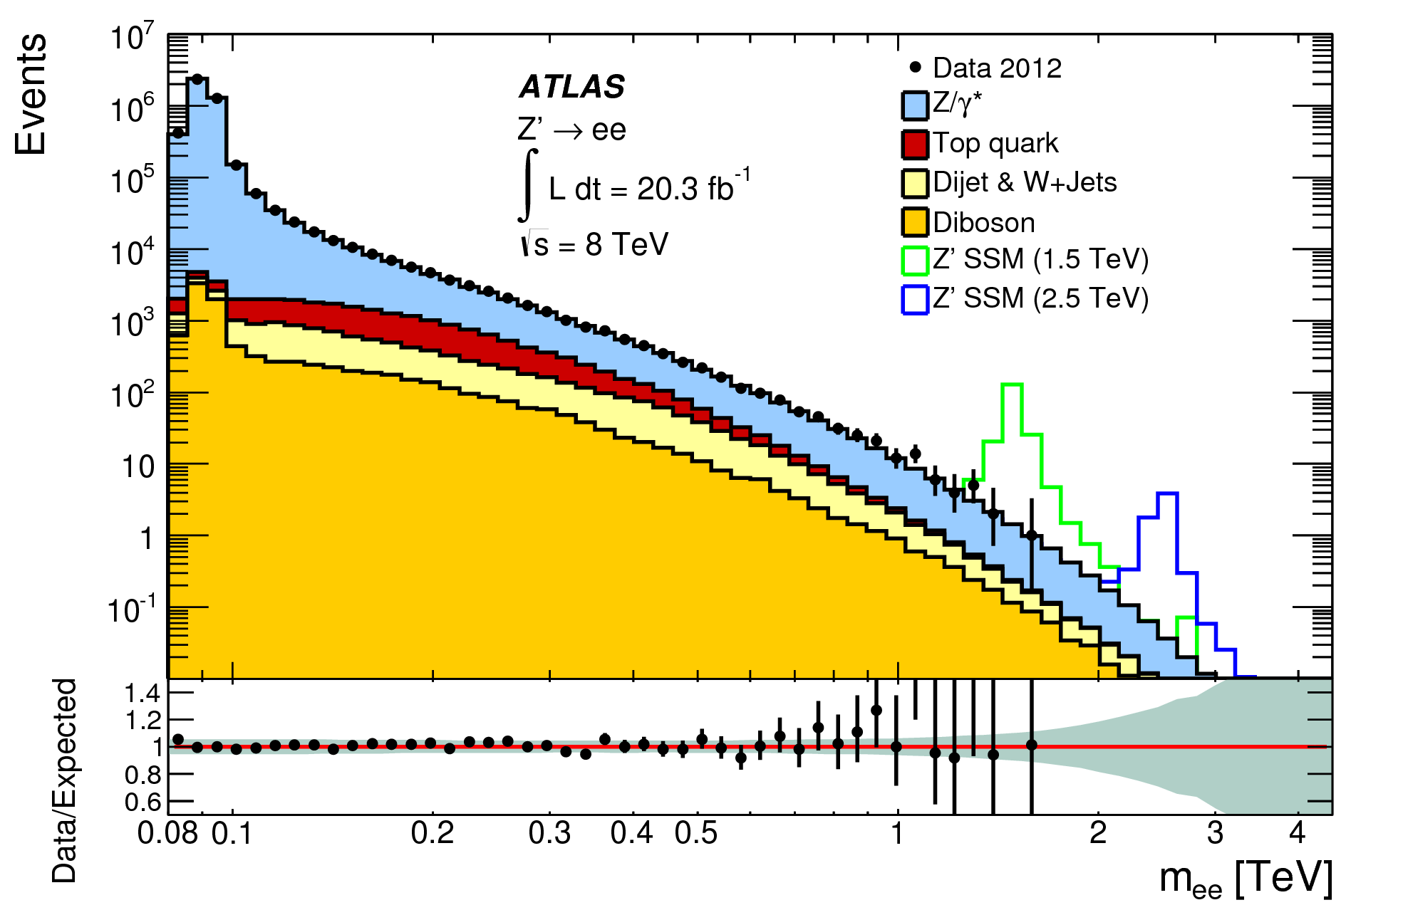
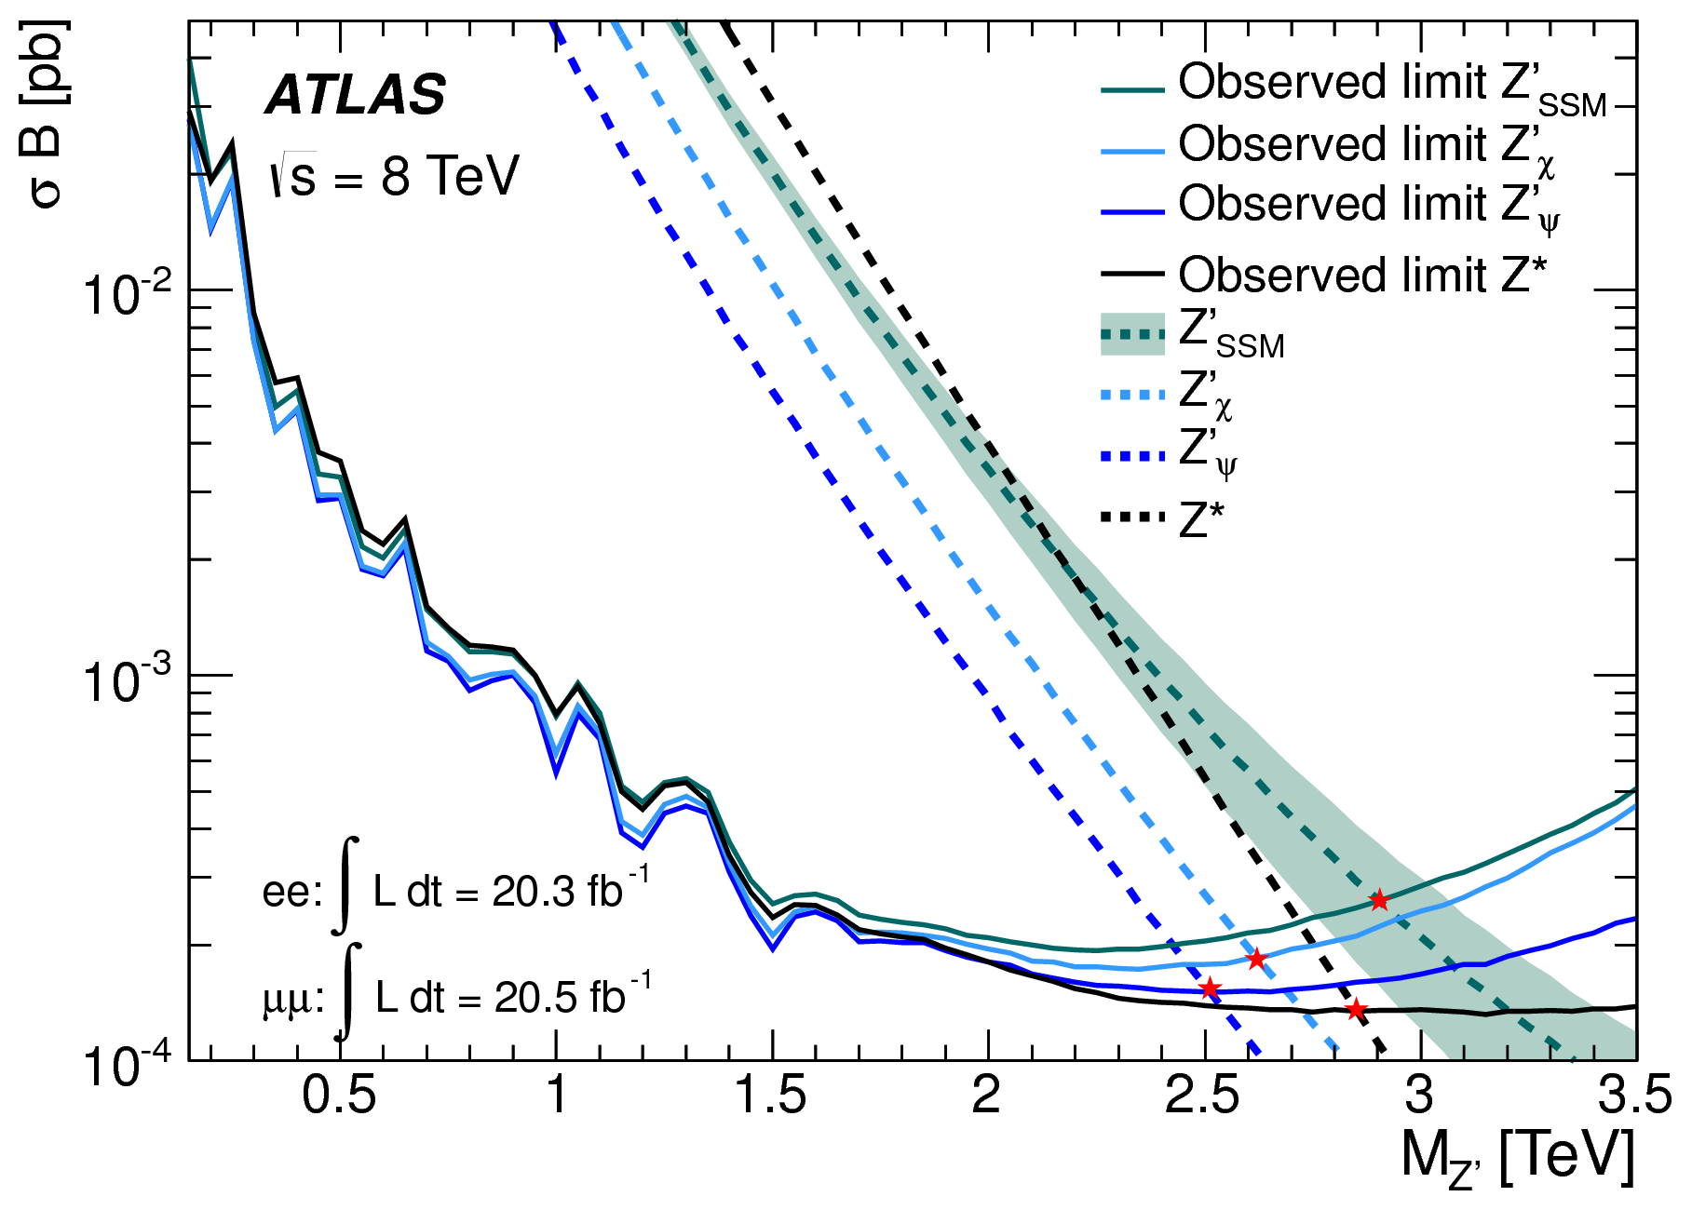
Dilepton resonance
Selection
  2 electrons with E_{T} > 40, 30 GeV
  OR 2 muons with p_{T} > 25 GeV
Background
  Drell-Yan, diboson, photon-induced, top and jets (fake rate from data)
  total MC background scaled to data at Z-peak
Data consistent with SM processes
Interpretation on various models
  SSM Z’; minimal Z’, E₆-motivated Z’_{ψ} and Z’_{χ}
  chiral excited Z (Z*)
  Randall-Sundrum graviton G*
  Quantum Black Holes in ADD
  extra dimension model
  Minimal Walking Technicolor
20.3 fb⁻¹ (e), 20.5 fb⁻¹ (μ) @ 8 TeV
arXiv:1405.4123

Slide 11
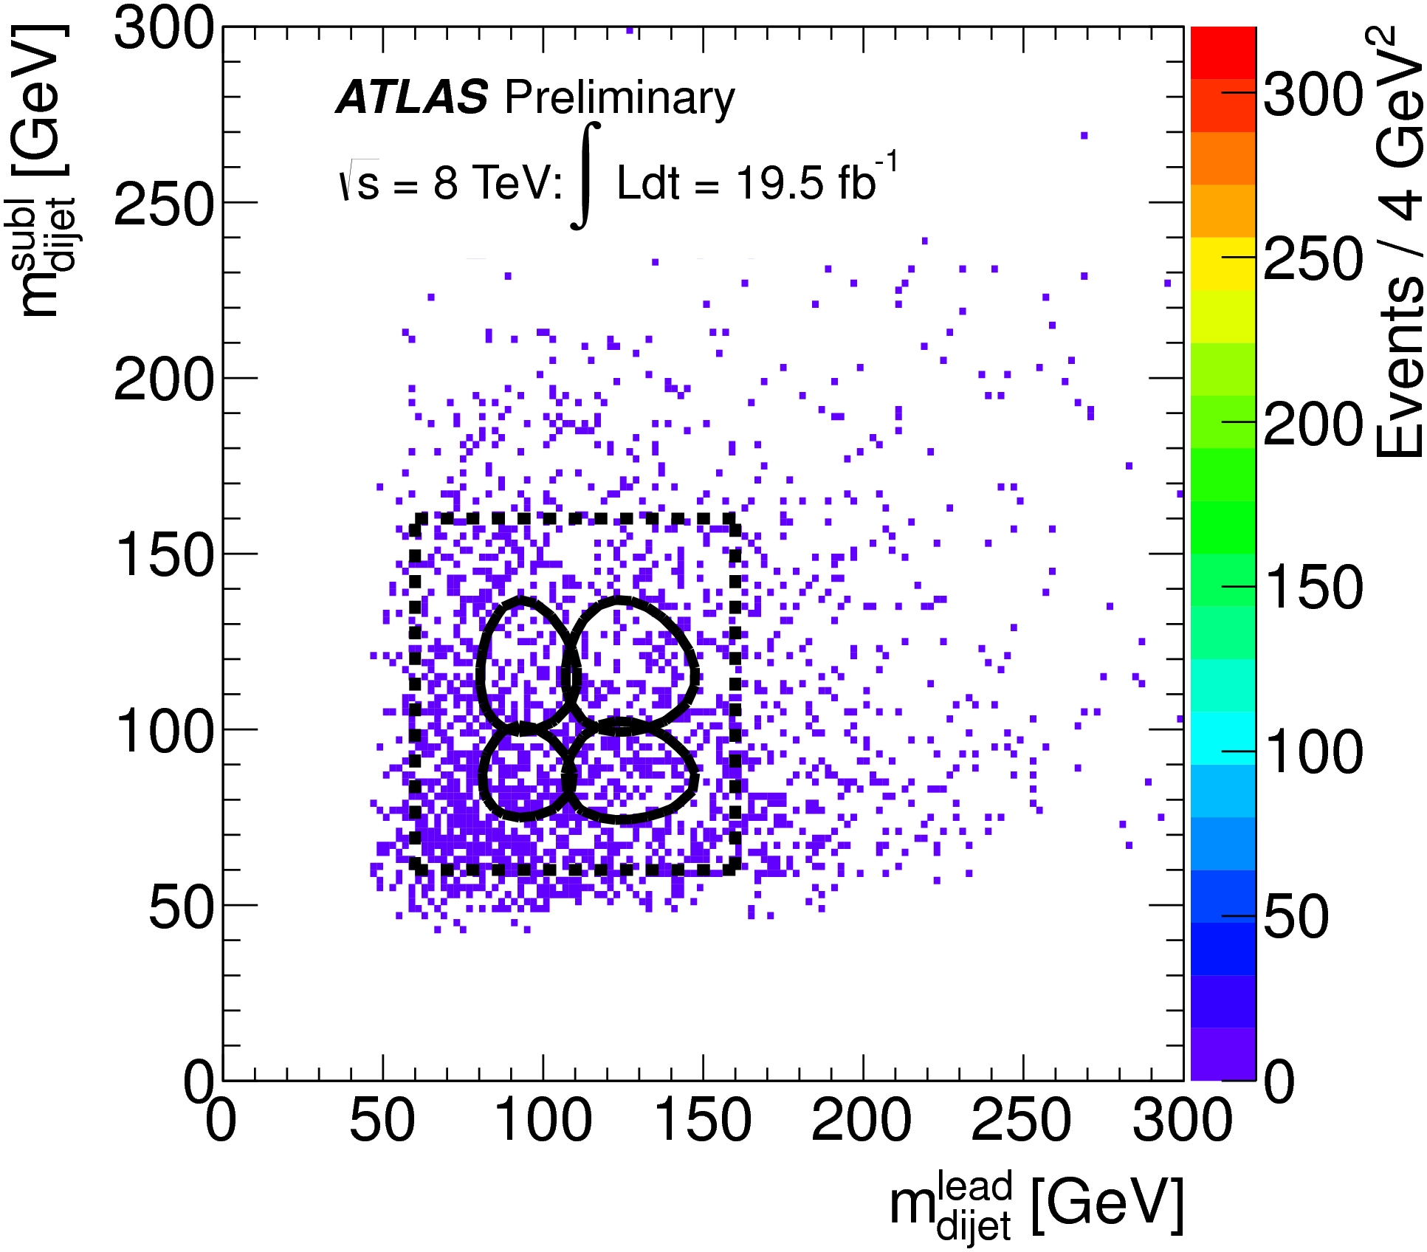
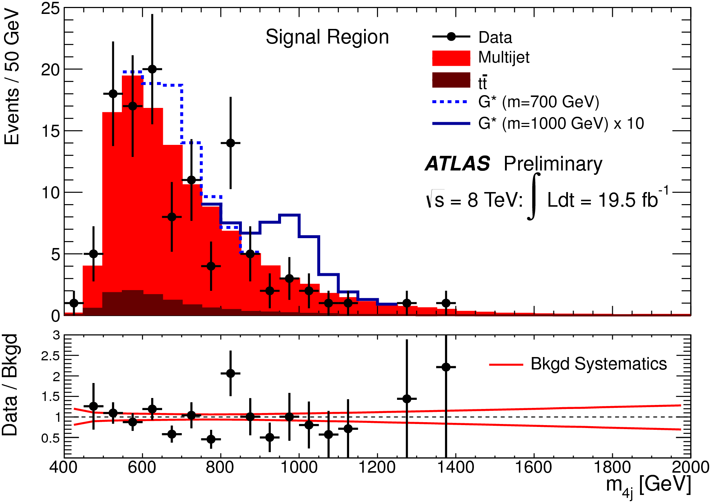
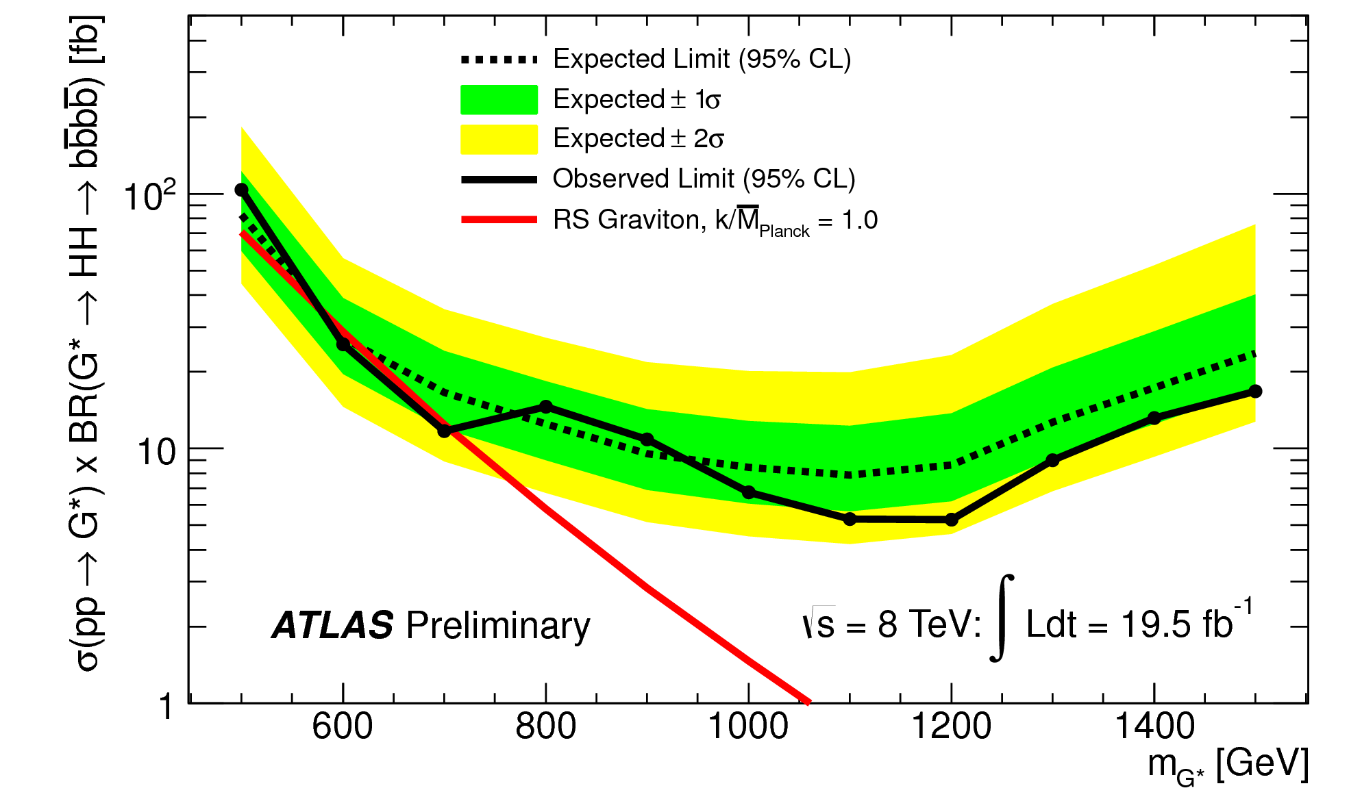
Diboson resonance: X → HH → bb̄bb̄b
Event selection
  four b-tagged jets, each with p_{T} > 40 GeV
  2 nearby (ΔR<1.5) tagged bb̄ pairs with
  p_{T}(dijet) > 200 GeV & m_{dijet} near Higgs mass
  “tt̄ veto”
  elliptical signal region (HH)
Multijets background
estimated by side band
Data compatible
with
SM hypothesis
Limits set on bulk RS graviton G*
(first KK excitation)
  Br(G*→HH) ≃ 7%
Side band
HH
ZZ
ZH
19.5 fb⁻¹ @ 8 TeV
ATLAS-CONF-2014-005

Slide 12
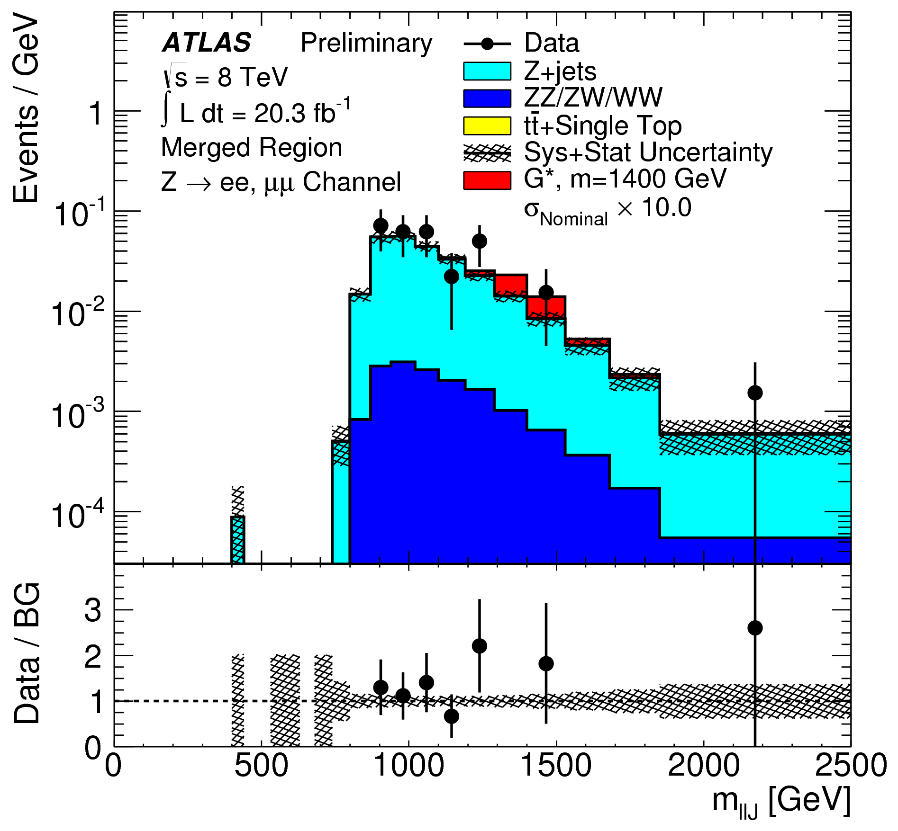
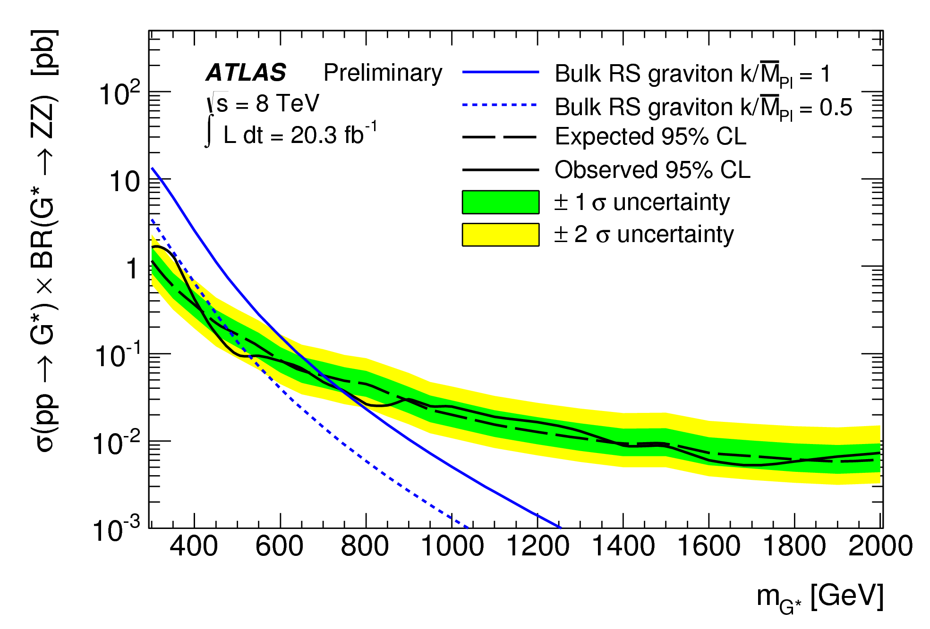
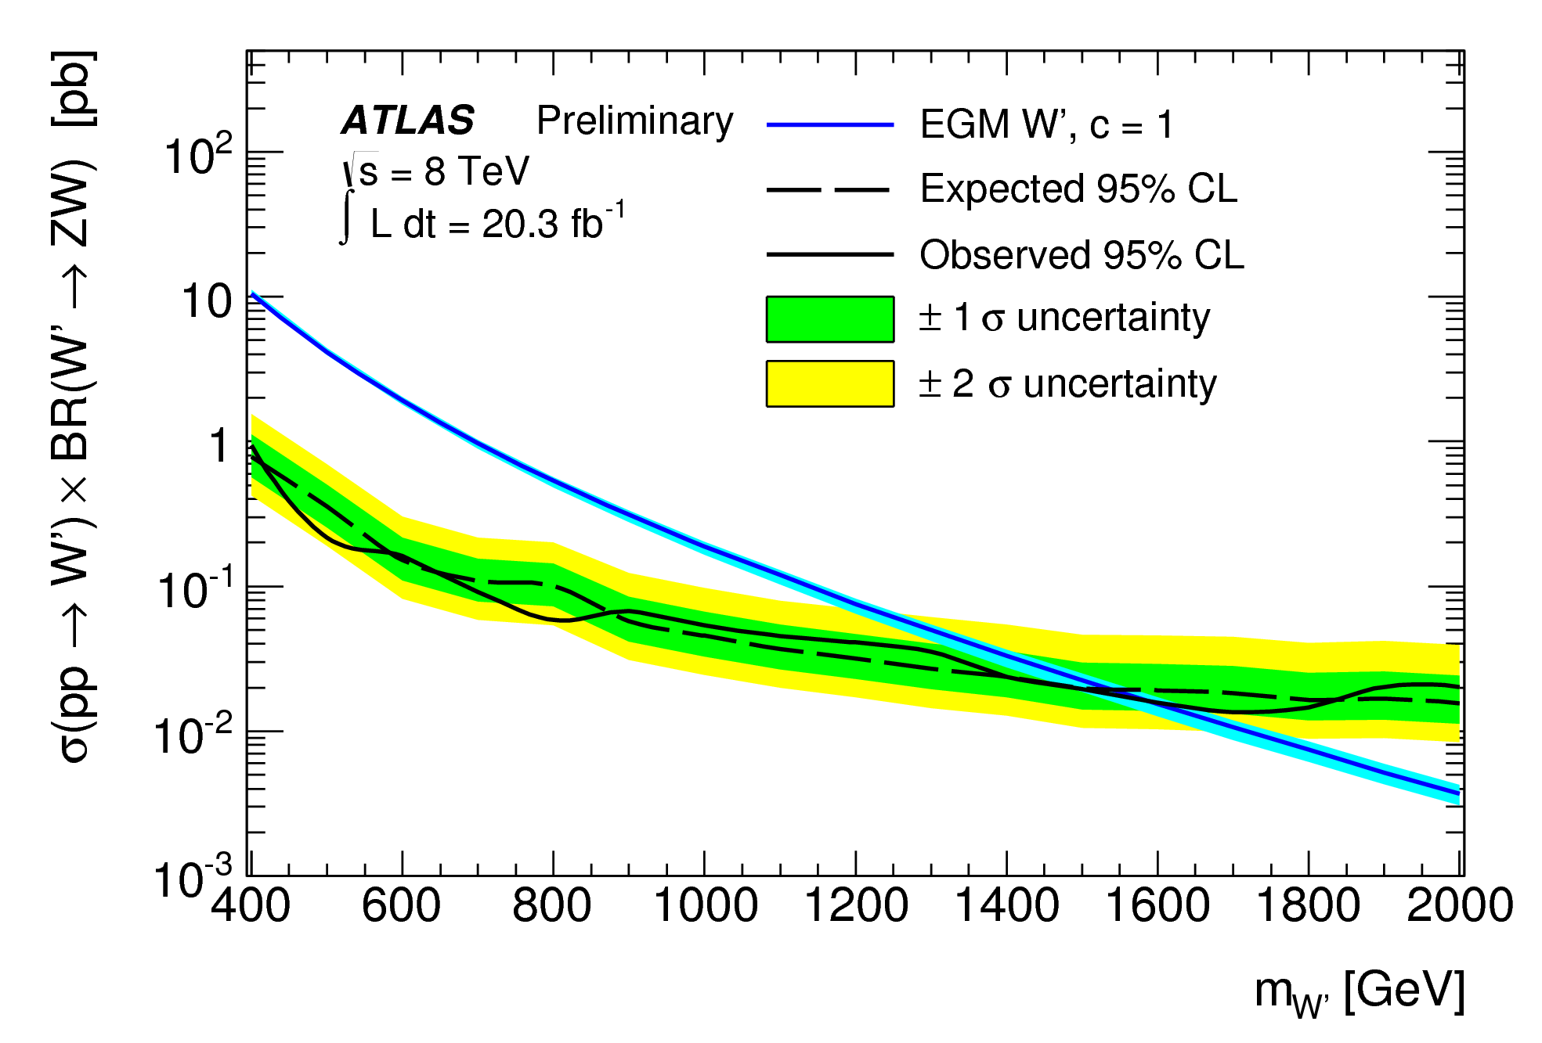
Diboson resonance: ZV → 𝓁𝓁qq̄
Allows full reconstruction of invariant mass X → ZV
Consider both resolved (jj) and “merged” (J)
–if highly boosted– dijet system
  jet substructure information optimised for longitudinally polarised high-p_{T} boson
Search for bump in m(𝓁𝓁jj) or m(𝓁𝓁J) distributions
ATLAS-CONF-2014-039
20.3 fb⁻¹ @ 8 TeV
extended bulk RS
spin-2 KK graviton G* → ZZ
Extended Gauge Model
W’ → ZW

Slide 13
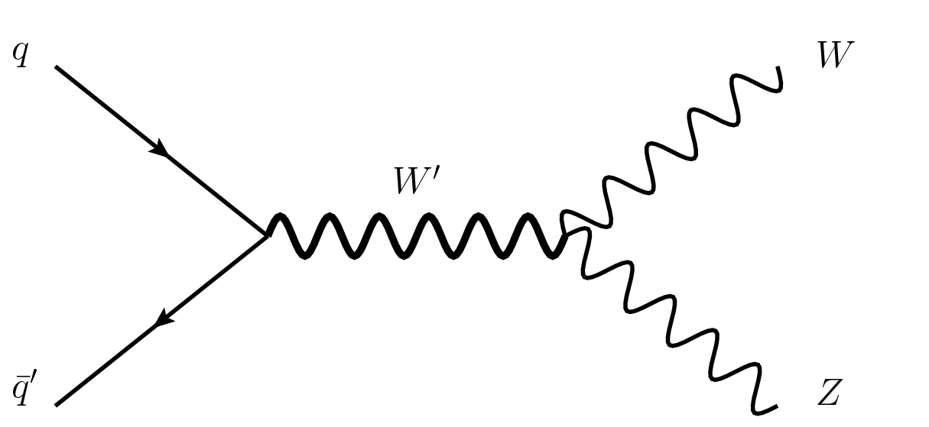
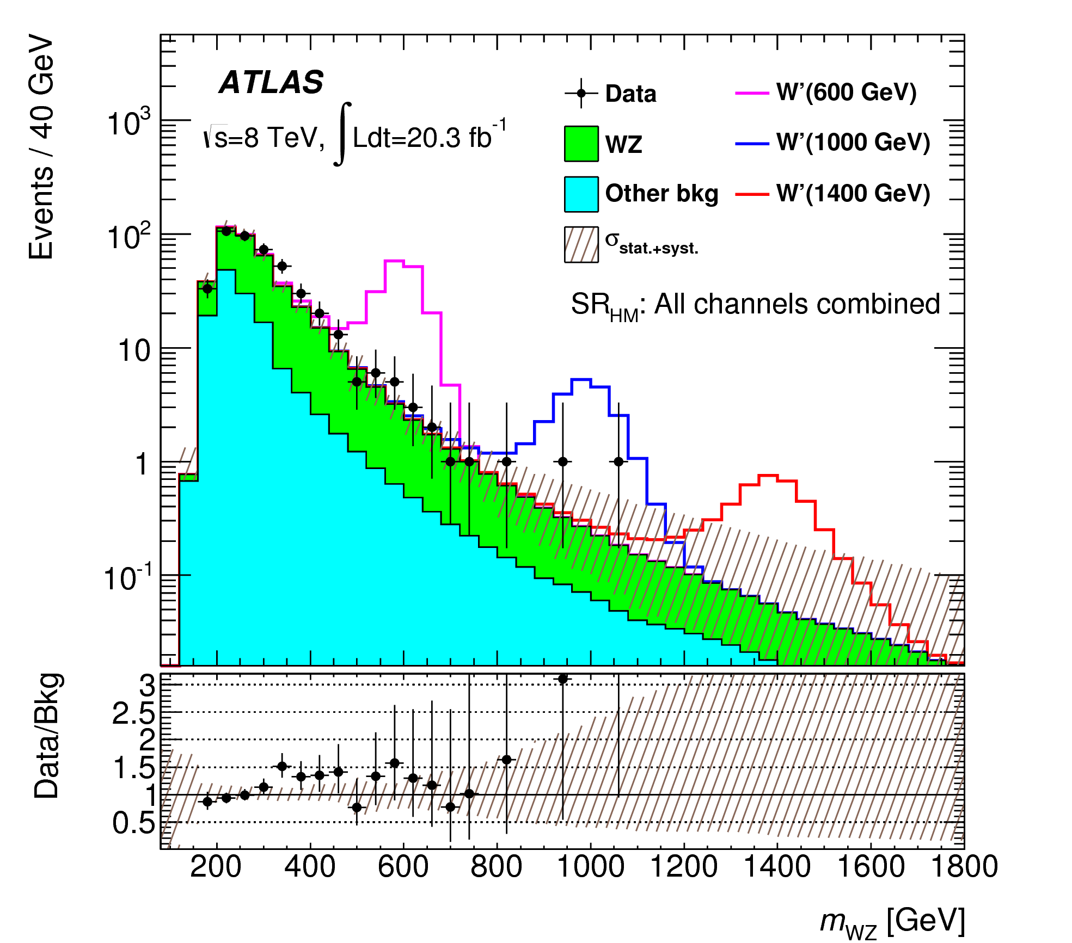
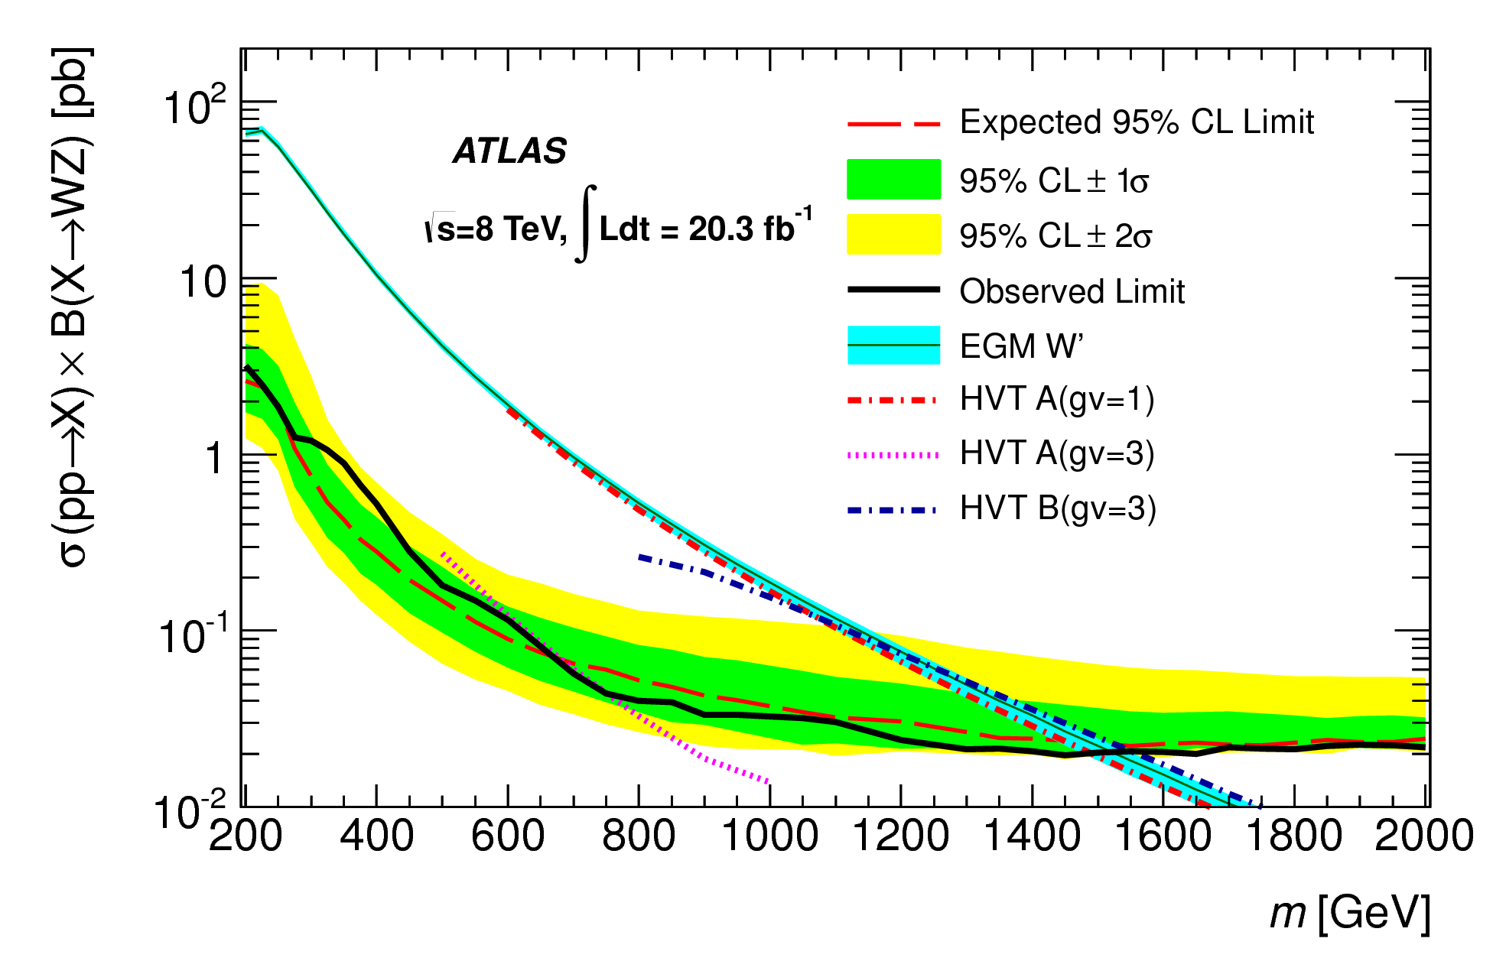
Diboson resonance: WZ → 𝓁ν𝓁’𝓁’
Fully leptonic channel ➜
good sensitivity due to
smaller background
compared to other channels
Event selection
  exactly 3 charged leptons with p_{T} > 25 GeV
  E_{T}^{miss} > 25 GeV
  |m_{𝓁+𝓁-} – m_{Z}| < 20 GeV
  Δy(W,Z) < 1.5
  Δφ(𝓁,E_{T}^{miss}) < 1.5 (> 1.5) for high (low) W’ mass
No excess of events over SM expectation seen
Interpretation
  Extended Gauge Model (EGM) with W′ boson
  phenomenological Lagrangian for Heavy Vector Triplet (HVT) ➜ limits on couplings
20.3 fb⁻¹ @ 8 TeV
arXiv:1406.4456

Slide 14
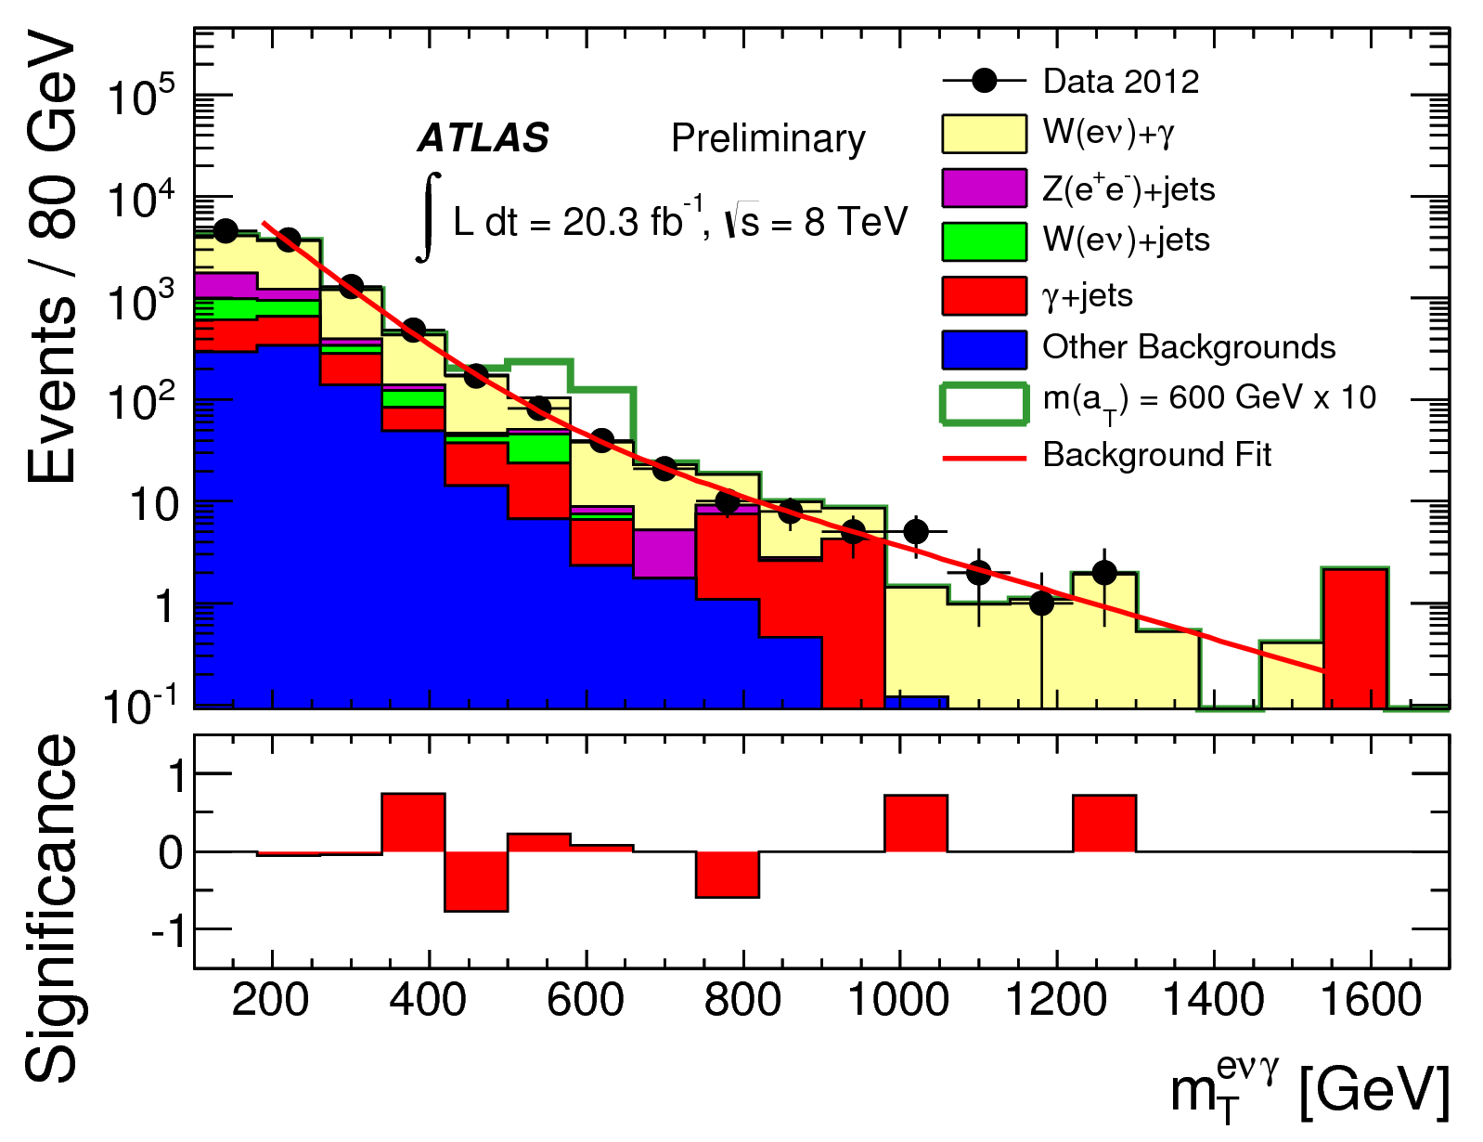
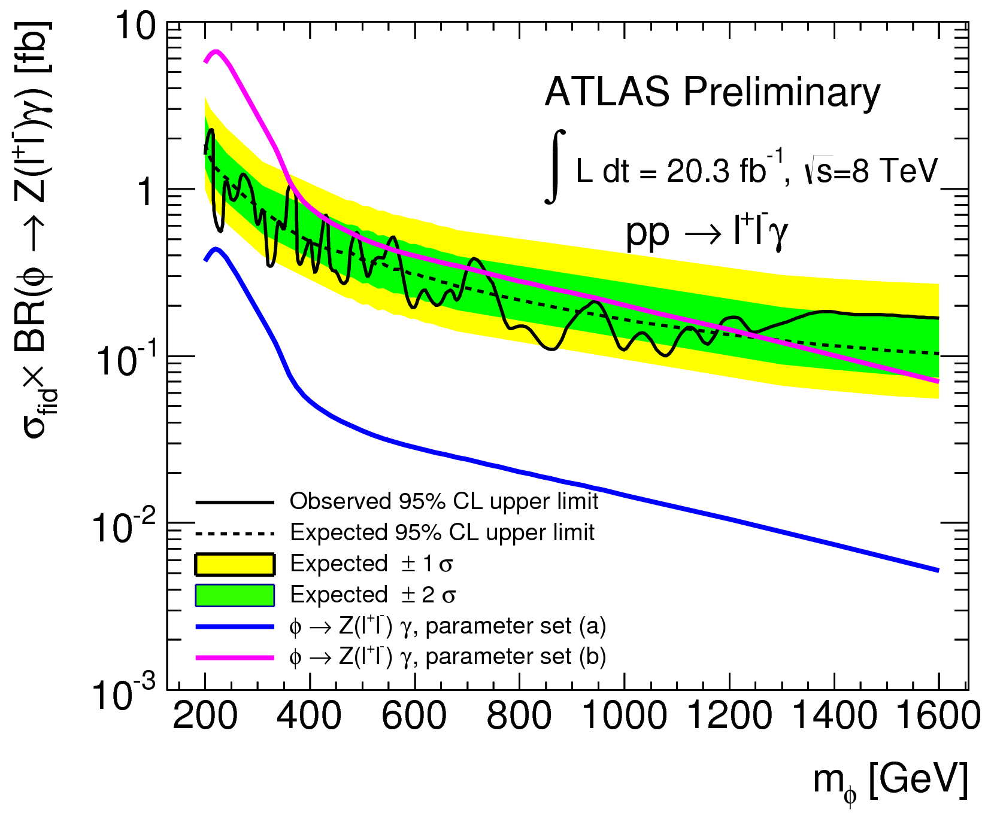
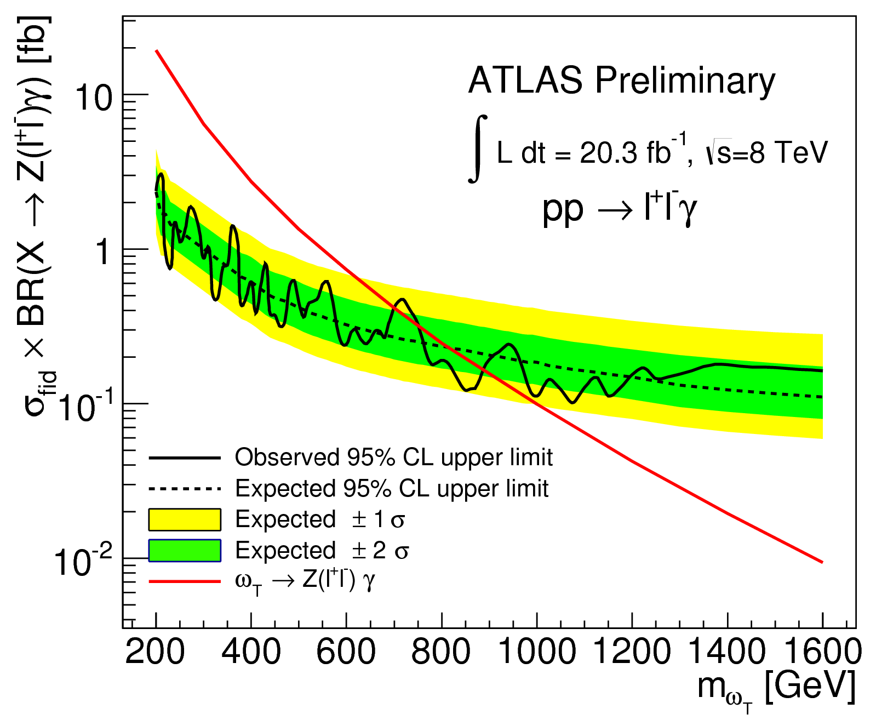
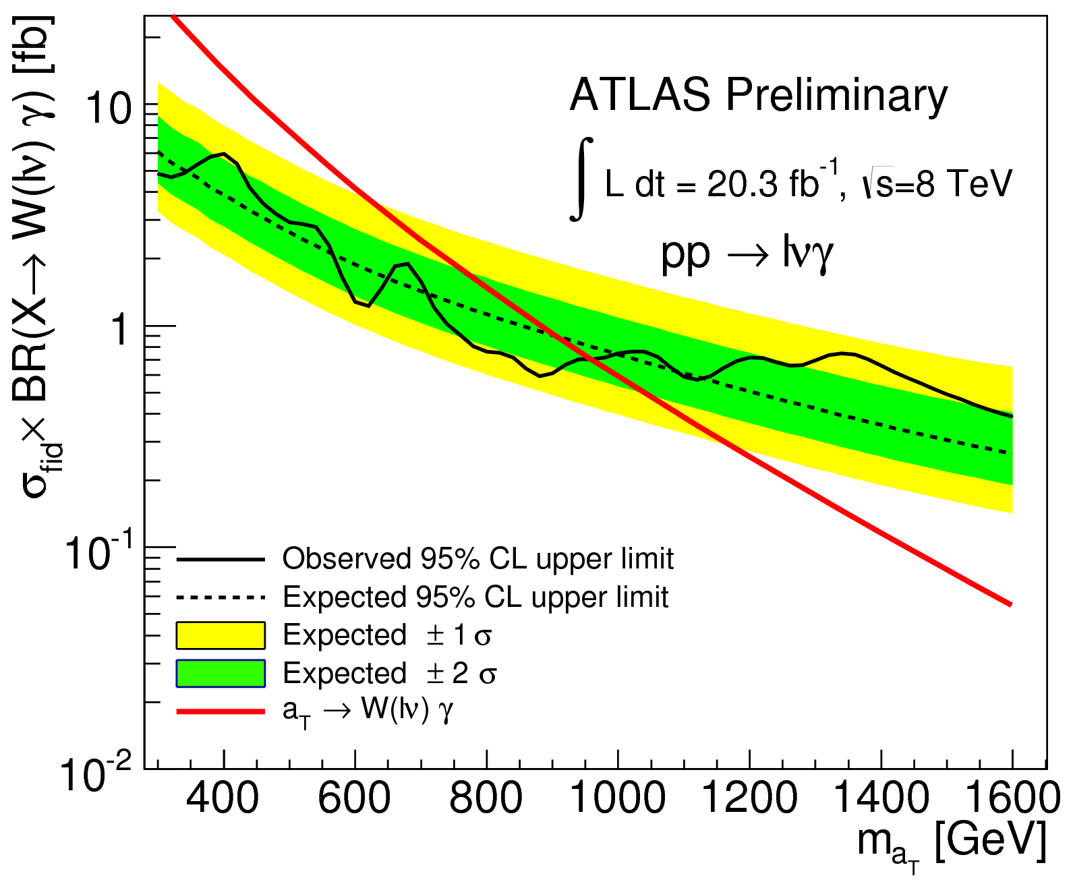
Diboson resonance: leptonic Vγ
Results to be published soon in PLB
Wγ → ℓνγ, Zγ → ℓℓγ
Event selection
  1 (or 2) isolated e/μ with p_{T} > 25 GeV
  1 isolated photon E_{T} > 40 GeV, ΔR(𝓁γ) > 0.7
  Wγ: E_{Τ}^{miss} > 35 GeV, p_{T}(𝓁ν) > 40 GeV
  Zγ: 65 < m(𝓁𝓁) < 115 GeV
Background
  Zγ, Wγ, Z+jets, W+jets, γ+jets
20.3 fb⁻¹ @ 8 TeV
Composite Scalar Model
spin-0 φ → Zγ
Low Scale Technicolor
spin-1 ω_{Τ} → Zγ
Low Scale Technicolor
spin-1 α_{Τ} → Wγ

Slide 15
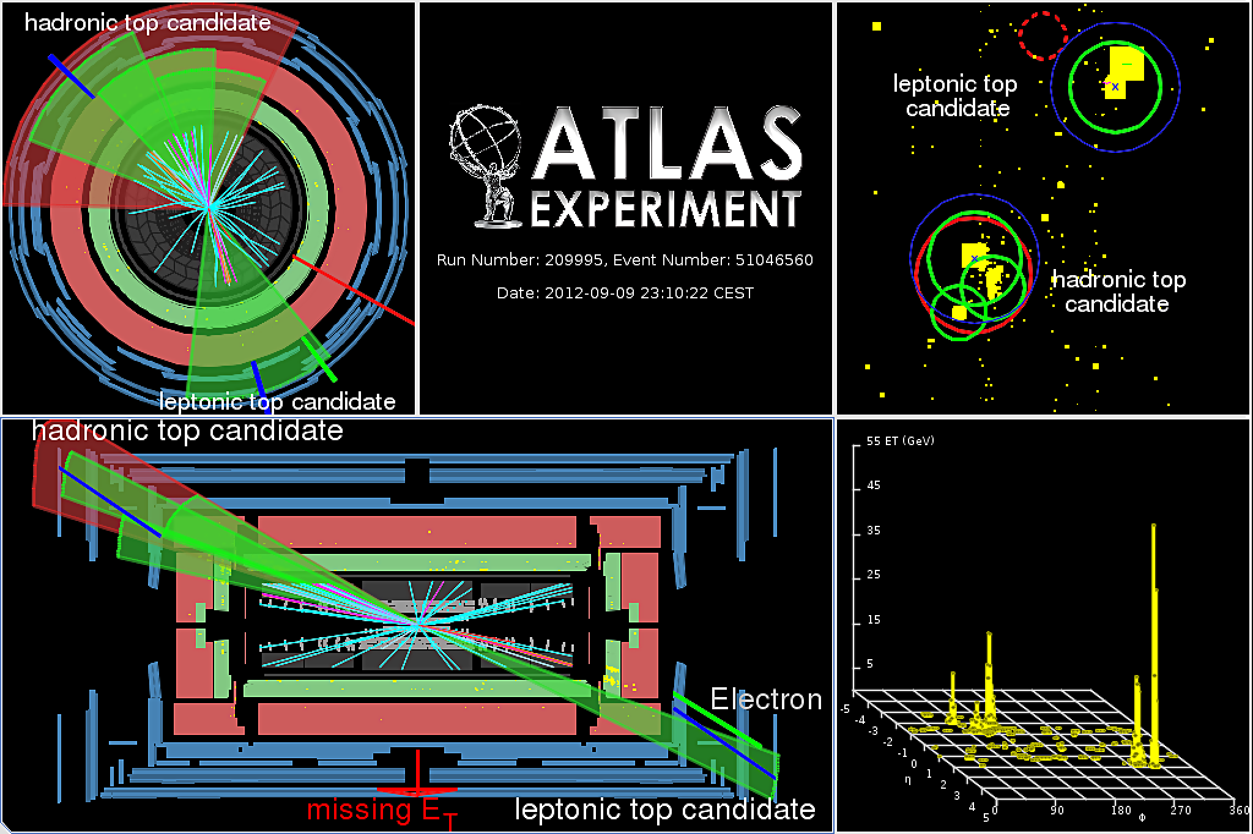
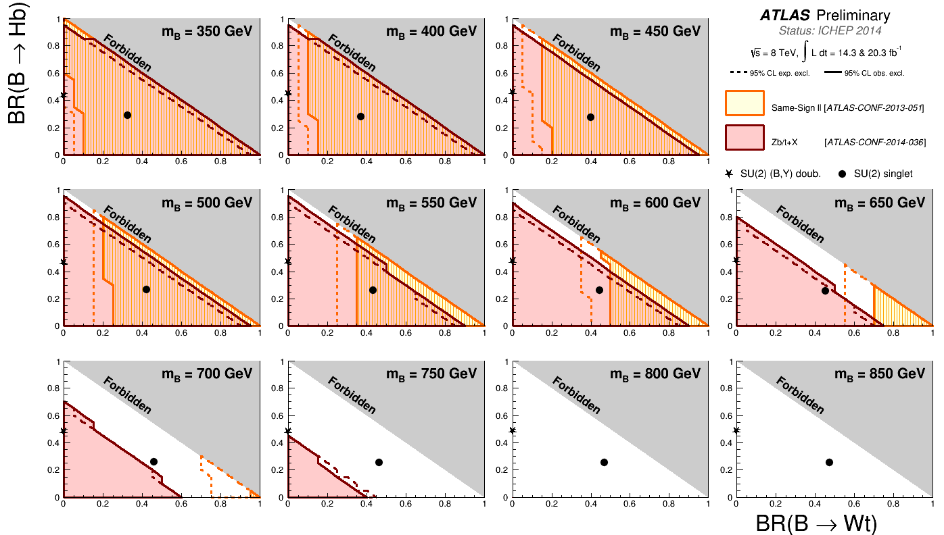
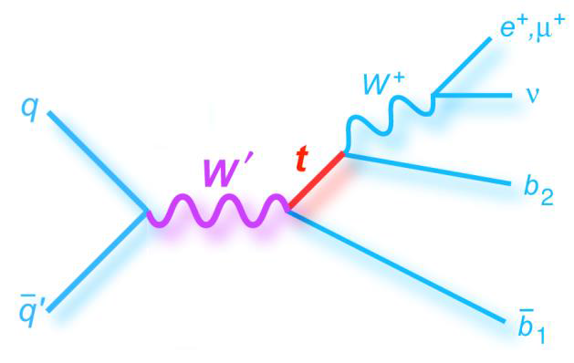
Top/bottom resonances
Heavy bosons searches
  tt̄ resonances
  W’ → tb̄sresonance
Vector-Like Quarks (VLQs) searches
  Zt+X
  Ht+X
  same-sign dilepton
☛ See Jiahang Zhong’s talk in Friday’s parallel session on Alternative Theories

Slide 16
Probing BSM physics in tails
Non-resonant dileptons [arXiv:1407.2410]
Leptons & jets [arXiv:1405.4254]
Generic search for New Physics [ATLAS-CONF-2014-006]
Mono-X plus E_{T}^{miss} signatures

Slide 17
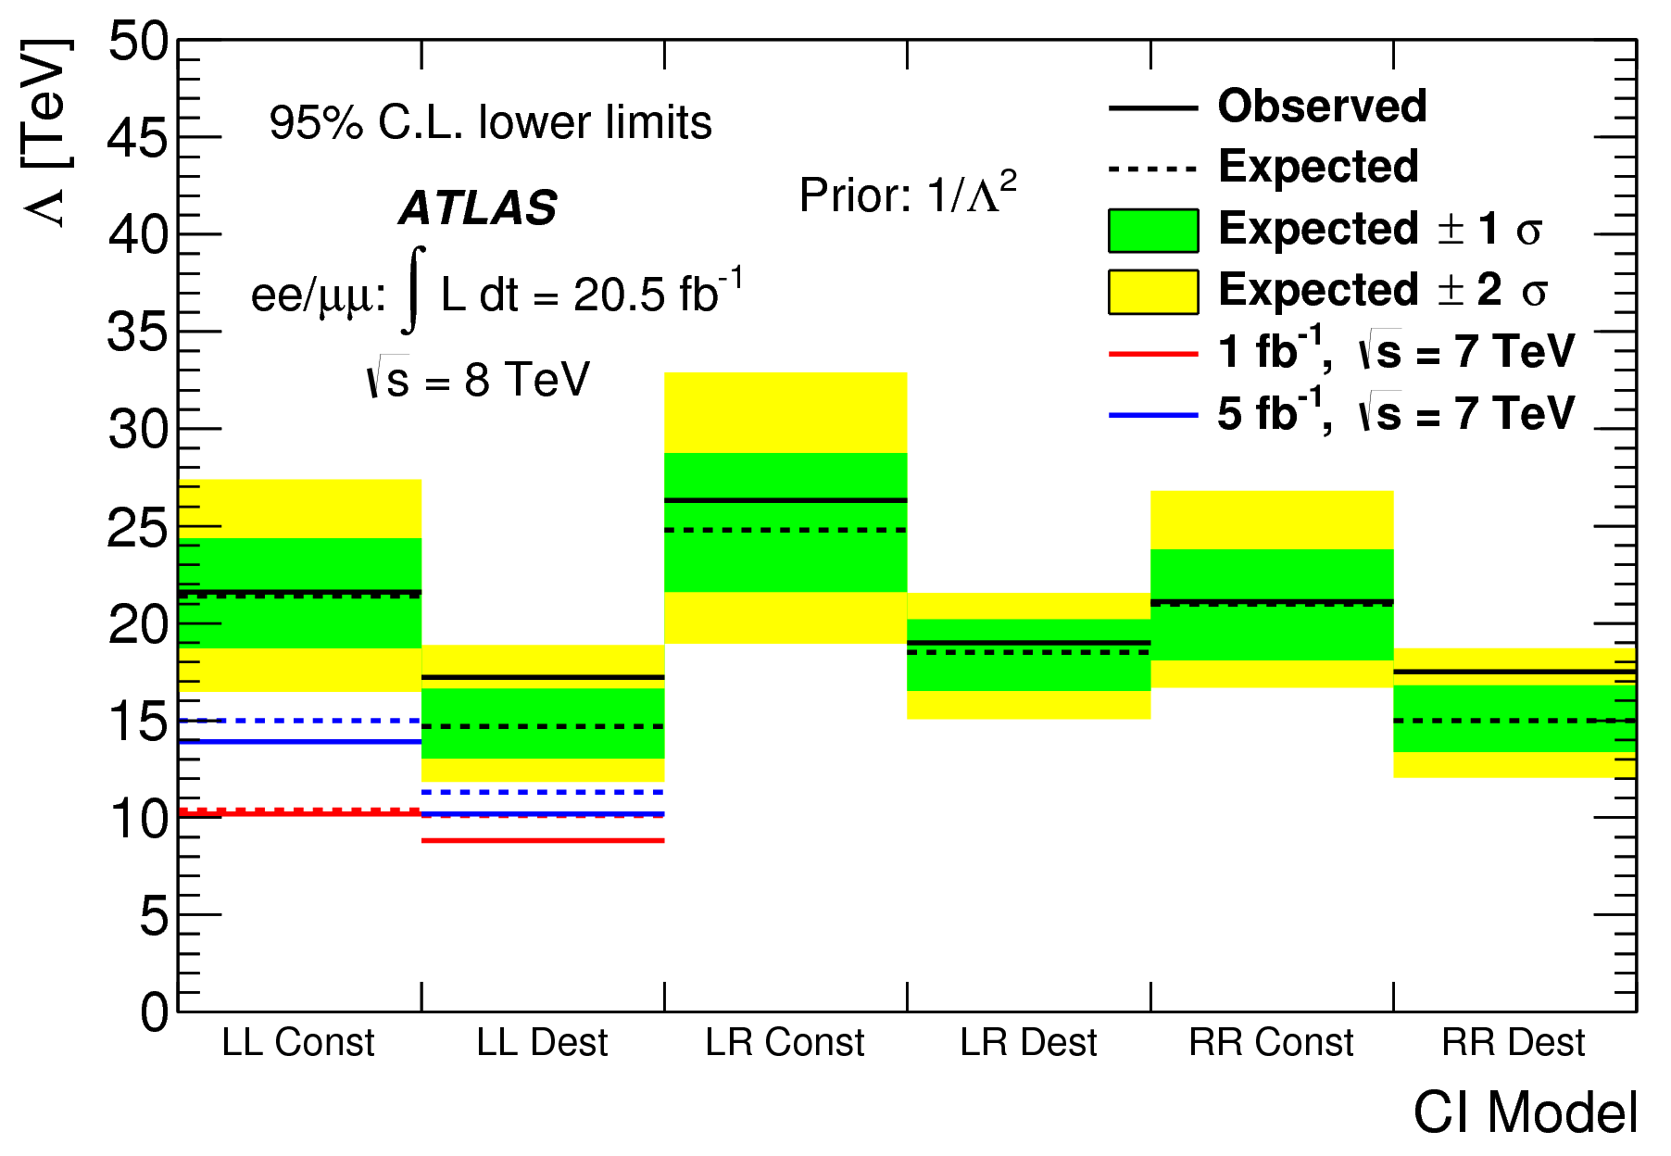
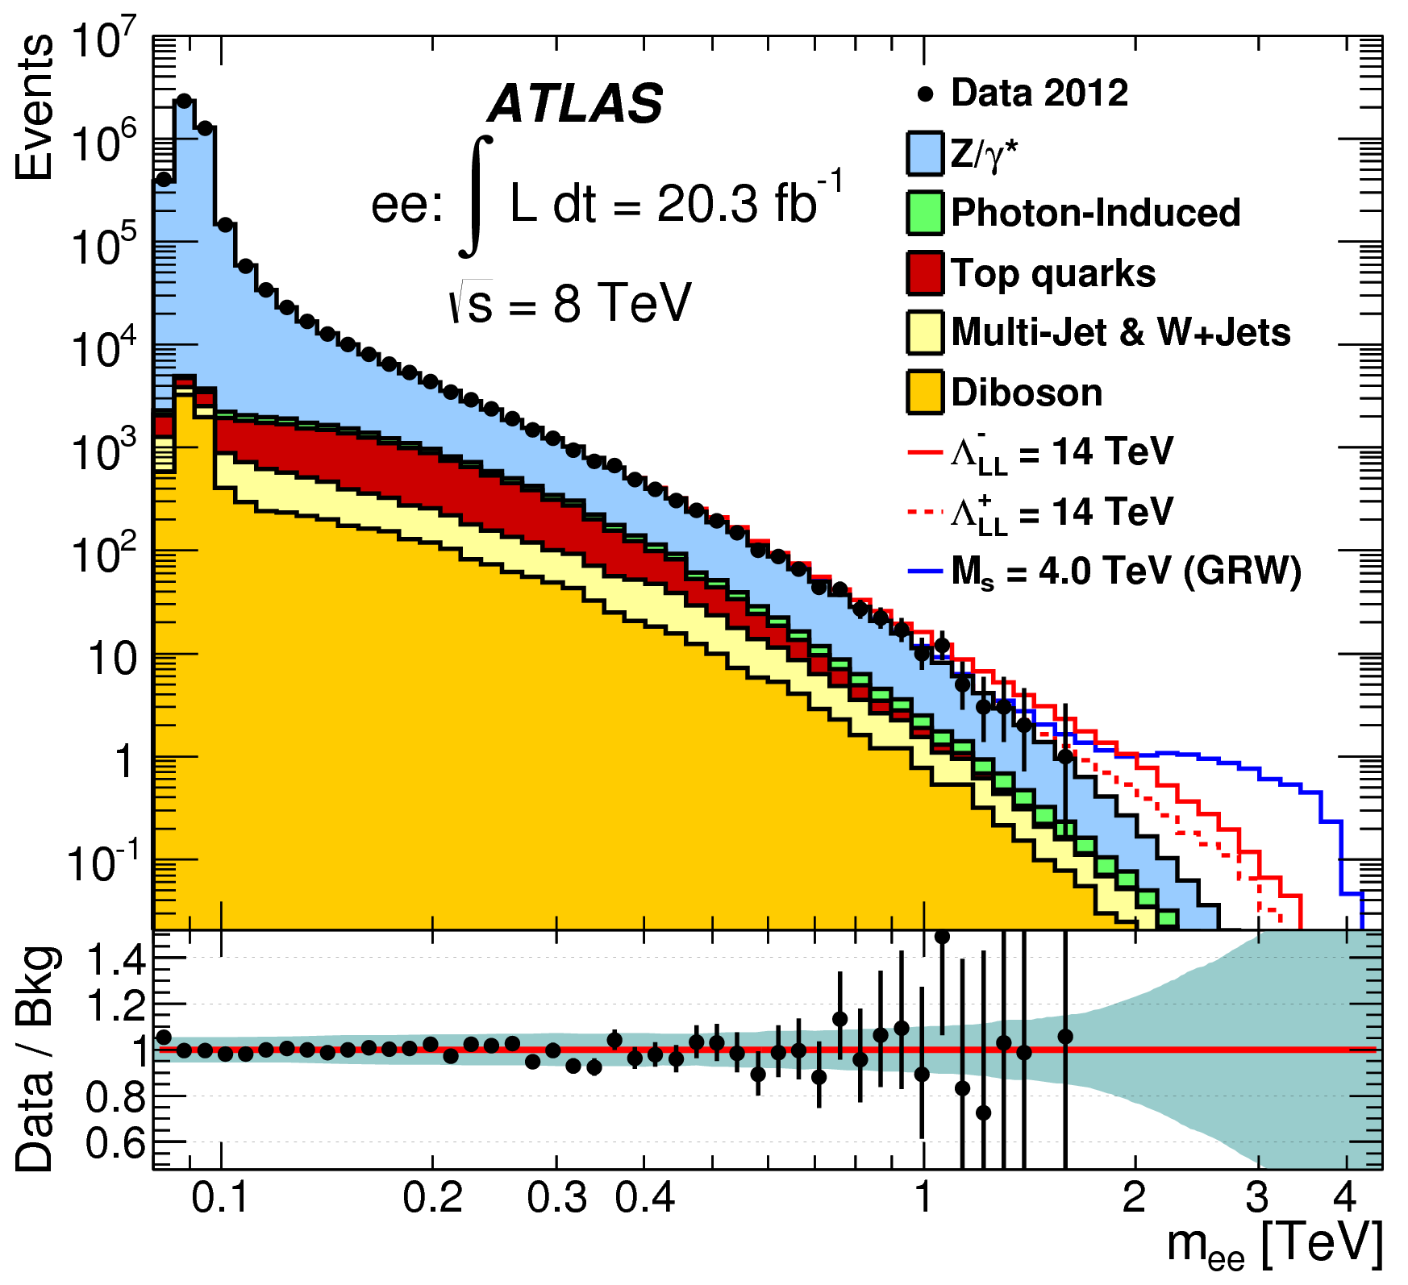
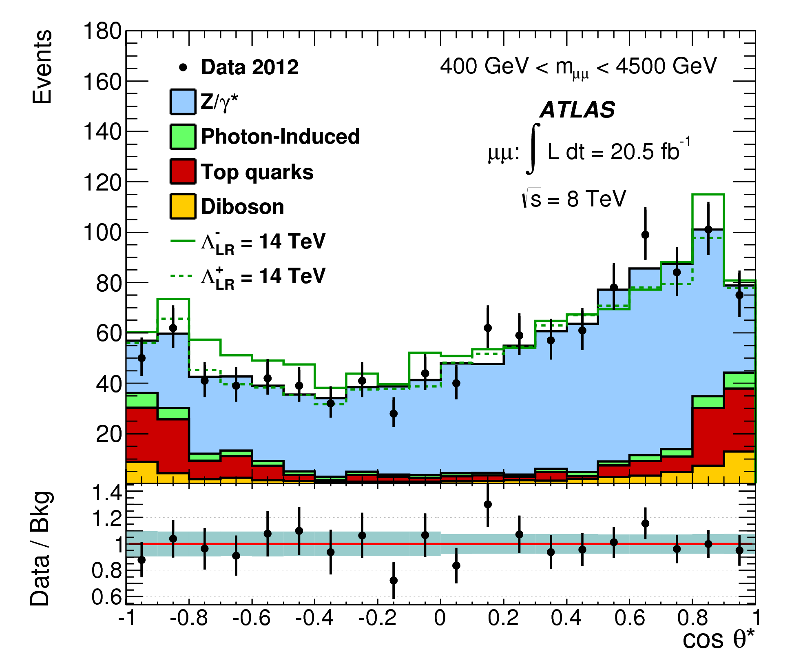
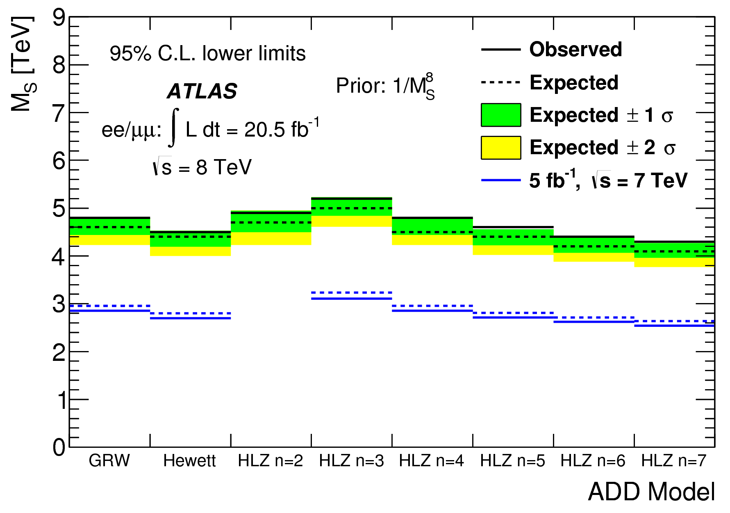
Non-resonant dileptons
20.3 fb⁻¹ @ 8 TeV
arXiv:1407.2410
Event selection and background similar to resonant
dilepton [arXiv:1405.4123]
m(𝓁𝓁) search bins optimised differently for contact interactions, CI, and for large extra dimension models
Forward-backward asymmetry used as discriminant for
CI search
No significant deviations from the SM expectation is observed
Contact Interactions due to quark and lepton compositeness
Large flat spatial extra dimensions (ADD)
  continuous dilepton production via virtual KK gravitons
Contact Interactions qq̄ → 𝓁⁺𝓁⁻
Large Extra Dimensions qq̄/gg → 𝓁⁺𝓁⁻

Slide 18
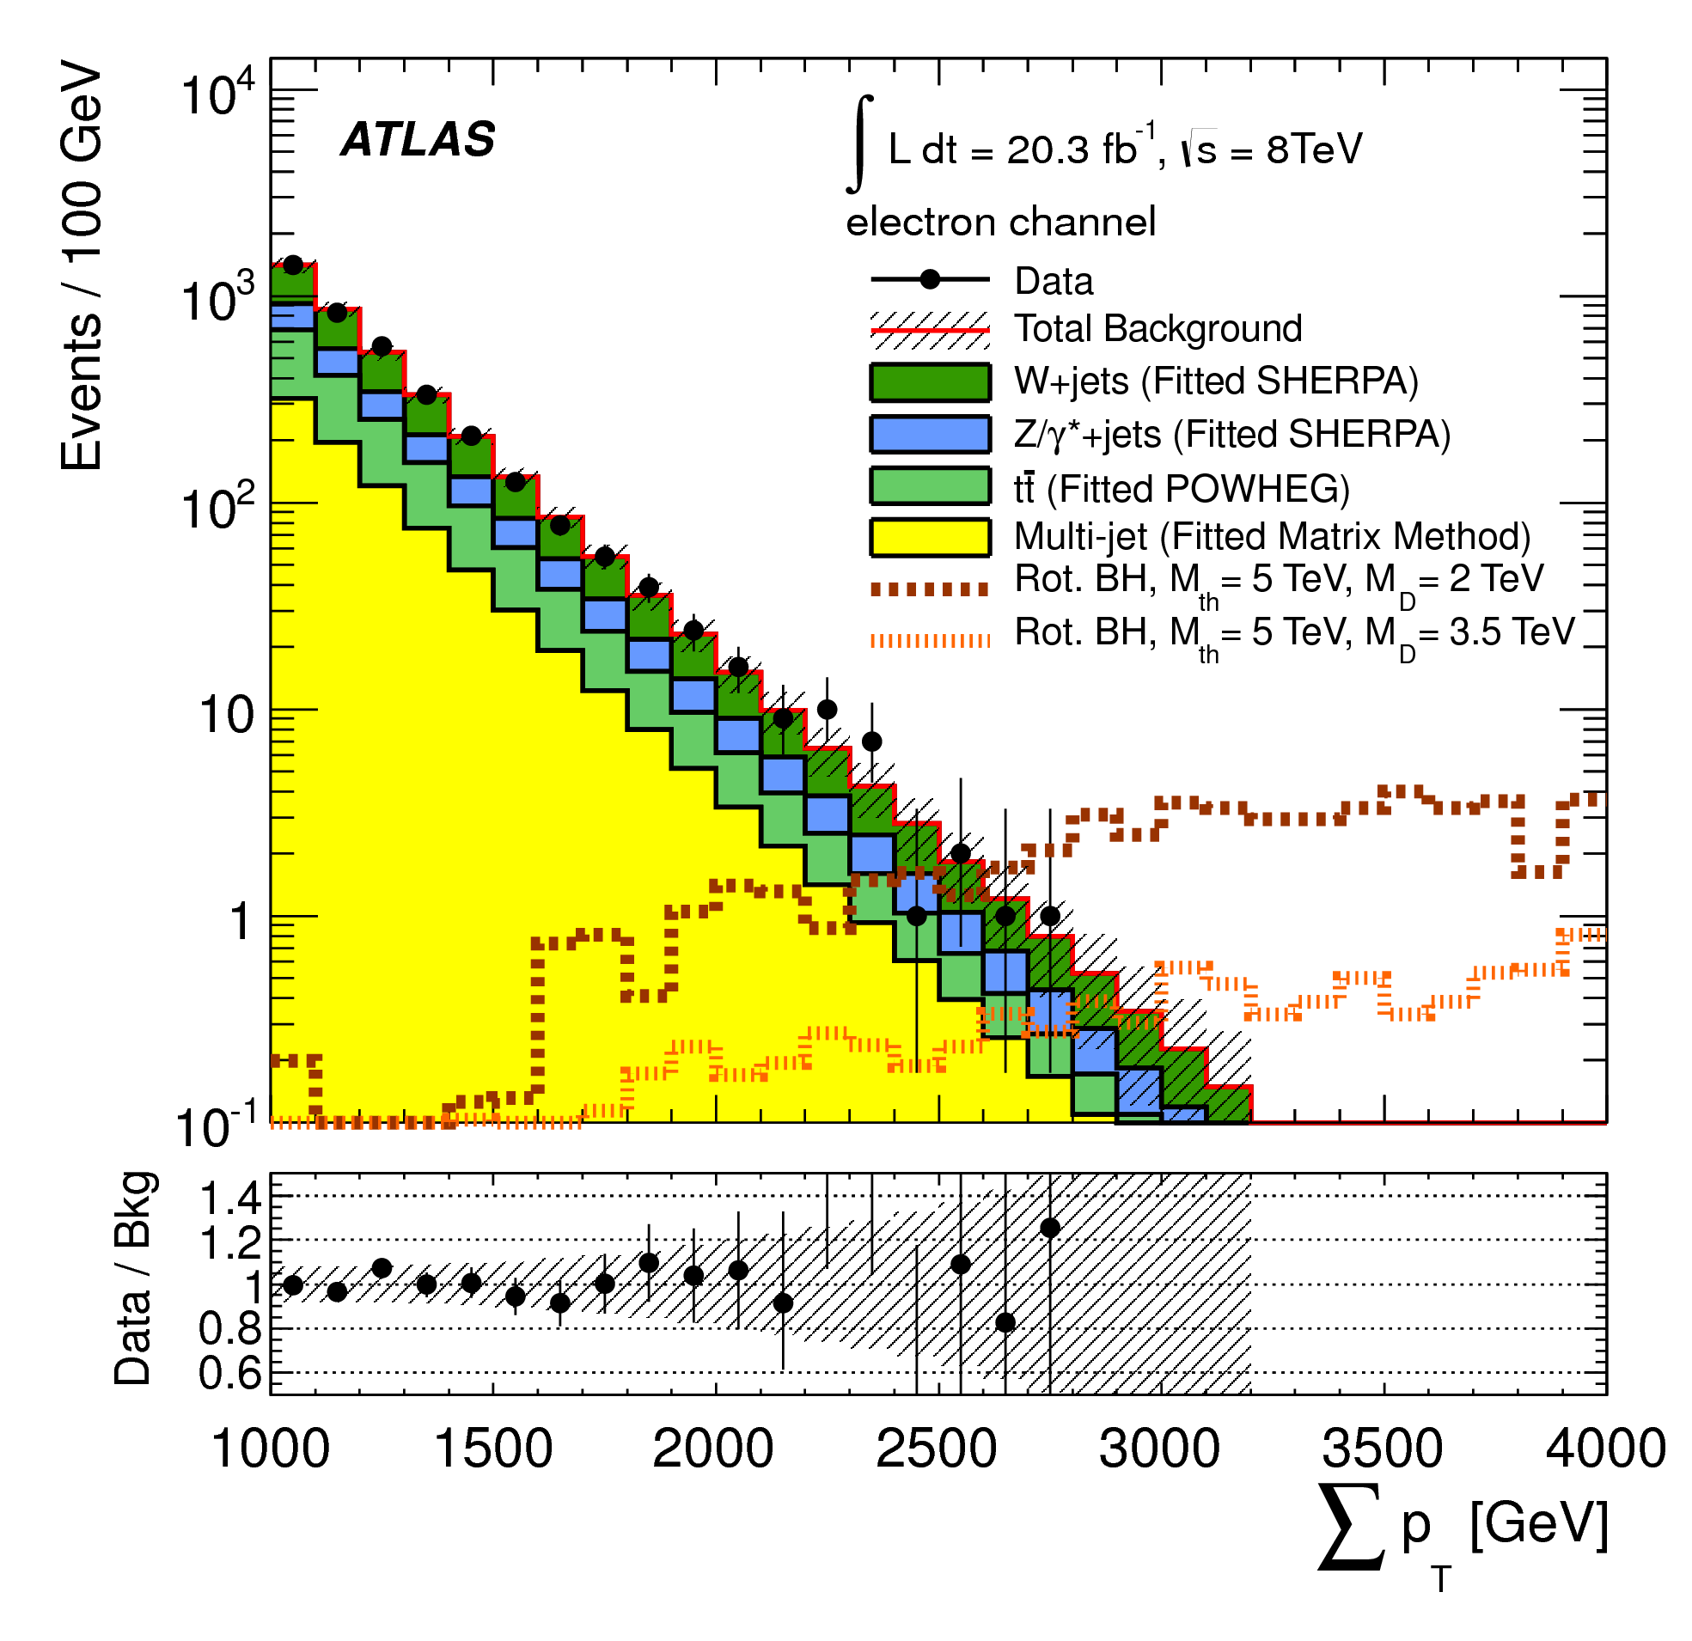
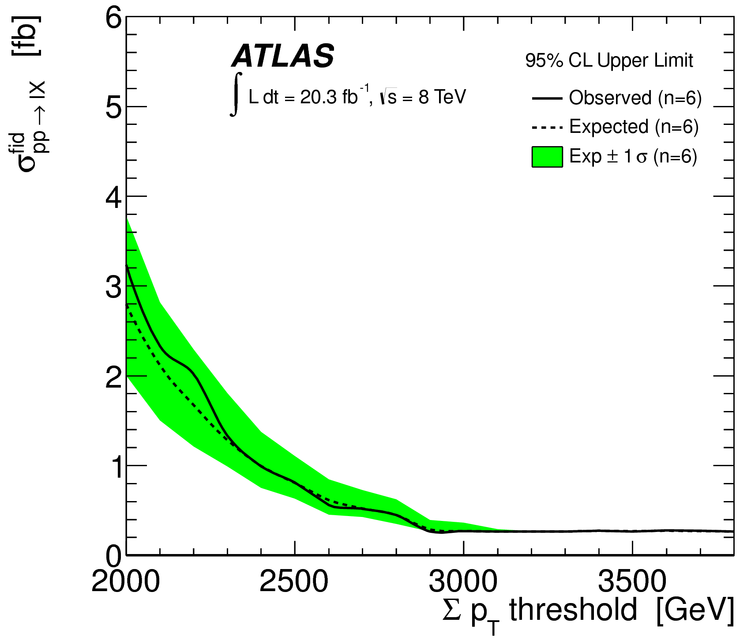
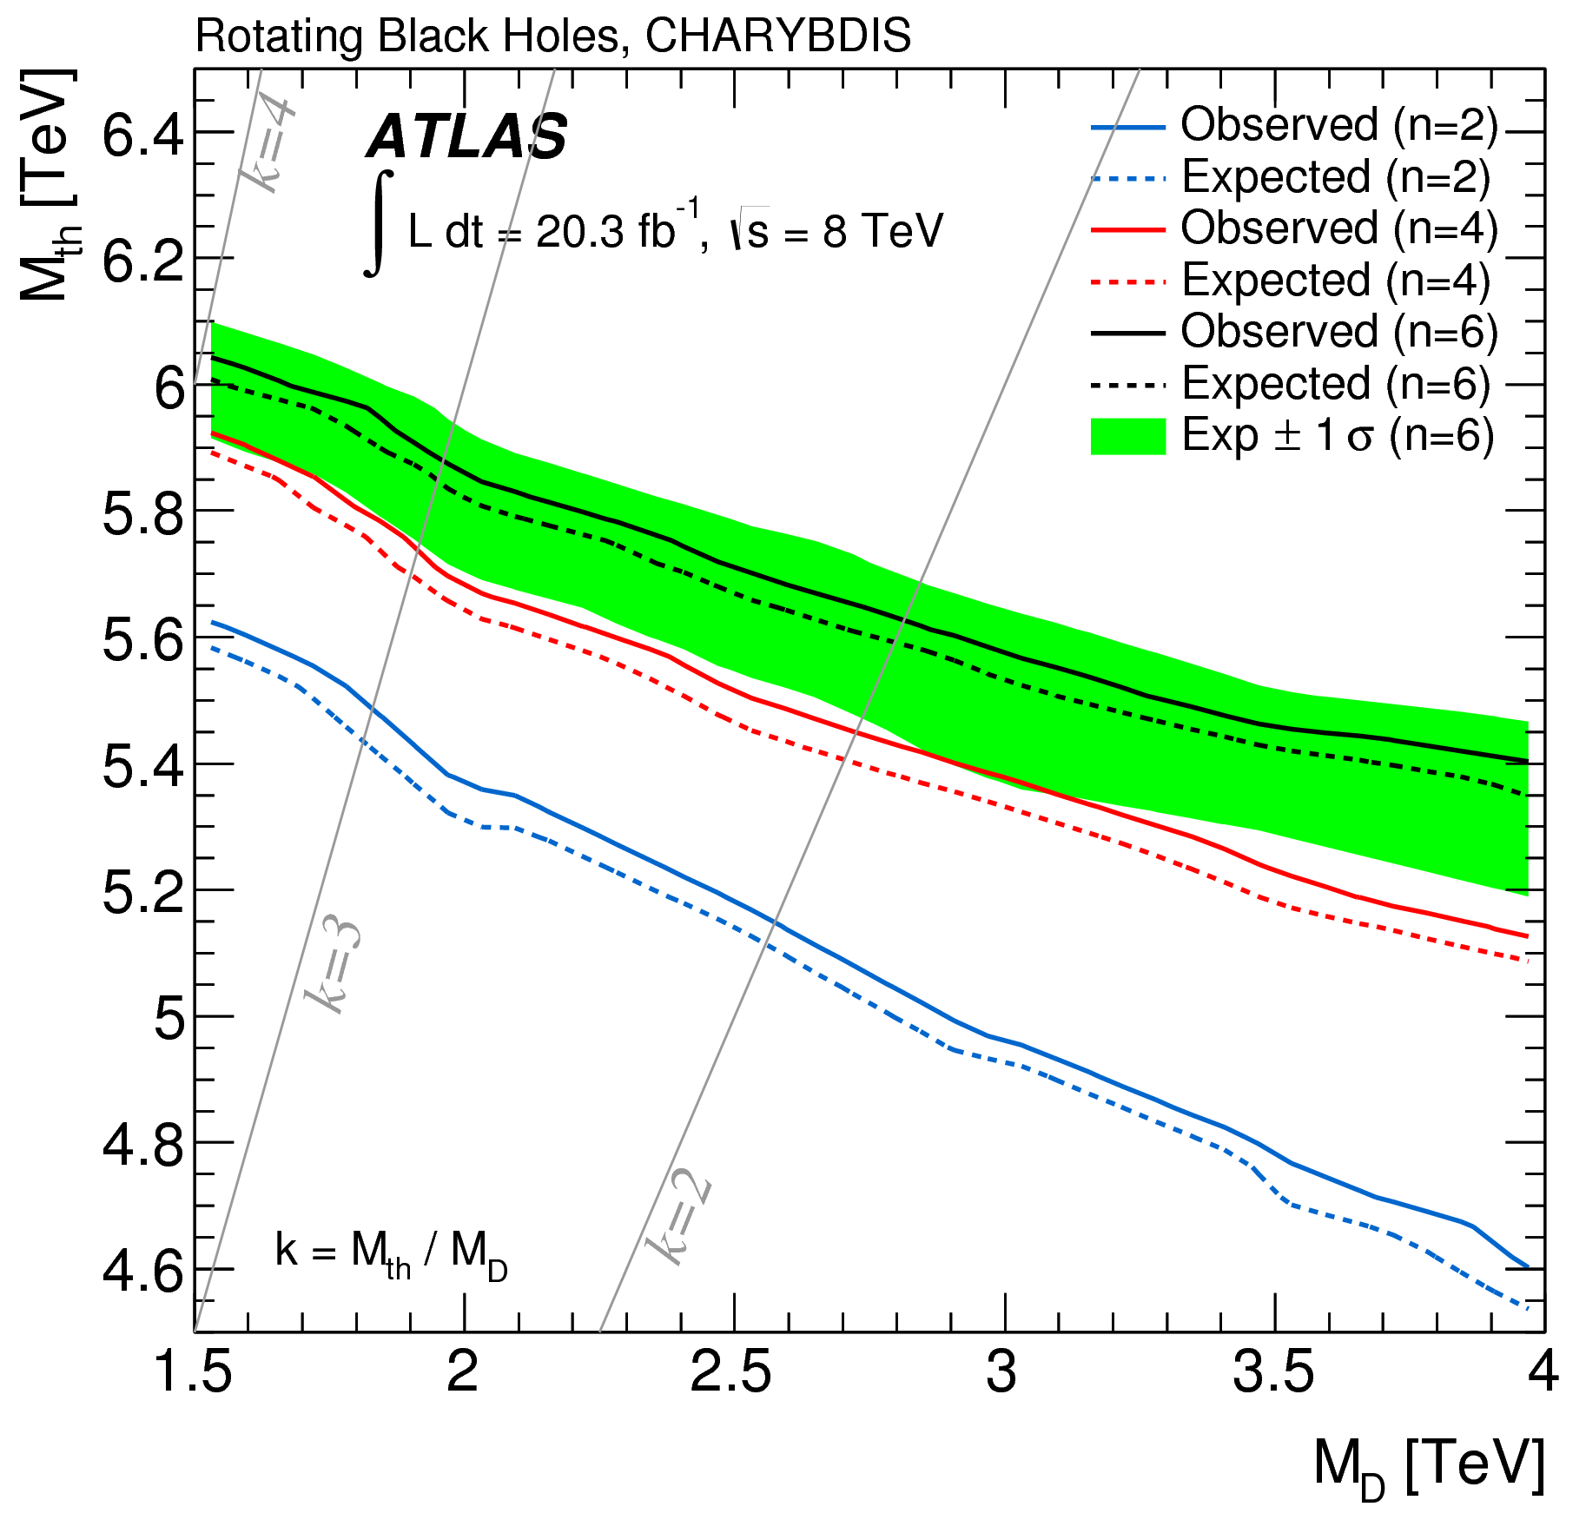
Black holes: leptons + jets
20.3 fb⁻¹ @ 8 TeV
Microscopic BH evaporation or BH-remnant decay leads to high mass, high object multiplicity
(large BR to leptons)
Event selection
  at least 3 high-p_{T} objects (jets + leptons) of p_{T} > 100 GeV
  scalar p_{T} sum of selected objects, ∑p_{T} > 2 TeV
Main background: W/Z+jets, tt̄, multijets (e channel) ⬅ estimated from data for each component
Slice signal region in order to be sensitive to wide range of signal phenomenologies
No significant excess of events seen
  model independent limits on signal cross section
  limits on 11 Black Hole / String Ball models
For search in same-sign dimuons: PRD88 (2013) 072001
arXiv:1405.4254
six extra dimensions

Slide 19
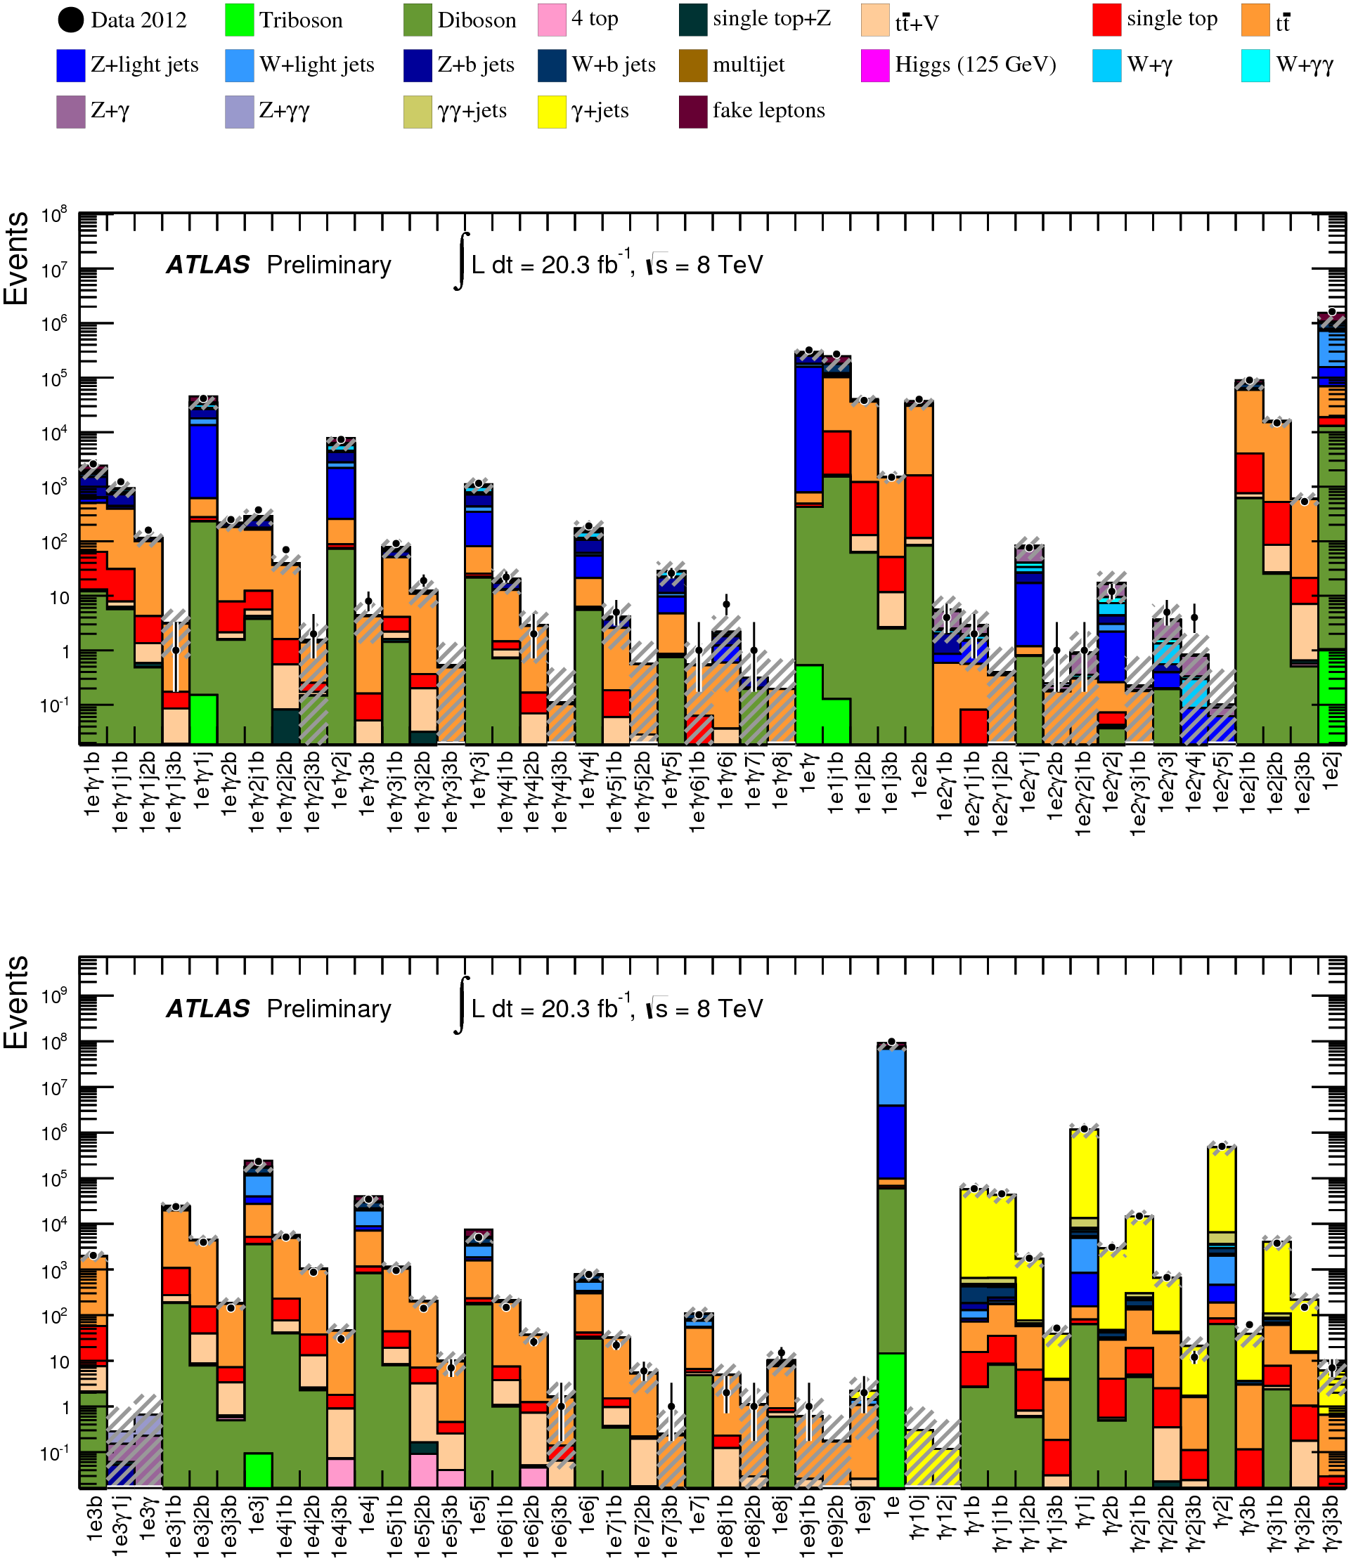
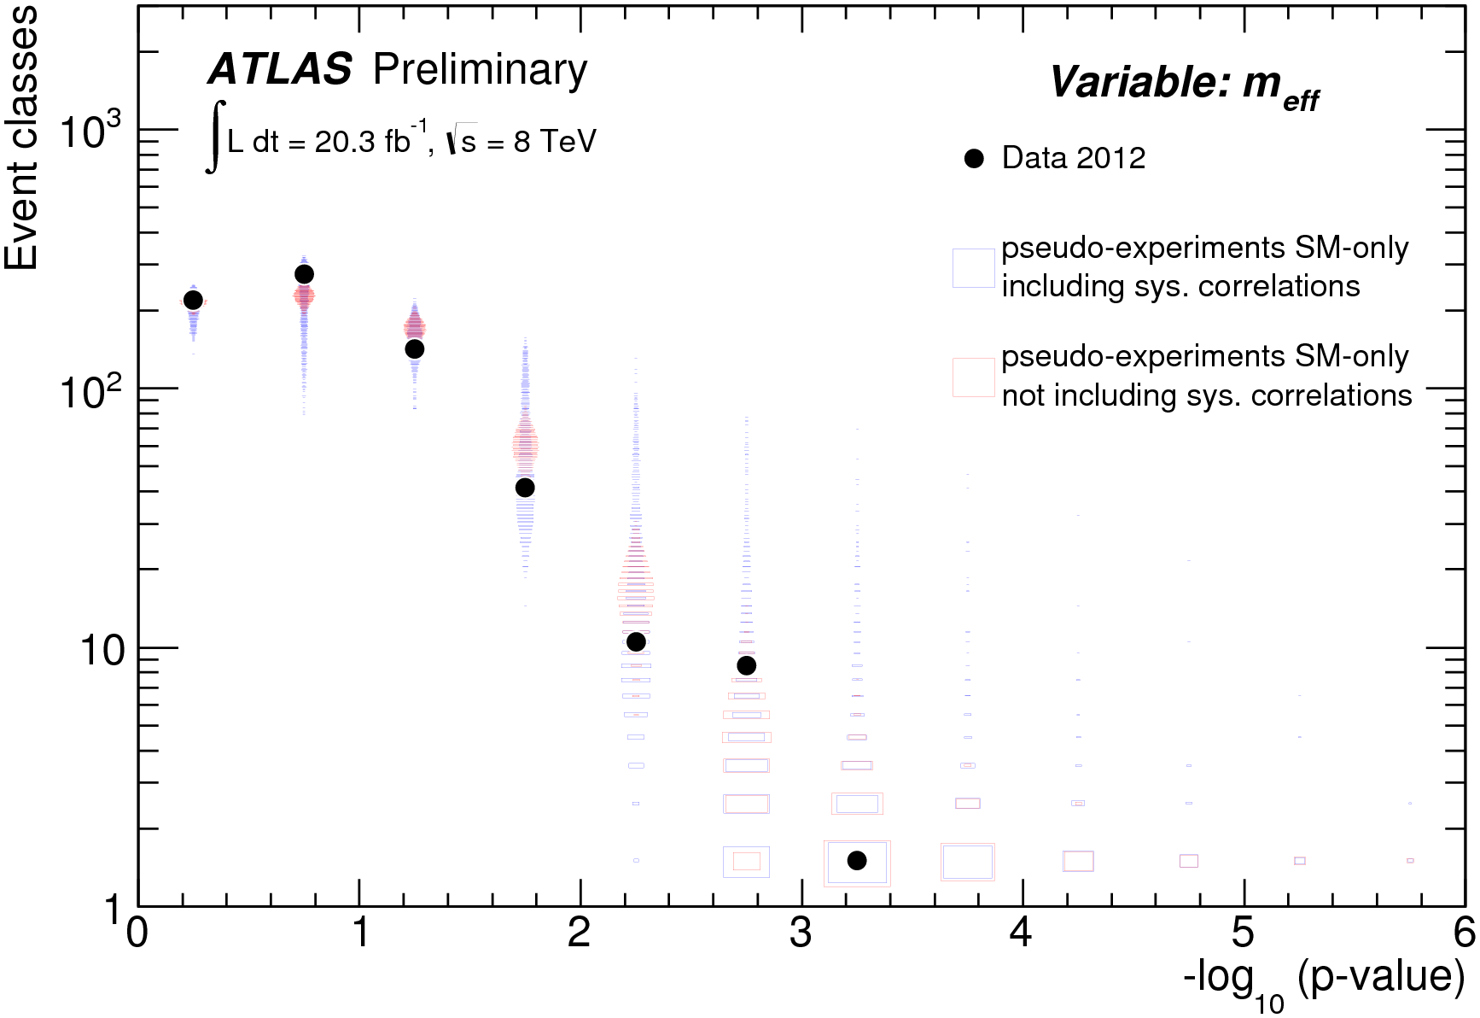
General search for new phenomena
Provides generic investigation for New Physics
  not motivated/optimised by specific model
Study topologies with isolated electrons, muons, photons, jets, b-jets, E_{T}^{miss}
697 search classes with SM expectation > 0.1 events
MC-based background estimation, except for lepton fakes
Three kinematic BSM-sensitive variables: m_{eff}, visible invariant mass & E_{T}^{miss}
20.3 fb⁻¹
@ 8 TeV
➜ No significant deviation from SM expectation is found in data overall
ATLAS-CONF-2014-006

Slide 20
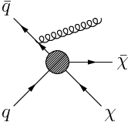
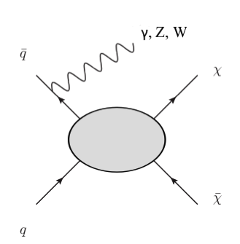
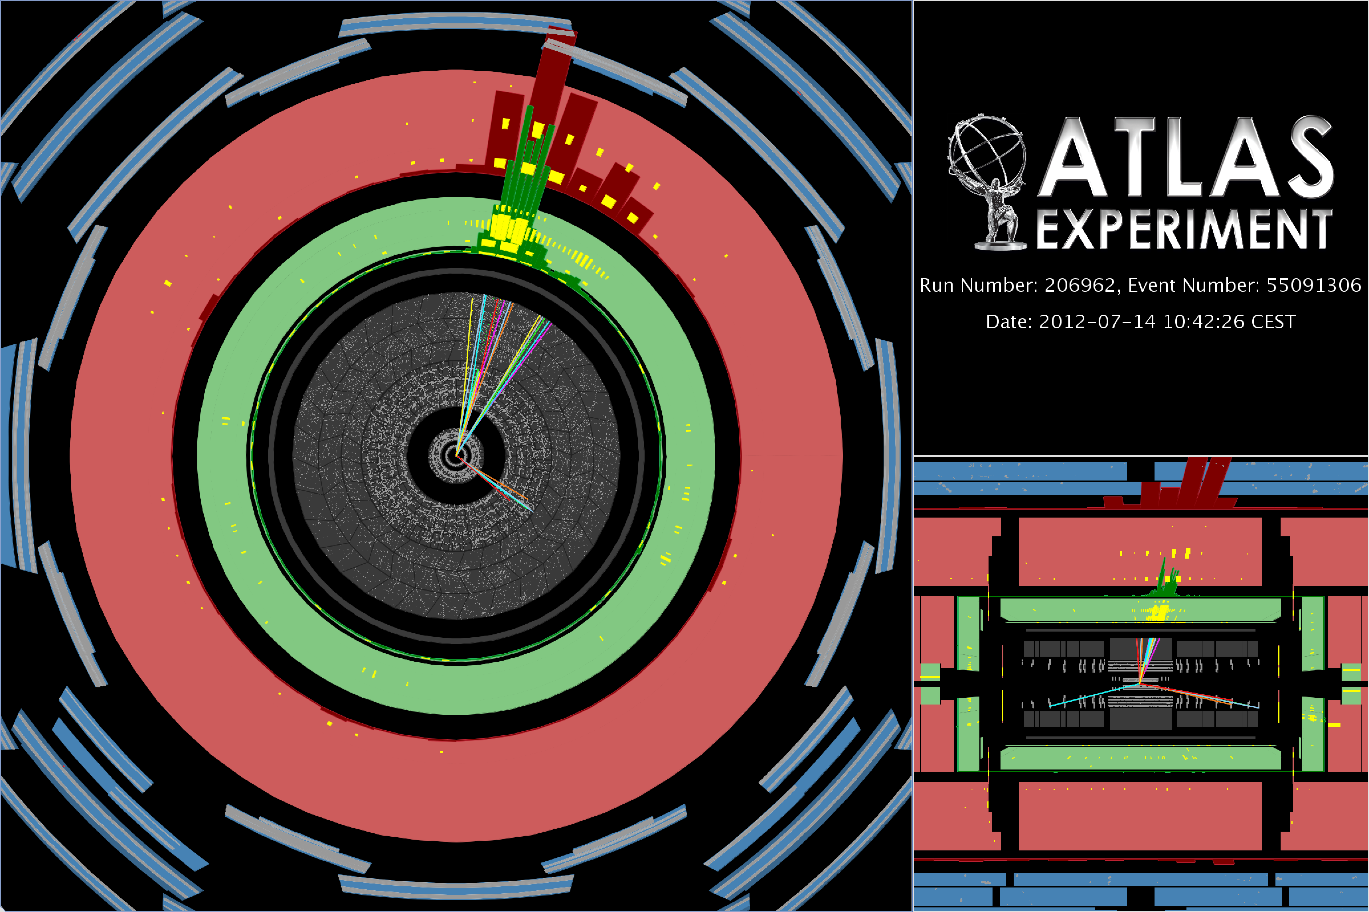
Mono-X signatures
Main motivation: dark matter (WIMP) production at LHC
  search also sensitive to large extra dimension models
Such events are tagged via the presence of an energetic jet or a photon or a W/Z coming from initial state radiation (ISR)
ISR particle necessary to
  provide highly energetic object
  balance two-WIMPs' momentum
  ➞ high missing transverse energy E_{T}^{miss}
➞ Mono‐jet, mono-photon,
mono‐W/Z distinctive signatures
☛ See David Salek’s talk in Thursday’s parallel session on Particle Cosmology

Slide 21
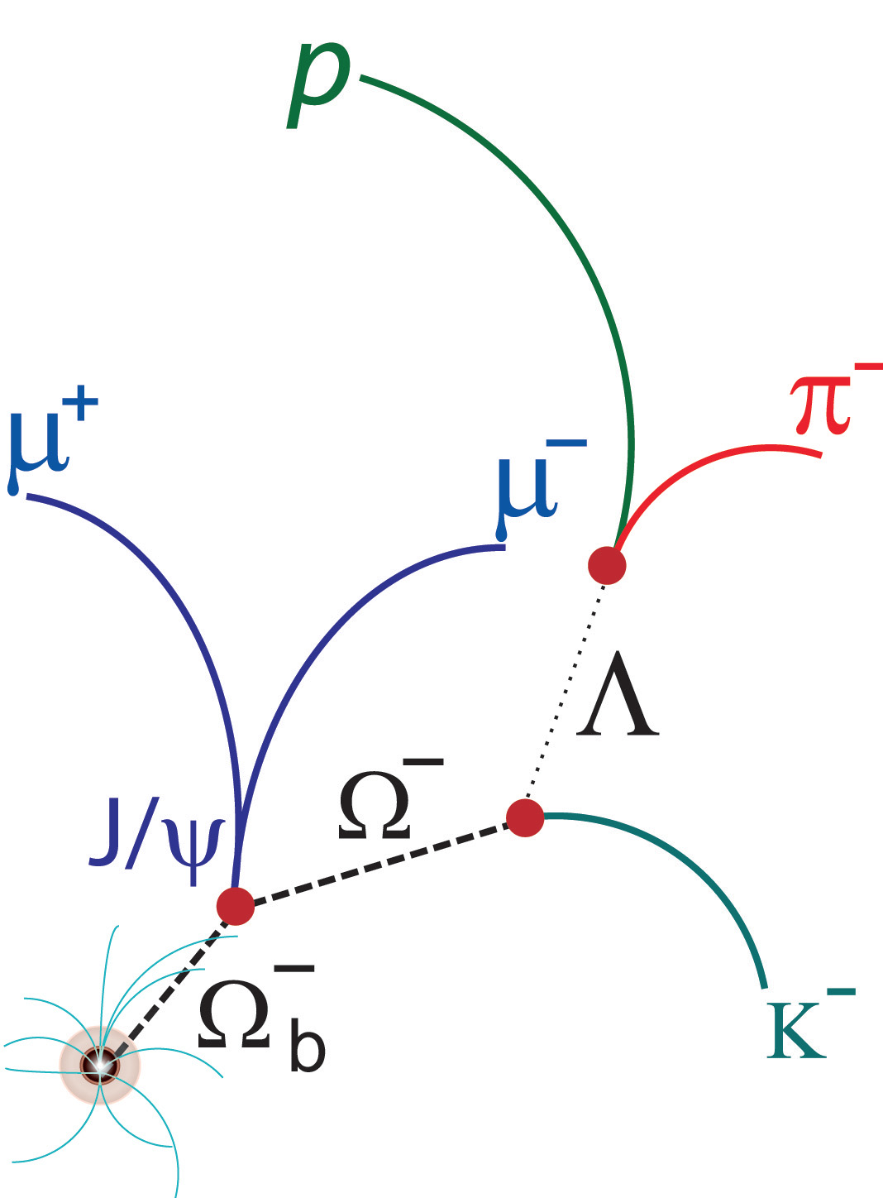
Even more exotic … long-lived particles
Highly-ionising particles
  magnetic monopoles [PRL109 (2012) 261803]
  multi-charged particles [PLB 722 (2013) 305]
Neutral long-lived particles (LLPs) in hadronic
calorimeter [ATLAS-CONF-2014-041]

Slide 22
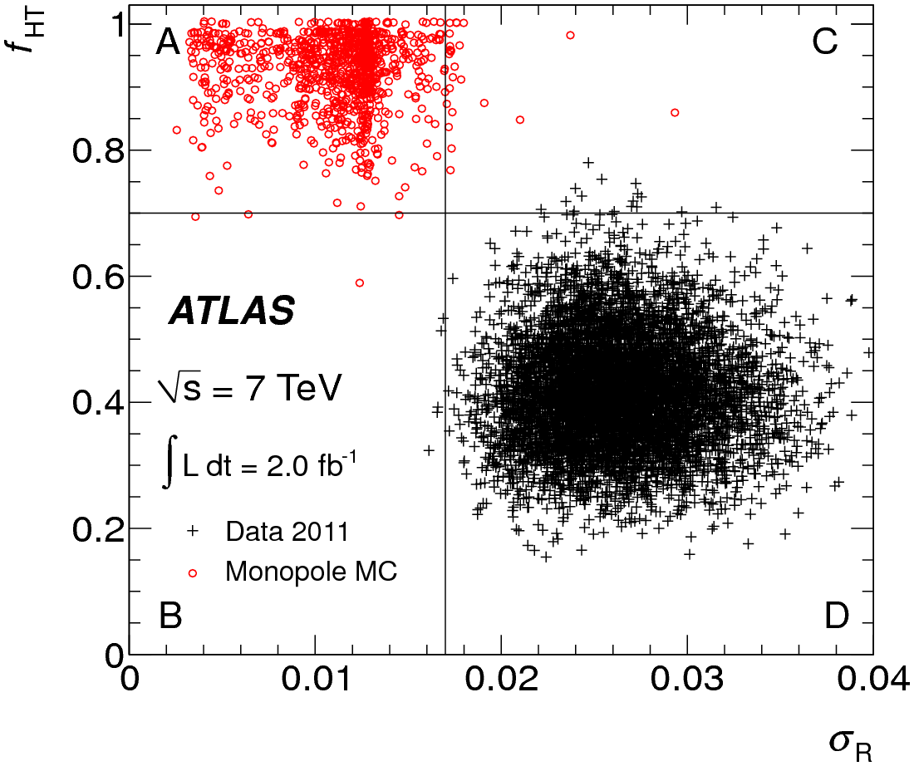
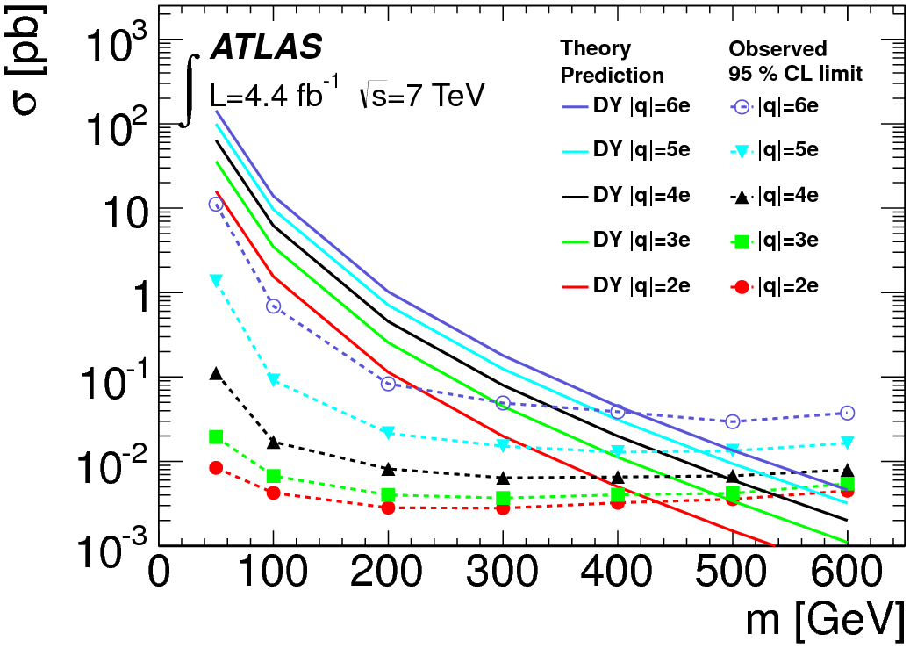
Highly-ionising particles
Magnetic monopoles
Multi-charged particles
Exploit distinct signals in Transition Radiation Tracker (high-threshold hit) and EM calorimeter (large localized energy deposit)
Upper cross-section limits set for Dirac monopoles of mass of 200 – 1200 GeV
Predicted in almost-commutative models and the walking technicolour model
Search based on specific energy loss,
dE/dx, measurements in the TRT and the Muon Spectrometer
Limits set assuming a simplified Drell-Yan production model
2.0 fb⁻¹ @ 7 TeV
PRL109 (2012) 261803
PLB 722 (2013) 305
High-threshold TRT hit fraction, f_{HT}, versus EM cluster dispersion, σ_{R}
4.4 fb⁻¹ @ 7 TeV

Slide 23



Neutral LLP: motivation & signature
Hidden Sector (HS) weakly coupled to SM via heavy communicator scalar Φ_{HS}
Benchmark: Hidden Valley model with the
Higgs or a Higgs-like scalar decaying to a pair
of neutral pseudoscalars (π_{v}) which in turn
decay to pairs of SM fermions: bb̄, cc̄, τ⁺τ⁻
  Hidden Valley can alter the branching
  fractions for Higgs decay
Signature: If π_{v} is long-lived, it will give rise
final states with π_{v} decaying in the
hadronic calorimeter (HCal) or the outer
edge of the electromagnetic (EM) calorimeter
energy
mediator
M. Strassler, arXiv:hep-ph/0607160
π_{v}
π_{v}
weakly coupled
H
Φ_{HS}
ATLAS-CONF-2014-041

Slide 24


Event selection & results
20.3 fb⁻¹ @ 8 TeV
Each heavy fermion pair from π_{v} decay reconstructed as single jet with
  narrow radius
  no tracks from charged particle pointing to the jet
  little or no energy deposited on the EM calorimeter
Dedicated CalRatio trigger developed to select events with these features [JINST 8 (2013) P07015]
Event selection
  E_{T}^{miss} < 50 GeV, against cosmic rays &
  beam-halo events
  Require two jets passing:
    log₁₀(E_{H}/E_{EM}) > 1.2, |η| < 2.5
    no good tracks within ΔR = 0.2 of jet
    −1 < |t| < 5 ns,
    against out-of-time events
  One jet must have fired the trigger &
  E_{T} > 60 GeV; the other E_{T} > 40 GeV
statistics only
statistics
⨁ systematics
ATLAS-CONF-2014-041

Slide 25




LLP: interpretation
m_{Φ} = 100 GeV
No significant excess was observed
➜ limits set in Hidden Valley scenario
m_{Φ} = 126 GeV
m_{Φ} = 140 GeV
20.3 fb⁻¹
@ 8 TeV
ATLAS-CONF-2014-041

Slide 26

All results in a nutshell

Slide 27

Summary
Standard Model limitations imperatively call for Physics beyond it, extending and complementing it
ATLAS has searched for physics BSM at TeV scale in a variety of signatures inspired by a multitude of theoretical scenarios
No significant deviation from SM expectations
observed so far
LHC Run 2 may reveal hints of New Physics
thanks to higher accessible energy
  ATLAS is well-prepared to make
  the most of it
Continuously updated public results:
https://twiki.cern.ch/twiki/bin/view/AtlasPublic/ExoticsPublicResults
… for 13-14 TeV
run in 2015

Slide 28

Thank you for your attention!

