Slide 1

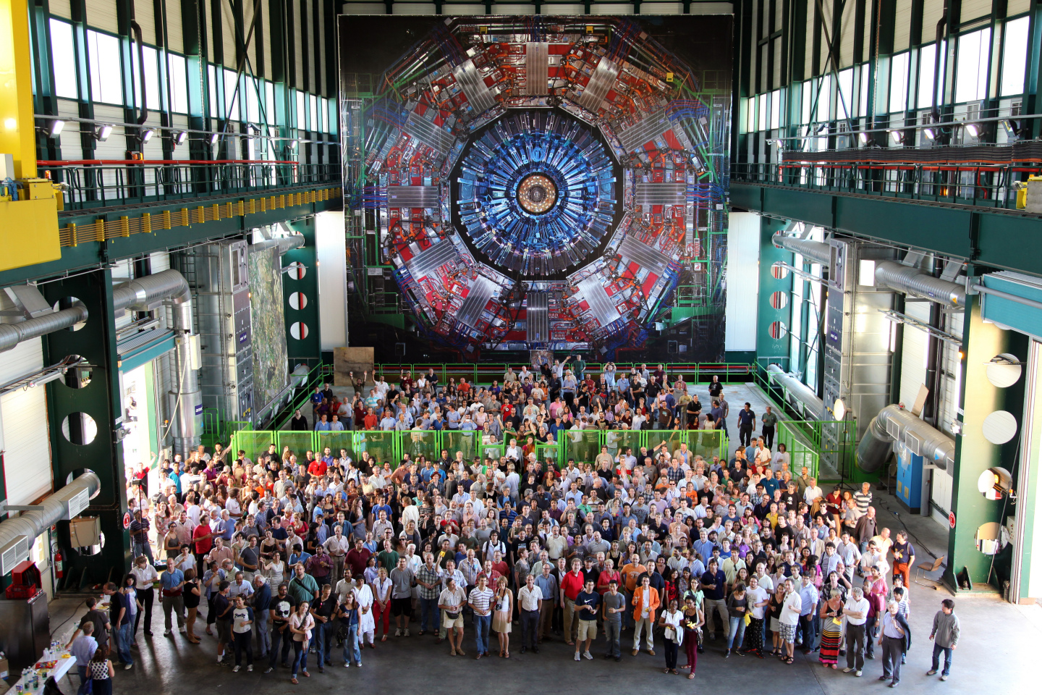
Higgs results from CMS
Nikitenko, Imperial College, London
SUSY 2014, 22 July.

Slide 2
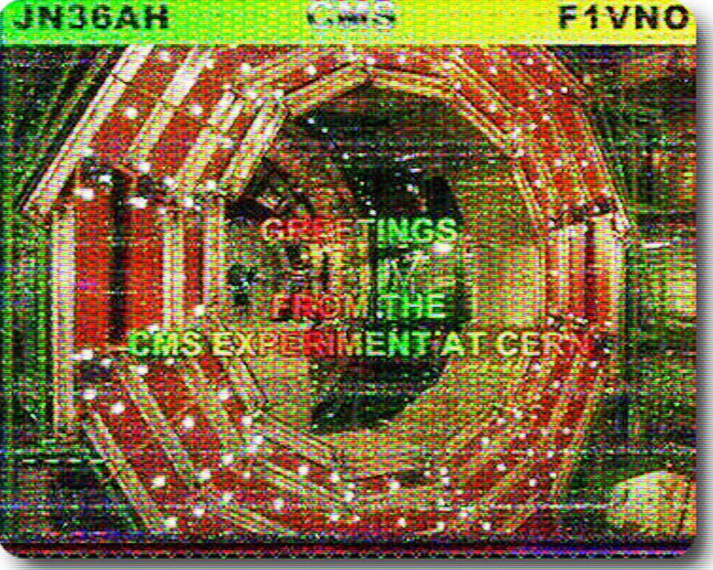
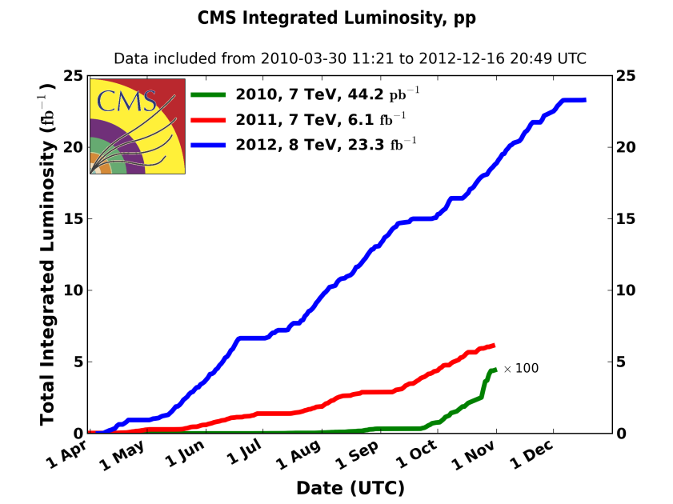

Slide 3
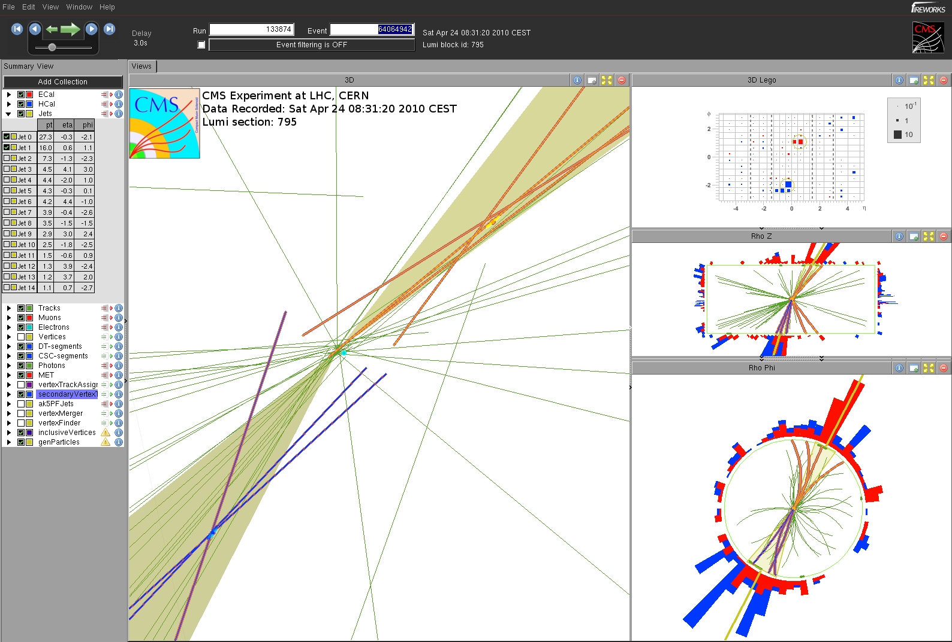
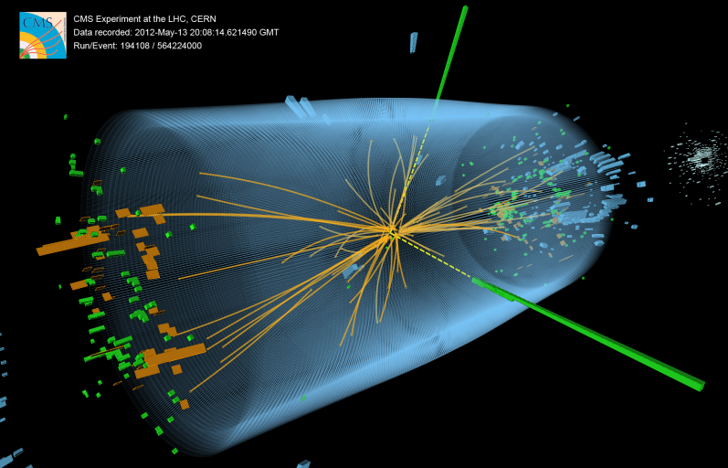
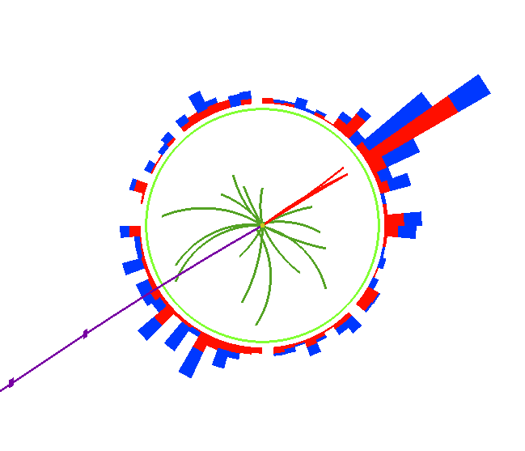
Few words about CMS reconstruction
γ₁
γ₂
Two b-jet candidates
Z->ττ->τ_{μ}τ_{h}

Slide 4
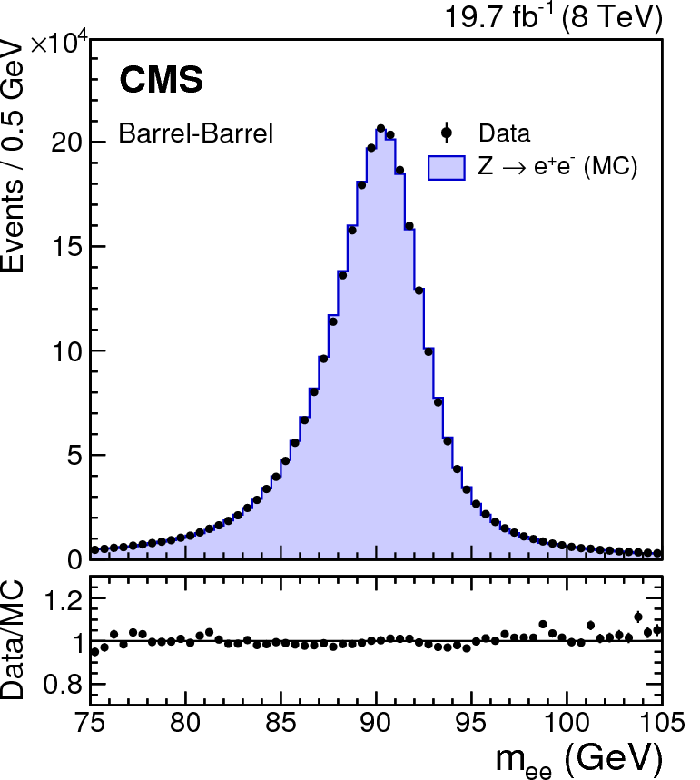
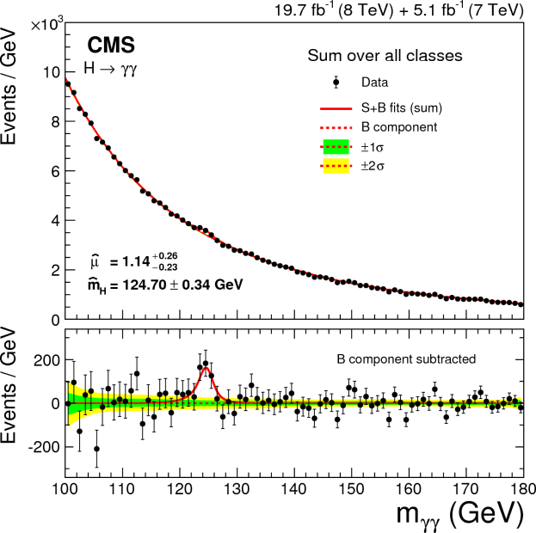
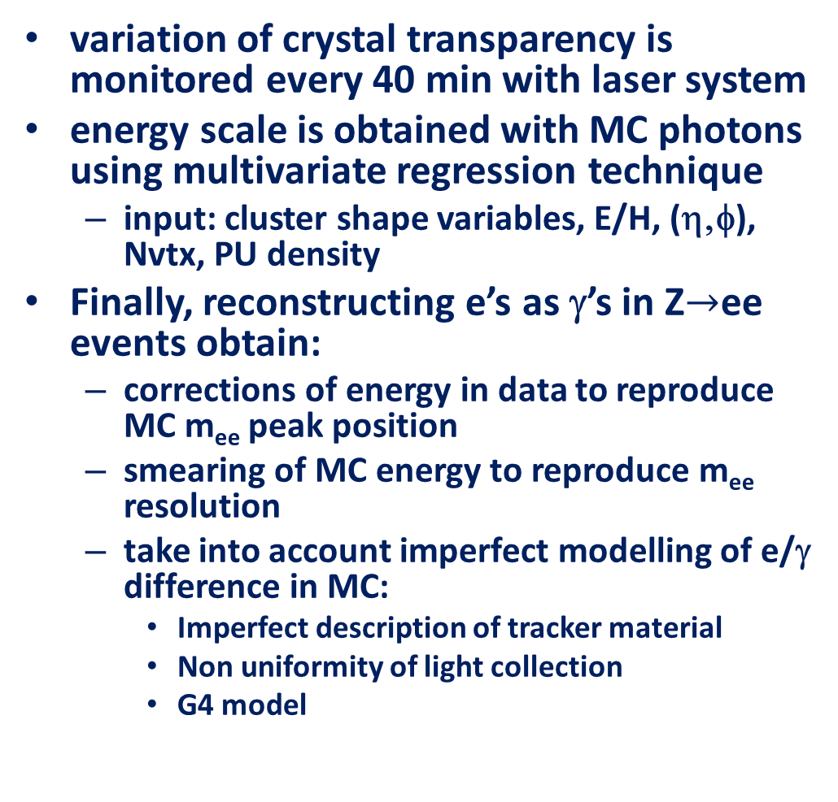
Reconstruction: photons
variation of crystal transparency is monitored every 40 min with laser system
energy scale is obtained with MC photons using multivariate regression technique
  input: cluster shape variables, E/H, (η,φ), Nvtx, PU density
Finally, reconstructing e’s as γ’s in Z$→$ee events obtain:
  corrections of energy in data to reproduce MC m_{ee} peak position
  smearing of MC energy to reproduce m_{ee} resolution
  take into account imperfect modelling of e/γ difference in MC:
    Imperfect description of tracker material
    Non uniformity of light collection
    G4 model
σ_{eff}(m_{γγ}) = [1.0-2.6] GeV

Slide 5
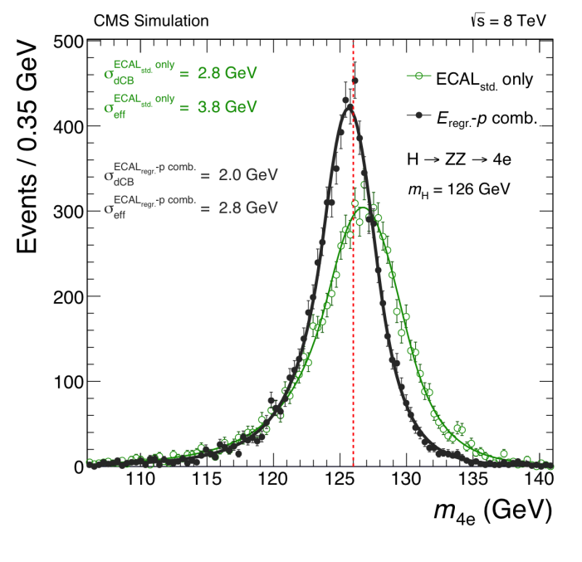
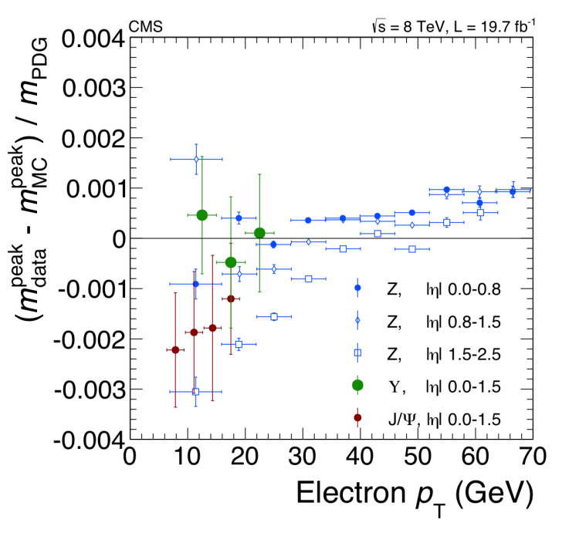
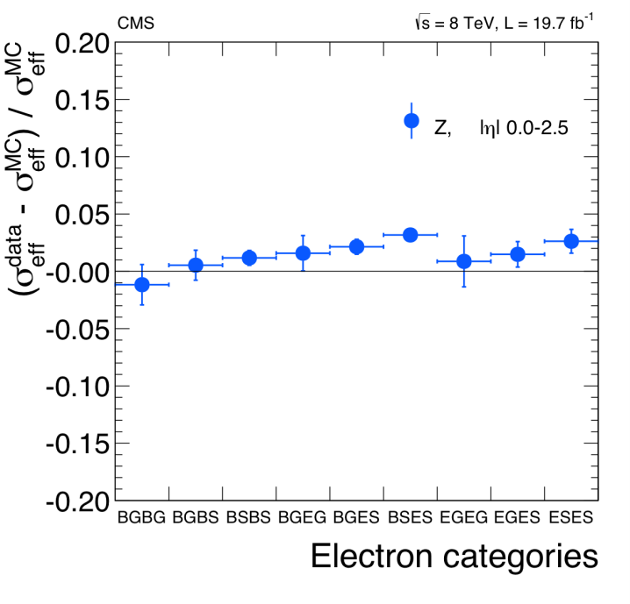
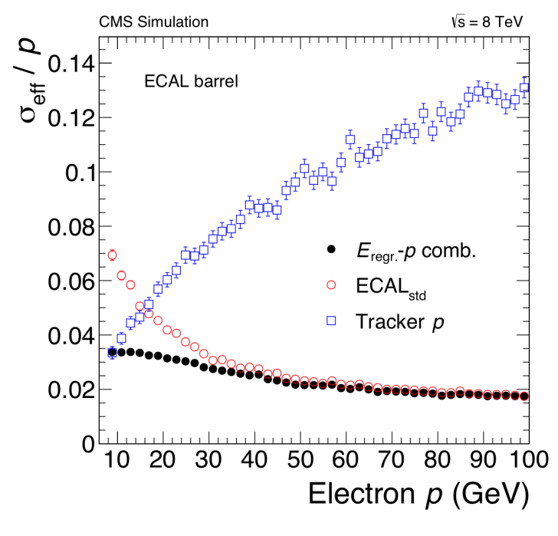
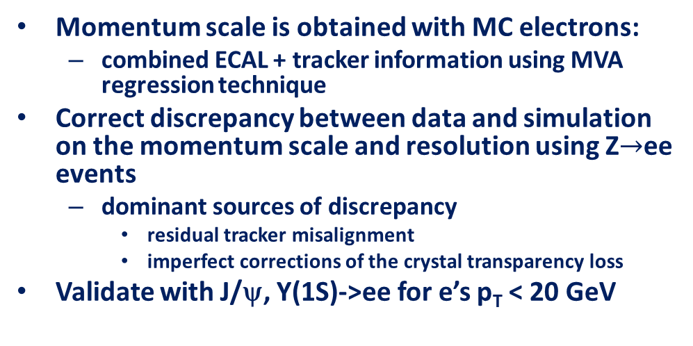
Reconstruction: electrons
Momentum scale is obtained with MC electrons:
  combined ECAL + tracker information using MVA regression technique
Correct discrepancy between data and simulation on the momentum scale and resolution using Z$→$ee events
  dominant sources of discrepancy
    residual tracker misalignment
    imperfect corrections of the crystal transparency loss
Validate with J/ψ, Y(1S)->ee for e’s p_{T} < 20 GeV

Slide 6
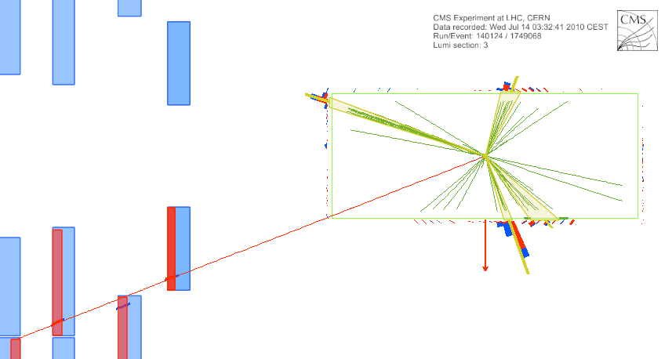
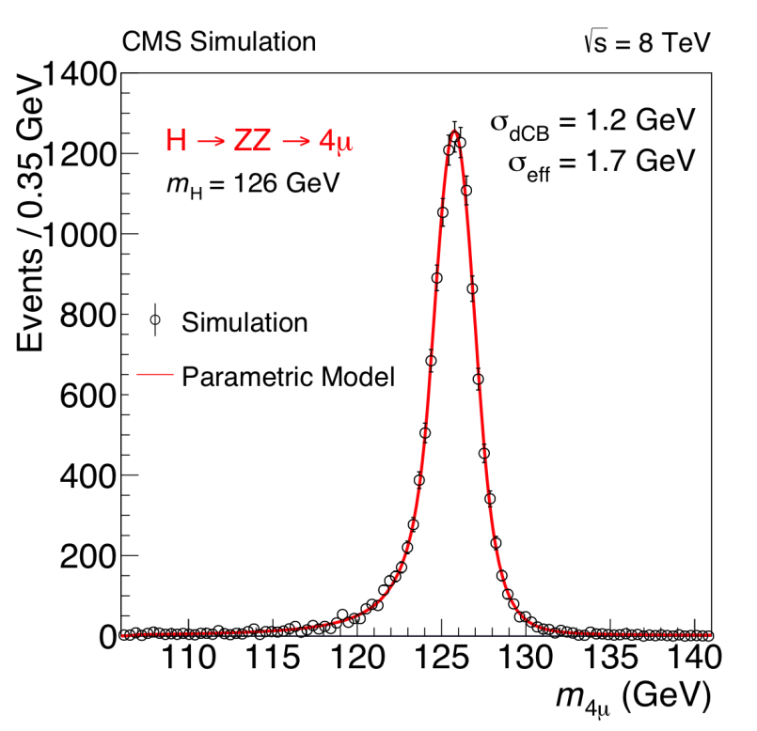
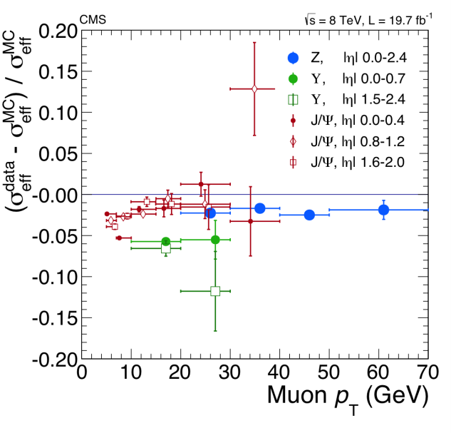
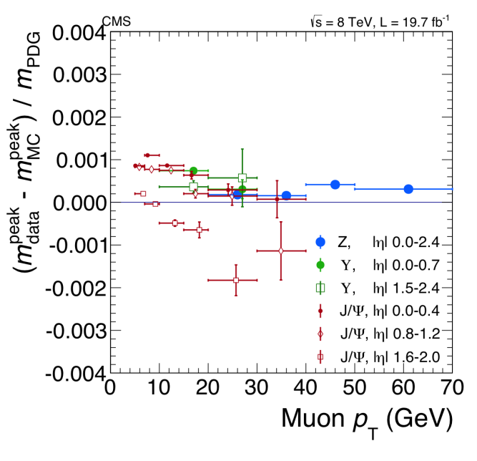
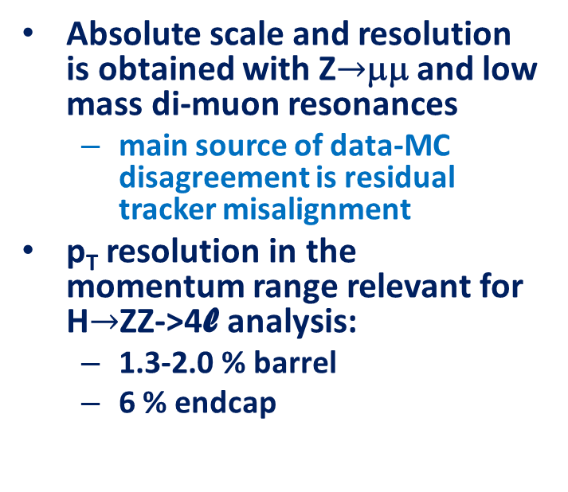
Reconstruction: muons
Absolute scale and resolution is obtained with Z$→$μμ and low mass di-muon resonances
  main source of data-MC disagreement is residual tracker misalignment
p_{T} resolution in the momentum range relevant for H$→$ZZ->4l analysis:
  1.3-2.0 % barrel
  6 % endcap
j2
j2
“Global” muon:
out-in or in-out
“Tracker” muon: in-out
j4
μ
j1
tt->WbWb->μνbjjb candidate

Slide 7
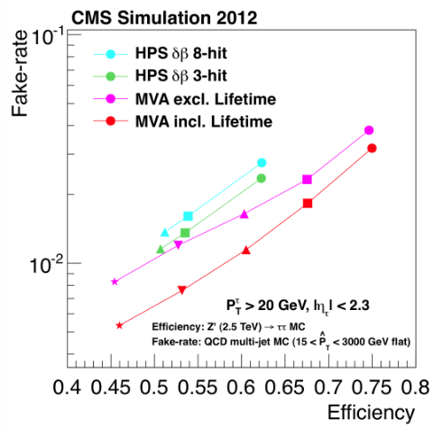
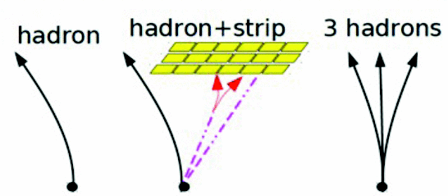
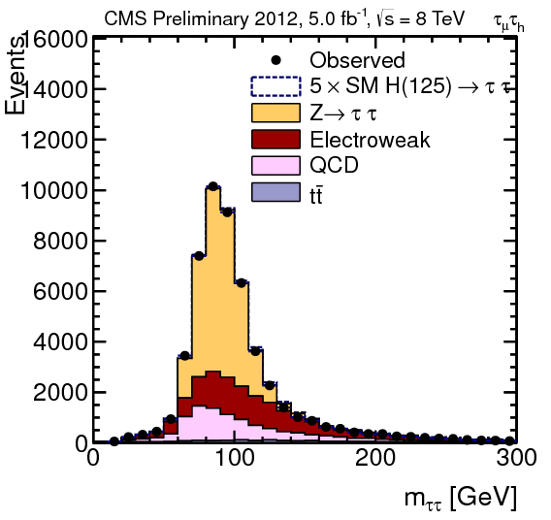
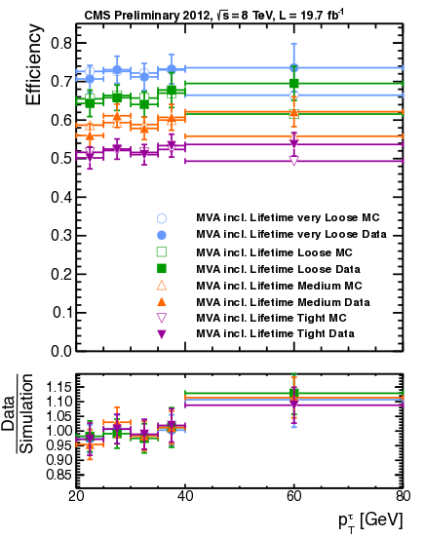
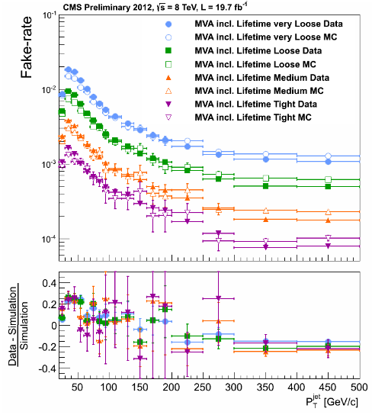
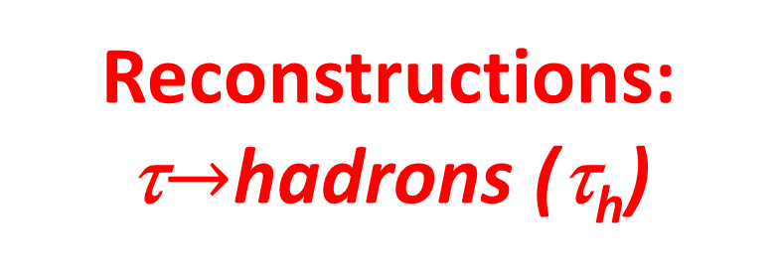
Reconstructions: τ$→$hadrons (τ_{h})
τ ID uncertainty – 7 %
τ JES uncertainty < 3 %
σ(m_{ττ})
15-20 %

Slide 8
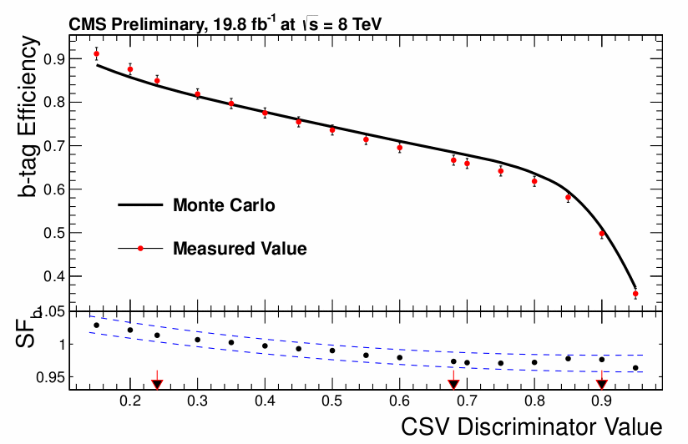
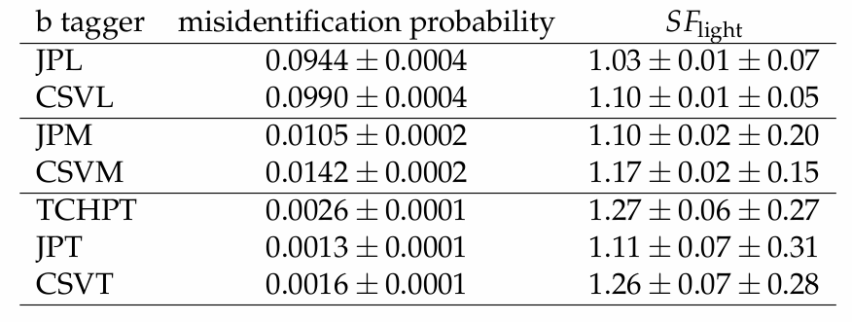
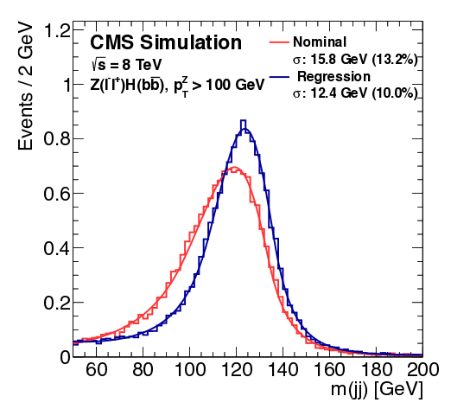
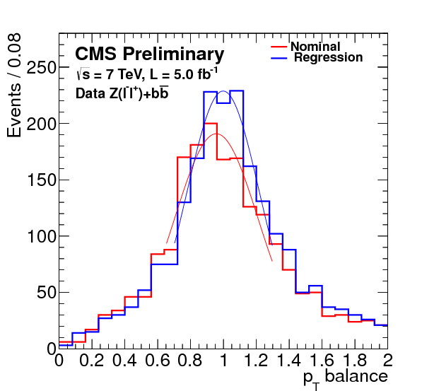
Reconstruction: b-jets
three operational points for b-tagging with Combined Secondary Vertex algorithm
Fake rate: for 80 < p_{T}^{j} < 120 GeV, |η| < 2.4
CSV “medium”
m_{bb} resolution ~ 10 %
CSVM efficiency vs p_{T} of b-jets

Slide 9
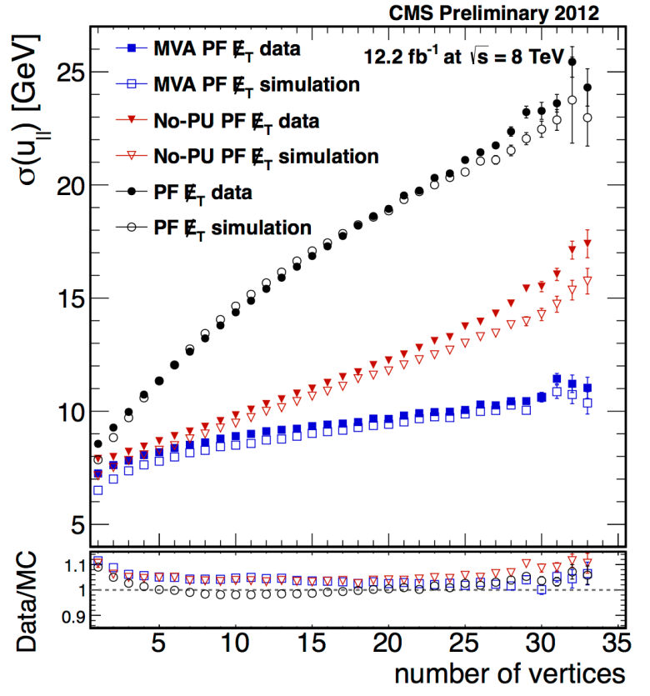
Reconstruction: jets, E_{T}^{miss}
PF (+JPT, Trk, Calo) jets - anti-k_{T} R=0.5
PU jet reductions
  most useful within the tracker acceptance
PU mitigation algos for E_{T}^{miss}
Performance of
PU jet discrimination

Slide 10

Layout for
Higgs result presentation
measurements of h properties
  mass, width, spin/CP
  consistency with SM couplings to bosons and fermions
Searches for BSM Higgs boson(s)
  non-SM h decays
  other Higgs bosons
Rare SM h decays
References to CMS publications are in backup slides

Slide 11
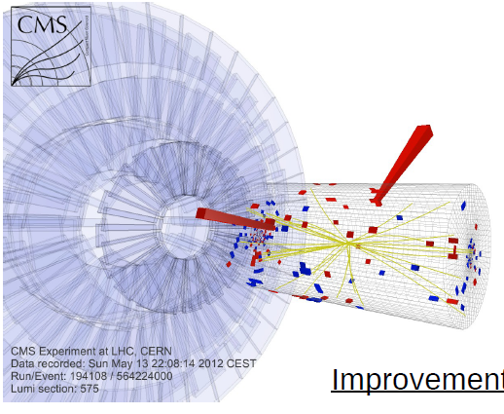
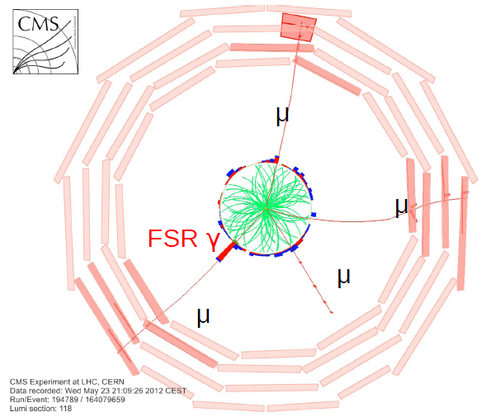
Measurement of h properties

Slide 12
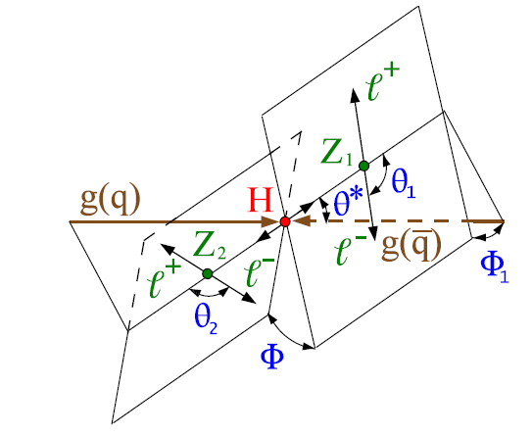

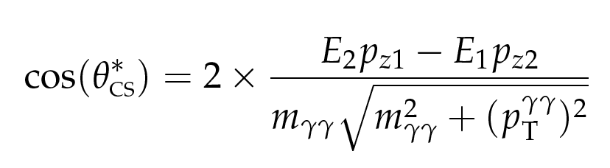

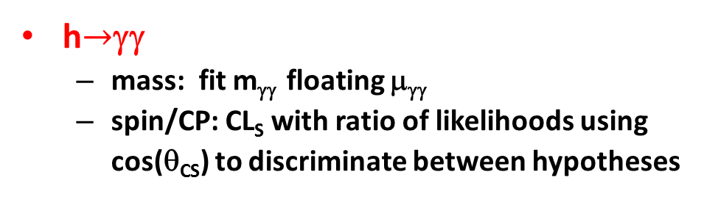
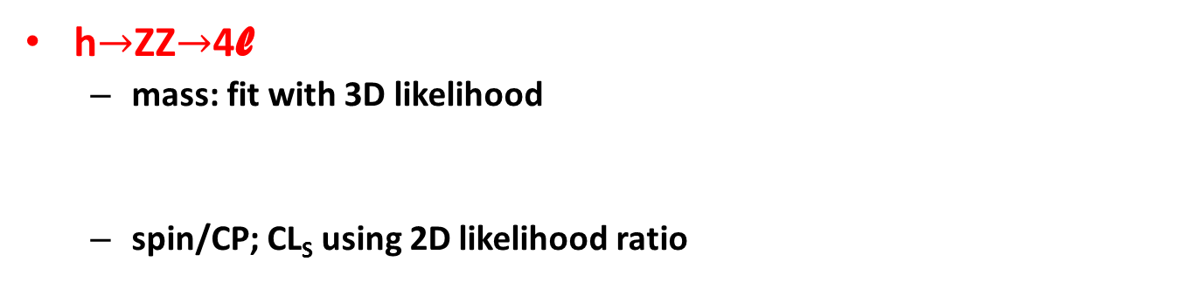
How mass, spin/CP are measured in h$→$ZZ$→$4l and h$→$γγ analyses
h$→$ZZ$→$4l
  mass: fit with 3D likelihood
  spin/CP; CL_{S} using 2D likelihood ratio
per-event mass uncertainty
Discriminants based on Matrix Element
h$→$γγ
  mass: fit m_{γγ} floating μ_{γγ}
  spin/CP: CL_{S} with ratio of likelihoods using
  cos(θ_{CS}) to discriminate between hypotheses
For spin/CP HJU generator
is used in both
γγ and ZZ->4l modes

Slide 13
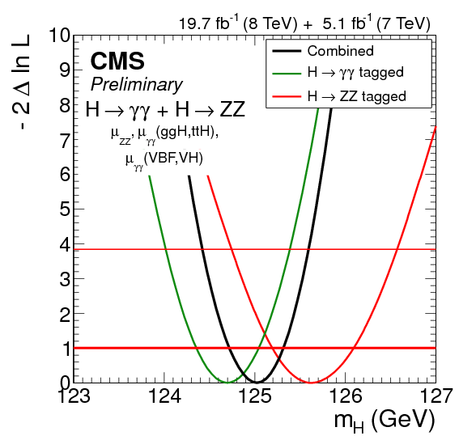
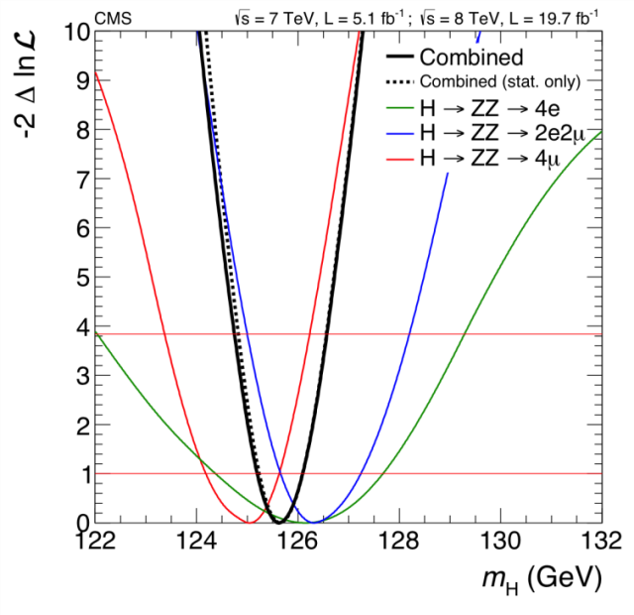
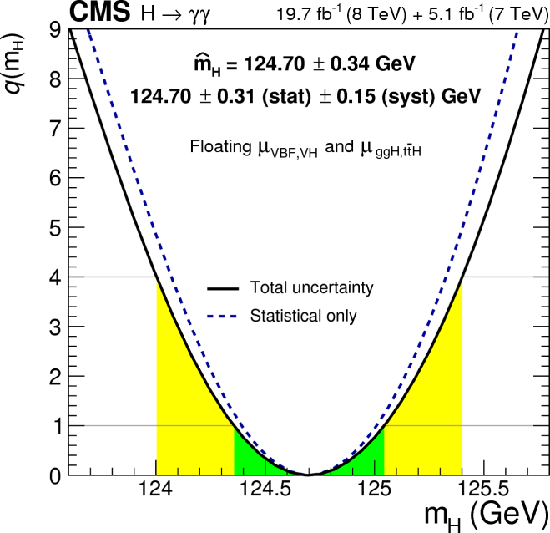
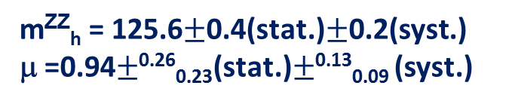

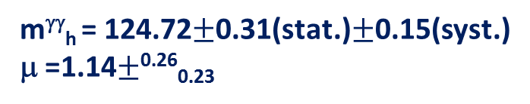


h boson mass
h$→$ZZ$→$4l
h$→$γγ
m^{ZZ}_{h} = 125.6$±$0.4(stat.)$±$0.2(syst.)
μ =0.94$±$^{0.26}_{0.23}(stat.)$±$^{0.13}_{0.09} (syst.)
m^{γγ}_{h} = 124.72$±$0.31(stat.)$±$0.15(syst.)
μ =1.14$±$^{0.26}_{0.23}
Combined m_{h} = 125.0$±$0.30 GeV

Slide 14
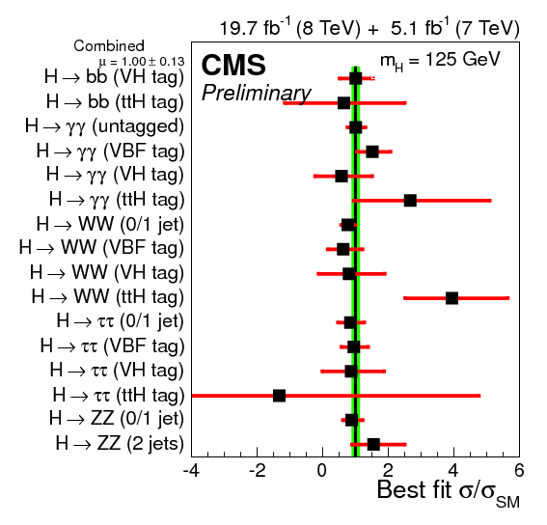
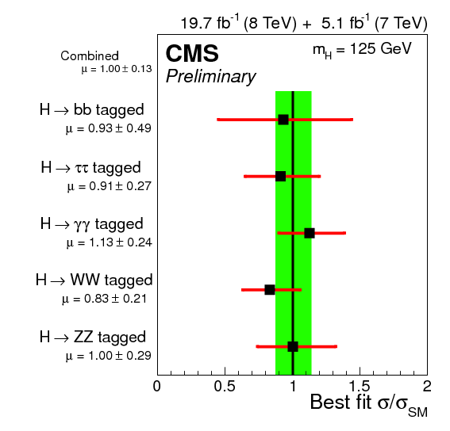

h signal strength at best fit mass
μ = 1.00$±$0.13

Slide 15
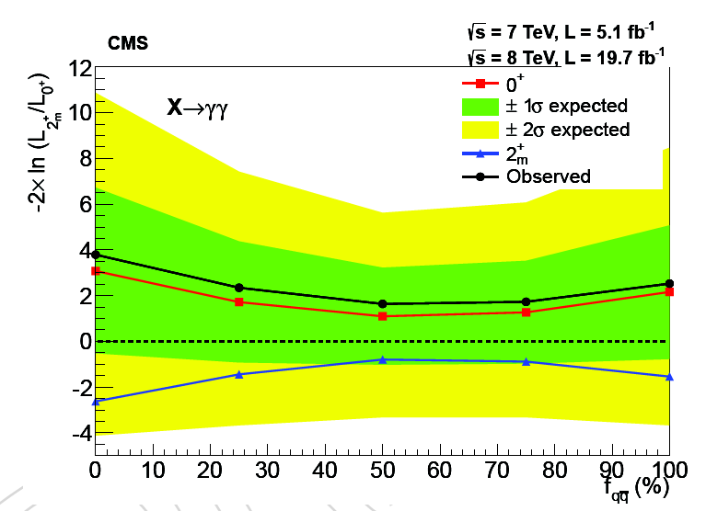
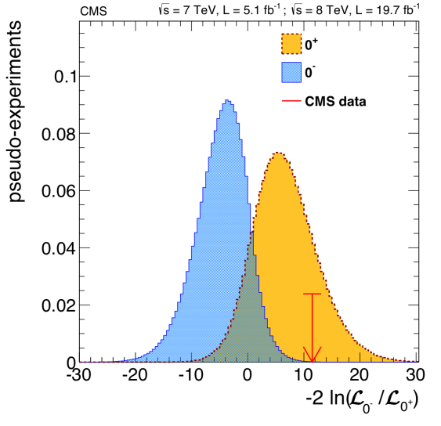
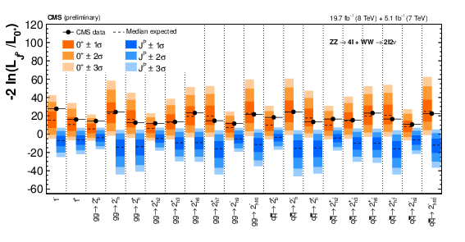
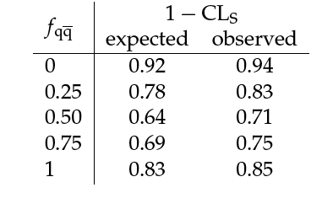


h spin/CP
CP even vs CP odd; spin 0 vs spin 1 or spin 2
h$→$ZZ$→$4l + H$→$WW$→$lνlν
h$→$γγ: 0⁺ vs 2⁺
Pseudoscalar boson,
spin-one and spin-two
hypotheses are excluded
at 99.9% C.L. or higher

Slide 16
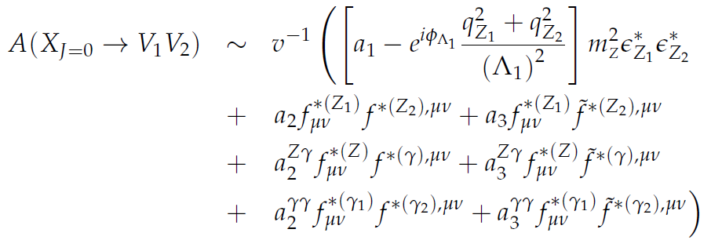
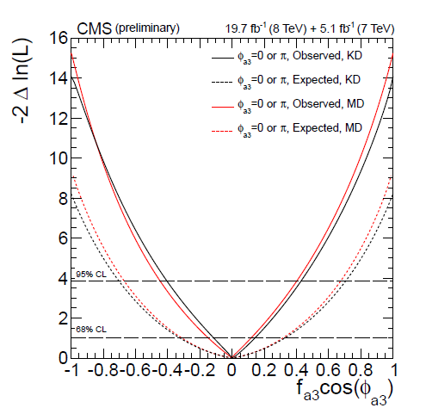

Measuring CP-odd fraction with h$→$ZZ$→$4l (I)
a₁, a₂ - CP-even couplings
a₃ – CP-odd couplings
Λ₁ – scale of new physics
fraction of CP-odd contribution:
σ₁/σ₃=6.36
assuming a₃ to be constant
a₂=0 (no CP-even high dim.)
a₃/a₁ = [-2.05,2.19] observed

Slide 17

Measuring CP-odd fraction with h$→$ZZ$→$4l (II)
Small f_{a3} does not necessary mean small CP-odd admixture
  observables involving the Higgs-gauge couplings project on the CP-even component
  better to look into observables with Higgs-fermion couplings

Slide 18
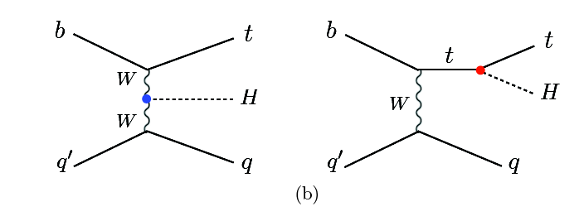




Single top+h, h$→$γγ analysis
J. Ellis, D.S.Hwang, M. Takeuchi arXiv:1312.5736
Due to interference pp$→$tqh process is sensitive to both magnitude and sign of y_{tth}
tth and th can be used to measure scalar and pseudo-scalar h-top couplings
pp->tth pp->th
Upper limit = 4.1 x expected cross-section with k_{t}=-1.

Slide 19



Width of h(125) boson using off-shell H production and ZZ decay
σ_{i->h(on-shell)->f}~ g_{i}²g_{f}²/ Γ_{h}
σ_{i->h(off-shell)->f}~ g_{i}²g_{f}²
σ_{h-gg->ZZ interference} ~ g_{i}g_{f}
Fit on- and off-shell mass region
  varying g_{i}²g_{f}² and Γ_{h}
  assuming SM off/on-shell yield ratio

Slide 20
Higgs boson couplings at LHC
determination of total width impossible without further assumptions
not all final states are accessible
what is done so far:
  perform fits to coupling strength modifiers to check consistency with SM
    LHC HXSWG Recommendations, benchmark models

Slide 21






October 2013 – January 2014 : h(125) boson couples to τ and b
h$→$ττ
Vh, h$→$bb

Slide 22


Some benchmark parameterizations of Higgs boson couplings
k_{V} – common scale factor for vector boson couplings
k_{f} – common scale factor for fermion couplings
assuming no invisible and undetectable widths
k_{γ}, k_{g} – probing loop structure assuming no invisible or undetectable width

Slide 23



Constraining h$→$BSM with “visible” modes
k_{V} < 1
BR_{BSM} < 0.58 at 95% CL

Slide 24


Non-SM h decays: searches for h$→$invisible with VBF h, Zh (Z->ll,bb)
Detection of Dark Matter

Slide 25





most sensitive mode qq’$→$qq’h (VBF h)
Z
Z
E_{T}^{miss}
Jet1
Jet2
Jet2

Slide 26



VBF h$→$invisible: offline signal selections and topology
two jets p_{T}>50 GeV, |η|<4.7
m_{jj} > 1100 GeV
Δη_{jj} > 4.2
E_{T}^{miss} > 130 GeV
Δφ_{jj} < 1.0
Central Jet Veto (CJV)
Signal: small Δφ_{jj}
QCD: large Δφ_{jj}
Δφ_{jj} after selections on:
  m_{jj}, E_{T}^{miss}, Δη_{jj}, CJV
H$→$χ⁰χ⁰
j1
multijets
(“QCD”)
j1
j2
j2

Slide 27


Signal region, with CJV (x,y view)

Slide 28



Interpretation of H->invisible direct search in Higgs-portal Dark Matter models
BR(h_{125 GeV}$→$inv)
< 0.58 at 95 % CL
(expected < 0.44)
combining
VBF and ZH modes

Slide 29





Non-SM h decays:
LFV with h$→$μτ
μτ_{e} 1 jet
μτ_{h} 2 jets
Events are subdivided on 0, 1, 2 jet categories
μτ_{e}, μτ_{h} topologies
m_{h} is reconstructed in collinear approximation
Upper limit:
  BR < 1.57 %
~ 2.5 σ access

Slide 30
Searches for other Higgs bosons

Slide 31

MSSM Higgs bosons
five Higgs bosons in MSSM:
  two CP-even h, H; one CP-odd A, two charged H^{+/-}
  what is discovered as state of 125 GeV, h or H ?

Slide 32



Landscape of
BSM Higgs channels in MSSM
High tanβ : φ$→$ττ, φ$→$μμ; H⁺$→$τν, tb
Intermediate tanβ:
  H/A$→$χ_{i}⁰χ_{j}⁰, χ_{i}⁺χ_{j}⁻
  H⁺$→$χ_{i}⁺χ_{j}⁰
A. Djouadi et.al. arXiv:1307.5205
Low tanβ: A$→$Zh; H$→$hh, tt; H⁺$→$cs, cb, τν, tb, Wh

Slide 33




H $→$hh $→$γγbb
Search strategy:
  looking for signal in m_{γγ} distribution for γγbb events selected within m_{bb} and m_{γγbb} mass windows
In hMSSM (A. Djouadi et.al. arXiv:1307.5205):
  σ(gg$→$H)xBR(H$→$hh$→$γγbb)=2.9 fb for m_{A}=300 GeV, tanβ=2
    close to observed limit !

Slide 34




tt$→$bWbH⁺, H⁺$→$cs, m_{H+} < m_{t}
Search strategy:
  trigger with muon from t->Wb->μνb decay
  search for bump in di-jet mass distribution for jets from 2nd top decay
  kinematic fit with top mass constraint

Slide 35






h,H,A$→$ττ
split events into b-tag and no-b-tag categories
consider τ_{μ}τ_{h}, τ_{e}τ_{h}, τ_{h}τ_{h}, τ_{e}τ_{μ}, τ_{μ}τ_{μ} final states
model independent limits
m_{A}-tanβ exclusions in new benchmark scenarios (M.Carena at al. arXiv:1302.7033)

Slide 36





Searches for heavy H decays into ZZ and WW
Interpretation in the
Additional EW singlet
model (h, H):
σ_{h}=c $×$ σ_{h,SM}
Γ_{h}=c $×$ Γ_{h,SM}
BR_{h,i} = BR_{h,SM,i}
σ_{H}=c’ $×$ σ_{H,SM}
Γ_{H}=c’ /[1-BR_{H,new}] Γ_{H,SM}
BR_{H,i} = [1-BR_{H,new}] BR_{H,SM,I}
c²+c’²=1
c’²=1-μ_{h}
μ_{H}=c’²[1-BR_{H,new}]
H->WW->2l2j H->ZZ->2l2ν

Slide 37








Rare SM h decay
Decay mode | limit σ / σ _{SM}
h$→$γ*γ$→$μμγ | ~ 10
h$→$Zγ | ~10
h$→$μμ | 7.4
h $→$γ*γ$→$μμγ m_{μμ} < 20 GeV
h$→$Zγ
h$→$μμ

Slide 38




Resent result on tth, h->bb: limit 3.3 σ_{SM} at 95 % C.L.
Not rare, but difficult and very important channel
  supposed to be the hot subject with 13 TeV data
1l + $≥$ 5 jets or 2l+ $≥$ 4 jets with $≥$ 2 b-tagged jets
ME method based on LO MadGraph
  must use NLO generation in Run2 analyses !

Slide 39
Conclusions
Very reach physics program for BSM Higgs boson searches and h(125) boson measurements at LHC
We expect to have another discovery in the Higgs sector during LHC or HL-LHC operation

Slide 40
BACK UP

Slide 41
References to CMS results shown
h->ZZ->4l, arXiv:1312.5353 Phys. Rev. D 89 (092007) , width: PAS-14-002
Tensor structure from H->WW and combined with H->ZZ; HIG-14-012, HIG-14-014
h->γγ, (p)
h->WW, arXiv:1312.1129, JHEP 01 (2014) 096
Combination for h decays to fermions, HIG-13-033, arXiv:1401.6527
  h->ττ , arXiv:1401.5041, JHEP 05 (2014) 104
  Vh, h->bb , arXiv:1310.3687, Phys. Rev. D 89, 012003 (2014)
tth combination, HIG-13-029 (to be paper), ttH with ME HIG-14-010
pp->qth, h->γγ HIG-14-001, h->bb HIG-14-015
h->Zγ/γ*γ->llγ, h->μμ, ee, arXiv:1307.5515, HIG-14-003, HIG-13-007
h->invisible, arXiv:1404.1344
h->μτ, HIG-14-005
φ->ττ, μμ HIG-13-021, HIG-13-024
H->hh->γγbb, HIG-13-032
H->hh, A->Zh with multi-leptons and di-γs, HIG-13-025
Heavy X->γγ , HIG-14-006
H⁺->τν with τ_{h}, no CADI line yet
H⁺->tb, τν (with τ_{l}), HIG-13-026
H⁺->cs, HIG-13-035
H->WW,ZZ, heavy Higgs combination HIG-13-031,
  heavy Higgs HIG-14-007 (ZZ->2l2q),14-008 (WW->lnuJ) , HIG-13-027(jj)/008 (J) (WW->lnujj), HIG-13-014 (H-ZZ->2l2ν)
Couplings from combination, HIG-14-009

Slide 42



Constraining BR(h$→$inv) using direct h$→$inv searches AND “visible” modes
BR_{invisible} < 0.50 at 95% CL
(“invisible” - any decay mode that goes into “non-interacting” particles)

Slide 43


Low tanβ: H->hh and A->Zh with multi-lepton and di-photon final states
Limits on σxBr for gg->H->hh (gg->A->Zh) are given assuming SM BRs for h and no contribution from gg->A->Zh (gg->H->hh)
In hMSSM (A. Djouadi et.al. arXiv:1307.5205):
  σ(gg->A)BR(A->Zh)=1.7 pb for m_{A}=300 GeV, tanβ=2.0 - close to observed limit !
  σ(gg->H)BR(H->hh)=3.9 pb for m_{A}=300 GeV, tanβ=1.0 – lower than observed limit

Slide 44


Slide 45


Constraining “invisible” and “undetectable” modes using direct h->inv searches AND “visible” modes
1σ 2σ 3σ
BR_{undet} < 0.53 at 95% CL
(“undetectable” - any mode, SM or BSM, that can’t be seen,
e.g. due. to bkg or other reasons)

