Slide 1
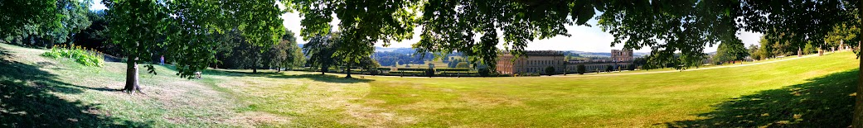


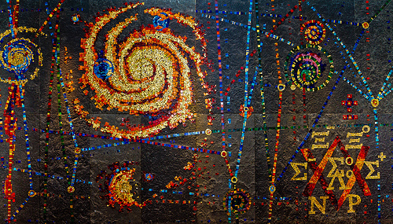
The Case of Light Neutralino
Dark Matter
Zhen Liu
with Tao Han and Shufang Su
arXiv:1406.1181, accepted by JHEP

Slide 2
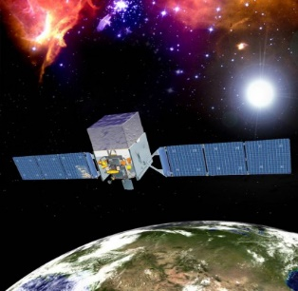
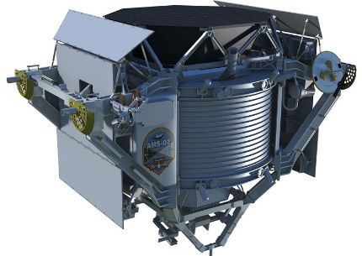
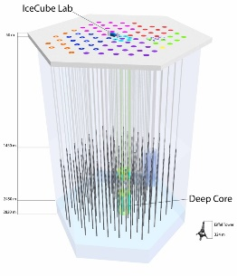
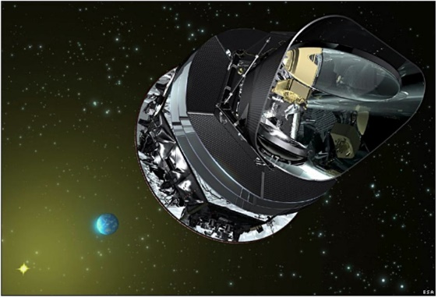

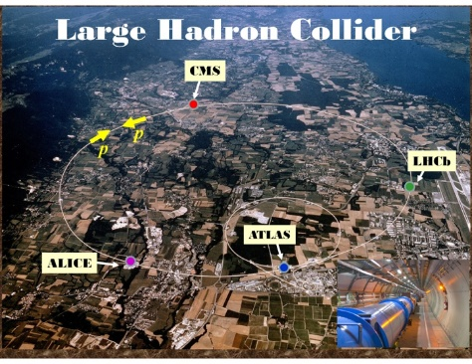
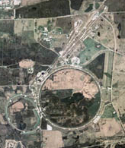
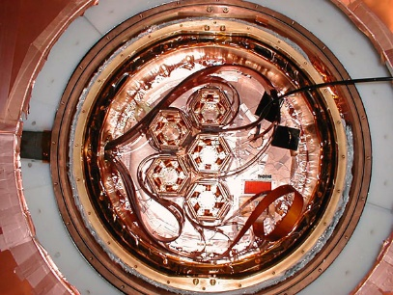

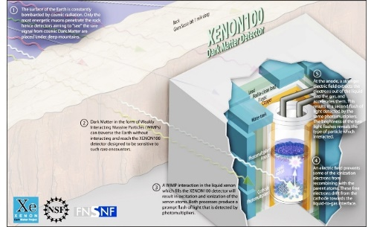
Dark Matter
Particle DM is well-motivated!
-
Dark Matter
We explore DM from ALL DIRECTIONS with unprecedented (and growing) sensitivity!

Slide 3
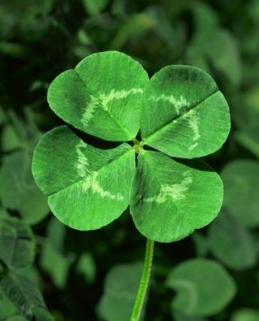


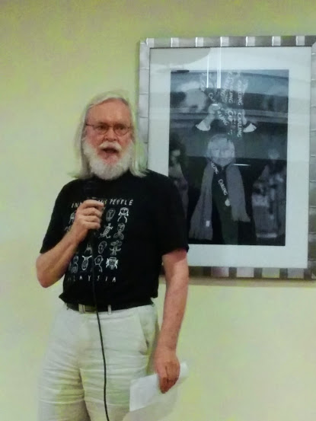

Complementarity
-
consistent observations among all approaches
indirect
detection
DM
SM
relic
density
collider
searches
direct
detection
DM
SM
To verify the consistence, one need to specify the model.
We all know SUSY is well-motivated according to

Slide 4


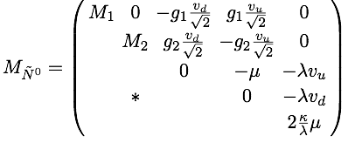

Neutralino Dark Matter @ MSSM
-
Gauginos and Higgsinos
Neutral ones: Bino, Wino, Hu⁰, Hd⁰
charged ones: Winos, Hu⁺, Hd⁻
Parameters: M1, M2, μ, tanβ
~
~
~
~
Neutralinos and charginos

Slide 5
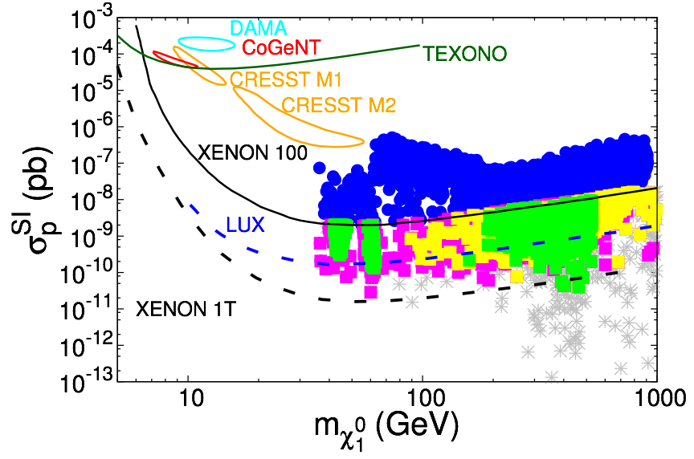
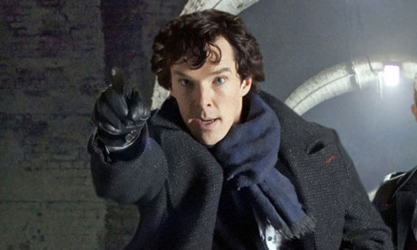
Dark Matter in MSSM
lightest neutralino LSP in MSSM as good dark matter candidate
-
Low mass region
(2-40 GeV)
not Wino/Higgsino
hard to obtain fast enough annihilation
need help from other particles
sfermion-coann
Z-funnel
H/A-funnel
h-funnel
blind-spots
Han, ZL and Natarajan , 1303.3040
Bino-like with Higgsino component

Slide 6
Light Neutralino LSP
Ways out if assuming thermal relic
Famous “Funnel” regions to hit the s-channel resonance for the mediator.
Especially near the PQ-limit NMSSM, automatically light CP-odd singlet like Higgs.
Famous “Co-annihilation” regions to have sfermions in thermal equilibrium help LSP annihilate efficiently.
Dark Light Higgs, P.Drapper, T.Liu, C.Wagner, L-T. Wang and H.Zhang
A.Arbey, M.Battaglia and F.Mahmoudi, 1205.2557

Slide 7
Light Neutralino LSP
Ways out if assuming thermal relic
Famous “Funnel” regions to hit the s-channel resonance for the mediator.
Especially near the PQ-limit NMSSM, automatically light CP-odd singlet like Higgs.
Famous “Co-annihilation” regions to have sfermions in thermal equilibrium help LSP annihilate efficiently.
Dark Light Higgs, P.Drapper, T.Liu, C.Wagner, L-T. Wang and H.Zhang
A.Arbey, M.Battaglia and F.Mahmoudi, 1205.2557

Slide 8
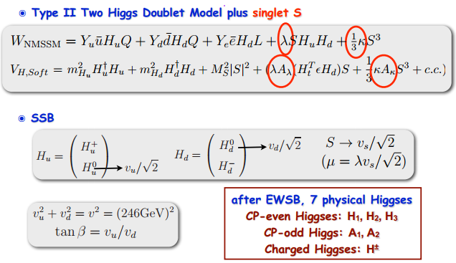
Higgs Sector in the NMSSM
For discussion about Low-mass Higgs states, see our work
N.Christensen, T. Han, ZL and S. Su, 1303.2113

Slide 9






Neutralinos @ NMSSM
-
Bino-like LSP
Singlino-like LSP

Slide 10
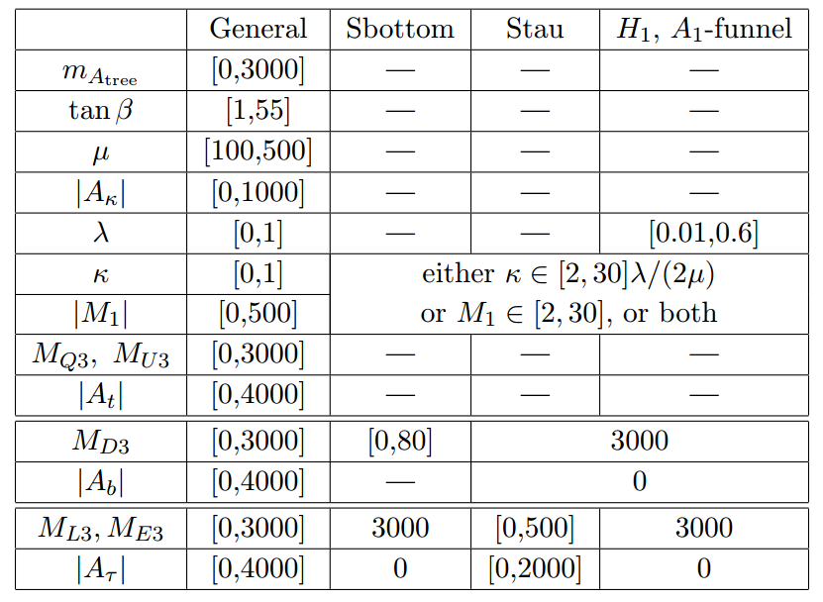
Finding the Solutions
Using modified NMSSMTools4
Multiple way of scanning:
General
Dedicated
Seeded
Log prior used for several dedicated scans

Slide 11
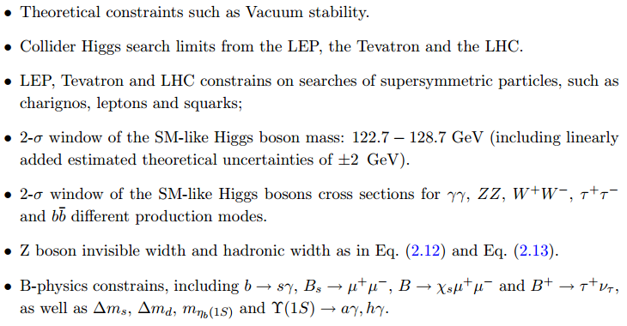
Finding the Solutions

Slide 12



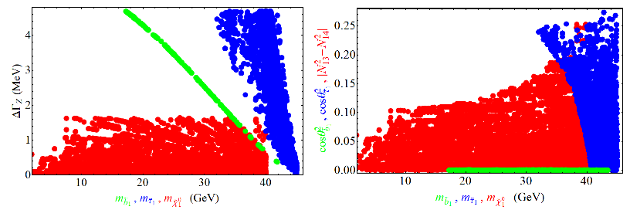
Constraints for Low Mass
-
Light neutralino LSP: invisible Z decay with
Bino LSP: μ > 140 GeV
Singlino LSP: μ/λ > 540 GeV
neutralino LSP
neutralino LSP

Slide 13



Constraints for Low Mass
-
Light sfermion: total Z decay width
sbottom: mostly right-handed
stau: even mixture of left and right-handed
stau
sbottom

Slide 14
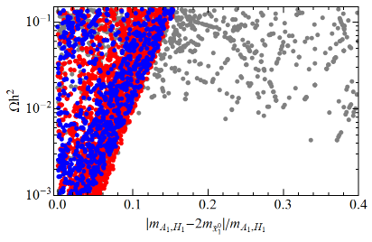
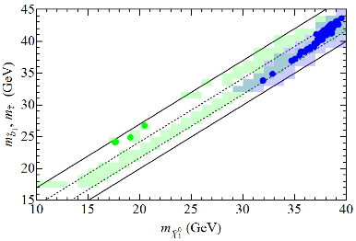
DM Properties
A1 /H1 funnel
-
coannihilation
H1-funnel
stau-coann
Z-contribution
A1-funnel
sb-coann

Slide 15
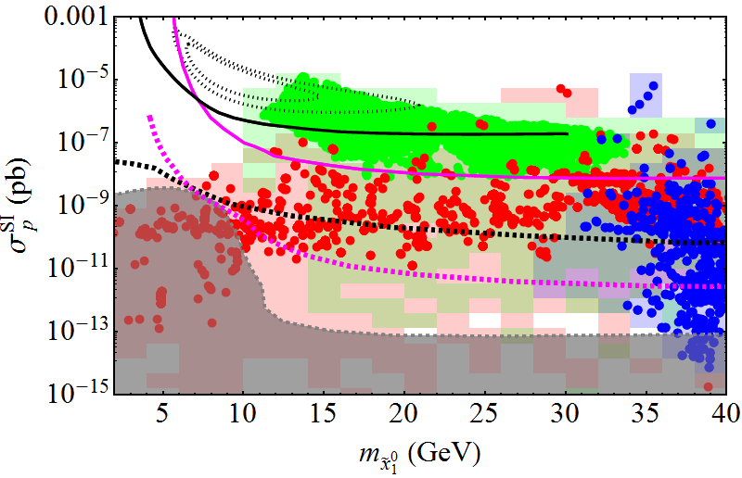

Direct Detection
CDMS
LUX
LZ
superCDMS
superCDMS
coherent neutrino scattering
Tight/Loose relic Density required
For Solid/Shaded
Red A1/H1-funnel
Blue Stau coannhilation
Green Sbottom coannihilation

Slide 16
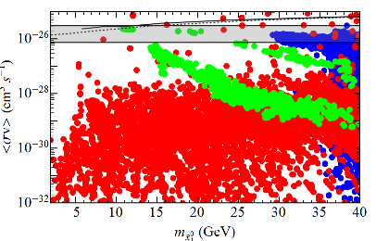
Indirect Detection
Fermi-LAT exclusion (NFW profile)
-
GeV γ ray excess with
35 GeV DM XX → bb

Slide 17
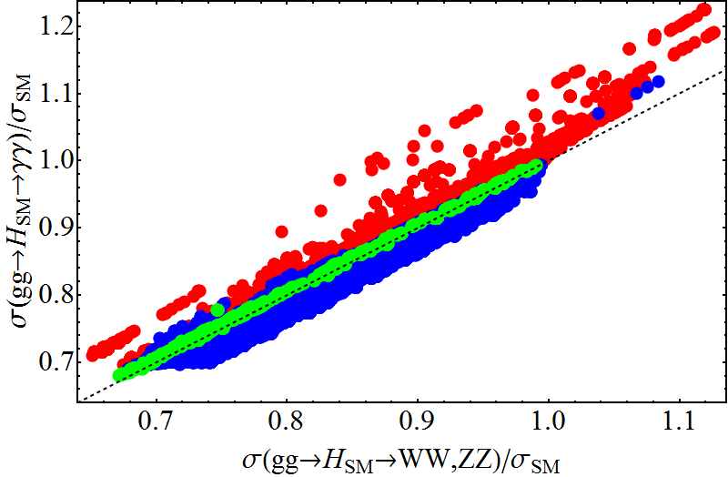
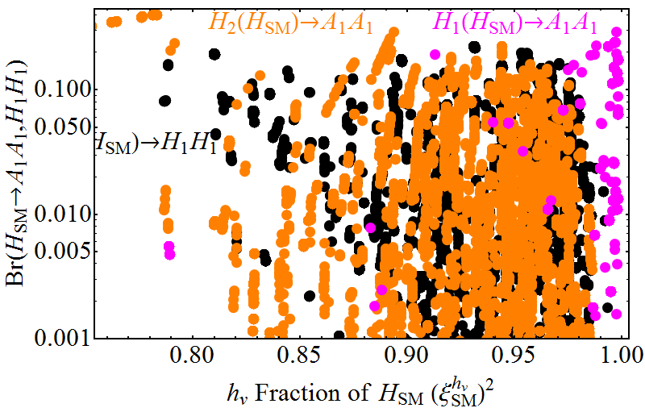
126 GeV
Higgs Boson!
Not much Enhanced Diphoton
Stau, sbottom loop does not contribute much in our case as one expected from limits of Br of Higgs.
Exotic decays
Up to 30%
May have triggering issue. See discussions by D.Curtin, ZL et al. the Exotic Higgs Decay Working Group,
1312.4992

Slide 18
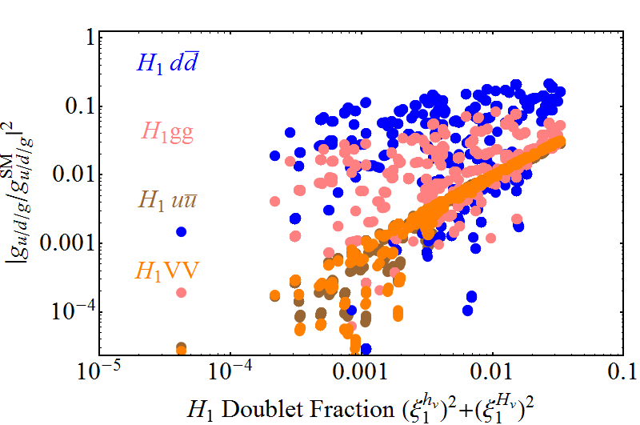
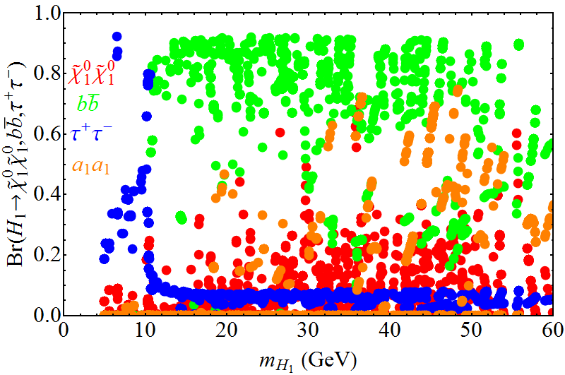
Example:
Light H1
Generally singlet-Higgs-like
<10% SM Higgs production rate for most modes for a given mass
Mainly bottom pairs
tau pairs.
Decay to LSP pairs kinematically suppressed as well as required by efficient annihilation.
a1 pairs possible

Slide 19
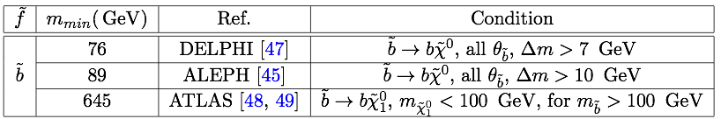

Light Sbottom
-
Light sbottom with compressed spectrum: small Δm
Δm > mb: prompt sbottom decay, 2b+MET
Δm < mb: R-hadron: prompt, displaced vertex, CHAMP...
depend on the flavor structure
LEP limits

Slide 20
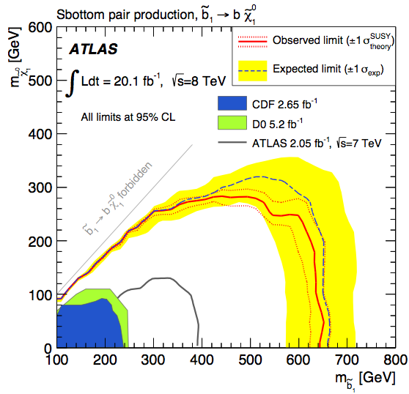


Light Sbottom
-
ATLAS limits: 2b+MET,bbj+MET
bbjMET
bbMET

Slide 21
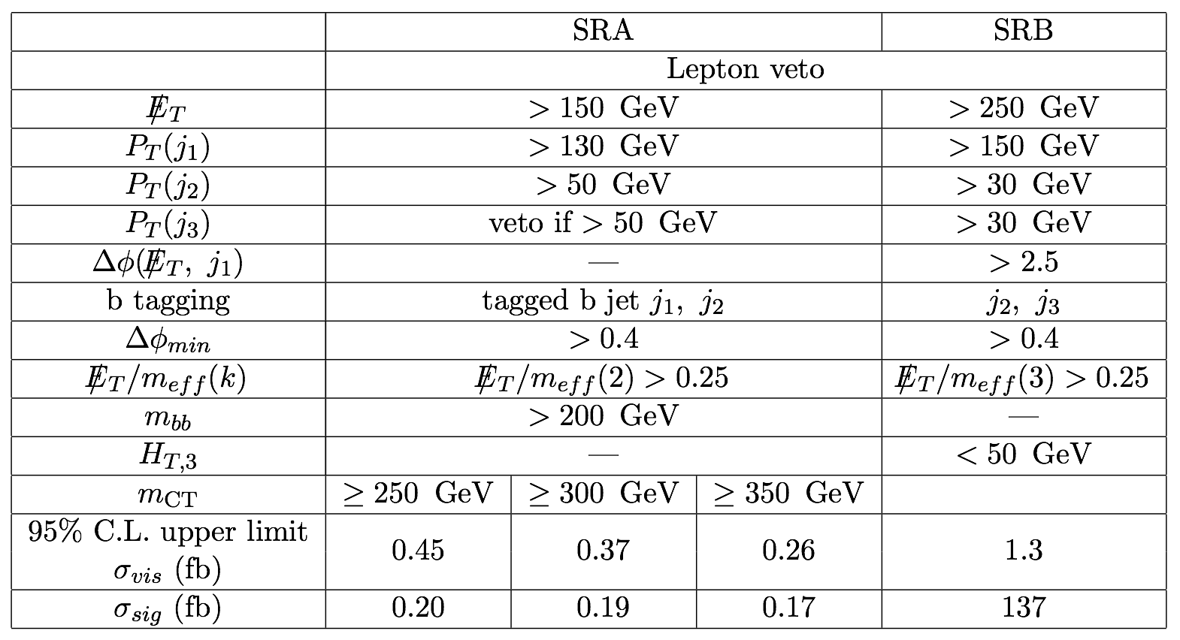

Light Sbottom
-
recast ATLAS sbottom search results for light sbottom
msb=20 GeV, mX=14 GeV, prompt decay
bbMET
bbjMET
Δm > mb (prompt sb decay): ruled out
Δm < mb: R-hadron, depends on the decay life time
prompt decay: difficult at LHC
quasi-stable: CHAMP, ruled out @ LEP

Slide 22
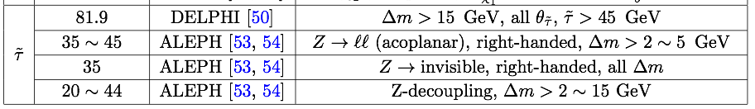
Light Stau
-
LEP limit
LHC limit with stau from neutralino/chargino decay
not applicable with large MT2 cut of 90-110 GeV
ττ(j) + MET search difficult with WW(j)+MET background.
light stau difficult at LHC as well.

Slide 23


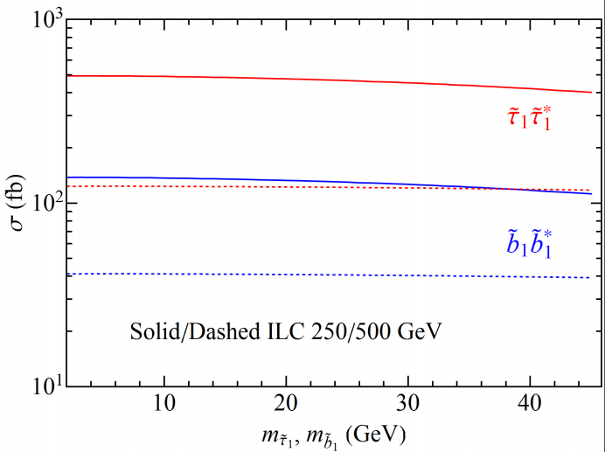

Light Sfermion @ ILC
sb, stau pair production
-
stau
Δm > mτ : ττ+MET
despite low tagging eff, observation @ ILC possible.
Δm < mτ : CHAMP
ruled out @ LEP
sbottom
Δm > mb : ruled out @ LHC
Δm < mb : R-hadron
stable: ruled out @ LEP
decay: ILC observation possible

Slide 24
Conclusion
Thank you!
-
light neutralino dark matter (2 - 40 GeV)
 | A1/H1 funnel | sb-coann | stau-coann
DM | Bino/Singlino | Bino | Bino/Singlino
light particle | mA1/H1~2mX singlet-like | msb > 16 GeV Δm < mb | mstau>32 GeV Δm < 3-5 GeV
relic | ✓ | ✓ | ✓
direct detection | ✓ | ✓ | ✓
indirect detection | ✓ | ✓ | ✓
via SM Higgs | ✓ | ✓ | ✓
LHC | ✓ | x | x
ILC | ✓ | ✓ | ✓

Slide 25
Tuning?
Showed up in many places
Resonance
Co-annihilation⬄ small mass splitting
Z decoupling

Slide 26
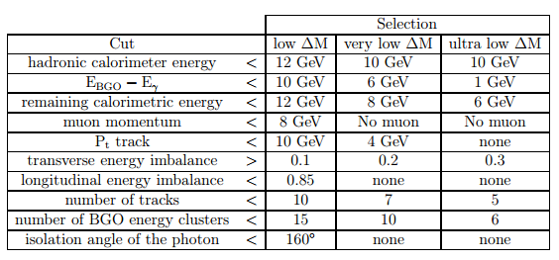
LEP ConstrAIns from mono-photon

Slide 27


