Slide 1
Geometric Description of the Standard Model
Kang-Sin CHOI
Ewha Womans University
SUSY 14, University of Manchester
June 22, 2014
Based on 1309.7297

Slide 2
Nontriviality of the Standard Model
Gauge theory SU(3)×SU(2)×U(1)
Bifundamental reprs.
3 × q (3,2)_{1/6}, u^{c} (3*,1)_{2/3}, l (1,2)_{1/2}, …
1 × h_{d} (1,2)_{1/2}

Slide 3
Bi-fundamental
Note bi-fundamental representation of the SM fields under non-Abelian gauge group.
  Open string has two ends: two charges of fundamental representations (m,n*)
  Between the same gauge group: adjoint
The lowest order interactions of scattering amplitudes are reproduced by (super-)Yang-Mills action.

Slide 4
Branes
In the T-dual space, the charges are translated into boundary conditions: possible endings or branes.
Remarks
  Local gauge symm enhancement to U(3).
  Either 2₁ or 2*₋₁ exclusively survives
  Problems in D-brane construction using perturbative srings.
U(3) U(1) x U(2) U(1) x U(2)

Slide 5
In M/F-theory
Strings are lifted to M2 branes: geometric origin of SYM.
Charge assignment: how such spheres are connected.
  Interval between branes are lifted to 2-spheres.
  Blowing-up and blowing-down.
  Exceptional group possible.
+1
-1
  U(1)xU(1)xU(1)
  U(2)xU(1)
  U(3)

Slide 6
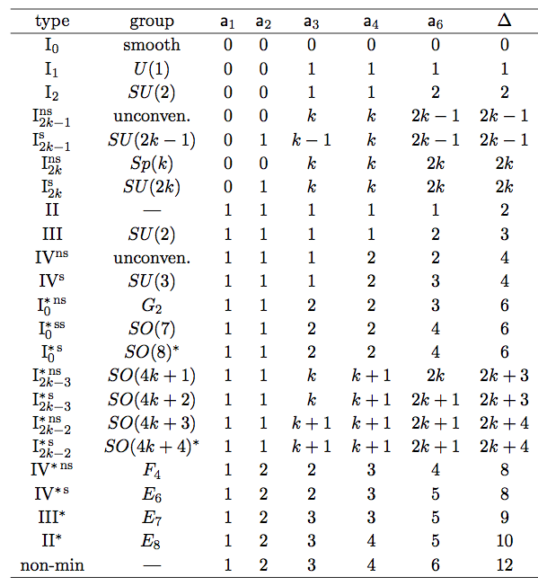
Constructing model
Way to construct a simple group is known.
  y² = x³ + a₁ x y + a₂ x² + a₃ y + a₄ x + a₆
  Minimal degrees in w in a_{i} determine topological structure.
  Model construction: Preparing Calabi-Yau manifold with a desired singularity.
Virtual M/F dir
x,y
w
normal to
brane dir

Slide 7
SU(5) singularity
SU(5) is described by series of 2-spheres,
having the same connectedness structure with SU(5) Dynkin diagram.
I₃ SU(3) 0 1 1 2 3 3
I₅ SU(5) 0 1 2 3 5 5
y² = x³ + a w⁰ x y + b w¹ x²
+ c w² y+ d w³ x + e w⁵

Slide 8
My results
Construction of semisimple group SU(3)×SU(2)
  Deformation of SU(5) singularity
  – footfrint of Grand Unified structure.
    Cf. separate construction of SU(3), SU(2) [Lin, Weigand].
Blow-up analysis
  Proof of the construction.
Construction of Abelian group U(1)
  Globally valid two-cycle
[KSC, Kobayashi]
[KSC 12]
[KSC 13] [Mayrhofer, Palti, Weigand] [Esole, Yau]

Slide 9
Deforming SU(5) singularity
y² = x³ + a x y + b w x² + c w² y + d w³ x + e w⁵
Addition of lower order terms
in w deforms the singularities.
  Ex. SU(5) → SU(3)
Very special, one parameter,
deformations.
I₃ SU(3) 0 1 1 2 3 3
I₅ SU(5) 0 1 2 3 5 5

Slide 10
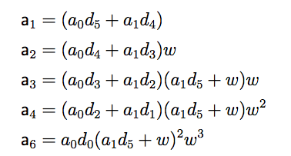
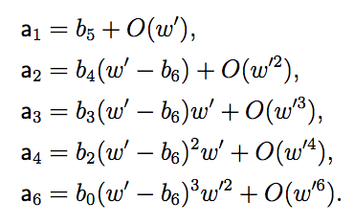
SU(3)×SU(2)×U(1) singularity
  The SU(3)×SU(2)×U(1) singularity is obtained by tuning the coeffs a_{i}.
  The SU(3) gauge theory is localized at hypersurface w = 0.
  The SU(2) at another w +a₁d₅ = 0.
  Desired gauge symmetry enhancements:
  u^{c},d^{c:} SU(3) → SU(4), l,h: SU(2) → SU(3), q: SU(3)xSU(2) → SU(5).

Slide 11
Need for unification
In F-theory, we have two ways to control the unbroken group and 4D chirality
  Configuration of 7-branes. Ex. SU(3)×SU(2)×U(1)_{Y}
  G-flux
We may turn on universal G-flux along the ‘commutant’ SU(5) or SU(4) in ‘E₈’.
  Unbroken gauge group still SU(3)×SU(2)×U(1)_{Y}.
  Matter unification: guaranteed 3 generations for matter fields in
  16 for SU(5) flux, or
  27 for SU(4) flux.
  Cf. No heterotic dual. We don’t touch U(1)_{Y}.
  The SM group is inherited from the unified group E₄ ⊂ E₅ ⊂ E₈.

Slide 12

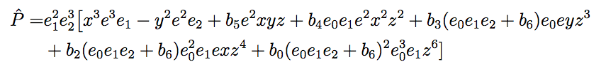
Resolution
accompanied by scalings.
The resolved SU(3)×SU(2) singularities:
Correct intersection structure.
e₀
e₁
e₂
e

Slide 13
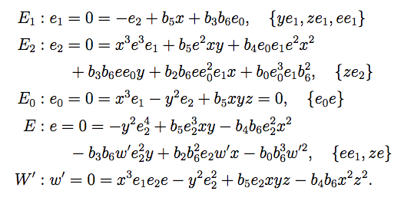
Resolution
e₀
  We have 3 resolutions e₁ = 0, e₂ = 0, e=0
  forming SU(3) and SU(2) Dynkin diagram.
  e₀ = 0 and w’=0 are already present but
  play similar roles (extended roots).
  SU(3) and SU(2) are independent
  but their resolutions are not.
e₁
e₂
e

Slide 14
Relation to group theory
The equation at y² = x³, or t² = x: we see other zeros
  ~ (t – t₁) (t – t₂) (t – t₃) (t – t₄) (t – t₅) (t – t₆)
  Similar to spectral cover equation parameterizing the locations of the ‘flavor’ 7-branes
  Monodromy: for generic coefficients, locally factorized but
  but not globally.
Unbroken group: the commutant of the described group SU(5) in E₈: SU(3)xSU(2).
Two
globally
connected

Slide 15
Factorization and U(1)
Factorization
  The 1+5 factors parameterize S[U(1)xU(5)].
= Globally adjusting the coefficient,
  The resulting CY is singular,
  of a form x y = z₁ z₂
  so we do small resolution to obtain a new
  resolved CP¹ now we call S. [Mayrhofer, Palti, Weigand] [Esole, Yau]
Globally valid U(1) from C₃ = ∑ A₁ w₂
Desirable charges from the intersection structure,
after Shioda map.
E₁
E₂
S
E

Slide 16
Conclusions
F-theory provides us:
  Geometric origin of gauge theory
  Exceptional group appropriate for GUT
Construction of the SM gauge group
  SU(3)×SU(2) from deformation of SU(5)
  Unification of quarks and lepton generations (+neutrinos)
  Blow-up analysis
  Globally valid U(1) with the desired charges.

