Slide 1

RGEs and group theory calculations with the Susyno program
Renato Fonseca
renato.fonseca@ific.uv.es
AHEP Group, Instituto de Física Corpuscular
CSIC/Universitat de València, Spain
SUSY 2014
Manchester

Slide 2
Outline
Using Susyno to make Group Theory calculations
Summary
The Susyno program: what is it for?
It was created to calculate the RGEs of SUSY models
I
I will focus mainly on this point in this presentation
II
III

Slide 3
The Susyno program: what is it for?
Notes:
Very broadly speaking, what is the context to this research program?
OR
So what is the backgroud [to all this]?

Slide 4
Automation in High Energy Physics
Alpgen, BlackHat, CalcHEP/CompHEP, CutTools, Delphes, DIANA, FeynArts/FormCalc, FlexibleSUSY, Golem, Grace, HAWK, HELAC-PHEGAS/HELAC-1Loop, Herwig++, ISAJET, MadGraph/MadEvent, MadGolem, MC@NLO, MCFM, PGS, POWHEG, Prophecy4f, PYTHIA, Samurai, SARAH, Sherpa, SOFTSUSY, VBF@NLO, Whizard, …
THEORY
Model definition
Lagrangian
Feynman rules
Process amplitudes
Hadronization
Event generation
FeynRules
LanHEP
ModelMaker
SARAH
…
OBSERVABLES
Gauge theories are defined by a gauge group and fields transforming under some of its representations. The rest are usually just conventions/notation (fixing a specific basis for the representations, naming the parameters, …)
Handling of Group Theory is needed
4

Slide 5


Susyno
web.ist.utl.pt/renato.fonseca/susyno.html
Susyno is a Mathematica package which was created to compute the Renormalization Group Equations (RGEs) of SUSY models.
The two-loop RGEs of a generic Yang-Mills theory are known for SUSY (and non-SUSY) models, but in order to apply them to specific models it takes some work. One reason for this is that the equations are written for and as a function of the following generic tensors:
RF 2012
Martin, Vaughn
1994, 2008
Yamada 1994
Note that are to be expanded in all indices (in principle).
This includes the gauge indices.
To my knowledge, LieART is the only other Mathematica package with some (not all) of these functions.
As such, a big part of Susyno’s code is dedicated to Group Theory. It can compute various quantities for any gauge group and field content. Such functions are available for other applications.
Feger, Kephart 2012

Slide 6
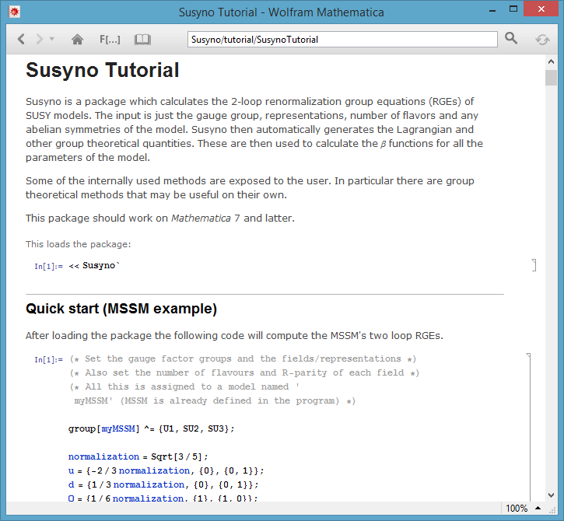
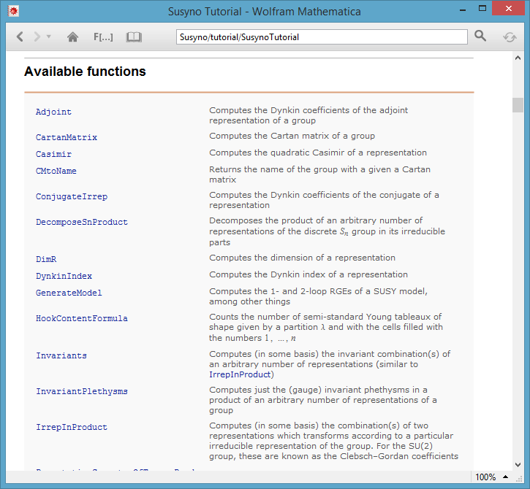
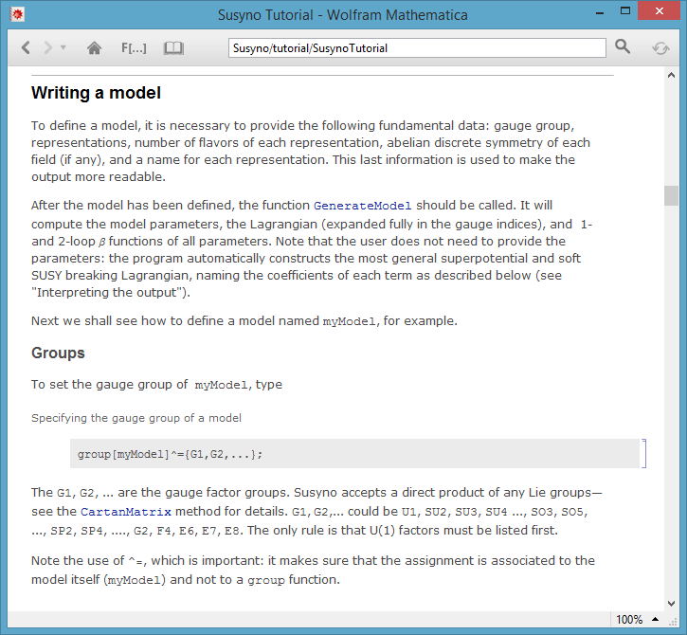
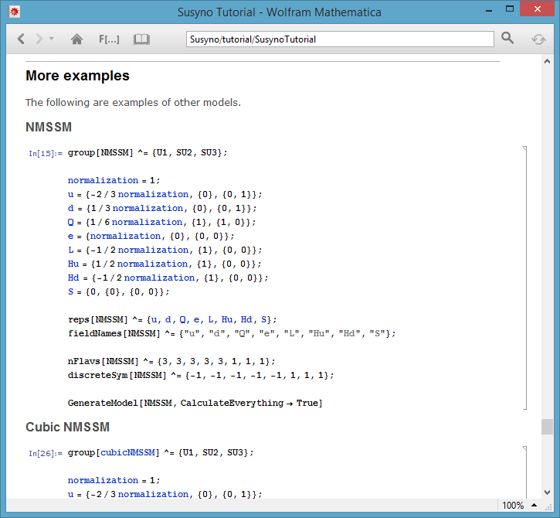
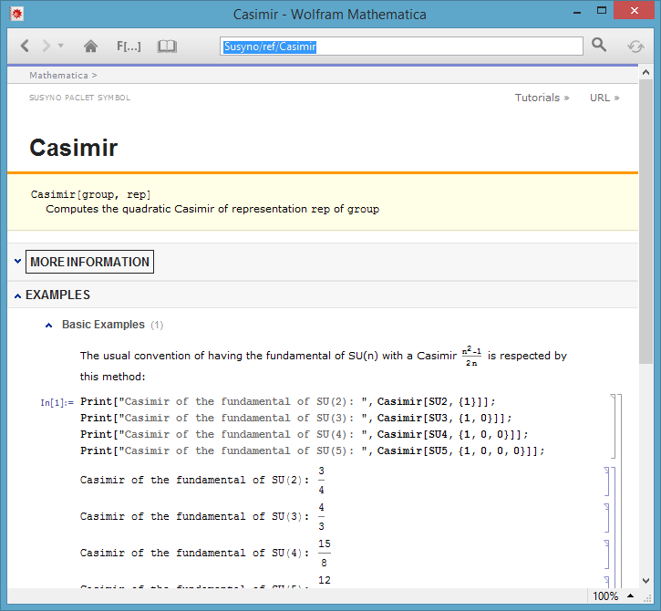
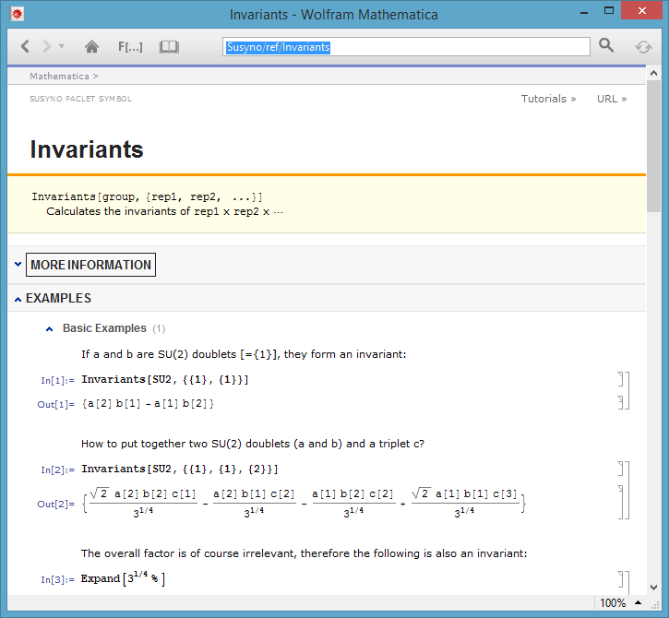
Susyno
Documentation
Published manual
Computer Physics Communications 183 (2012) 2298
arXiv:1106.5016 [hep-ph]
Built-in documentation
Up-to-date
More detailed
Easier to use

Slide 7
Susyno
Built-in documentation: easy to use and very handy

Slide 8
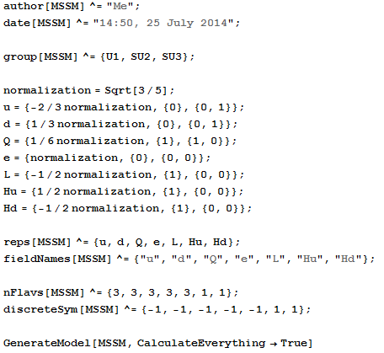
Input example: the MSSM
Output: see extra slides
Pick a name for the model (any)
Provide some optional data
Specify the model’s gauge group (any)
Specify the model’s representations (any)
Provide the number of flavors and the charges under any abelian symmetry
Tell the program to calculate the model’s RGEs (among other things)

Slide 9
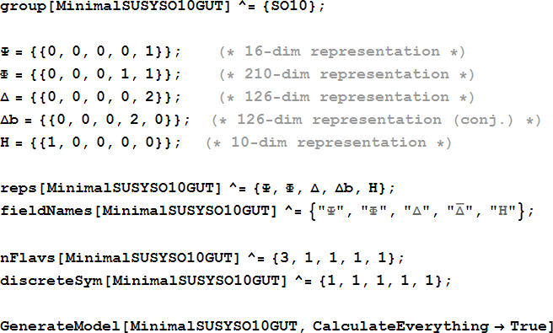
Input example: minimal SO(10)
Output: see extra slides

Slide 10
Using Susyno to make
Group Theory calculations

Slide 11

Overview
Some useful functions
Casimir | ConjugateIrrep | DynkinIndex | DimR | PermutationSymmetryOfInvariants | ReduceRepProduct |
RepName | RepsUpToDimN | TriangularAnomalyValue …
Basis-independent functions
Basis-dependent functions
RepMatrices | Invariants
HookContentFormula | DecomposeSnProduct | SnClassCharacter | SnClassOrder |
SnIrrepDim | SnIrrepGenerators
Permutation group ( ) functions
NEW
DecomposeReps | RegularSubgroupProjectionMatrix | SubgroupEmbeddingCoefficients
Symmetry breaking functions
11
Staub 2010, 2011, 2013

Slide 12
Specifying a gauge group/representation
Group
Just type the group’s name:
U1, SU2, SU3, …, SO3, SO5, SO6, SO7, …, SP4, SP6, SP8, …, G2, F4, E6, E7, E8
If the group contains more than one factor, use lists: {U1,SU2,SU3}, {SU5,E8}, …
Representations
Representations of simple groups have to be given by their Dynkin indices, which are a list of non-negative integers
(for U(1)’s: provide the hypercharge).
For example, the complete list of representations of SU(3) is {0,0}, {0,1}, {1,0}, {1,1}, {0,2}, …
Tables of representations in this notation are available for example in Slansky 1981
But Susyno itself can be used to identify them…
12
Staub 2010, 2011, 2013

Slide 13



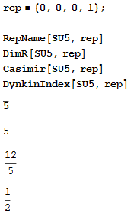
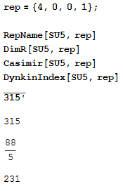
RepName, DimR, Casimir, DynkinIndex
Identify by name a representation *
Dimension of representation
Example 1
Example 2
* Convention for assigning names to representations: RepName follows the scheme described in Feger, Kephart 2012 (tables in the literature — for example Slansky 1981 — are finite)
13
Staub 2010, 2011, 2013

Slide 14
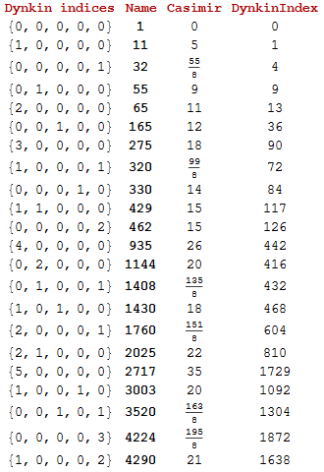
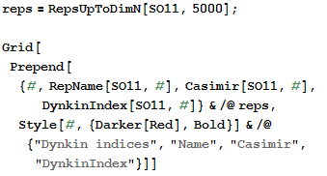
RepName, DimR, Casimir, DynkinIndex
and RepsUpToDimN
OUTPUT
CODE
14
Staub 2010, 2011, 2013

Slide 15

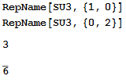
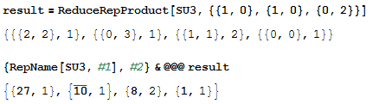

ReduceRepProduct
Computes the decomposition of a product of group representations into irreducible parts
Very useful function in model building
Example
Output is a list of representations with multiplicity
15
Staub 2010, 2011, 2013

Slide 16
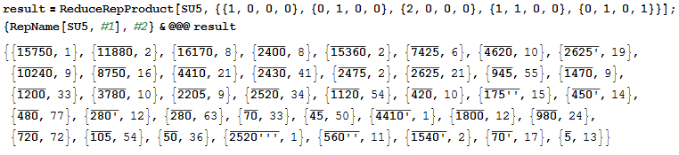
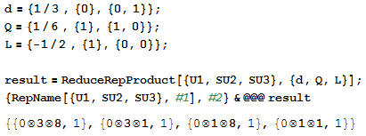
ReduceRepProduct
Code and algorithm are very fast
Snow 1990, 1993
Products of groups can also be used
(contains a gauge singlet)
16
Staub 2010, 2011, 2013

Slide 17



PermutationSymmetryOfInvariants
Does the same as ReduceRepProduct but also provides information on how the irreducible parts transform under permutations of the representations being multiplied
This is relevant only when there are repeated representations
Leeuwen, Cohen, Lisser 1992
It is well known that three triplets of SU(3) form one invariant which is completely anti-symmetric
Example
In other words, the invariant is in the {1,1,1} irreducible representation of
OUTPUT MEANING
(see documentation for details and more
complex examples)
Input reps #1, #2, #3 are the same
The given product contains 1 invariant, in
an {1,1,1} irrep of
17
Staub 2010, 2011, 2013

Slide 18
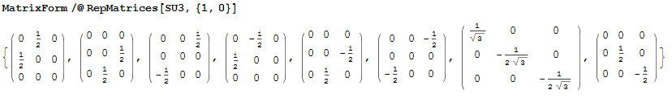
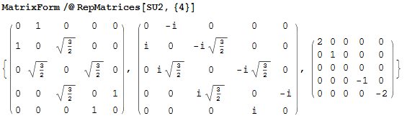
RepMatrices
RF 2013
This function builds explicitly the representation matrices of a given gauge group. To do so, a particular basis is chosen by the program
Example 1
Representation matrices of 3 of SU(3)
Example 2
Representation matrices
of 5 of SU(2)
18

Slide 19

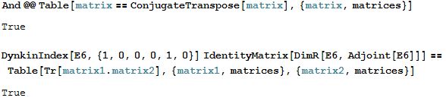


RepMatrices
650 rep of E(6)
Code is fast in most cases
In general, what are the properties of these matrices? They are hermitian and conform to the usual trace condition used in Particle Physics


19
Staub 2010, 2011, 2013

Slide 20
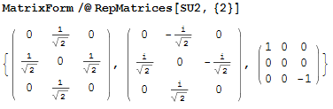
RepMatrices
Real representations: a word of caution
The basis used by Susyno always keeps a maximum number of generators in diagonal form (these generators are always the last ones listed)
3 of SU(2)
This is a perfectly fine basis, as long as one is aware of it. In fact, this basis is the best one to read off the quantum numbers of the representation components
EASY TO
CHECK
An important consequence of this is that the matrices of real representations are complex.
Adjust results if needed.
The matrices of a real representation in a real basis must all be anti-symmetric, therefore they cannot be diagonal
20
Staub 2010, 2011, 2013

Slide 21
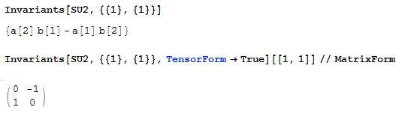

Invariants
RF 2013
CB coefficients are ubiquitous in model building
Computes the Clebsch-Gordon coefficients of a product of Lie group representations.
In other words, it calculates the linear combinations of field components which are group invariant.
They are needed to write down a Lagrangian of a gauge theory
Transformation matrices?
As given by RepMatrices
field
a
field
b
…
Example
21
Staub 2010, 2011, 2013

Slide 22
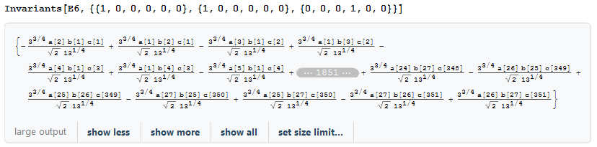

Invariants
~16s
27 rep of E(6)
27 rep of E(6)
351 rep of E(6)
IMPORTANT QUESTION
How are the Clebsch-Gordon coefficients normalized?
ANSWER: for ,
ALWAYS
E.g.: if a[1]b[2]-a[2]b[1] is an invariant combination of two SU(2) doublets, so is any multiple of this
Two SU(2) doublets form the invariants x(a[1]b[2]-a[2]b[1]) for any x. Which x does Susyno take?
22
Staub 2010, 2011, 2013

Slide 23
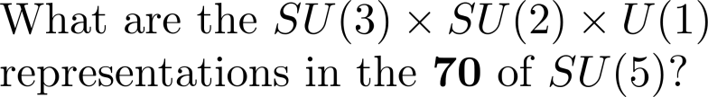
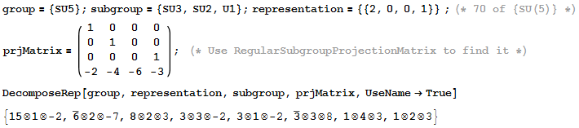
DecomposeRep
Decomposes some (irreducible) representation of a group G into irreducible components of some subgroup of G. In other words, it calculates branching rules
Example 1
23

Slide 24
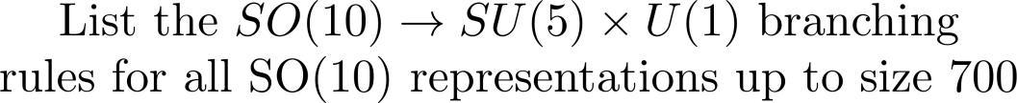
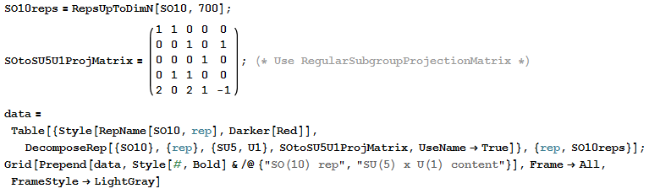
DecomposeRep
Example 2
CODE
24

Slide 25
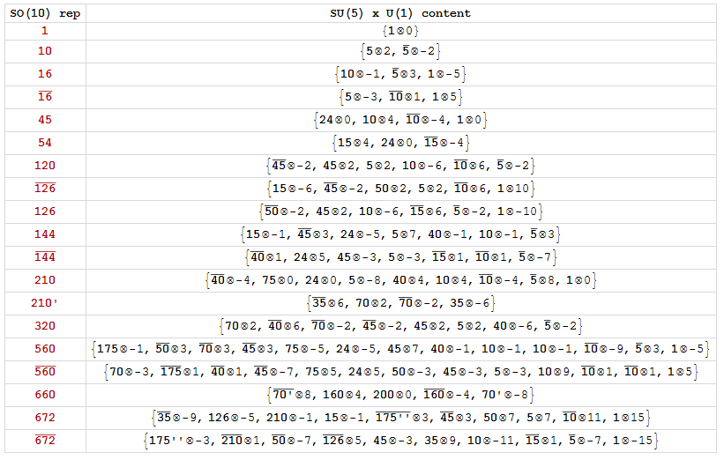
DecomposeRep
OUTPUT
Takes around 5 minutes to extend this table up to all reps of size 10000 or smaller
25
Staub 2010, 2011, 2013

Slide 26







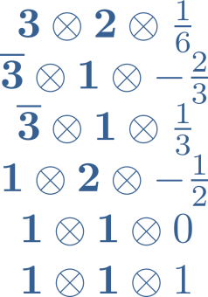
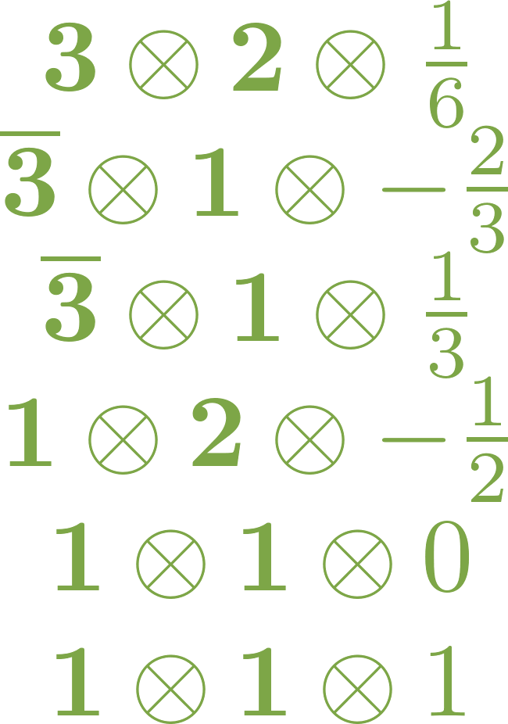
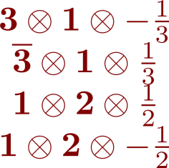
SubgroupEmbeddingCoefficients
Calculates the relations between the subgroup invariants (i.e., Clebsch-Gordon coefficients) in a theory which is symmetric under a bigger group
Easier to explain with an example!
Consider the invariant combination of the representations .
We can see it from a perspective:
1 SO(10) invariant
=
Linear combination of the 17 subgroup invariants
26

Slide 27
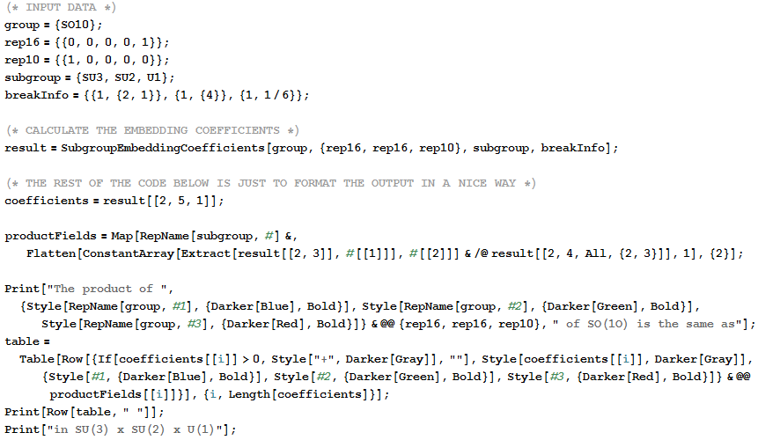
SubgroupEmbeddingCoefficients
CODE
27

Slide 28
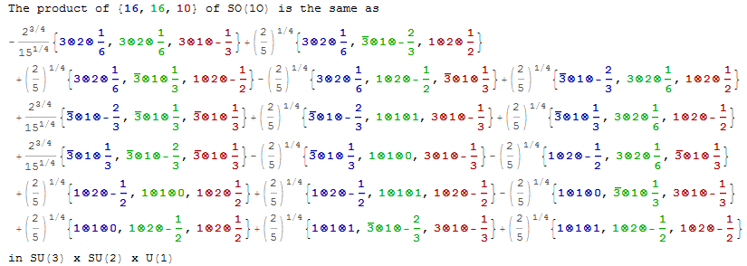

SubgroupEmbeddingCoefficients
OUTPUT
Here, we can opt to quickly eliminate the SO(10) Clebsch-Gordon’s normalization issue by just looking at ratios of these embedding coefficients
On the other hand, most of the
invariants shown here are normalized as usually expected
Why the strange factors?
The answer is simple: it is due to the program’s default normalization of the invariants (i.e., Clebsch-Gordon coefficients)
Both the SO(10) Clebsch-Gordon coefficients and the subgroup ones
The only ones which are not are the ones involving of SU(3)
28

Slide 29

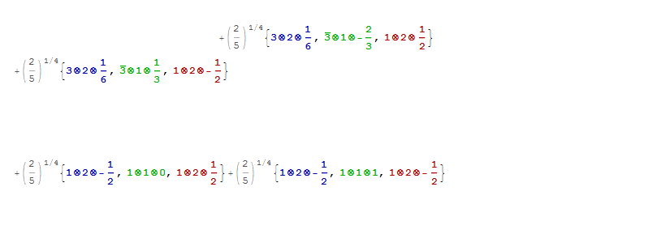



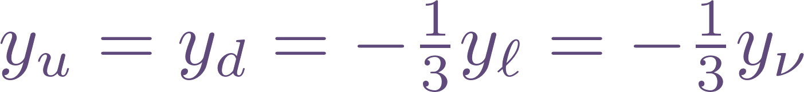

SubgroupEmbeddingCoefficients
The 4 coefficients are the same
Conclusion
Now, if we just change in the input {1,0,0,0,0} (the 10) to {0,0,0,2,0} (the 126) …
With minimal code change
Georgi-Jarlskog relation
1979
29

Slide 30
Summary

Slide 31
Summary
The Susyno program can calculate
RGEs of a SUSY model
Group theory quantities
Generate list of model parameters, check anomalies, …
Useful for model
building in general
Quick start
1
Download from
http://web.ist.utl.pt/renato.fonseca/susyno.html
2
Unpack the folder Susyno and drop it inside
(Mathematica base directory)/AddOns/Applications
3
Type in Mathematica’s front the following: <<Susyno`
The built-in documentation becomes readily available
Thank you

Slide 32
Extra slides

Slide 33
Input example: the MSSM
Pick a name for the model (any)
Provide some optional data
Specify the model’s gauge group (any)
Specify the model’s representations (any)
Provide the number of flavors and the charges under any abelian symmetry
Tell the program to calculate the model’s RGEs (among other things)

Slide 34
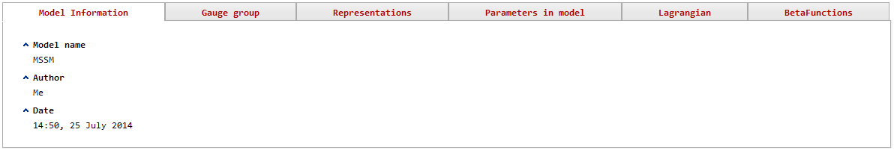
Output example: the MSSM

Slide 35
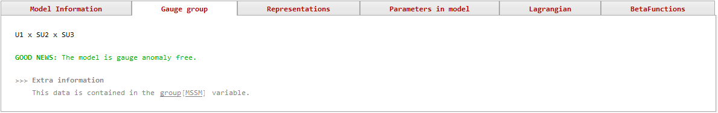
Output example: the MSSM

Slide 36
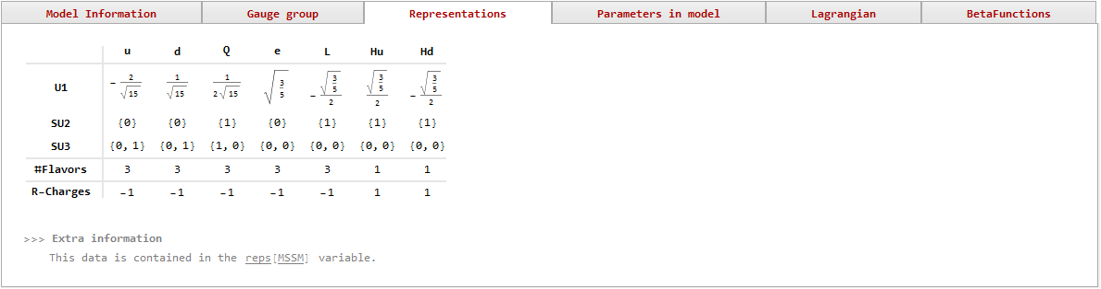
Output example: the MSSM

Slide 37
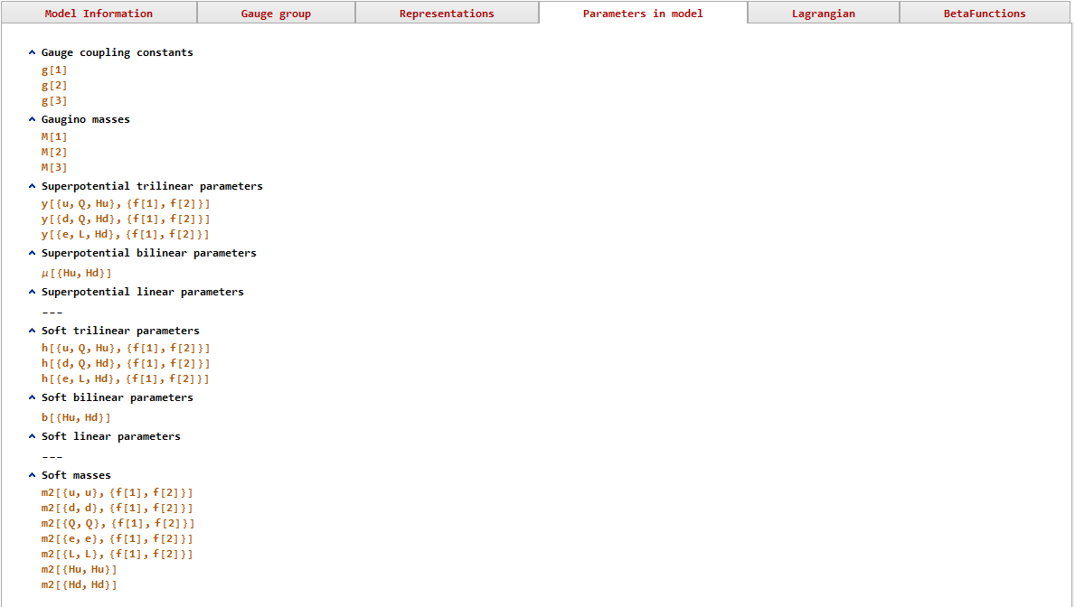
Output example: the MSSM
…

Slide 38
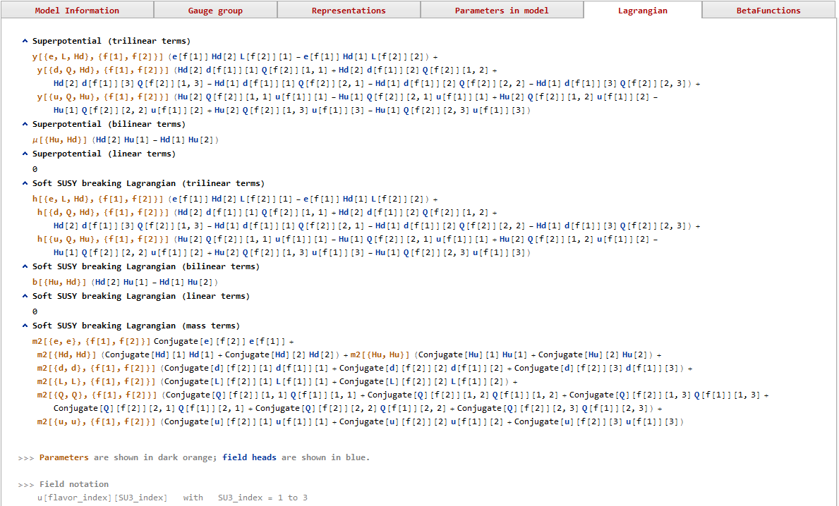
Output example: the MSSM
…

Slide 39
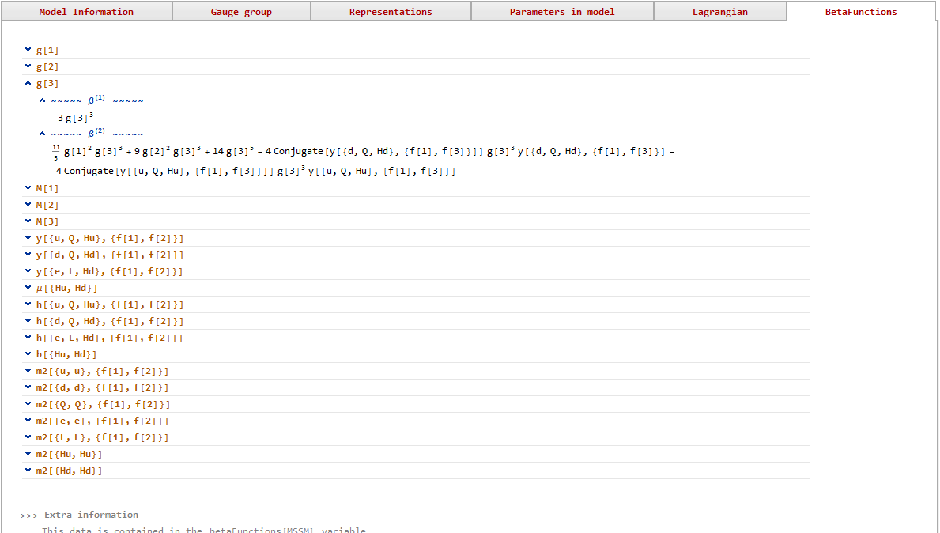
Output example: the MSSM
…

Slide 40
Input example: minimal SO(10)

Slide 41
Output example: minimal SO(10)

Slide 42
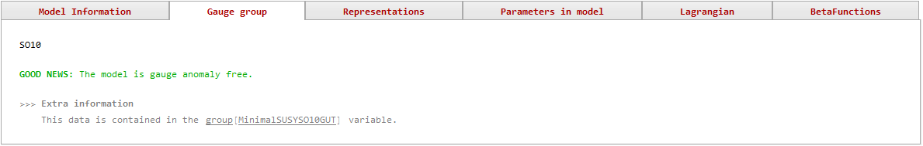
Output example: minimal SO(10)

Slide 43
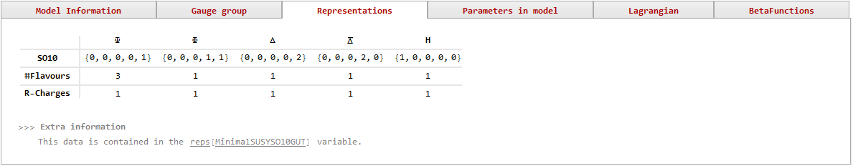
Output example: minimal SO(10)

Slide 44
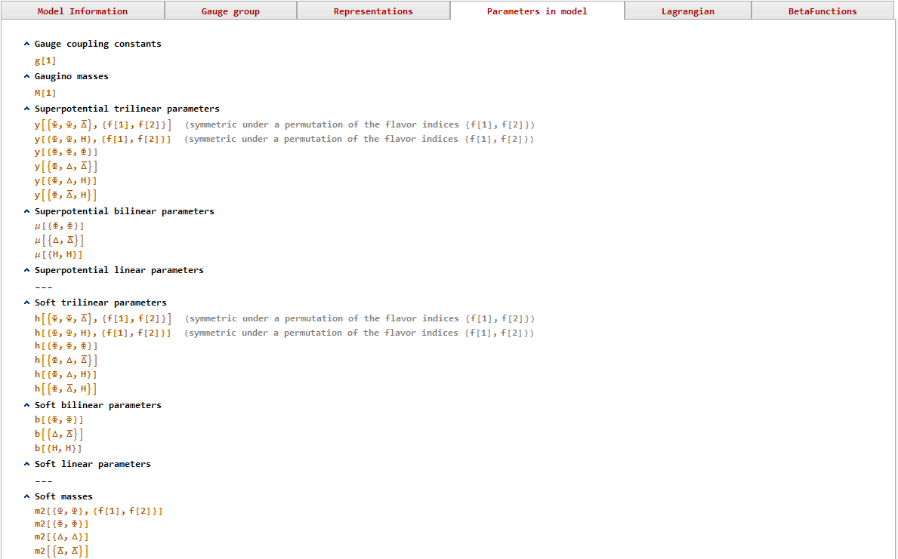
Output example: minimal SO(10)
…

Slide 45
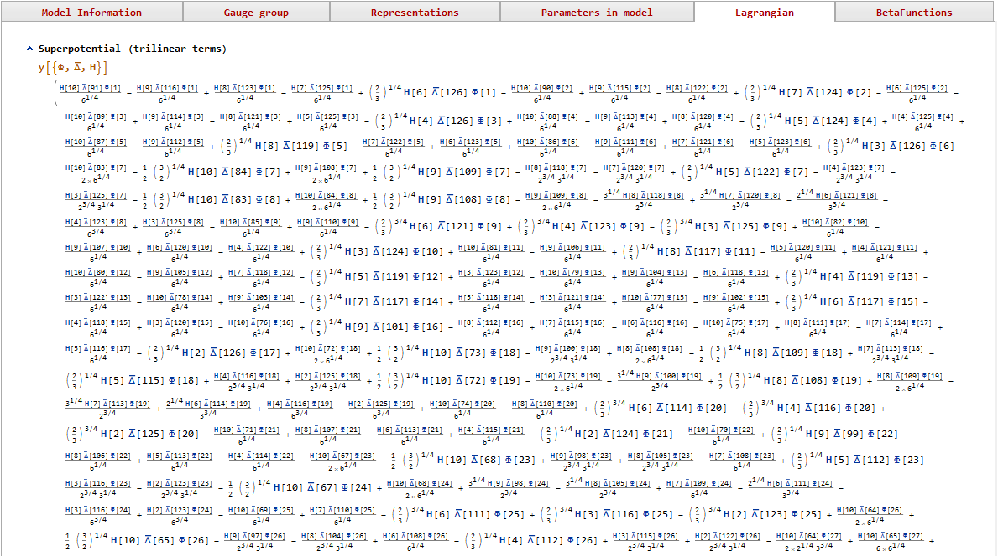
Output example: minimal SO(10)
Peculiar numerical factors in the Lagrangian: this is due to the Clebsch-Gordon normalization convention of the program, which is used consistently for all groups, all products of representations. (see slide 22)
…

Slide 46
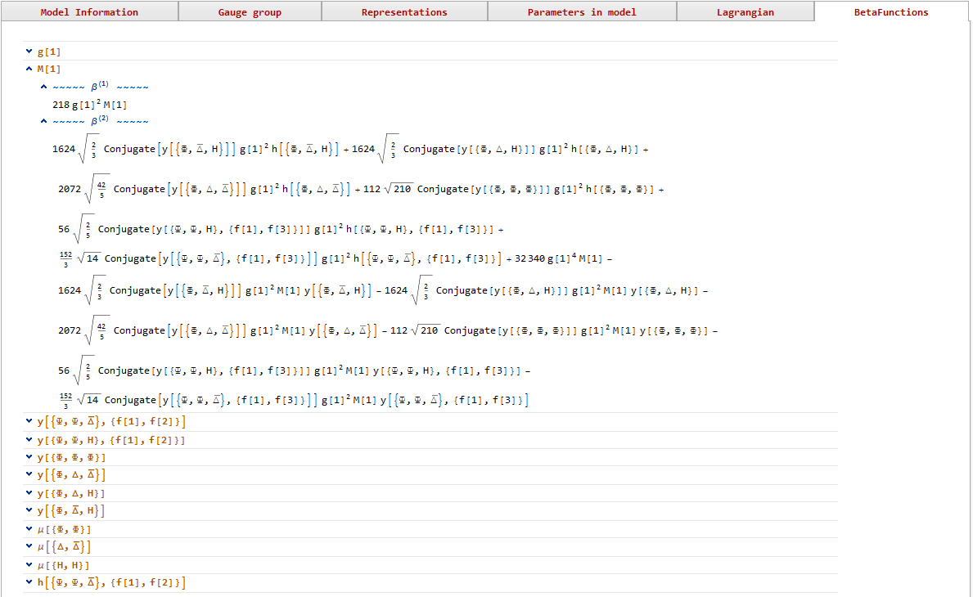
Output example: minimal SO(10)
Peculiar numerical factors in the RGEs are a consequence of the normalization of the Clebsch-Gordon factors used by the program. Conversion to other normalizations is easy (see documentation)
…

