Slide 1

6D Gauge-Higgs unification with custodial symmetry
Yutaka Sakamura (KEK)
in collaboration with
Yoshio Matsumoto (Sokendai)
[arXiv:1407.0133]

Slide 2

Introduction
Gauge-Higgs unification (GHU)
[Manton, 1979; Fairlie, 1979; Hosotani, 1983; …]
=
Higgs
Higher-dim. gauge sym. protects the Higgs mass
against quantum correction.
Simplest model
5D U(3) model on S /Z (flat spacetime)
5D SO(5)xU(1) model on S /Z (warped spacetime)
1
2
[Scrucca, Serone, Silvestrini, Wulzer, 2004; …]
1
2
[Agashe, Contino, Pomarol, 2005; …]

Slide 3
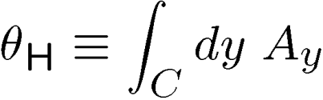
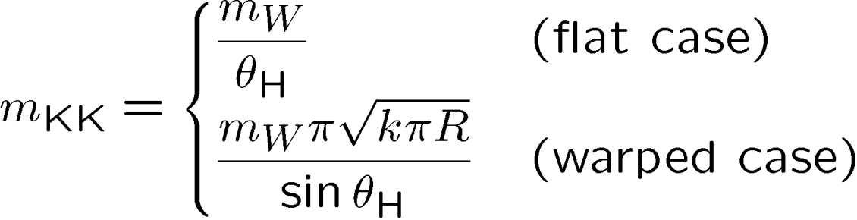




Wilson line phase :
must be small, i.e.,
[Agashe, Contino, Pomarol, 2005; …]
In 5D GHU,
quadratic (1 loop)
quartic (1 loop)
In 6D GHU,
quadratic (1 loop)
quartic (tree)

Slide 4
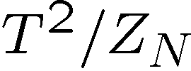






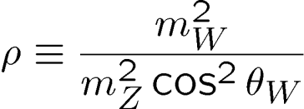
We consider 6D GHU on .
simple group
Gauge group :
(gauge couplings)
The Weinberg angle is obtained by adjusting .
can deviate from 1 even at tree-level
due to the mixing with the KK modes.
We focus on models with the custodial symmetry.

Slide 5

Custodial symmetry
[Agashe, Contino, Da Rold, Pomarol, 2006]
Purpose
Select viable gauge group, orbifold, and
representations of the matters.
Rank 2
Rank 3

Slide 6


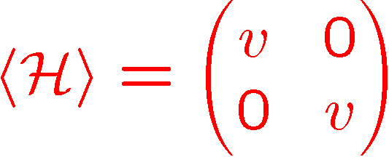
Symmetry breaking
Rank 2
orbifold
(at the fixed point)
Rank 3
orbifold
(at the fixed point)
EW sym. is broken by a bidoublet Higgs:

Slide 7
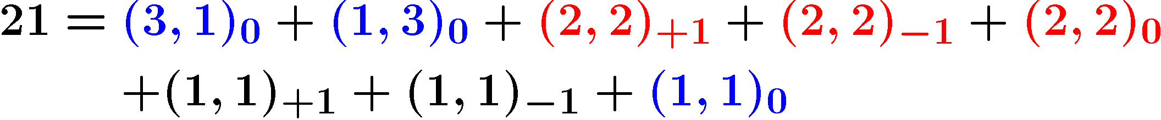
Irreducible decomposition
Rank 2
SO(5) :
G :
2
Rank 3
SU(4) :
SO(7) :
Sp(6) :

Slide 8
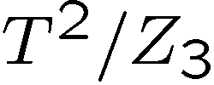
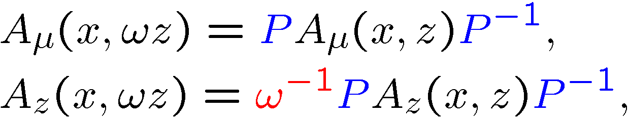

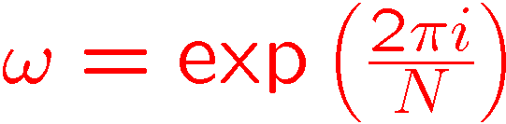




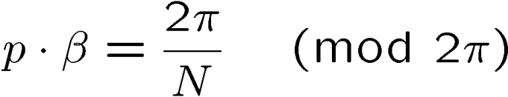

T /Z orbifold
2
N
(N=2,3,4,6)
Orbifold conditions
where
and .
Cartan generator
fixed points
Zero-mode conditions
roots of G

Slide 9





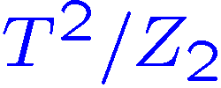
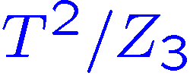
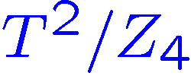
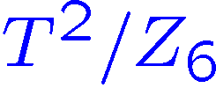
Number of Higgs bidoublets
1
0
2
1
0
0
1
1
0
0
0
1
1
0

Slide 10
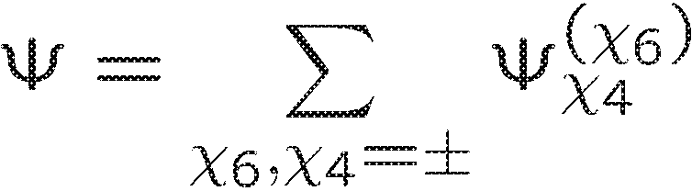


Matter sector
We focus on the third generation quarks.
6D chirality
6D fermion :
4D chirality
belongs to an irreducible rep. of G.
is restricted by the condition for
the VEV alignment of .

Slide 11

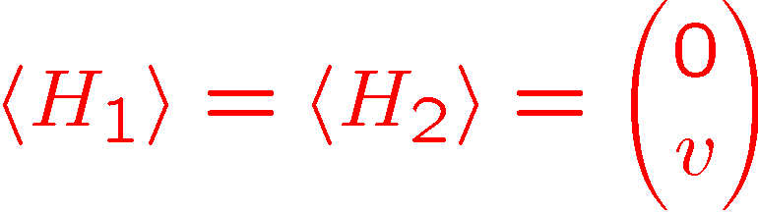
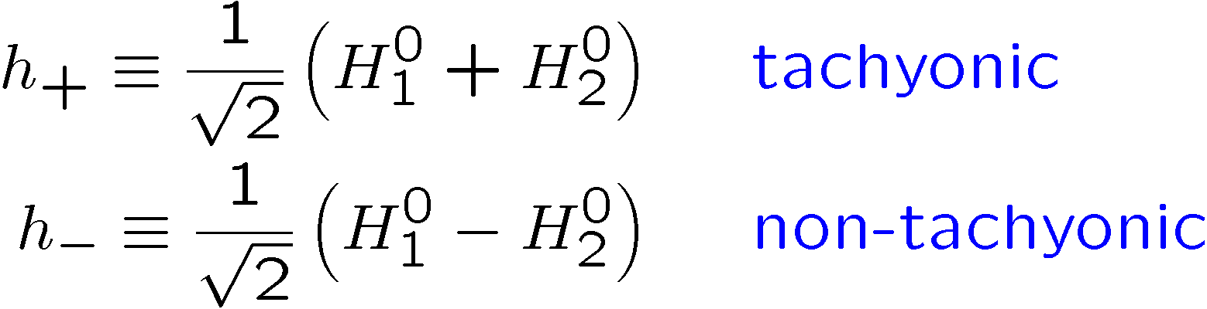

VEV alignment
Higgs bidoublet :
VEVs must be aligned as .
The alignment can be achieved if

Slide 12


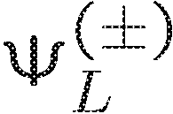

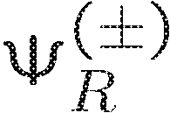


Conditions for the VEV alignment
The corresponding weights are related as
have zero-modes in , and
have zero-modes in .
Top Yukawa
Among the representations such that ,
only of SU(4) satisfies the above conditions.

Slide 13


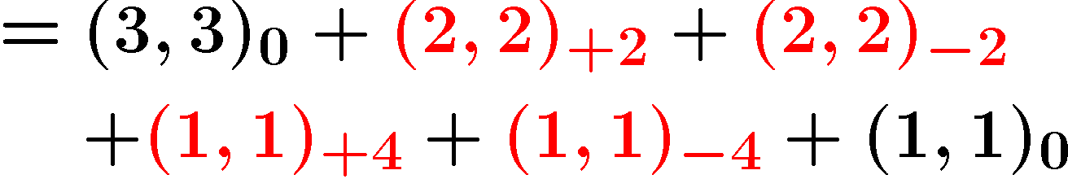
of SU(4)
By orbifolding,
Only on T /Z , there is a choice of the orbifold conditions
that satisfy the condition 3.
2
3

Slide 14





Summary
Gauge-Higgs unification on T /Z with custodial symmetry
is considered.
2
N
The requirements we demanded are
A Scalar bidoublet zero-mode exists.
The bosonic sector is symmetric
under .
The top and bottom quarks are coupled to
through .
provides a right size group factor
for the top Yukawa coupling.
The best candidate is
, and .

Slide 15






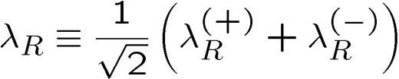
Yukawa couplings
includes
If
includes ,
we obtain
If and only has zero-modes,
we obtain
After integrating out unnecessary modes,

Slide 16
Tree-level mass relations:

Slide 17
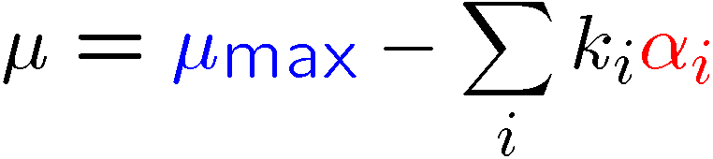
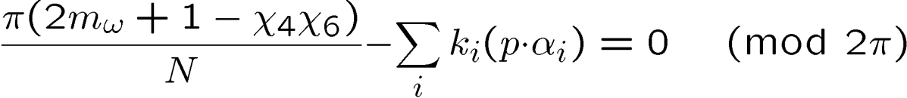
Weight
simple root
Zero-mode conditions
integer

