Slide 1

The Gravitational Wave Background and Higgs False Vacuum Inflation
Isabella Masina
University of Ferrara, INFN Sez. Ferrara (Italy) and CP3-Origins (Denmark)
SUSY 2014, Manchester, 22/07/2014

Slide 2
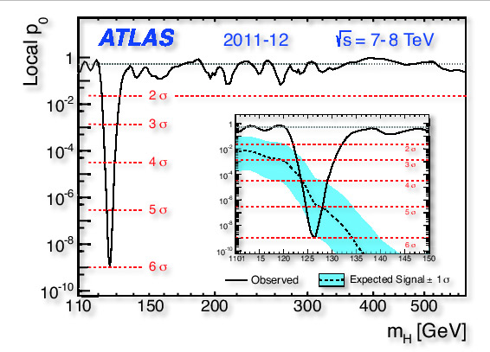
4/07/12: A scalar particle
has been discovered
Phys. Lett. B 716 (2012) 1-29
[1207.7214]
Phys. Lett. B 716 (2012) 30 [1207.7235]
CMS

Slide 3

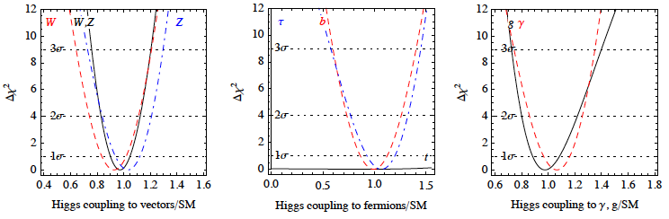
Likely it is
the SM Higgs boson!
Many combined analysis, see e.g.
Giardino Kannike IM Raidal Strumia, JHEP arXiv:1303.3570
All r-parameters significantly close to 1 (SM)

Slide 4
ATLAS (ZZ, γγ)
CMS (WW, ZZ, γγ, ττ, bb)
SO WHAT?

Slide 5
ATLAS (ZZ, γγ)
CMS (WW, ZZ, γγ, ττ, bb)
SO WHAT?
Finally possible to study the shape
of the SM Higgs potential
up to the Planck scale!!!

Slide 6
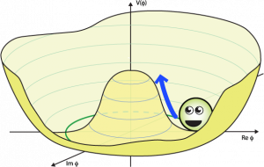
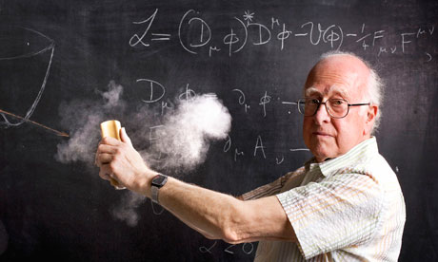
Consider the Higgs doublet
and the SM Higgs potential:
V(φ_{H})
and now… how shall I continue?
φ_{H}

Slide 7
Consider the Higgs doublet
and the SM Higgs potential:
V(φ_{H})
unstable? No, we wouldn’t be there
φ_{H}
Tunneling
with τ < τ_{Universe}

Slide 8
Consider the Higgs doublet
and the SM Higgs potential:
V(φ_{H})
metastable?
φ_{H}
Tunneling
with τ > τ_{Universe}

Slide 9
Consider the Higgs doublet
and the SM Higgs potential:
two degenerate vacua?
[Froggatt Nielsen]
V(φ_{H})
φ_{H}

Slide 10
Consider the Higgs doublet
and the SM Higgs potential:
n.1
n.2
n.3
V(φ_{H})
stable? but which kind?
φ_{H}

Slide 11
Consider the Higgs doublet
and the SM Higgs potential:
To study λ(μ) one needs
the low energy values of
g_{1,2,3} m_{t} m_{H}
V(φ_{H})
φ_{H}

Slide 12
Consider the Higgs doublet
and the SM Higgs potential:
1) DO WE LIVE IN A STABLE OR METASTABLE VACUUM ?
V(φ_{H})
φ_{H}

Slide 13
Consider the Higgs doublet
and the SM Higgs potential:
1) DO WE LIVE IN A STABLE OR METASTABLE VACUUM ?
V(φ_{H})
2) IF STABLE, CAN THE HIGH POTENTIAL ENERGY OF THE HIGGS HAVE BEEN RESPONSIBLE FOR INFLATION?
φ_{H}

Slide 14

1)
To be or not to be (stable), that is the (first) question…

Slide 15
(Assuming desert)
extrapolate the SM Higgs potential at renormalization scale μ via RGE
[Hung, Cabibbo et al ‘79, Lindner, Sher, Casas, Espinosa, Quiros, Giudice, Riotto, Isidori, Strumia, etc etc etc]
This can now be done at NNLO!!
3-loop running & 2-loop matching of
g(μ), g’ (μ), g₃(μ), λ(μ), y_{t}(μ)
in MS scheme

Slide 16
Matching
g(μ), g’ (μ), g₃(μ), λ(μ), y_{t}(μ)
matched directly at m_{Z}
According to PDG,
the larger exp error is in:

Slide 17
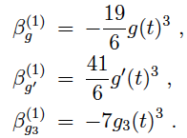
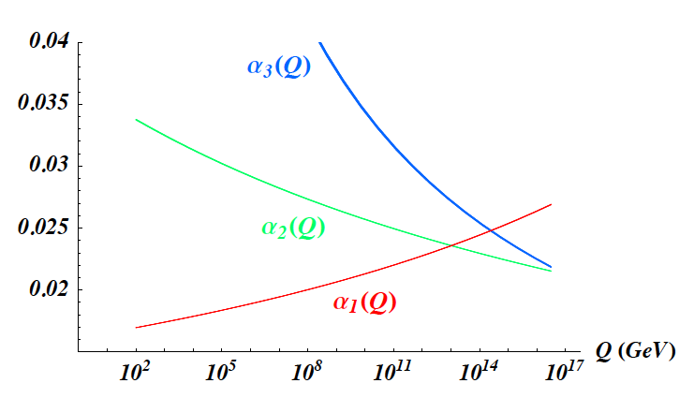
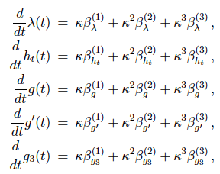
Running
g(μ), g’ (μ), g₃(μ), λ(μ), y_{t}(μ)
α₃(μ)
α₂(μ)
α₁(μ)
μ (GeV)
Mihaila Salomon Steinhauser,
PRL, arXiv:1201.5868

Slide 18


Matching
g(μ), g’ (μ), g₃(μ), λ(μ), y_{t}(μ)
Need to know m_{H}:
1-loop by
Sirlin Zucchini NPB ‘86
2-loop by
Bezrukov Kalmykov Kniehl Shaposhnikov JHEP, arXiv:1205.2893
Degrassi Di Vita Elias-Miro Espinosa Giudice Isidori Strumia JHEP, arXiv:1205.6497

Slide 19


Matching
g(μ), g’ (μ), g₃(μ), λ(μ), y_{t}(μ)
Need to know top mass:
running MS top mass
pole
top mass
known at 2-loop
Analyses use (2-loop) matching via ”Tevatron” m_{t} pole mass
(corresponding to a non-perturbative parameter of a MonteCarlo):
This method introduces an unavoidable theoretical error associated to 2-loop matching
3-loop

Slide 20
Matching
g(μ), g’ (μ), g₃(μ), λ(μ), y_{t}(μ)
Need to know top mass:
running MS top mass
pole
top mass
known at 2-loop
Alekhin Djouadi Moch, PLB arXiv:1207.0980
say it is not meaningful to use Tevatron measure: could underestimate error!
BETTER to match directly with running MS:
as it can also be experimentally extracted from the total cross section for top quark pair production at hadron colliders
In this way one avoids the theoretical error due to matching
Method followed in: IM, PRD arXiv:1209.0393
…essentially agrees with results obtained via the other method for: m_{t}= m_{t} + 10 GeV

Slide 21
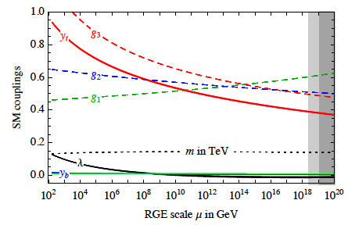
Running
g(μ), g’ (μ), g₃(μ), λ(μ), y_{t}(μ)
Chetyrkin Zoller, JHEP arXiv:1205.2892, 1303.2890
Fig from: Buttazzo Degrassi Giardino Giudice Sala Salvio Strumia, JHEP 1307.3536

Slide 22
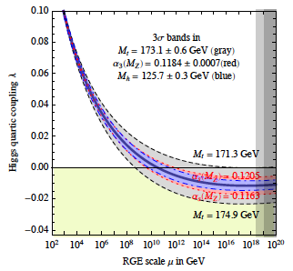
Let focus on the running of λ
Largest error due
to top mass
Second largest to α₃
Towards λ<0 if:
M_{t} large,
α₃ small,
m_{H} small
Fig from: Buttazzo Degrassi Giardino Giudice Sala Salvio Strumia, JHEP 1307.3536

Slide 23
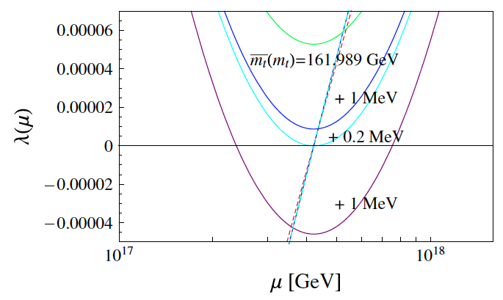
m_{t}
Fix m_{H} = 126 GeV and α₃(m_{Z})
Increasing m_{t}
λ goes negative…
λ(μ) > 0 stability
m_{t}
λ(μ) < 0 metastability
… and V is destabilized
Fig from: IM, PRD 1209.0393

Slide 24
m_{t}
Fix m_{H} = 126 GeV and α₃(m_{Z})
stable
stable with flex
m_{t}
deg. with EW vacuum
Fig from: IM, PRD 1209.0393

Slide 25
m_{t}
Fix m_{H} = 126 GeV and α₃(m_{Z})
m_{t}
metastable
even deeper: unstable
Fig from: IM, PRD 1209.0393

Slide 26
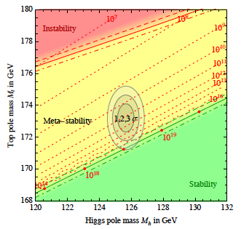
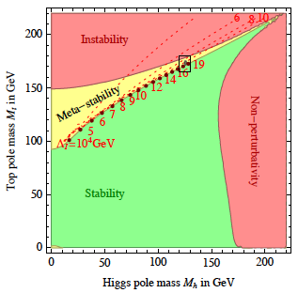
RESULTS
200
INSTABILITY
STABILITY
180
Top mass in MS bar scheme
160
METASTABILITY
Landau pole
140
110
120
130
140
150
160

Slide 27
EXP
A.D.2011
Excluded by Tevatron
200
INSTABILITY
STABILITY
180
Top mass in MS bar scheme
METASTABILITY
163.3 ± 2.7
160
Landau pole
140
110
120
130
140
150
160

Slide 28

EXP
A.D.2013
Found by LHC
200
INSTABILITY
STABILITY
180
Top mass in MS bar scheme
METASTABILITY
163.3 ± 2.7
160
Landau pole
140
110
120
130
140
150
160

Slide 29
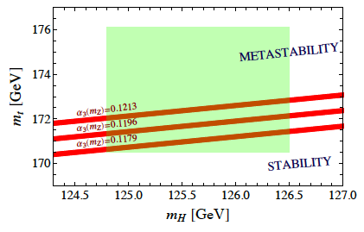
IM, PRD arXiv:1209.0393
Thickness dominated by error due to matching of λ
STABILITY BOUND
…essentially agrees with results obtained via the other method for: m_{t}= m_{t} + 10 GeV

Slide 30
Fig from: Buttazzo Degrassi Giardino Giudice Sala Salvio Strumia, JHEP 1307.3536
IM, PRD arXiv:1209.0393
… anyway results are essentially the same!

Slide 31
PROSPECTS
NEED MORE PRECISE MEASURE
LHC
ILC
For a recent paper on the determination of m_{t} see e.g. S. Frixione 1407.2763

Slide 32
Possible to stabilize the Higgs potential
in case it will turn out that the SM one is metastable?
YES! e.g. extend the SM by including scalar
[J.Elias-Miro, J.R.Espinosa, G.F.Giudice, H.M.Lee , 1203. 0237]
…instead seesaw neutrinos could destabilize!

Slide 33

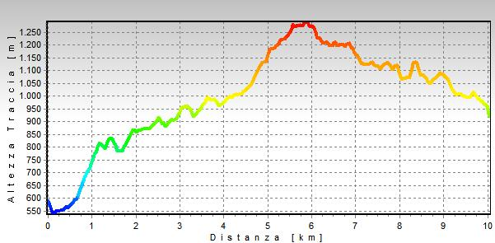
2)
Higgs inflation
Now that we have some idea of the shape of SM Higgs potential “hill”,
is it possible to exploit it for inflation?
Profilo altimetrico delle alpi apuane

Slide 34
YES! If, for some reason, there has been a period in which the Hubble rate was dominated by a nearly constant V_{H}>0
V_{H} acts as cosmological constant term
EXPONENTIAL EXPANSION

Slide 35
Small field:
does not work in the “pure” SM (without any addition)
because
there is no slow roll in general

Slide 36
Small field:
does not work in the “pure” SM (without any addition)
With an inflection point
slow roll can occur …
…but there are not enough e-folds for inflation
[see e.g. G.Isidori V.Rychkov A.Strumia N.Tetradis, 0712.0242]

Slide 37
These conclusions holds for a rolling Higgs having
canonical kinetic term and minimal coupling to gravity
There would arise possibilities that the SM Higgs field is the inflaton
if we loose the above assumptions

Slide 38
These conclusions holds for a rolling Higgs having
canonical kinetic term and minimal coupling to gravity
+ξ h²
There would arise possibilities that the SM Higgs field is the inflaton
if we loose the above assumptions
Flatten the Higgs potential:
e.g. via non-minimal gravitational coupling
(new inflation = slow roll)
1

Slide 39
These conclusions holds for a rolling Higgs having
canonical kinetic term and minimal coupling to gravity
+curvaton
There would arise possibilities that the SM Higgs field is the inflaton
if we loose the above assumptions
The Higgs is not rolling but is trapped in
a false vacuum (=old inflation);
another slow rolling field acts as curvaton
and as a clock to end inflation
2

Slide 40
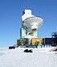
The NEW DATA from BICEP2
arXiv:1403.3985
17 March 2014:
detected B-modes (curl component) of the polarization of the CMB at the level of
r = 0.20_{−0.05}
tensor-to-scalar ratio of amplitudes
^{+0.07}
disfavouring r = 0 at the level of 7σ (5.9σ after foreground subtraction)

Slide 41

In a model were slow-roll is applicable
Pl
^{+0.07}
0.20_{−0.05}
V^{1/4} ≈ 2 x 10¹⁶ GeV

Slide 42
EXAMPLE 1
Non-minimal coupling Higgs Inflation
(new inflation type)

Slide 43
BIBLIOGRAPHY
F.Bezrukov M.Shaposhnikov, 0710.3755
“The Standard Model Higgs boson as the inflaton” Phys.Lett. B659 (2008) 703
Following papers also in collaboration with Gorbunov, Magnin, Sibiryakov, Kalmykov, Kniehl
0812.4950, 0904.1537,1008.5157, 1111.4397, 1205.2893
A.O.Barvinsky A.Kamenshchik C.Kiefer A.Starobinsky C.Steinwachs
0809.2104, 0910.1041
A. De Simone, M.P. Hertzberg F. Wilczek, 0812.4946
L.A. Popa, N. Mandolesi, A. Caramete, C. Burigana, 0907.5558, 0910.5312, 1009.1293
H.M. Lee G.Giudice O. Lebedev, 1010.1417, 1105.2284
H.M. Lee 1301.1787
etc
After BICEP2, see e.g.
F.Bezrukov M.Shaposhnikov,
1403.6078
1403.5043
Y.Hamada H.Kawai K.Oda S.C.Park

Slide 44
SM Higgs potential
Non minimal coupling of Higgs with gravity

Slide 45
SM Higgs potential
Non minimal coupling of Higgs with gravity
Upon conformal transformation to Einstein frame and redefinition of Higgs field to have canonical kinetic term
Higgs potential flattened below
Planck scale

Slide 46
V(φ_{H})
plateau for slow-roll
φ_{H}
A configuration more (or as stable as) an inflection point is necessary for Higgs inflation via non-minimal gravitation couplings
stay on RED BAND

Slide 47
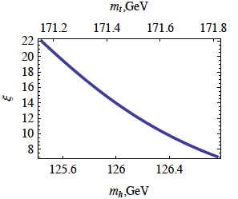
A non-minimal coupling of about 10 might do the job
(for quite low m_{t} and quite high m_{H} )
F.Bezrukov M.Shaposhnikov,
1403.6078

Slide 48
EXAMPLE 2
Shallow false minimum
(old inflation type revisited)
BIBLIOGRAPHY
I.M. A.Notari, Phys.Rev. D85 (2012) 123506 [1112.2659],
Phys.Rev.Lett. 108 (2012) 191302 [1112.5430],
JCAP 1211 (2012) 031 [1204.4155]
After BICEP2, see e.g.
I.M., PRD 1403.5244

Slide 49
assume that the Universe started with the Higgs trapped in this false vacuum
V(φ_{H})
shallow false minimum
M_{Pl}
φ_{H}
Inflation ends thanks to some other mechanism
In this scenario the Higgs cannot be the curvaton

Slide 50
assume that the Universe started with the Higgs trapped in this false vacuum
V(φ_{H})
shallow false minimum
M_{Pl}
φ_{H}
NB 1.
This scenario required m_{H} = 123-130 GeV (before Higgs discovery)

Slide 51
Before LHC…
LHC
200
INSTABILITY
STABILITY
180
Top mass in MS bar scheme
METASTABILITY
163.3 ± 2.7
160
Shallow false minimum Higgs inflation requires stability
Landau pole
140
110
120
130
140
150
160
Prediction that m_{H} is in the range 123-130 GeV appeared on the arXiv before LHC 3σ announcement [I.M. A.Notari 1112.2659]

Slide 52
assume that the Universe started with the Higgs in this false vacuum
V(φ_{H})
shallow false minimum
M_{Pl}
φ_{H}
NB 1.
This scenario required m_{H} = 123-130 GeV (before Higgs discovery)
NB 2.
Clean prediction for r (n_{s} is instead model dependent)

Slide 53
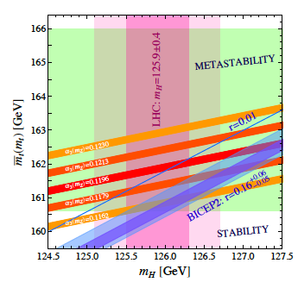
determined by m_{H}
(m_{t} choosen in order to have false minimum)
IM, PRD 1403.5244
BICEP2 can be accomodated within 2σ:
large m_{H}
small m_{t}
small α₃(m_{Z})

Slide 54
assume that the Universe started with the Higgs in this false vacuum
V(φ_{H})
shallow false minimum
M_{Pl}
φ_{H}
Realizations of the scenario:
A model in scalar-tensor gravity
& a model with hybrid inflation
IM Notari, arXiv:1112.2659,
1204.4155
Not satisfactory but maybe…
KO because or r and n_{S}
[see e.g. Fairbairn et al 1403.7483]

Slide 55
Anyway…
the numerical concordance
is so intriguing
IM, PRD 1403.5244
worth to develop more models to better explore the idea of shallow false minimum Higgs inflation

Slide 56
CONCLUSIONS
Stability/Metastability of the Higgs potential in the SM:
calls for more precise measurement of top mass
2) SM Higgs inflation models:
seem promising and calls for confirmation of r

Slide 57
CONCLUSIONS
Stability/Metastability of the Higgs potential in the SM:
calls for more precise measurement of top mass
2) SM Higgs inflation models:
seem promising and calls for confirmation of r
The measured value
of the Higgs boson mass is intriguing!!

Slide 58
backup

Slide 59
Main difficulty of the false vacuum scenario:
provide a graceful exit from inflation
To end inflation the field have to tunnel by nucleating bubbles
which eventually collide and reheat the Universe.
If
nucleation rate per
unit time and volume
H⁴ >> Γ
There are enough e-folds of inflation
…but an insufficient number of bubbles is produced inside a Hubble horizon…
A graceful exit would require that after some time
H⁴ ≤ Γ
But in standard gravity as both are time-independent:
That’s why old inflation [Guth ‘80] was abandoned

Slide 60
Main difficulty of the false vacuum scenario:
provide a graceful exit from inflation
To end inflation the field have to tunnel by nucleating bubbles
which eventually collide and reheat the Universe.
If
nucleation rate per
unit time and volume
H⁴ >> Γ
There are enough e-folds of inflation
…but an insufficient number of bubbles is produced inside a Hubble horizon…
A graceful exit would require that after some time
H⁴ ≤ Γ
Time dependent H is possible e.g. in a scalar-tensor theory of gravity
C.Mathiazhagan V.B.Johri, 1984
D.La P.J.Steinhardt, 1989
P.J.Steinhardt F.S.Accetta, 1990
For power-low expansion
(extended or hyperextended inflation)
For exponential expansion followed by power-low
T.Biswas F.Di Marco A.Notari, 2006

Slide 61
Higgs false vacuum inflation
via scalar-tensor gravity
[IM Notari, arXiv:1112.2659]
A new scalar φ decoupled from the SM
but coupled to gravity
n=2,4,6,8,…

Slide 62
Higgs false vacuum inflation
via scalar-tensor gravity
[IM Notari, arXiv:1112.2659]
A new scalar φ decoupled from the SM
but coupled to gravity
Einstein frame potential is dominated by the Higgs field
V(φ)
H
exponential inflation until φ becomes large
and H decreases. Power low inflation stage
then allows Higgs tunnelling with efficient
bubble production and collisions
φ

Slide 63
Quantum fluctuations in φ generate the spectrum of density perturbations with
Number of efolds

Slide 64
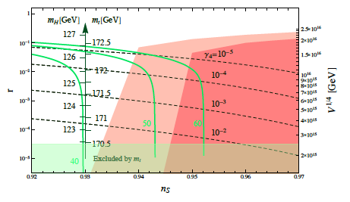
Quantum fluctuations in φ generate the spectrum of density perturbations with
Number of efolds
n=4
BICEP2
PLANCK

Slide 65
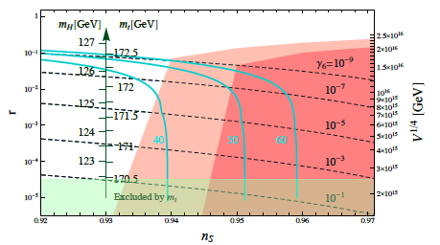
Quantum fluctuations in φ generate the spectrum of density perturbations with
Marginally consistent with BICEP2
n=6
BICEP2
PLANCK

Slide 66
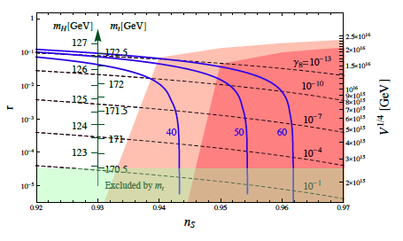
Quantum fluctuations in φ generate the spectrum of density perturbations with
Marginally consistent with BICEP2
n=8
BICEP2
PLANCK

Slide 67




3)
Effect of neutrinos on the shape of the Higgs potential

Slide 68
Type I seesaw Dirac Yukawa interactions neutrinos could destabilize V…
[Casas Ibarra Quiros, Okada Shafi, Giudice Strumia Riotto, Rodejohann Zhang, etc ]

Slide 69




Type I seesaw Dirac Yukawa interactions neutrinos could destabilize V…
[Casas Ibarra Quiros, Okada Shafi, Giudice Strumia Riotto, Rodejohann Zhang, etc ]
The larger is h_{ν} the larger is M_{ν}
so that one matches with light neutrino masses

Slide 70
Requirement of stability of the Higgs potential
→ h_{ν} not too large → “upper bound” on M_{ν}
E.g. : assume one generation giving m_{ν}=0.06 eV
IM arXiv:1209.0393

Slide 71
The “upper bound” is even more stringent if one does not want to waste
an inflection point configuration (interesting for inflation)
IM arXiv:1209.0393

