Slide 1

Effect of interaction terms on particle production due to time-varying mass
[work in progress]
Seishi Enomoto (Univ. of Warsaw)
Collaborators : Olga Fuksińska (Univ. of Warsaw)
Zygmunt Lalak (Univ. of Warsaw)
Outline
Introduction
How to calculate particle number
Calculation of particle number
Summary
Notes:
Here is outline.
First of all, I’ll explain about this particle production effect, briefly.
Next I’ll mention about our study,
and finally, I’ll summarize.
OK, let’s move to introduction.

Slide 2
1. Introduction
VACUUM
))
))
x
Particle production from vacuum
  It is known that a varying background causes production of particles
    Oscillating Electric field → pair production of electrons
      [E. Brezin and C. Itzykson, Phys. Rev. D 2,1191 (1970)]
    Changing metric → gravitational particle production
      [L. Parker, Phys. Rev. 183, 1057 (1969)]
      [L. H. Ford, Phys. Rev. D 35, 2955 (1987)]
    Oscillating inflaton → (p)reheating
      [L. Kofman, A. D. Linde, A. A. Starobinsky, Phys. Rev. Lett. 73, 3195 (1994)]
      [L. Kofman, A. D. Linde, A. A. Starobinsky, Phys. Rev. D 56, 3258 (1997)]
    etc…
Notes:
Now, it is known that particle production from vacuum happens if a background is changing.

Slide 3





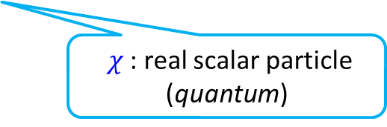



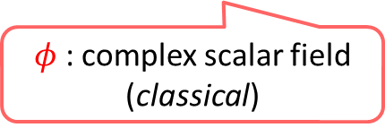
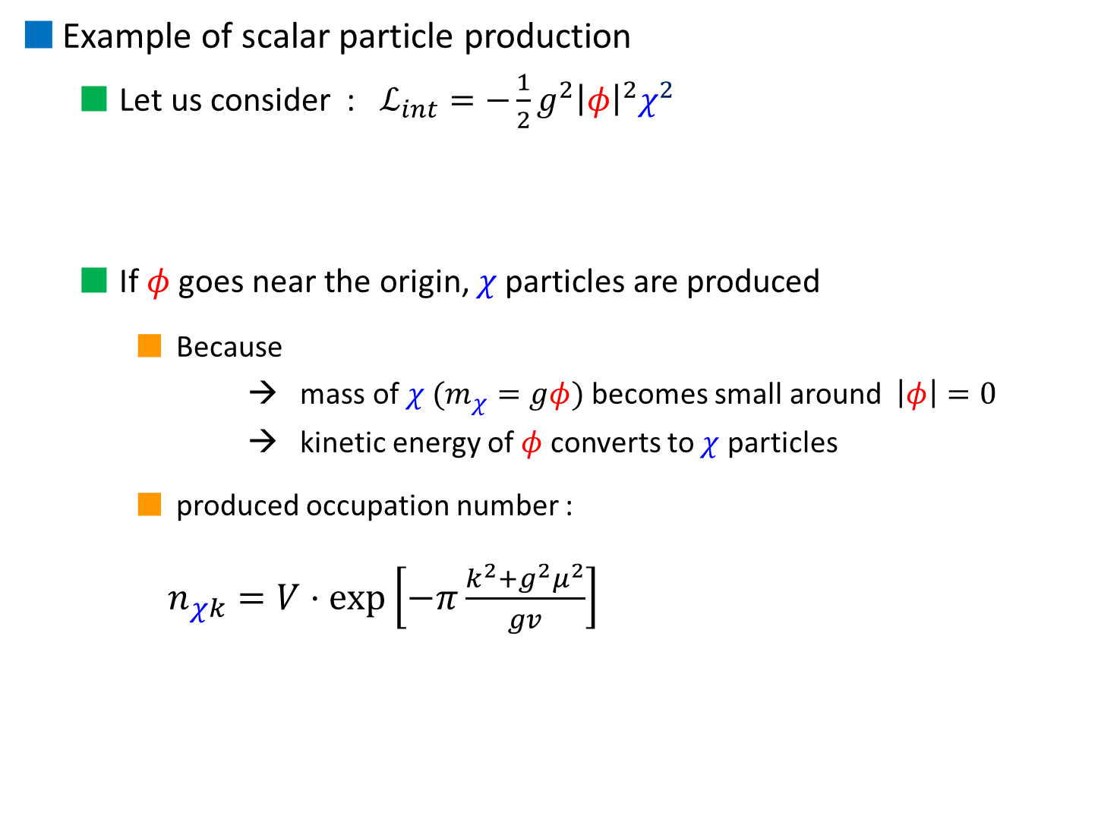






Example of scalar particle production
  Let us consider : $ℒ_{int}=−\frac{1}{2}g^{2}{\left|φ\right|}^{2}χ^{2}$
  If $φ$ goes near the origin, $χ$ particles are produced
    Because
    → mass of $χ$ ($m_{χ}=gφ$) becomes small around $\left|φ\right|=0$
    → kinetic energy of $φ$ converts to $χ$ particles
    produced occupation number :
$n_{χk}=V⋅exp\left[−π\frac{k^{2}+g^{2}μ^{2}}{gv}\right]$
$g$ : coupling
$φ$ : complex scalar field (classical)
$χ$ : real scalar particle (quantum)
$$m_{χ}$$
$$χ$$
$$χ$$
$$χ$$
$$χ$$
$$χ$$
$$χ$$
$$t$$
$$Im φ$$
$$v$$
[L. Kofman, A. D. Linde, X. Liu, A. Maloney,
L. McAllister and E. Silverstein,
JHEP 0405, 030 (2004)].
$$μ$$
$$φ$$
$$Re φ$$

Slide 4

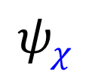


Our interests
  How about supersymmetric model?
    What is the role of the superpartner of the background field?
  How do (quantum) interaction terms affect particle production?
    Usually production rates are calculated in the purely classical background
    → We would like to estimate the contribution of the quantum interaction term
$$φ$$
classical
$$χ$$
quantum
classical
classical
quantum
$$ψ_{φ}$$
quantum
$$ψ_{χ}$$
Notes:
We want to know not only green effect but also purple effect.

Slide 5

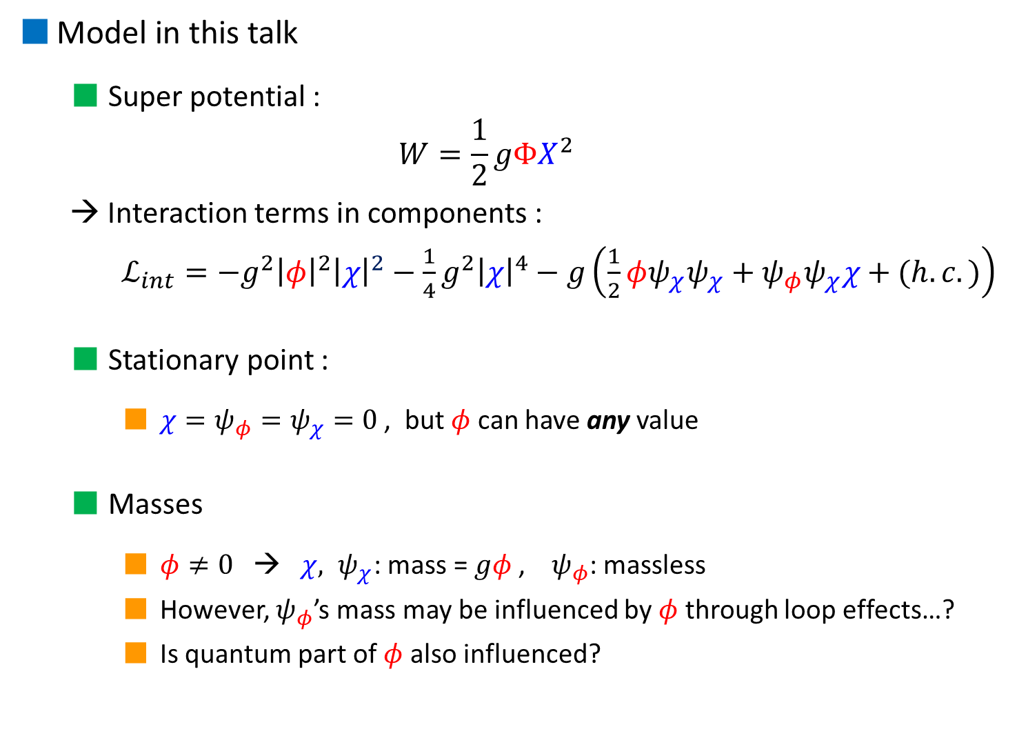





Model in this talk
  Super potential :
  $$W=\frac{1}{2}gΦX^{2}$$
  → Interaction terms in components :
  $ℒ_{int}=−g^{2}{\left|φ\right|}^{2}{\left|χ\right|}^{2}−\frac{1}{4}g^{2}{\left|χ\right|}^{4}−g\left(\frac{1}{2}φψ_{χ}ψ_{χ}+ψ_{φ}ψ_{χ}χ+(h.c.)\right)$
  Stationary point :
    $χ=ψ_{φ}=ψ_{χ}=0$ , but $φ$ can have any value
  Masses
    $φ≠0$ → $χ, ψ_{χ}\text{: }\text{mass}\text{ = }gφ$ , $ψ_{φ}$: massless
    However, $ψ_{φ}$’s mass may be influenced by $φ$ through loop effects…?
    Is quantum part of $φ$ also influenced?
$$Φ=φ+\sqrt{2}θψ_{φ}+θ^{2}F_{φ}$$
$$Χ=χ+\sqrt{2}θψ_{χ}+θ^{2}F_{χ}$$
$g$ : coupling
$$Im φ$$
$$φ$$
Production is possible
impossible
$$Re φ$$

Slide 6
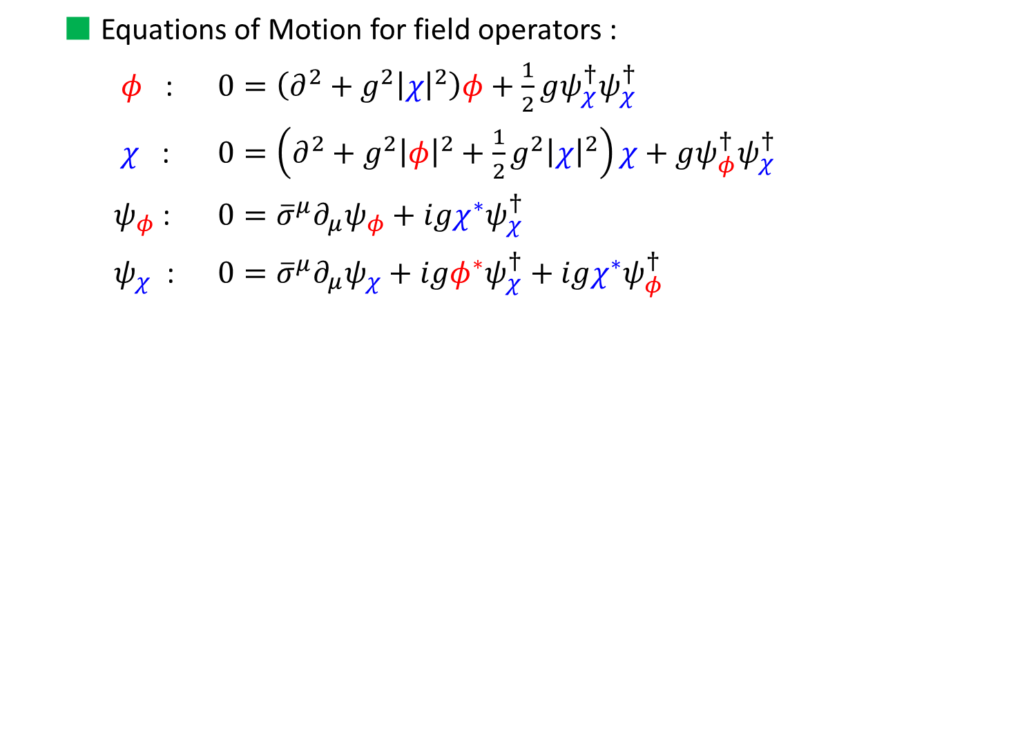
  Equations of Motion for field operators :
  $φ$ : $0=\left(∂^{2}+g^{2}{\left|χ\right|}^{2}\right)φ+\frac{1}{2}gψ_{χ}^{†}ψ_{χ}^{†}$
  $χ$ : $0=\left(∂^{2}+g^{2}{\left|φ\right|}^{2}+\frac{1}{2}g^{2}{\left|χ\right|}^{2}\right)χ+gψ_{φ}^{†}ψ_{χ}^{†}$
  $ψ_{φ}$ : $0={\overline{σ}}^{μ}∂_{μ}ψ_{φ}+igχ^{∗}ψ_{χ}^{†}$
  $ψ_{χ}$ : $0={\overline{σ}}^{μ}∂_{μ}ψ_{χ}+igφ^{∗}ψ_{χ}^{†}+igχ^{∗}ψ_{φ}^{†}$
How do we calculate produced particle number including interaction term ?

Slide 7
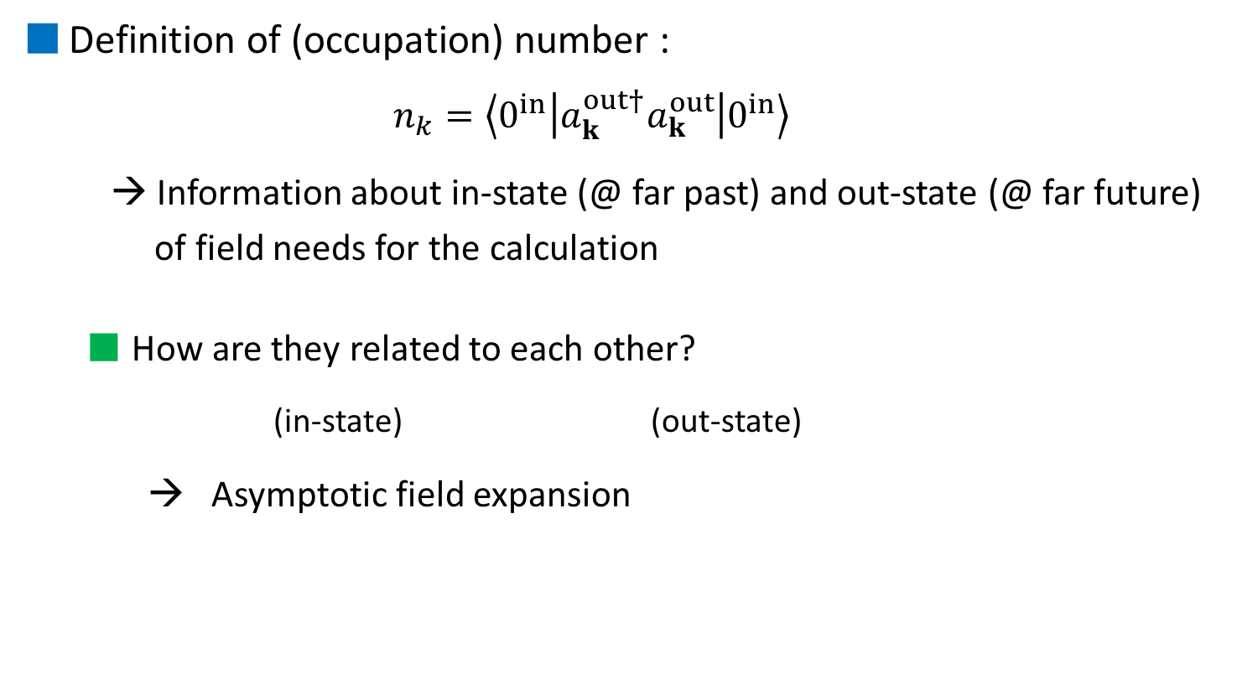
2. How to calculate particle number
Definition of (occupation) number :
  $$n_{k}=\left\langle 0^{in} | a_{k}^{out†}a_{k}^{out} | 0^{in}\right\rangle$$
  → Information about in-state (@ far past) and out-state (@ far future)
  of field needs for the calculation
  How are they related to each other?
    (in-state) (out-state)
  → Asymptotic field expansion
Notes:
In this section, I will show how to calculate the particle number.
This is the definition of number.
Number operator is given by out-state, but vacuum state is taken by in-state.
You can look like Heisenberg picture.
So we need in-state and out-state information for calculation.
Next question is how in-state and out-state are related to each other.
The Key is asymptotic field expansion.

Slide 8

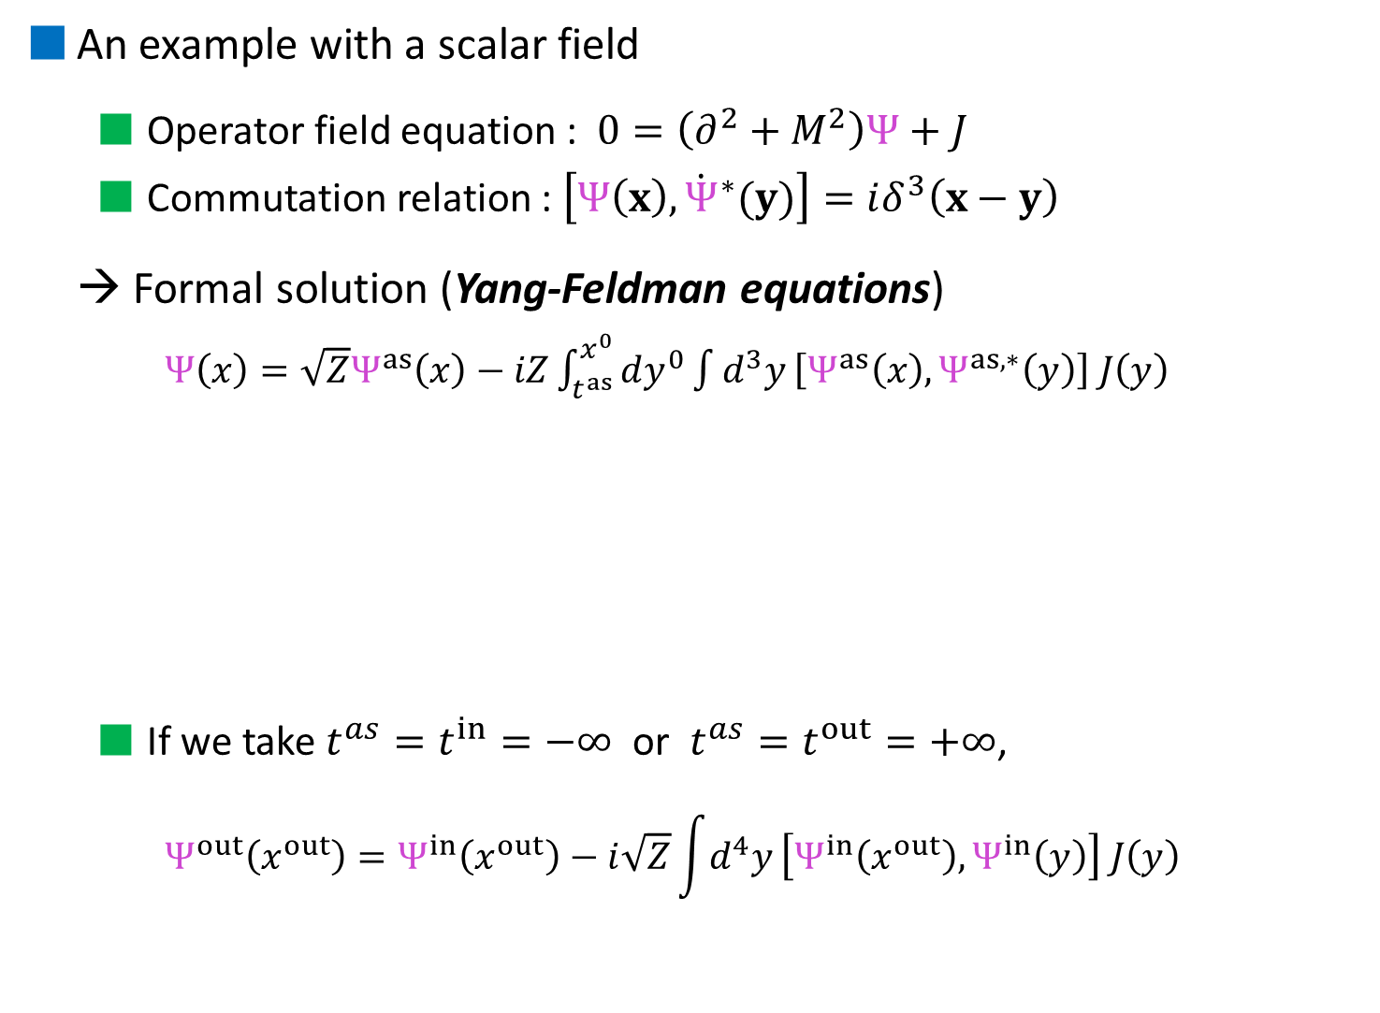




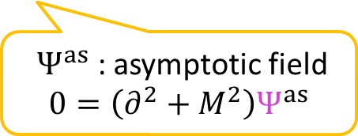



An example with a scalar field
  Operator field equation : $0=\left(∂^{2}+M^{2}\right)Ψ+$ $J$
  Commutation relation : $\left[Ψ\left(x\right),{\dot{Ψ}}^{∗}(y)\right]=iδ^{3}\left(x−y\right)$
→ Formal solution (Yang-Feldman equations)
    $Ψ\left(x\right)=\sqrt{Z}Ψ^{as}\left(x\right)−iZ\int_{t^{as}}^{x^{0}}{dy^{0}}\int{d^{3}y}\left[Ψ^{as}\left(x\right),Ψ^{as,∗}\left(y\right)\right] J\left(y\right)$
  If we take $t^{as}=t^{in}=−∞$ or $t^{as}=t^{out}=+∞$,
    $$Ψ^{out}\left(x^{out}\right)=Ψ^{in}\left(x^{out}\right)−i\sqrt{Z}\int{d^{4}y}\left[Ψ^{in}\left(x^{out}\right),Ψ^{in}\left(y\right)\right] J\left(y\right)$$
(mass) (source term)
$Z$ : some const.
$Ψ^{as}$ : asymptotic field
$$0=\left(∂^{2}+M^{2}\right)Ψ^{as}$$
$$J(y)$$
$$J(y)$$
$$a_{k}^{out}$$
$$a_{k}^{in}$$
$$Ψ^{as}(x)$$
$$J(y)$$
$$J(y)$$
Notes:
In order to explain how to calculate, let’s consider by a simple example, using a scalar case.

Slide 9
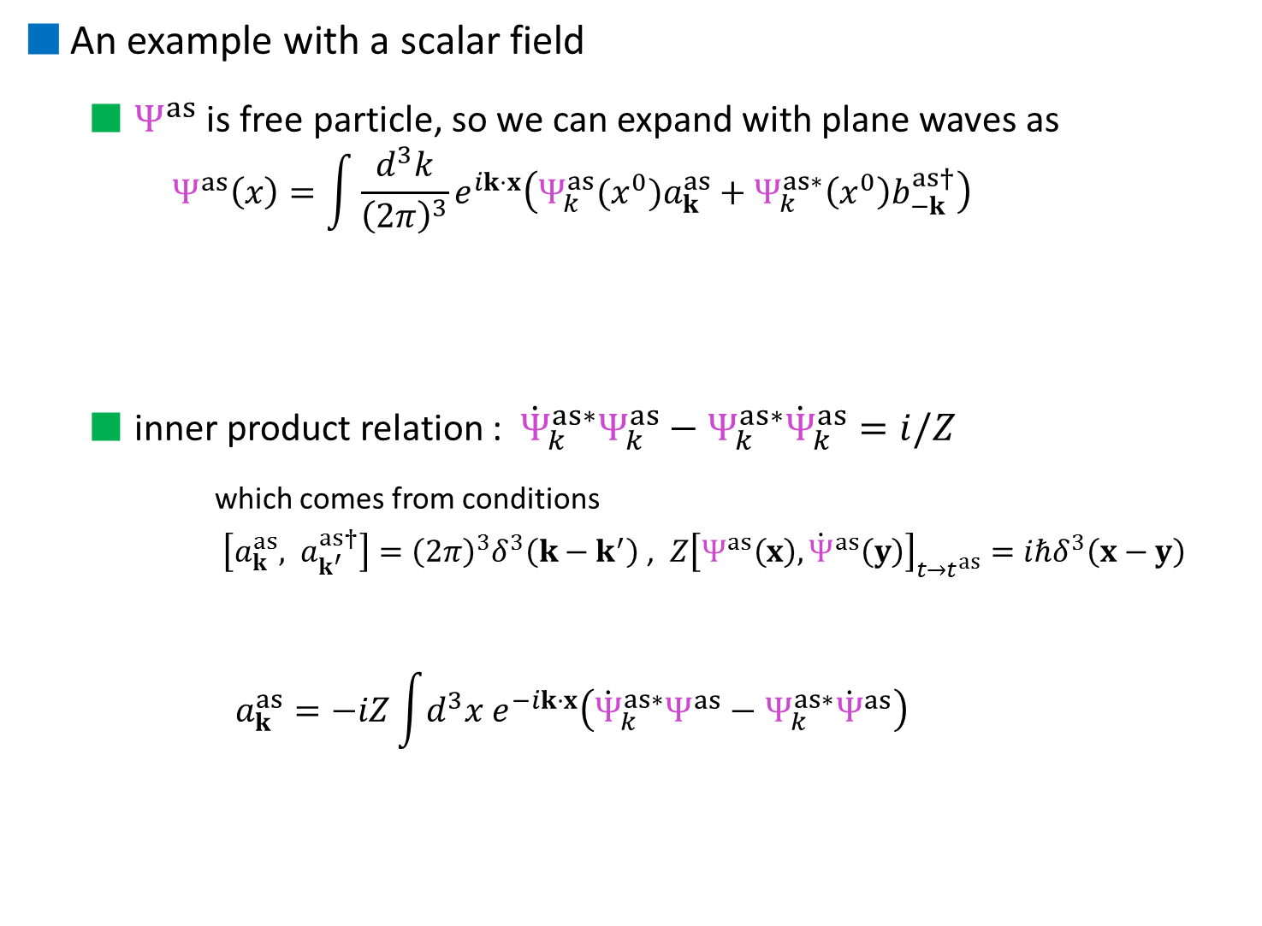
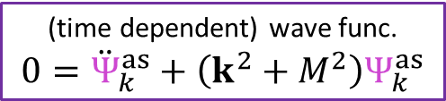
An example with a scalar field
  $Ψ^{as}$ is free particle, so we can expand with plane waves as
    $$Ψ^{as}\left(x\right)=\int{\frac{d^{3}k}{{\left(2π\right)}^{3}}e^{ik⋅x}\left(Ψ_{k}^{as}(x^{0})a_{k}^{as}+Ψ_{k}^{as∗}\left(x^{0}\right)b_{−k}^{as†}\right)}$$
  inner product relation : ${\dot{Ψ}}_{k}^{as∗}Ψ_{k}^{as}−Ψ_{k}^{as∗}{\dot{Ψ}}_{k}^{as}=i/Z$
      which comes from conditions
      $\left[a_{k}^{as}, a_{k^{′}}^{as†}\right]={\left(2π\right)}^{3}δ^{3}\left(k−k^{′}\right)$ , $Z{\left[Ψ^{as}\left(x\right),{\dot{Ψ}}^{as}\left(y\right)\right]}_{t→t^{as}}=iℏδ^{3}\left(x−y\right)$
    $$a_{k}^{as}=−iZ\int{d^{3}x e^{−ik⋅x}\left({\dot{Ψ}}_{k}^{as∗}Ψ^{as}−Ψ_{k}^{as∗}{\dot{Ψ}}^{as}\right)}$$
plane wave
(time dependent) wave func.
$$0={\ddot{Ψ}}_{k}^{as}+\left(k^{2}+M^{2}\right)Ψ_{k}^{as}$$
creation/annihilation op.

Slide 10
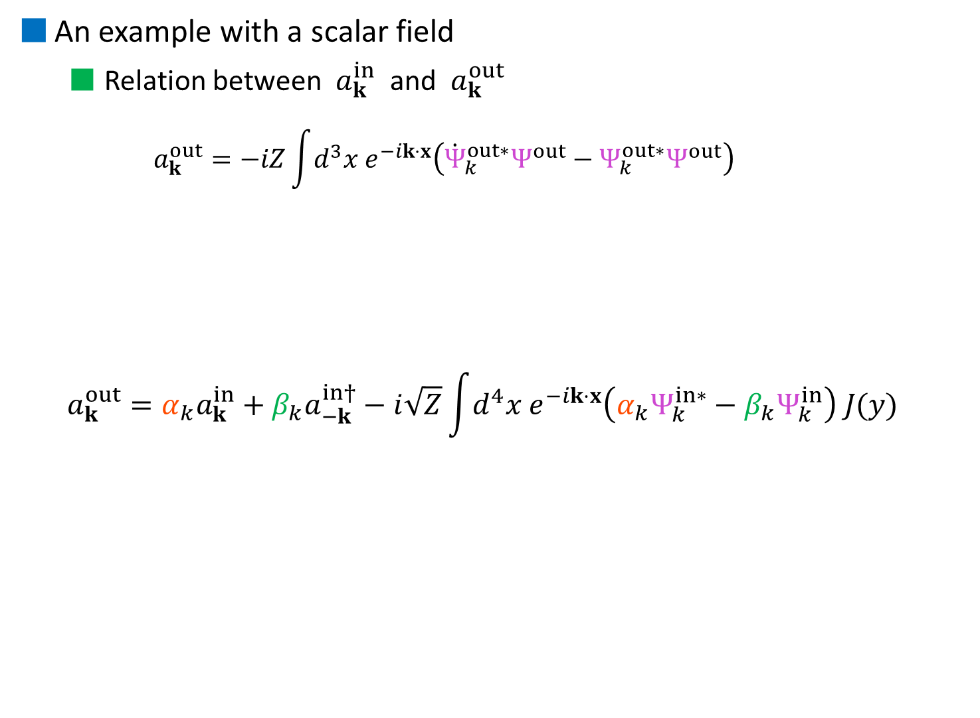
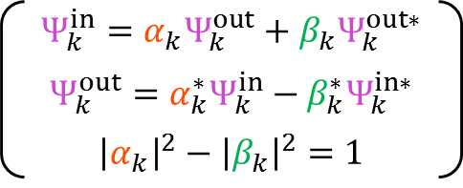
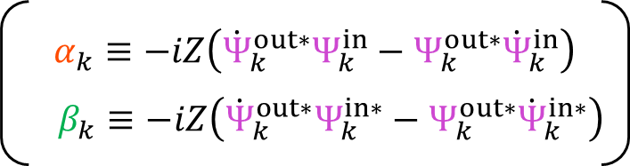
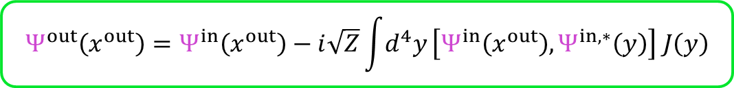
An example with a scalar field
  Relation between $a_{k}^{in}$ and $a_{k}^{out}$
    $$a_{k}^{out}=−iZ\int{d^{3}x e^{−ik⋅x}\left({\dot{Ψ}}_{k}^{out∗}Ψ^{out}−Ψ_{k}^{out∗}Ψ^{out}\right)}$$
  $$a_{k}^{out}=α_{k}a_{k}^{in}+β_{k}a_{−k}^{in†}−i\sqrt{Z}\int{d^{4}x e^{−ik⋅x}\left(α_{k}Ψ_{k}^{in∗}−β_{k}Ψ_{k}^{in}\right) J(y)}$$
      $$Ψ^{out}\left(x^{out}\right)=Ψ^{in}\left(x^{out}\right)−i\sqrt{Z}\int{d^{4}y}\left[Ψ^{in}\left(x^{out}\right),Ψ^{in,∗}\left(y\right)\right] J\left(y\right)$$
(usual) Bogoliubov tf low
Interaction effects
$$α_{k}≡−iZ\left({\dot{Ψ}}_{k}^{out∗}Ψ_{k}^{in}−Ψ_{k}^{out∗}{\dot{Ψ}}_{k}^{in}\right)$$
$$β_{k}≡−iZ\left({\dot{Ψ}}_{k}^{out∗}Ψ_{k}^{in∗}−Ψ_{k}^{out∗}{\dot{Ψ}}_{k}^{in∗}\right)$$
$$Ψ_{k}^{in}=α_{k}Ψ_{k}^{out}+β_{k}Ψ_{k}^{out∗}$$
$$Ψ_{k}^{out}=α_{k}^{∗}Ψ_{k}^{in}−β_{k}^{∗}Ψ_{k}^{in∗}$$
$${\left|α_{k}\right|}^{2}−{\left|β_{k}\right|}^{2}=1$$

Slide 11
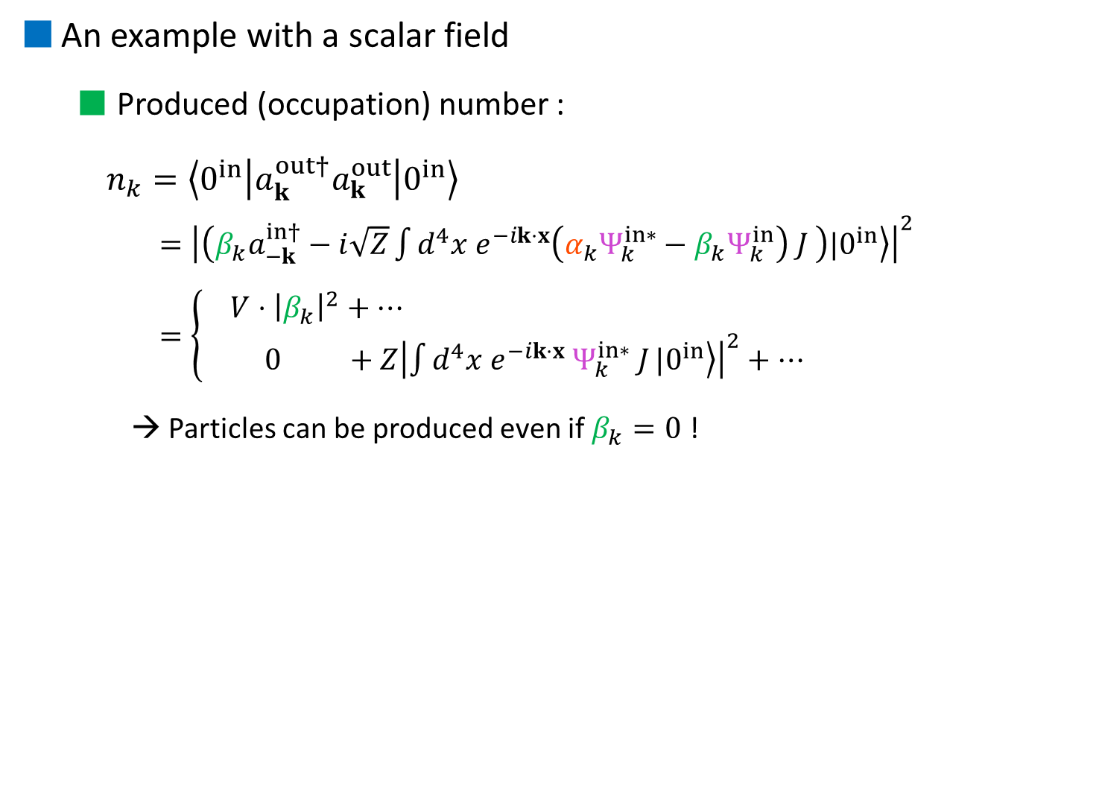


An example with a scalar field
  Produced (occupation) number :
  $n_{k}=\left\langle 0^{in} | a_{k}^{out†}a_{k}^{out} | 0^{in}\right\rangle$
    $={\left|\left(β_{k}a_{−k}^{in†}−i\sqrt{Z}\int{d^{4}x e^{−ik⋅x}\left(α_{k}Ψ_{k}^{in∗}−β_{k}Ψ_{k}^{in}\right) J }\right)|\left.0^{in}\right\rangle \right|}^{2}$
    $=\left\{\begin{aligned} V⋅{\left|β_{k}\right|}^{2}+⋯ \\ 0 +Z{\left|\int{d^{4}x e^{−ik⋅x} Ψ_{k}^{in∗} J}|\left.0^{in}\right\rangle \right|}^{2}+⋯\end{aligned}\right.$
    → Particles can be produced even if $β_{k}=0$ !
$$β_{k}≠0$$
$$β_{k}=0$$
Notes:
So, even if beta is zero, particle production can be happened due to interaction effect.

Slide 12
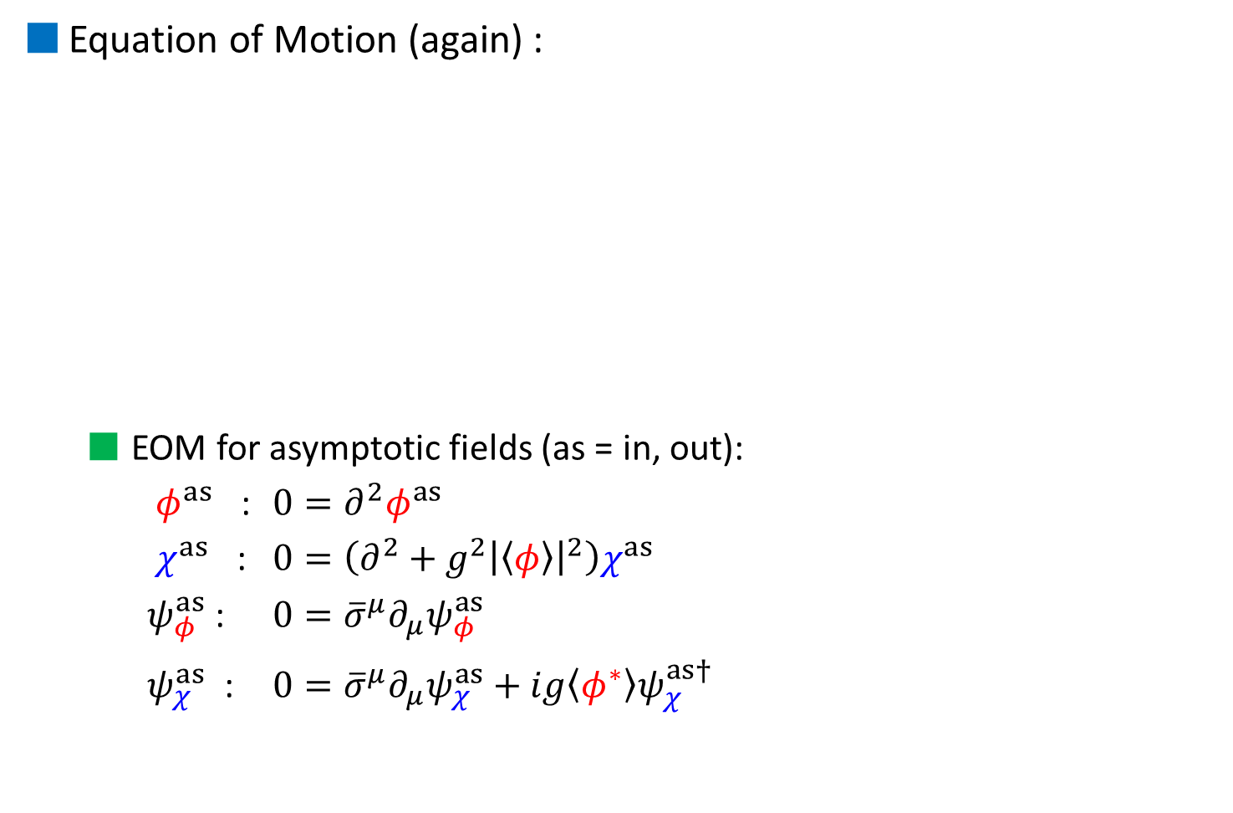
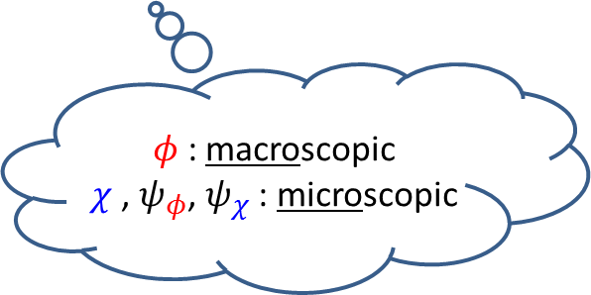
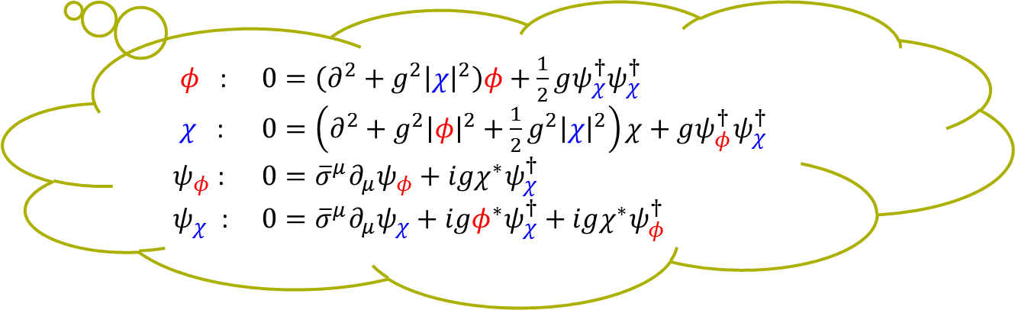
3. Calculation of particle number
Equation of Motion (again) :
  EOM for asymptotic fields (as = in, out):
  $φ^{as}$ : $0=∂^{2}φ^{as}$
  $χ^{as}$ : $0=\left(∂^{2}+g^{2}{\left|\left\langle φ\right\rangle \right|}^{2}\right)χ^{as}$
  $ψ_{φ}^{as}$ : $0={\overline{σ}}^{μ}∂_{μ}ψ_{φ}^{as}$
  $ψ_{χ}^{as}$ : $0={\overline{σ}}^{μ}∂_{μ}ψ_{χ}^{as}+ig\left\langle φ^{∗}\right\rangle ψ_{χ}^{as†}$
$φ$ : $0=\left(∂^{2}+g^{2}{\left|χ\right|}^{2}\right)φ+\frac{1}{2}gψ_{χ}^{†}ψ_{χ}^{†}$
$χ$ : $0=\left(∂^{2}+g^{2}{\left|φ\right|}^{2}+\frac{1}{2}g^{2}{\left|χ\right|}^{2}\right)χ+gψ_{φ}^{†}ψ_{χ}^{†}$
$ψ_{φ}$ : $0={\overline{σ}}^{μ}∂_{μ}ψ_{φ}+igχ^{∗}ψ_{χ}^{†}$
$ψ_{χ}$ : $0={\overline{σ}}^{μ}∂_{μ}ψ_{χ}+igφ^{∗}ψ_{χ}^{†}+igχ^{∗}ψ_{φ}^{†}$
$φ$ : macroscopic
$χ$ , $ψ_{φ}$, $ψ_{χ}$ : microscopic

Slide 13


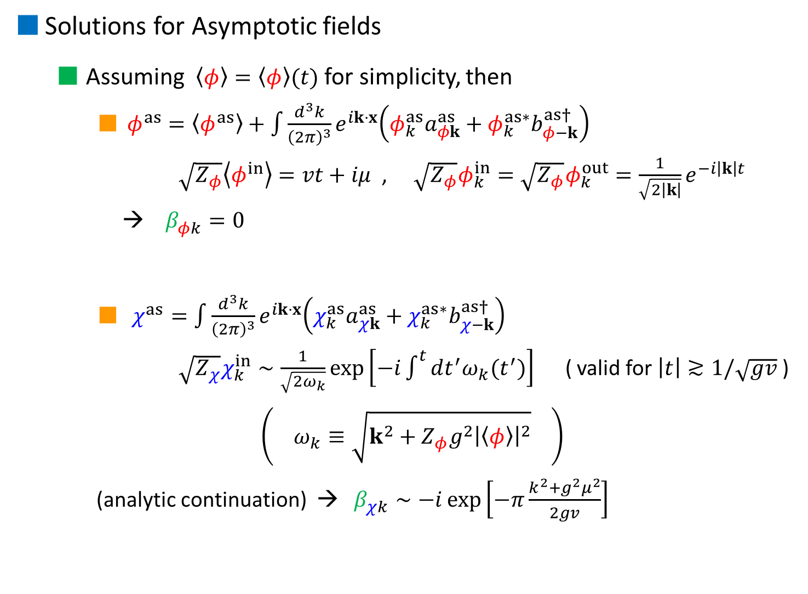


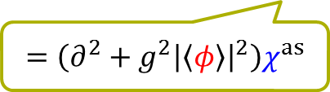




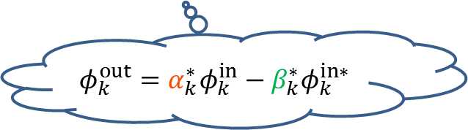


Solutions for Asymptotic fields
  Assuming $\left\langle φ\right\rangle =\left\langle φ\right\rangle (t)$ for simplicity, then
    $φ^{as}=\left\langle φ^{as}\right\rangle +\int{\frac{d^{3}k}{{\left(2π\right)}^{3}}e^{ik⋅x}\left(φ_{k}^{as}a_{φk}^{as}+φ_{k}^{as∗}b_{φ−k}^{as†}\right)}$
    $\sqrt{Z_{φ}}\left\langle φ^{in}\right\rangle =vt+iμ$ , $\sqrt{Z_{φ}}φ_{k}^{in}=\sqrt{Z_{φ}}φ_{k}^{out}=\frac{1}{\sqrt{2\left|k\right|}}e^{−i\left|k\right|t}$
    → $β_{φk}^{}=0$
    $χ^{as}=\int{\frac{d^{3}k}{{\left(2π\right)}^{3}}e^{ik⋅x}\left(χ_{k}^{as}a_{χk}^{as}+χ_{k}^{as∗}b_{χ−k}^{as†}\right)}$
    $\sqrt{Z_{χ}}χ_{k}^{in}∼\frac{1}{\sqrt{2ω_{k}}}\exp\left[−i\int^{t}{dt^{′}ω_{k}(t^{′})}\right]$ ( valid for $\left|t\right|≳1/\sqrt{gv}$ )
    $\left( ω_{k}≡\sqrt{k^{2}+Z_{φ}g^{2}{\left|\left\langle φ\right\rangle \right|}^{2}} \right)$
    (analytic continuation) → $β_{χk}^{}∼−i\exp\left[−π\frac{k^{2}+g^{2}μ^{2}}{2gv}\right]$
$$Im φ$$
$$v$$
$$φ$$
$$μ$$
$$Re φ$$
$$0=∂^{2}φ^{as}$$
$$φ_{k}^{out}=α_{k}^{∗}φ_{k}^{in}−β_{k}^{∗}φ_{k}^{in∗}$$
$$=\left(∂^{2}+g^{2}{\left|\left\langle φ\right\rangle \right|}^{2}\right)χ^{as}$$
$$Im t$$
$$Re t$$
$$χ^{in}$$
$$χ^{out}$$

Slide 14
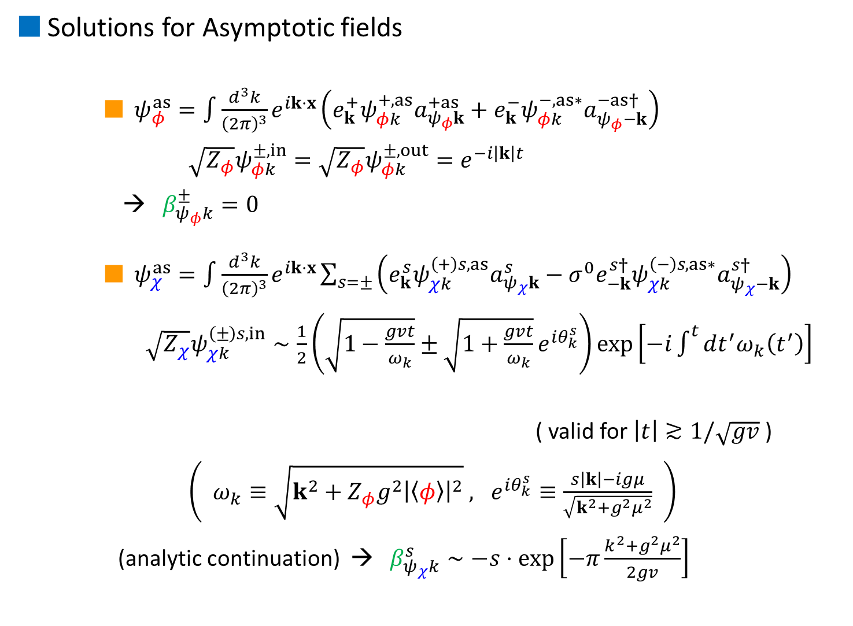
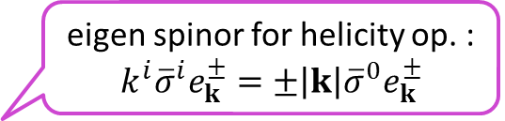
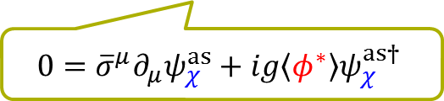

Solutions for Asymptotic fields
    $ψ_{φ}^{as}=\int{\frac{d^{3}k}{{\left(2π\right)}^{3}}e^{ik⋅x}\left(e_{k}^{+}ψ_{φk}^{+,as}a_{ψ_{φ}k}^{+as}+e_{k}^{−}ψ_{φk}^{−,as∗}a_{ψ_{φ}−k}^{−as†}\right)}$
    $\sqrt{Z_{φ}}ψ_{φk}^{±,in}=\sqrt{Z_{φ}}ψ_{φk}^{±,out}=e^{−i\left|k\right|t}$
    → $β_{ψ_{φ}k}^{±}=0$
    $ψ_{χ}^{as}=\int{\frac{d^{3}k}{{\left(2π\right)}^{3}}e^{ik⋅x}\sum_{s=±}{\left(e_{k}^{s}ψ_{χk}^{\left(+\right)s,as}a_{ψ_{χ}k}^{s}−σ^{0}e_{−k}^{s†}ψ_{χk}^{\left(−\right)s,as∗}a_{ψ_{χ}−k}^{s†}\right)}}$
    $\sqrt{Z_{χ}}ψ_{χk}^{\left(±\right)s,in}∼\frac{1}{2}\left(\sqrt{1−\frac{gvt}{ω_{k}}}±\sqrt{1+\frac{gvt}{ω_{k}}}e^{iθ_{k}^{s}}\right)\exp\left[−i\int^{t}{dt^{′}ω_{k}\left(t^{′}\right)}\right]$
    ( valid for $\left|t\right|≳1/\sqrt{gv}$ )
    $\left( ω_{k}≡\sqrt{k^{2}+Z_{φ}g^{2}{\left|\left\langle φ\right\rangle \right|}^{2}} , e^{iθ_{k}^{s}}≡\frac{s\left|k\right|−igμ}{\sqrt{k^{2}+g^{2}μ^{2}}} \right)$
    (analytic continuation) → $β_{ψ_{χ}k}^{s}∼−s⋅\exp\left[−π\frac{k^{2}+g^{2}μ^{2}}{2gv}\right]$
eigen spinor for helicity op. : $k^{i}{\overline{σ}}^{i}e_{k}^{±}=±\left|k\right|{\overline{σ}}^{0}e_{k}^{±}$
$$0={\overline{σ}}^{μ}∂_{μ}ψ_{φ}^{as}$$
$$0={\overline{σ}}^{μ}∂_{μ}ψ_{χ}^{as}+ig\left\langle φ^{∗}\right\rangle ψ_{χ}^{as†}$$

Slide 15
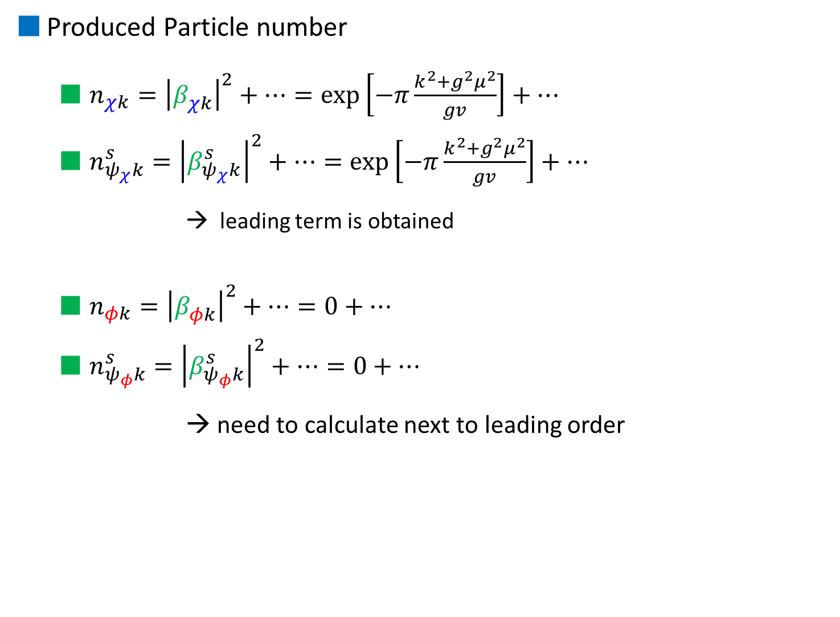
Produced Particle number
  $n_{χk}={\left|β_{χk}^{}\right|}^{2}+⋯=\exp\left[−π\frac{k^{2}+g^{2}μ^{2}}{gv}\right]+⋯$
  $n_{ψ_{χ}k}^{s}={\left|β_{ψ_{χ}k}^{s}\right|}^{2}+⋯=\exp\left[−π\frac{k^{2}+g^{2}μ^{2}}{gv}\right]+⋯$
    → leading term is obtained
  $n_{φk}={\left|β_{φk}^{}\right|}^{2}+⋯=0+⋯$
  $n_{ψ_{φ}k}^{s}={\left|β_{ψ_{φ}k}^{s}\right|}^{2}+⋯=0+⋯$
  → need to calculate next to leading order
Focus on!

Slide 16
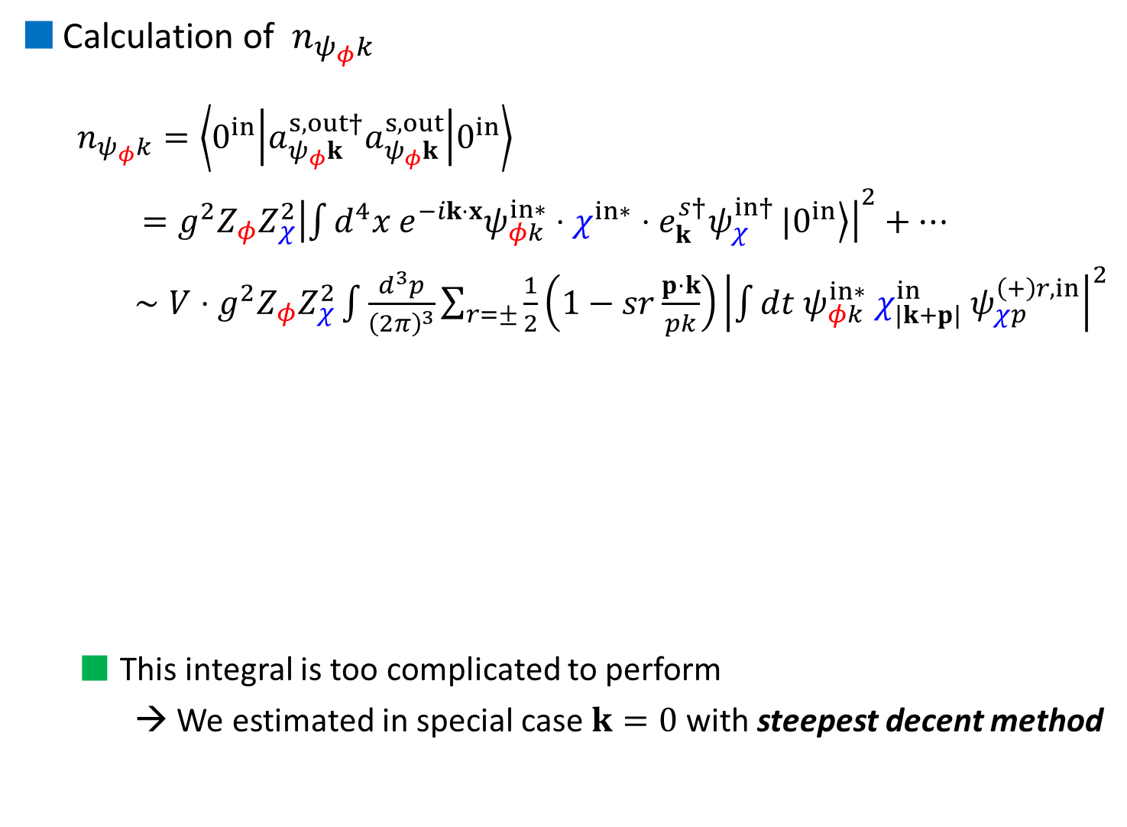


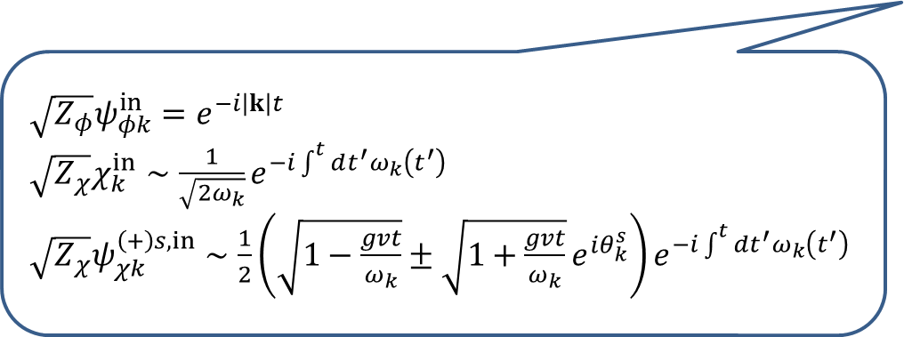
Calculation of $n_{ψ_{φ}k}$
  $n_{ψ_{φ}k}=\left\langle 0^{in} | a_{ψ_{φ}k}^{s,out†}a_{ψ_{φ}k}^{s,out} | 0^{in}\right\rangle$
  $=g^{2}Z_{φ}Z_{χ}^{2}{\left|\int{d^{4}x e^{−ik⋅x}ψ_{φk}^{in∗}⋅χ^{in∗}⋅e_{k}^{s†}ψ_{χ}^{in†}}|\left.0^{in}\right\rangle \right|}^{2}+⋯$
  $∼V⋅g^{2}Z_{φ}Z_{χ}^{2}\int{\frac{d^{3}p}{{\left(2π\right)}^{3}}}\sum_{r=±}{\frac{1}{2}\left(1−sr\frac{p⋅k}{pk}\right){\left|\int{dt ψ_{φk}^{in∗} χ_{\left|k+p\right|}^{in} ψ_{χp}^{\left(+\right)r,in}}\right|}^{2}}$
  This integral is too complicated to perform
  → We estimated in special case $k=0$ with steepest decent method
$\sqrt{Z_{φ}}ψ_{φk}^{in}=e^{−i\left|k\right|t}$
$\sqrt{Z_{χ}}χ_{k}^{in}∼\frac{1}{\sqrt{2ω_{k}}}e^{−i\int^{t}{dt^{′}ω_{k}\left(t^{′}\right)}}$
$\sqrt{Z_{χ}}ψ_{χk}^{\left(+\right)s,in}∼\frac{1}{2}\left(\sqrt{1−\frac{gvt}{ω_{k}}}±\sqrt{1+\frac{gvt}{ω_{k}}}e^{iθ_{k}^{s}}\right)e^{−i\int^{t}{dt^{′}ω_{k}\left(t^{′}\right)}}$
steepest decent method
$$Im t$$
$$Re t$$

Slide 17
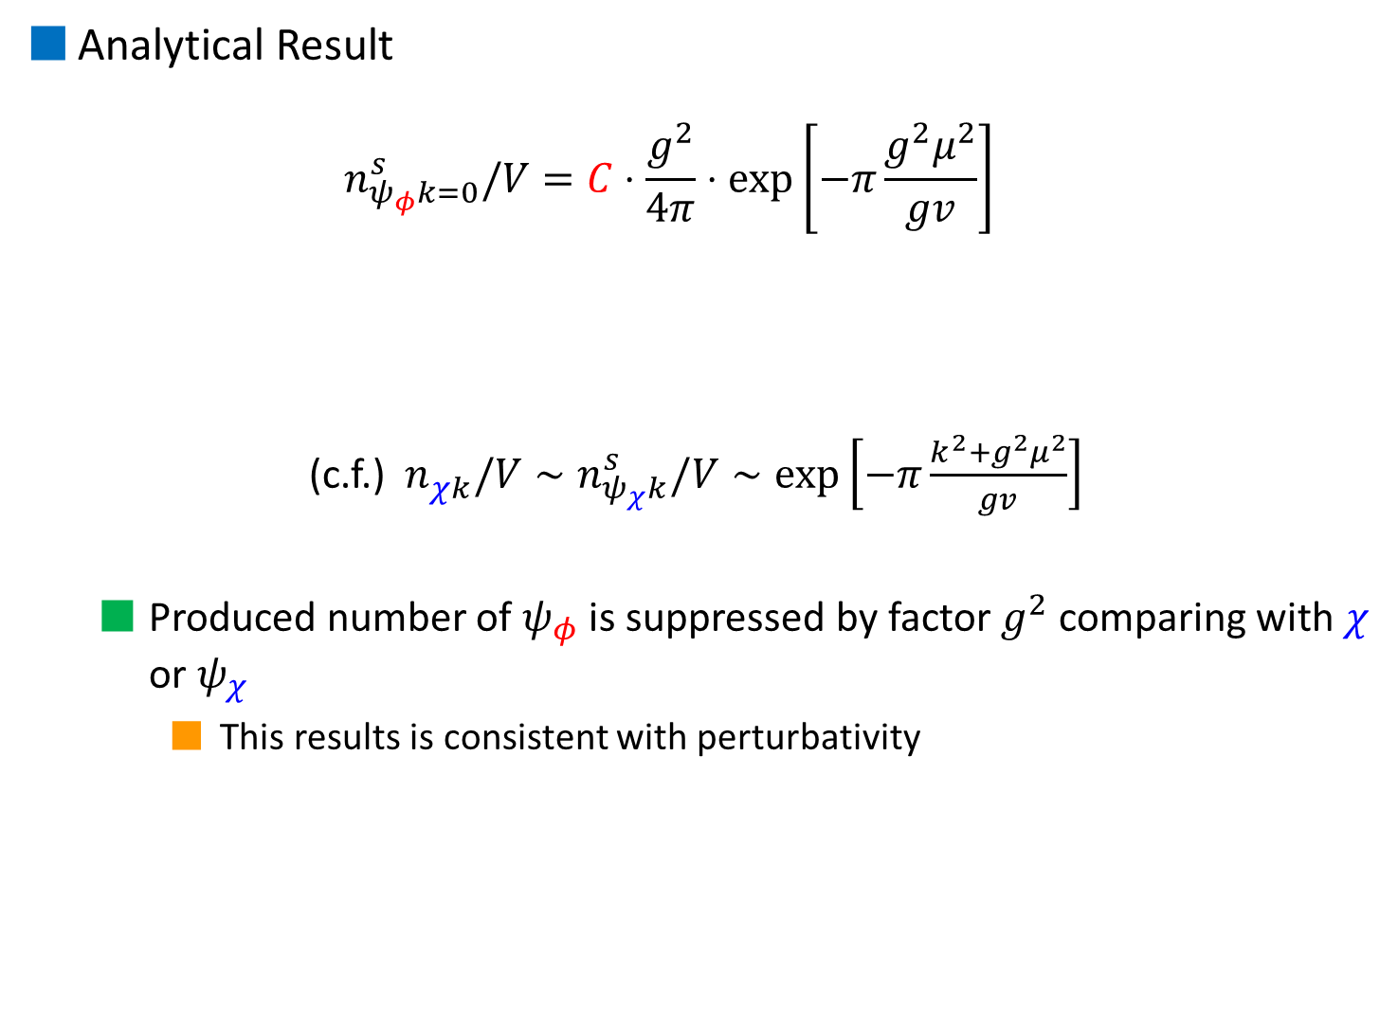
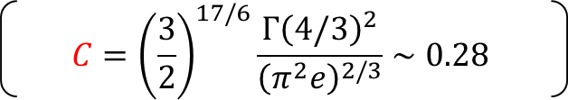
Analytical Result
  $$n_{ψ_{φ}k=0}^{s}/V=C⋅\frac{g^{2}}{4π}⋅\exp\left[−π\frac{g^{2}μ^{2}}{gv}\right]$$
  (c.f.) $n_{χk}^{}/V∼n_{ψ_{χ}k}^{s}/V∼\exp\left[−π\frac{k^{2}+g^{2}μ^{2}}{gv}\right]$
  Produced number of $ψ_{φ}$ is suppressed by factor $g^{2}$ comparing with $χ$ or $ψ_{χ}$
    This results is consistent with perturbativity
  $$C={\left(\frac{3}{2}\right)}^{17/6}\frac{Γ{\left(4/3\right)}^{2}}{{\left(π^{2}e\right)}^{2/3}}∼0.28$$

Slide 18
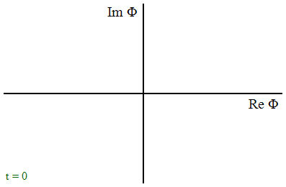
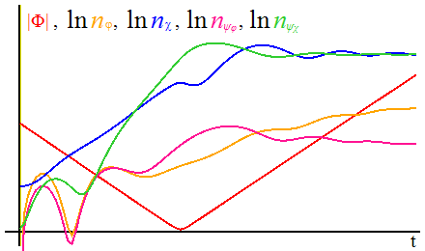
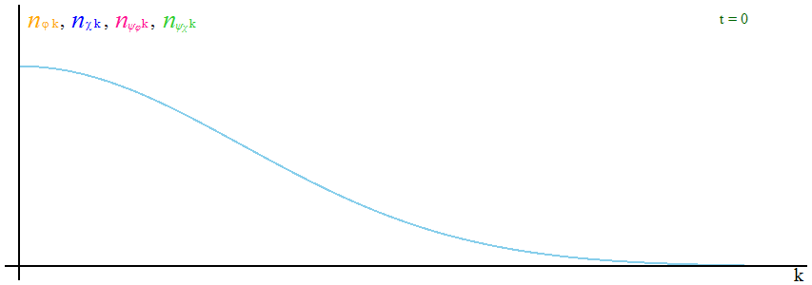
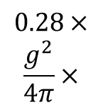
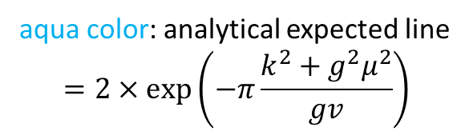
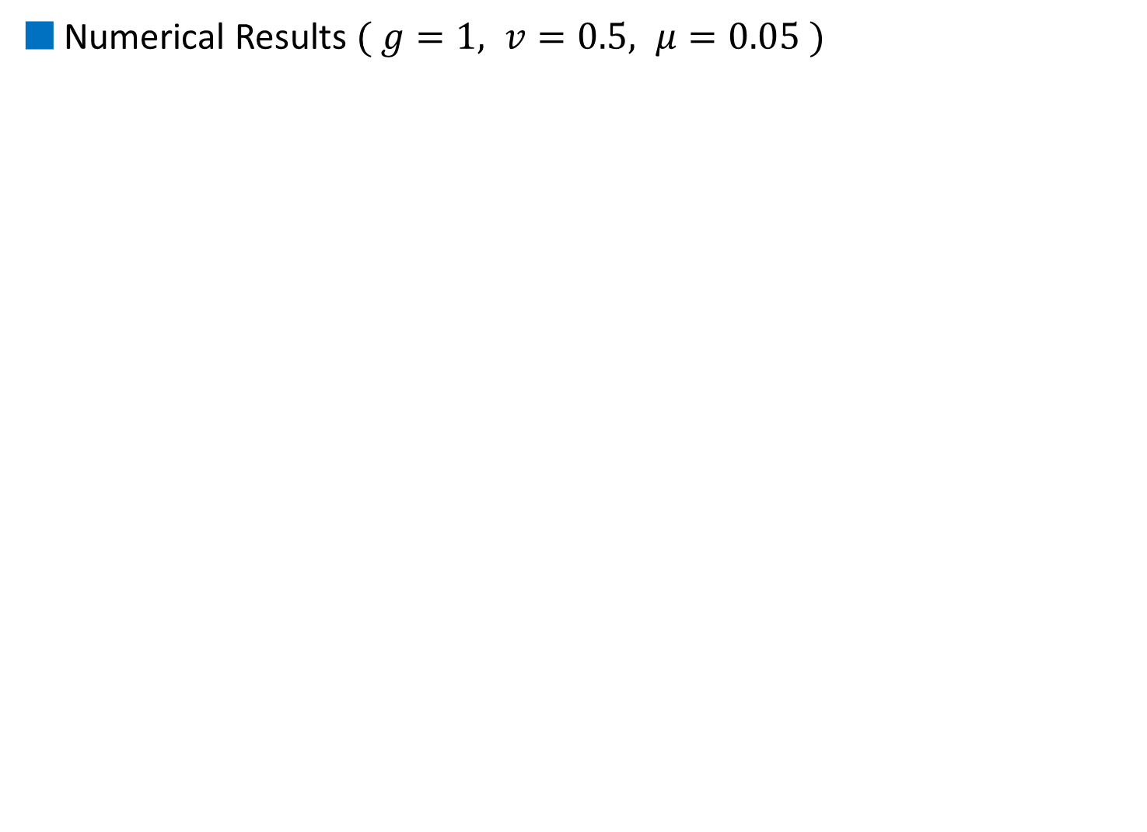
Numerical Results $( g=1, v=0.5, μ=0.05 )$
Preliminary
aqua color: analytical expected line
$$=2×\exp\left(−π\frac{k^{2}+g^{2}μ^{2}}{gv}\right)$$
$$0.28×$$
$$\frac{g^{2}}{4π}×$$

Slide 19
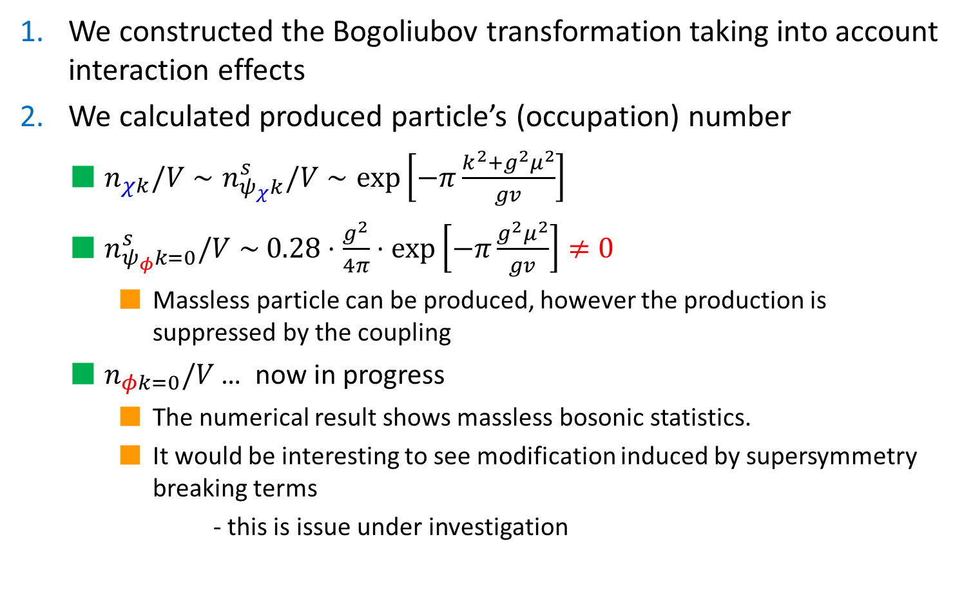
4. Summary
We constructed the Bogoliubov transformation taking into account interaction effects
We calculated produced particle’s (occupation) number
  $n_{χk}/V∼n_{ψ_{χ}k}^{s}/V∼\exp\left[−π\frac{k^{2}+g^{2}μ^{2}}{gv}\right]$
  $n_{ψ_{φ}k=0}^{s}/V∼$ $0.28⋅\frac{g^{2}}{4π}⋅\exp\left[−π\frac{g^{2}μ^{2}}{gv}\right]≠0$
    Massless particle can be produced, however the production is suppressed by the coupling
  $n_{φk=0}/V$ … now in progress
    The numerical result shows massless bosonic statistics.
    It would be interesting to see modification induced by supersymmetry breaking terms
    - this is issue under investigation

Slide 21
Introduction
  Brief overview of particle production
  Our Model
How to calculate particle number
  Relation between in-field and out-field
  Bogoliubov transformation within interaction term
Calculation of produced particle number
  Asymptotic solution, Formal solutions
  Produced particle number
Summary

Slide 22


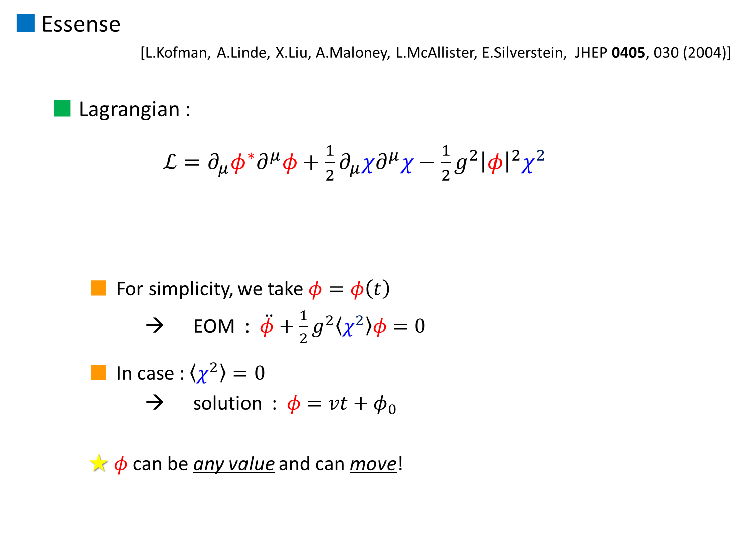


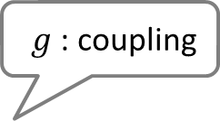

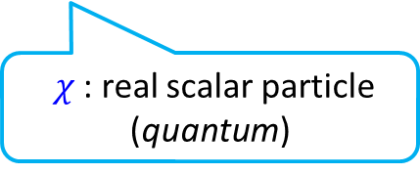

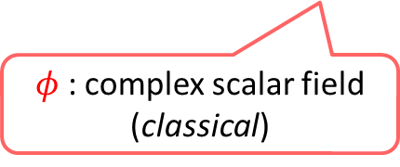


Essense
[L.Kofman, A.Linde, X.Liu, A.Maloney, L.McAllister, E.Silverstein, JHEP 0405, 030 (2004)]
  Lagrangian :
  $ℒ=∂_{μ}φ^{∗}∂^{μ}φ+\frac{1}{2}∂_{μ}χ∂^{μ}χ−\frac{1}{2}g^{2}{\left|φ\right|}^{2}χ^{2}$
    For simplicity, we take $φ=φ\left(t\right)$
    → EOM : $\ddot{φ}+\frac{1}{2}g^{2}\left\langle χ^{2}\right\rangle φ=0$
    In case : $\left\langle χ^{2}\right\rangle =0$
    → solution : $φ=vt+φ_{0}$
    ★ $φ$can be any value and can move!
$g$ : coupling
$φ$ : complex scalar field (classical)
$χ$ : real scalar particle (quantum)
$$φ$$
$$Im φ$$
$$v$$
$$v$$
$$φ$$
$$Re φ$$
$$φ$$
$$v$$

Slide 23

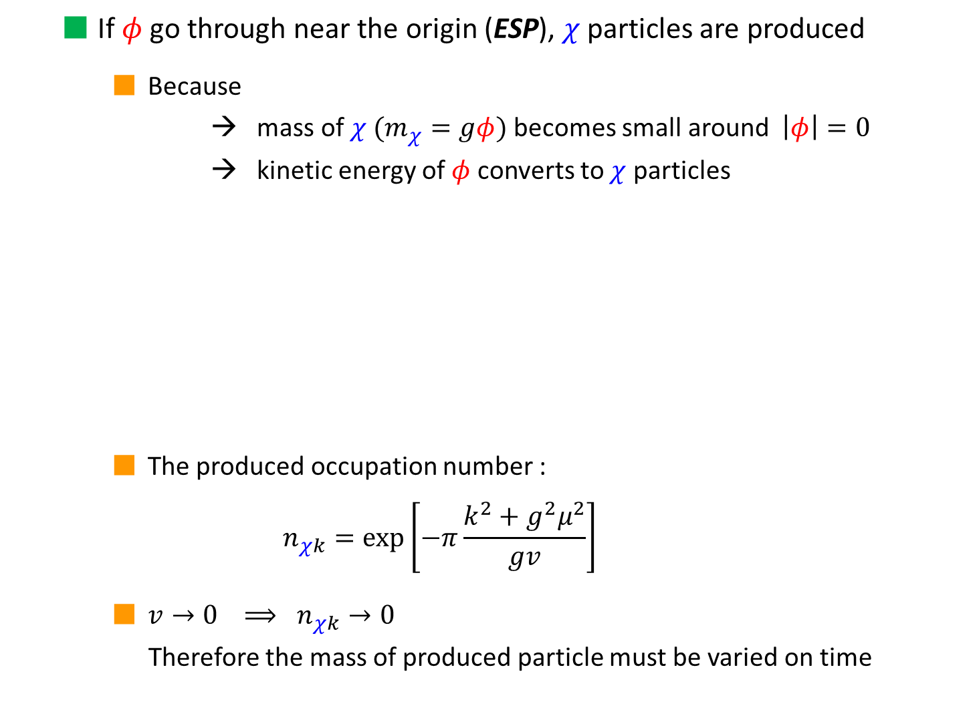






  If $φ$ go through near the origin (ESP), $χ$ particles are produced
    Because
    → mass of $χ$ ($m_{χ}=gφ$) becomes small around $\left|φ\right|=0$
    → kinetic energy of $φ$ converts to $χ$ particles
    The produced occupation number :
    $$n_{χk}=exp\left[−π\frac{k^{2}+g^{2}μ^{2}}{gv}\right]$$
    $v→0 ⟹ n_{χk}→0$
    Therefore the mass of produced particle must be varied on time
$$χ$$
$$χ$$
$$Im φ$$
$$v$$
$$μ$$
$$φ$$
ESP
$$Re φ$$

Slide 24
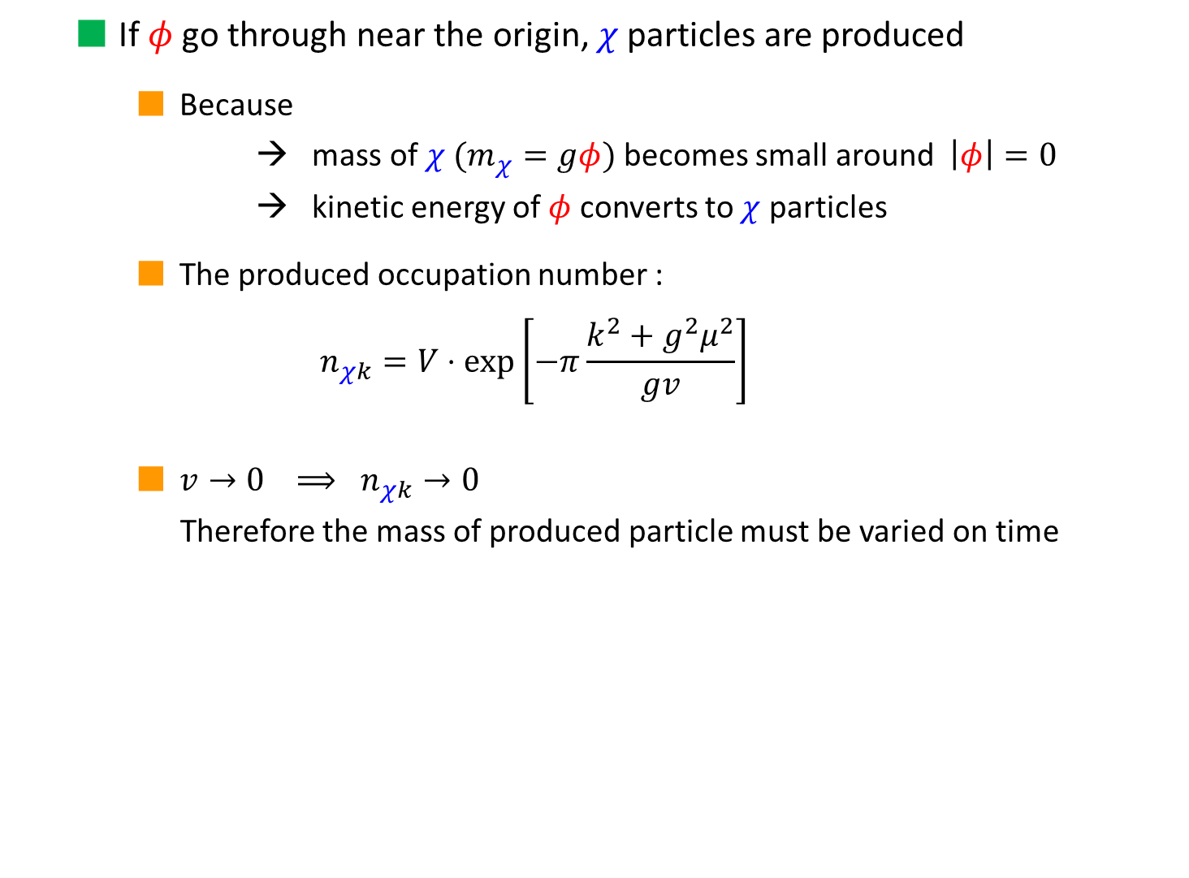
  If $φ$ go through near the origin, $χ$ particles are produced
    Because
    → mass of $χ$ ($m_{χ}=gφ$) becomes small around $\left|φ\right|=0$
    → kinetic energy of $φ$ converts to $χ$ particles
    The produced occupation number :
    $$n_{χk}=V⋅exp\left[−π\frac{k^{2}+g^{2}μ^{2}}{gv}\right]$$
    $v→0 ⟹ n_{χk}→0$
    Therefore the mass of produced particle must be varied on time
$$Im φ$$
$$v$$
$$φ$$
$$μ$$
$$Re φ$$

Slide 25

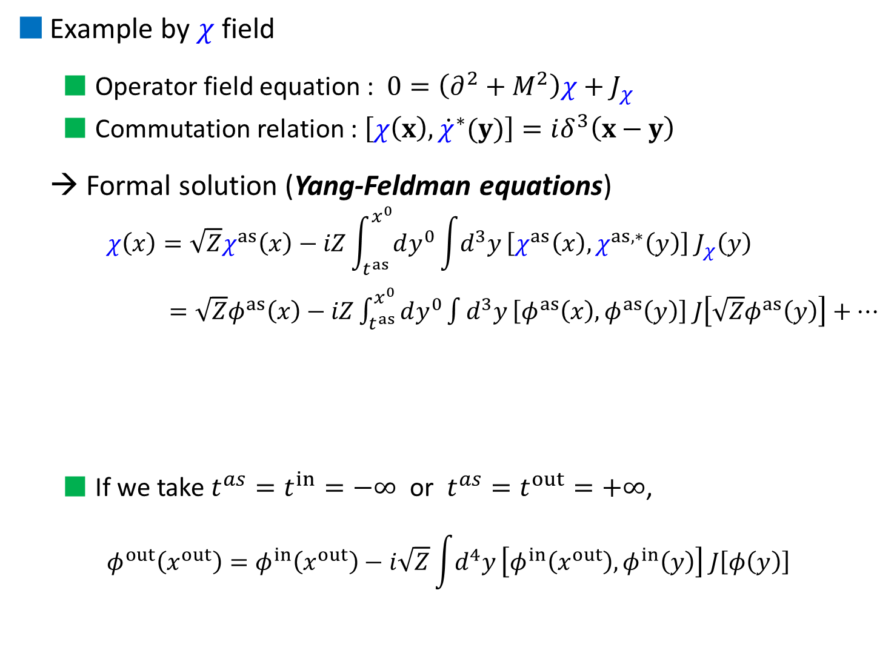


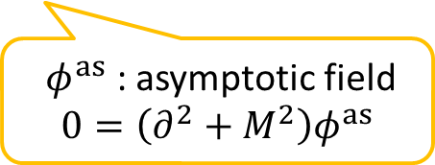



Example by $χ$ field
  Operator field equation : $0=\left(∂^{2}+M^{2}\right)χ+J_{χ}$
  Commutation relation : $\left[χ\left(x\right),{\dot{χ}}^{∗}(y)\right]=iδ^{3}\left(x−y\right)$
→ Formal solution (Yang-Feldman equations)
    $$χ\left(x\right)=\sqrt{Z}χ^{as}\left(x\right)−iZ\int_{t^{as}}^{x^{0}}{dy^{0}}\int{d^{3}y}\left[χ^{as}\left(x\right),χ^{as,∗}\left(y\right)\right] J_{χ}\left(y\right)$$
    $=\sqrt{Z}φ^{as}\left(x\right)−iZ\int_{t^{as}}^{x^{0}}{dy^{0}}\int{d^{3}y}\left[φ^{as}\left(x\right),φ^{as}\left(y\right)\right] J\left[\sqrt{Z}φ^{as}\left(y\right)\right]+⋯$
  If we take $t^{as}=t^{in}=−∞$ or $t^{as}=t^{out}=+∞$,
    $$φ^{out}\left(x^{out}\right)=φ^{in}\left(x^{out}\right)−i\sqrt{Z}\int{d^{4}y}\left[φ^{in}\left(x^{out}\right),φ^{in}\left(y\right)\right] J\left[φ\left(y\right)\right]$$
$$a_{k}^{out}$$
$$a_{k}^{in}$$
$Z$ : some const.
$φ^{as}$ : asymptotic field
$$0=\left(∂^{2}+M^{2}\right)φ^{as}$$
$$J(y)$$
$$J(y)$$
$$φ^{as}(x)$$
$$J(y)$$
$$J(y)$$
Notes:
In order to explain how to calculate, let’s consider by a simple example, using a scalar case.

Slide 26
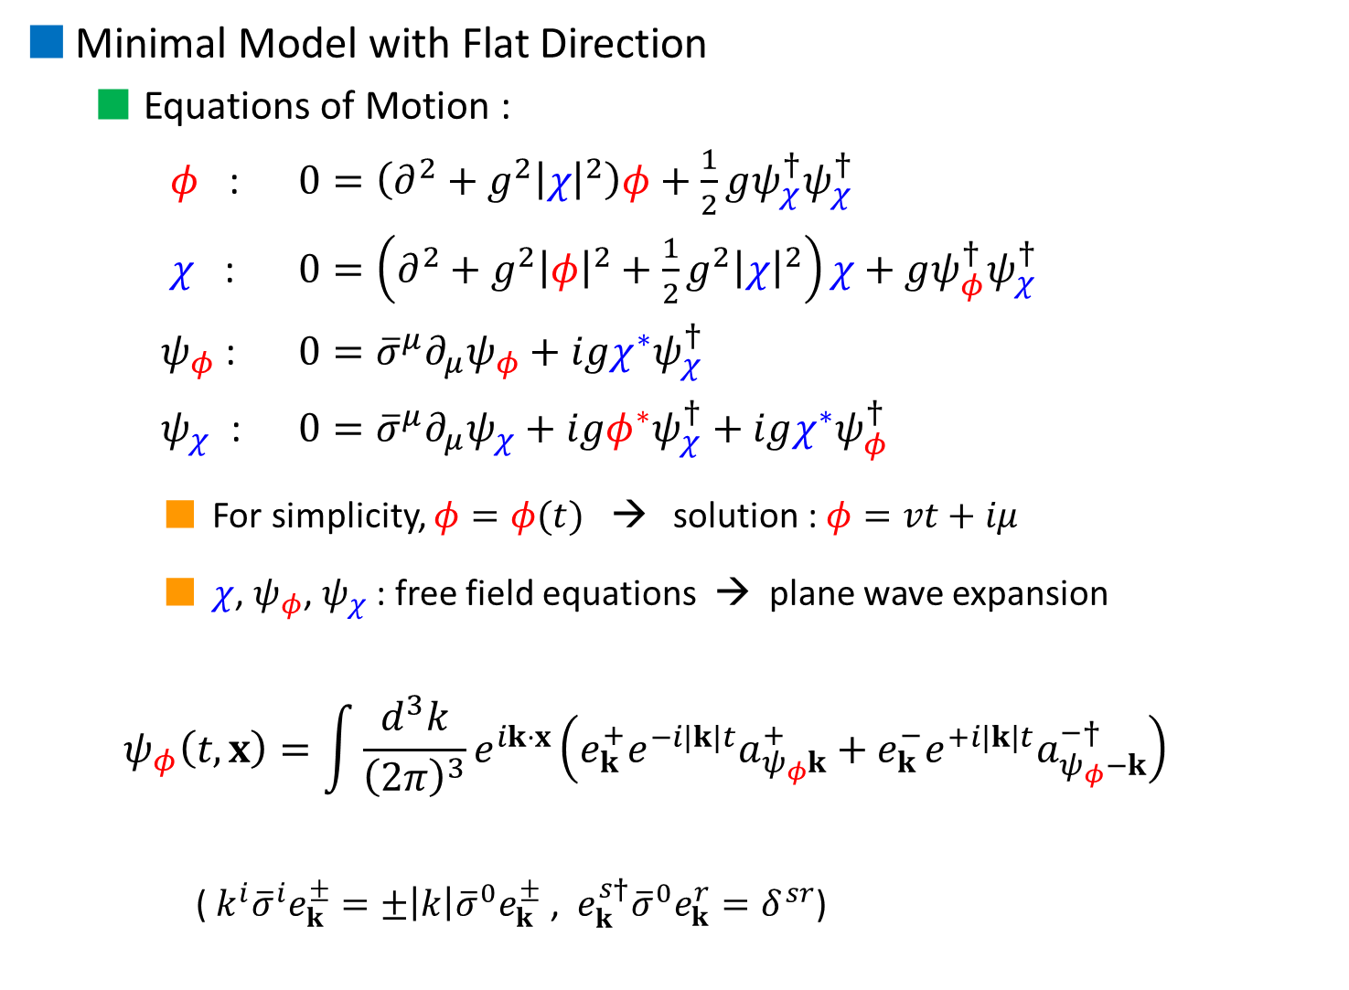
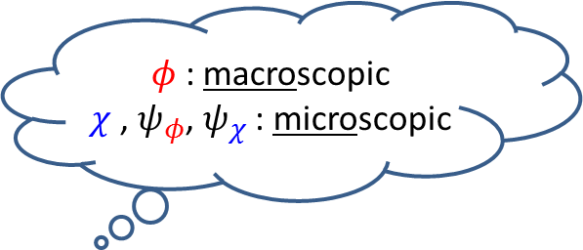
$φ$ : macroscopic
$χ$ , $ψ_{φ}$, $ψ_{χ}$ : microscopic
Minimal Model with Flat Direction
  Equations of Motion :
  $φ$ : $0=\left(∂^{2}+g^{2}{\left|χ\right|}^{2}\right)φ+\frac{1}{2}gψ_{χ}^{†}ψ_{χ}^{†}$
  $χ$ : $0=\left(∂^{2}+g^{2}{\left|φ\right|}^{2}+\frac{1}{2}g^{2}{\left|χ\right|}^{2}\right)χ+gψ_{φ}^{†}ψ_{χ}^{†}$
  $ψ_{φ}$ : $0={\overline{σ}}^{μ}∂_{μ}ψ_{φ}+igχ^{∗}ψ_{χ}^{†}$
  $ψ_{χ}$ : $0={\overline{σ}}^{μ}∂_{μ}ψ_{χ}+igφ^{∗}ψ_{χ}^{†}+igχ^{∗}ψ_{φ}^{†}$
    For simplicity, $φ=φ(t)$ → solution : $φ=vt+iμ$
    $χ$, $ψ_{φ}$, $ψ_{χ}$ : free field equations → plane wave expansion
  $$ψ_{φ}\left(t,x\right)=\int{\frac{d^{3}k}{{\left(2π\right)}^{3}}e^{ik⋅x}\left(e_{k}^{+}e^{−i\left|k\right|t}a_{ψ_{φ}k}^{+}+e_{k}^{−}e^{+i\left|k\right|t}a_{ψ_{φ}−k}^{−†}\right)}$$
    ( ${k^{i}\overline{σ}}^{i}e_{k}^{±}=±\left|k\right|{\overline{σ}}^{0}e_{k}^{±}$ , $e_{k}^{s†}{\overline{σ}}^{0}e_{k}^{r}=δ^{sr}$)
$$Im φ$$
$$v$$
$$φ$$
$$μ$$
$$Re φ$$
plane wave
(time dependent) wave func.
eigen spinor for helicity op.
creation/annihilation op.

Slide 27
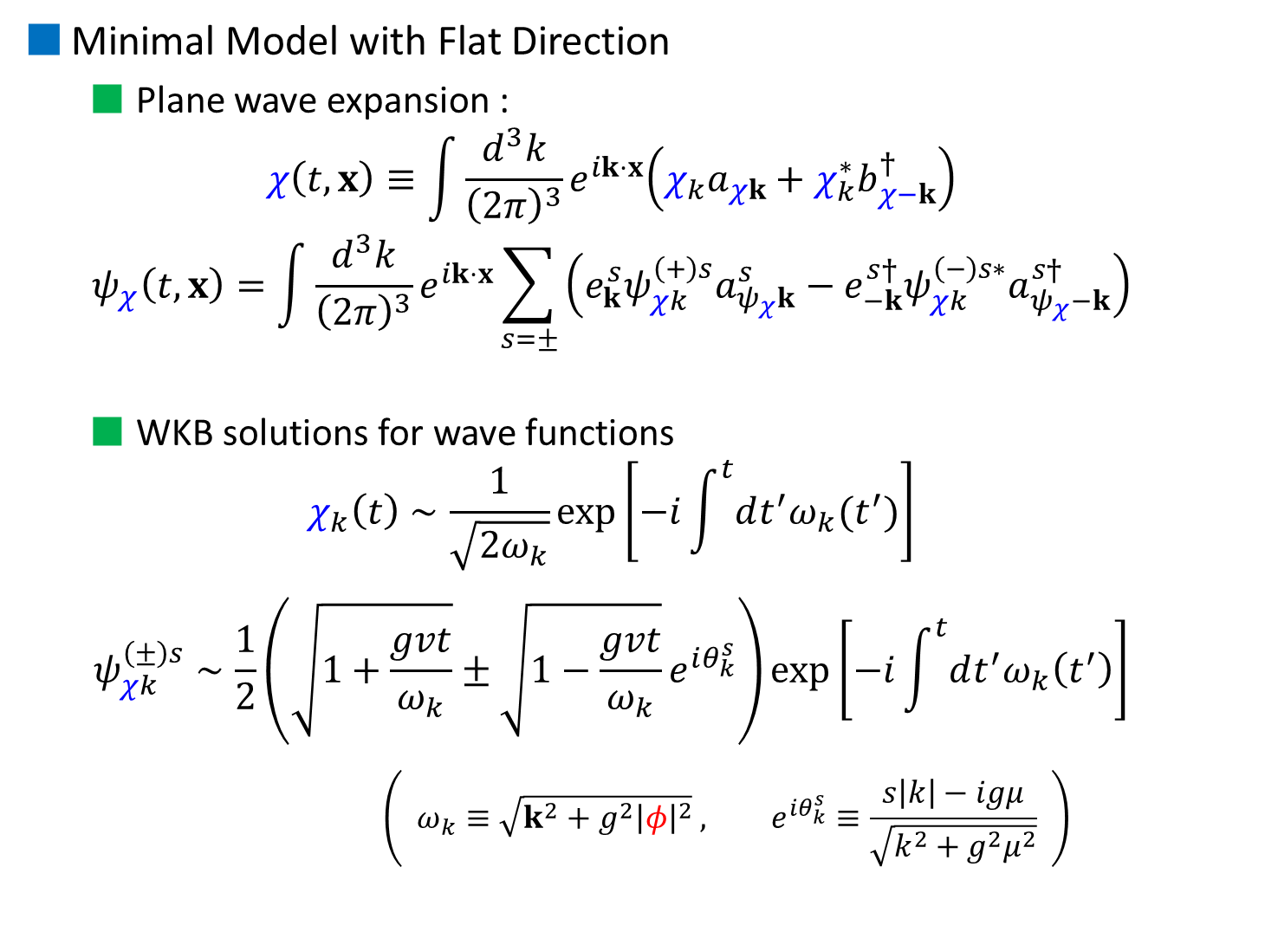
Minimal Model with Flat Direction
  Plane wave expansion :
  $$χ\left(t,x\right)≡\int{\frac{d^{3}k}{{\left(2π\right)}^{3}}e^{ik⋅x}\left(χ_{k}a_{χk}+χ_{k}^{∗}b_{χ−k}^{†}\right)}$$
  $$ψ_{χ}\left(t,x\right)=\int{\frac{d^{3}k}{{\left(2π\right)}^{3}}e^{ik⋅x}\sum_{s=±}{\left(e_{k}^{s}ψ_{χk}^{\left(+\right)s}a_{ψ_{χ}k}^{s}−e_{−k}^{s†}ψ_{χk}^{\left(−\right)s∗}a_{ψ_{χ}−k}^{s†}\right)}}$$
  WKB solutions for wave functions
  $$χ_{k}\left(t\right)∼\frac{1}{\sqrt{2ω_{k}}}\exp\left[−i\int^{t}{dt^{′}ω_{k}(t^{′})}\right]$$
  $$ψ_{χk}^{\left(±\right)s}∼\frac{1}{2}\left(\sqrt{1+\frac{gvt}{ω_{k}}}±\sqrt{1−\frac{gvt}{ω_{k}}}e^{iθ_{k}^{s}}\right)\exp\left[−i\int^{t}{dt^{′}ω_{k}\left(t^{′}\right)}\right]$$
      $$\left( ω_{k}≡\sqrt{k^{2}+g^{2}{\left|φ\right|}^{2}} , e^{iθ_{k}^{s}}≡\frac{s\left|k\right|−igμ}{\sqrt{k^{2}+g^{2}μ^{2}}} \right)$$

Slide 28
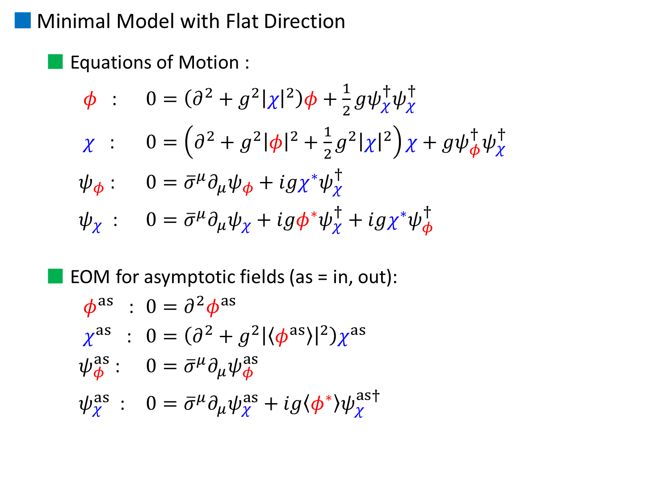
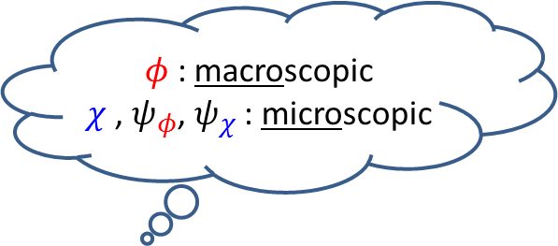
$φ$ : macroscopic
$χ$ , $ψ_{φ}$, $ψ_{χ}$ : microscopic
Minimal Model with Flat Direction
  Equations of Motion :
  $φ$ : $0=\left(∂^{2}+g^{2}{\left|χ\right|}^{2}\right)φ+\frac{1}{2}gψ_{χ}^{†}ψ_{χ}^{†}$
  $χ$ : $0=\left(∂^{2}+g^{2}{\left|φ\right|}^{2}+\frac{1}{2}g^{2}{\left|χ\right|}^{2}\right)χ+gψ_{φ}^{†}ψ_{χ}^{†}$
  $ψ_{φ}$ : $0={\overline{σ}}^{μ}∂_{μ}ψ_{φ}+igχ^{∗}ψ_{χ}^{†}$
  $ψ_{χ}$ : $0={\overline{σ}}^{μ}∂_{μ}ψ_{χ}+igφ^{∗}ψ_{χ}^{†}+igχ^{∗}ψ_{φ}^{†}$
  EOM for asymptotic fields (as = in, out):
  $φ^{as}$ : $0=∂^{2}φ^{as}$
  $χ^{as}$ : $0=\left(∂^{2}+g^{2}{\left|\left\langle φ^{as}\right\rangle \right|}^{2}\right)χ^{as}$
  $ψ_{φ}^{as}$ : $0={\overline{σ}}^{μ}∂_{μ}ψ_{φ}^{as}$
  $ψ_{χ}^{as}$ : $0={\overline{σ}}^{μ}∂_{μ}ψ_{χ}^{as}+ig\left\langle φ^{∗}\right\rangle ψ_{χ}^{as†}$
How do we calculate particle number ?

Slide 29

3. Calculation of particle number
Equation of Motion (again) :
  EOM for asymptotic fields (as = in, out):
  $φ^{as}$ : $0=∂^{2}φ^{as}$
  $χ^{as}$ : $0=\left(∂^{2}+g^{2}{\left|\left\langle 0^{in}|φ|0^{in}\right\rangle \right|}^{2}\right)χ^{as}$
  $ψ_{φ}^{as}$ : $0={\overline{σ}}^{μ}∂_{μ}ψ_{φ}^{as}$
  $ψ_{χ}^{as}$ : $0={\overline{σ}}^{μ}∂_{μ}ψ_{χ}^{as}+ig\left\langle 0^{in}|φ^{∗}|0^{in}\right\rangle ψ_{χ}^{as†}$
$φ$ : $0=\left(∂^{2}+g^{2}{\left|χ\right|}^{2}\right)φ+\frac{1}{2}gψ_{χ}^{†}ψ_{χ}^{†}$
$χ$ : $0=\left(∂^{2}+g^{2}{\left|φ\right|}^{2}+\frac{1}{2}g^{2}{\left|χ\right|}^{2}\right)χ+gψ_{φ}^{†}ψ_{χ}^{†}$
$ψ_{φ}$ : $0={\overline{σ}}^{μ}∂_{μ}ψ_{φ}+igχ^{∗}ψ_{χ}^{†}$
$ψ_{χ}$ : $0={\overline{σ}}^{μ}∂_{μ}ψ_{χ}+igφ^{∗}ψ_{χ}^{†}+igχ^{∗}ψ_{φ}^{†}$
$φ$ : macroscopic
$χ$ , $ψ_{φ}$, $ψ_{χ}$ : microscopic

Slide 30


Solutions for Asymptotic fields
  Assuming $\left\langle φ^{in}\right\rangle =\left\langle φ^{in}\right\rangle (t)$ for simplicity, then
    $φ^{as}=\left\langle φ^{as}\right\rangle +\int{\frac{d^{3}k}{{\left(2π\right)}^{3}}e^{ik⋅x}\left(φ_{k}^{as}a_{φk}^{as}+φ_{k}^{as∗}b_{φ−k}^{as†}\right)}$
    $\sqrt{Z_{φ}}\left\langle φ^{in}\right\rangle =vt+iμ$ , $\sqrt{Z_{φ}}φ_{k}^{in}=\sqrt{Z_{φ}}φ_{k}^{out}=\frac{1}{\sqrt{2\left|k\right|}}e^{−i\left|k\right|t}$
    → $β_{φk}^{}=0$
    $χ^{as}=\int{\frac{d^{3}k}{{\left(2π\right)}^{3}}e^{ik⋅x}\left(χ_{k}^{as}a_{χk}^{as}+χ_{k}^{as∗}b_{χ−k}^{as†}\right)}$
    $\sqrt{Z_{χ}}χ_{k}^{in}∼\frac{1}{\sqrt{2ω_{k}}}\exp\left[−i\int^{t}{dt^{′}ω_{k}(t^{′})}\right]$ ( valid for $\left|t\right|≳1/\sqrt{gv}$ )
    $\left( ω_{k}≡\sqrt{k^{2}+Z_{φ}g^{2}{\left|\left\langle φ^{in}\right\rangle \right|}^{2}} \right)$
    (analytic continuation) → $β_{χk}^{}∼−i\exp\left[−π\frac{k^{2}+g^{2}μ^{2}}{2gv}\right]$
$$Im φ$$
$$v$$
$$φ$$
$$μ$$
$$Re φ$$
$$0=∂^{2}φ^{as}$$
$$φ_{k}^{out}=α_{k}^{∗}φ_{k}^{in}−β_{k}^{∗}φ_{k}^{in∗}$$
$$=\left(∂^{2}+g^{2}{\left|\left\langle φ^{as}\right\rangle \right|}^{2}\right)χ^{as}$$
$$Im t$$
$$Re t$$
$$χ^{in}$$
$$χ^{out}$$

Slide 31

4. Summary
We constructed the Bogoliubov transformation taking into account interaction effects
We calculated produced particle’s (occupation) number
  $n_{χk}/V∼\exp\left[−π\frac{k^{2}+g^{2}μ^{2}}{gv}\right]$ , $n_{ψ_{χ}k}/V∼2×\exp\left[−π\frac{k^{2}+g^{2}μ^{2}}{gv}\right]$
  $n_{ψ_{φ}k=0}/V∼$ $0.07⋅\frac{g^{2}}{4π}⋅\exp\left[−π\frac{g^{2}μ^{2}}{gv}\right]$
    Massless particle can be produced, however the production is suppressed by the coupling
  $n_{φk=0}/V$ … now in progress
    It may become same quantity because of SUSY
    However, it is interesting to find out whether it is same or not

Slide 32



  2. Estimation of produced particle number
    WKB type solution (wave func. of $χ$)
      $$u_{k}\left(t\right)=α_{k}\left(t\right) {\overline{u}}_{k}\left(t\right)+β_{k}\left(t\right) {\overline{u}}_{k}^{∗}(t)$$
      $α_{k}$ , $β_{k}$ : generalized Bogoliubov coefficients
      $1=i\int{d^{3}x\left(u_{k}^{∗}{\dot{u}}_{k}−{\dot{u}}_{k}^{∗}u_{k}\right)}$ ⇒ ${\left|α_{k}\right|}^{2}−{\left|β_{k}\right|}^{2}=1$
      $$χ=\int{\frac{d^{3}k}{{\left(2π\right)}^{3/2}}\left({\overline{u}}_{k}{\overline{a}}_{k}+{\overline{u}}_{k}^{∗}{\overline{a}}_{−k}^{†}\right)e^{ik⋅x}}=\int{\frac{d^{3}k}{{\left(2π\right)}^{3/2}}\left(u_{k}a_{k}+u_{k}^{∗}a_{−k}^{†}\right)}e^{ik⋅x}$$
      → $a_{k}=α_{k}^{∗}{\overline{a}}_{k}−β_{k}^{∗}{\overline{a}}_{−k}^{†}$
    Occupation number
    $n_{k}≡\left\langle \overline{0} | a_{k}^{†}a_{k} | \overline{0}\right\rangle ={\left|β_{k}\right|}^{2}$
      Initial conditions ： $α_{k}\left(t=−∞\right)=1, β_{k}\left(t=−∞\right)=0$
      → $n_{k}(t=−∞)=0$
${\overline{u}}_{k}=\frac{1}{\sqrt{2ω_{k}(t)}}e^{−i\int^{t}{dt^{′}ω_{k}(t^{′})}}$
Bogoliubov transformation
In state
out state
If you want to know the particle number, you only calculate $β_{k}$.

Slide 33


  Estimation of produced particle number
    WKB type solution (wave func. of $χ$)
      $$u_{k}(t)=\frac{α_{k}(t)}{\sqrt{2ω_{k}(t)}}e^{−i\int^{t}{dt^{′}ω_{k}(t^{′})}}+\frac{β_{k}(t)}{\sqrt{2ω_{k}(t)}}e^{+i\int^{t}{dt^{′}ω_{k}(t^{′})}}$$
      $α_{k}$ , $β_{k}$ : generalized Bogoliubov coefficients
      $1=i\int{d^{3}x\left(u_{k}^{∗}{\dot{u}}_{k}−{\dot{u}}_{k}^{∗}u_{k}\right)}$ ⇒ ${\left|α_{k}\right|}^{2}−{\left|β_{k}\right|}^{2}=1$
      EOMs : ${\ddot{u}}_{k}+ω_{k}^{2}u_{k}=0$
      ↓
      $\left\{\begin{aligned} {\dot{α}}_{k}=\frac{{\dot{ω}}_{k}}{2ω_{k}}exp\left(+2i\int^{t}{dt^{′}ω_{k}(t^{′})}\right)β_{k} \\ {\dot{β}}_{k}=\frac{{\dot{ω}}_{k}}{2ω_{k}}exp\left(−2i\int^{t}{dt^{′}ω_{k}(t^{′})}\right)α_{k}\end{aligned}\right.$
      Initial conditions ： $α_{k}\left(t=−∞\right)=1, β_{k}(t=−∞)=0$
      ⇒ $n_{k}={\left|β_{k}\right|}^{2}$
${\overline{u}}_{k}=\frac{1}{\sqrt{2ω_{k}(t)}}e^{−i\int^{t}{dt^{′}ω_{k}(t^{′})}}$
Bogoliubov transformation

Slide 34




Slide 35


